Slide 1
Heart failure and pulmonary embolism
Dr MAZ

Slide 2
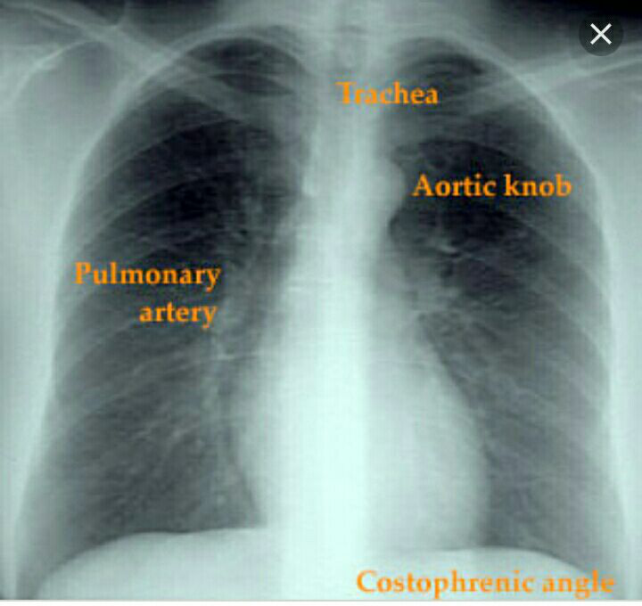
Normal chest

Slide 3
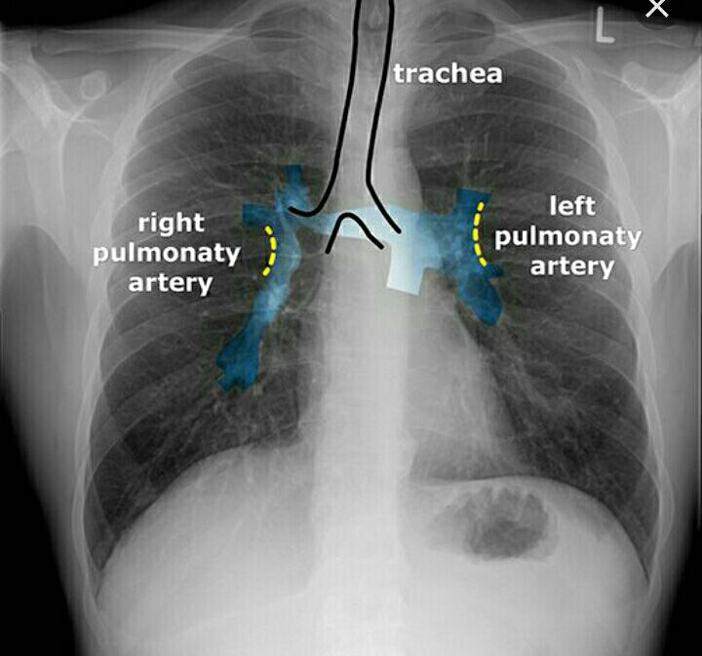
Normal chest

Slide 4
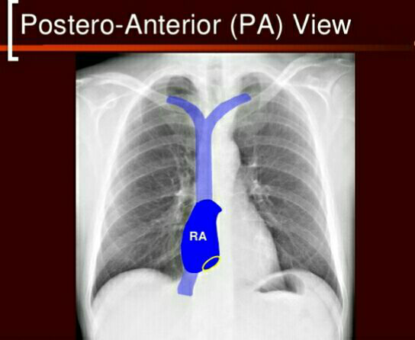
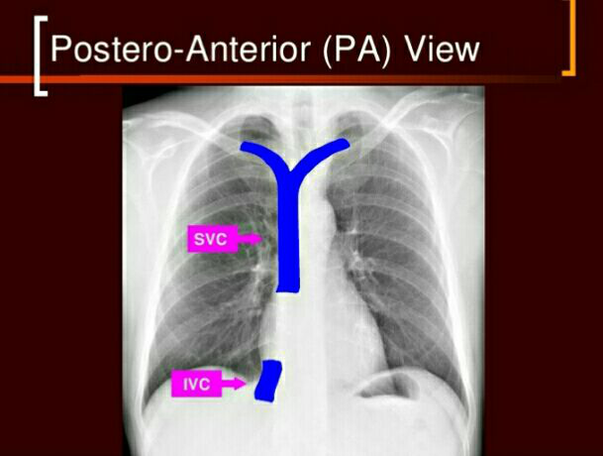

Slide 5
Pulmonary odema and congestive heart failure
Vascular redistribution and upper lobe blood diversion.( pulmonary plethora ),which represent a. prominent pulmonary vessels and increase caliber .
b. reaching lung apex
c. reaching the outer third of the pulmonary space.
Fluid leak from the loaded vessels to adjacent interstetium forming septal lines (interstitial odema)
Fluid leak from interstetium to alveoli ( alveolar odema )
Fluid leak to pleural space (pleural effusion).

Slide 6
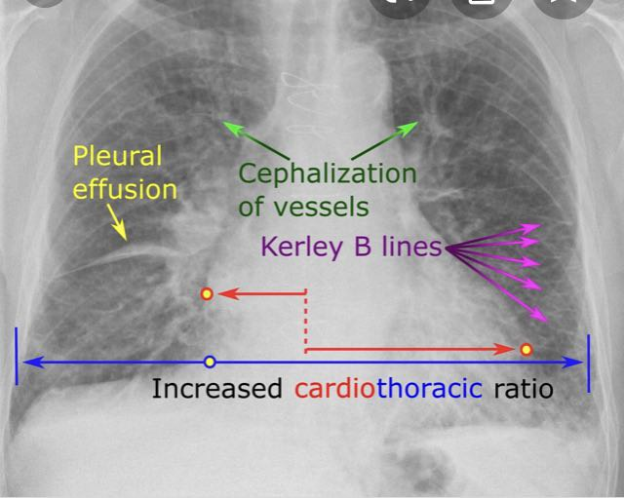

Slide 7
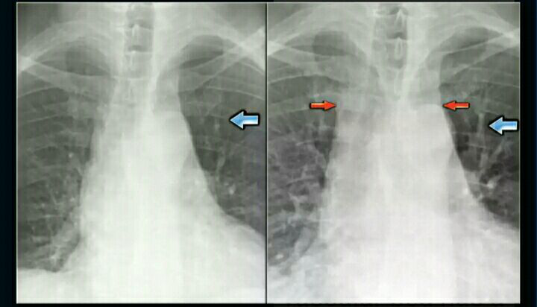
Redistribution ( upper lobe blood diversion

Slide 8
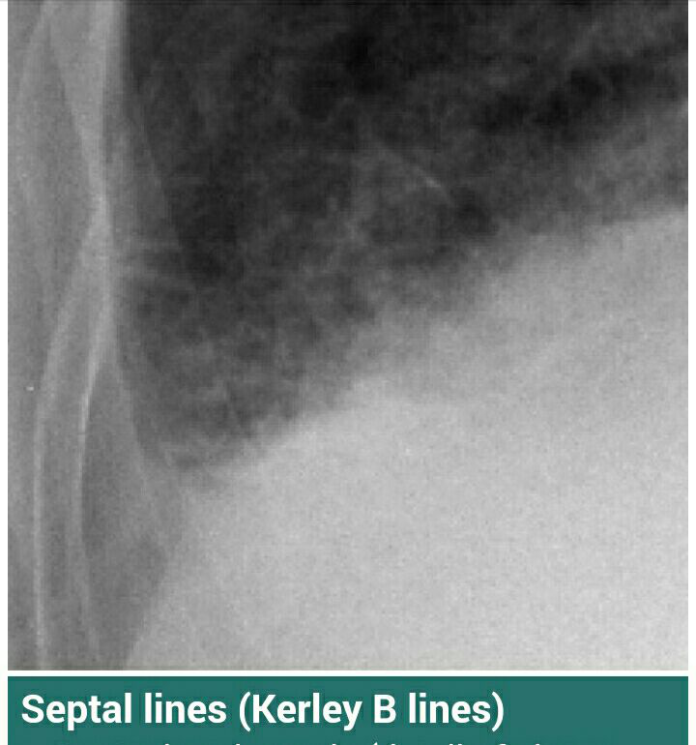
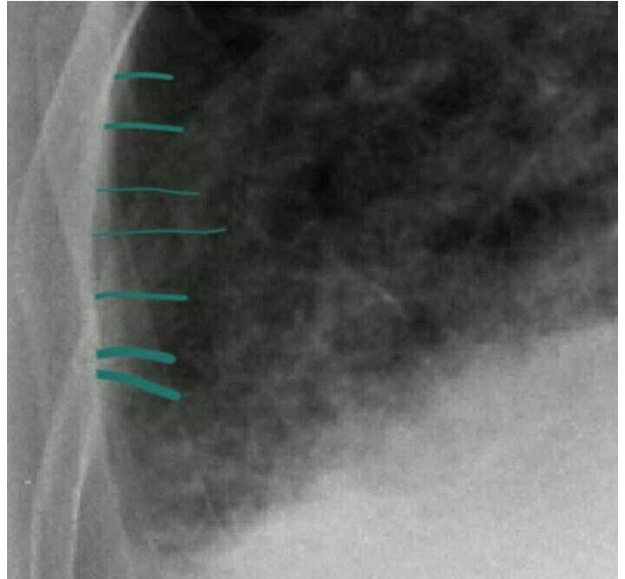

Slide 9
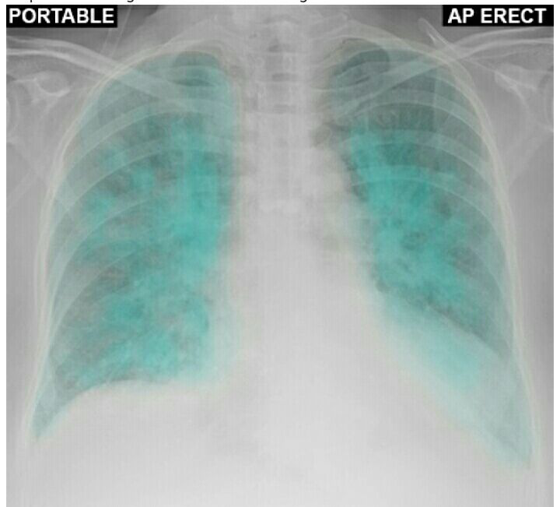
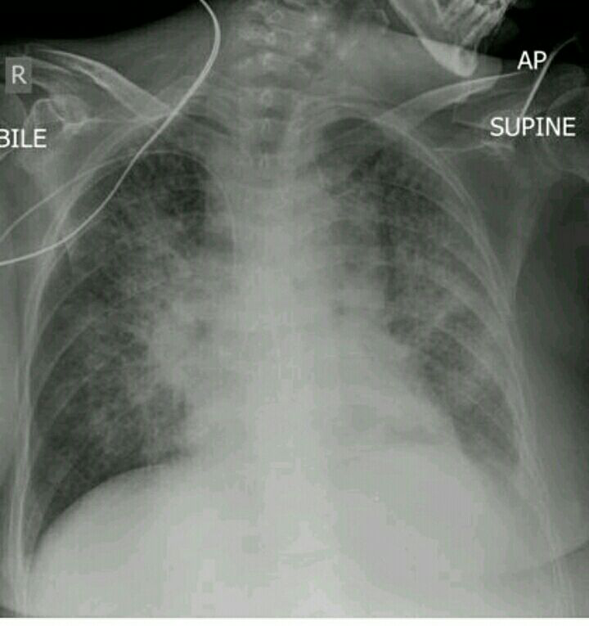
Alveolar odema

Slide 10
Alveolar odema

Slide 11
Pleural effusion

Slide 12
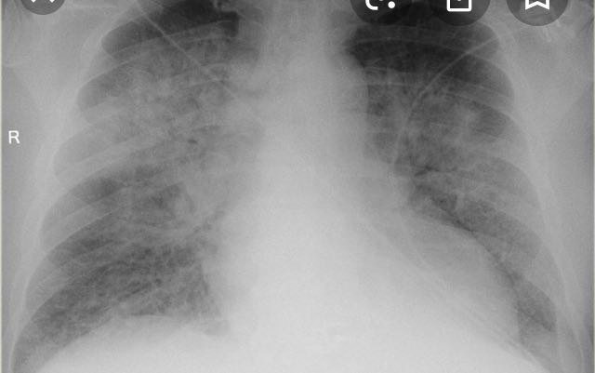

Slide 13
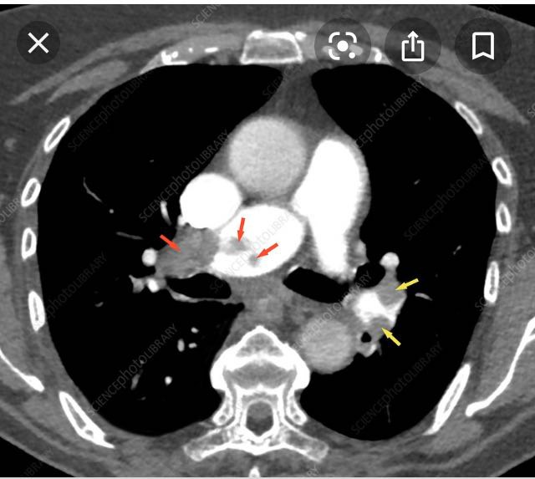
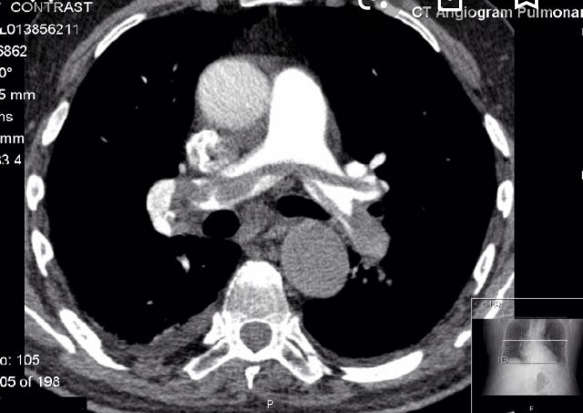
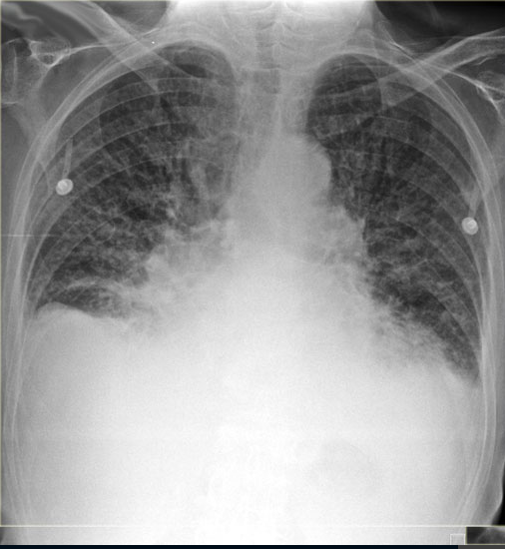
Congestive heart failure

