Slide 1
Anus and anal canal
Dr Hasanain Abdulameer Jasim

Slide 2
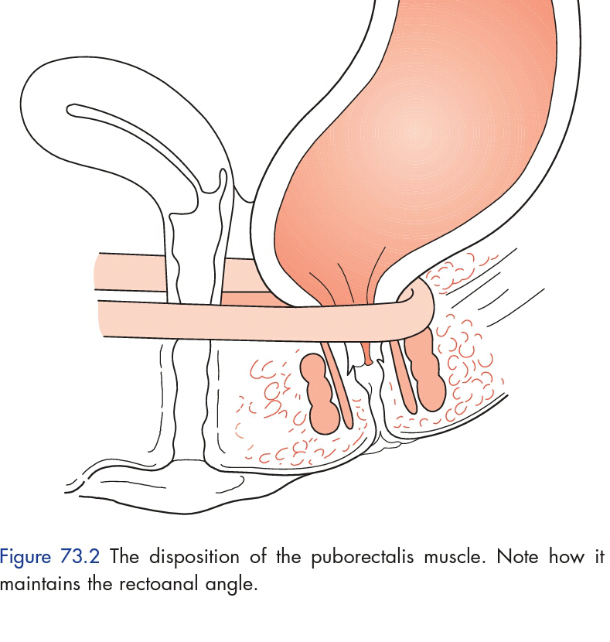
Surgical anatomy
The anal canal commences at the level where the rectum passes through the pelvic diaphragm and ends at the anal verge.
The anorectal ring marks the junction between the rectum and the anal canal.

Slide 3
anorectal ring formed by the joining of the puborectalis muscle, the deep external sphincter, conjoined longitudinal muscle and the highest part of the internal sphincter.
. Puborectalis, maintains the angle between the anal canal and rectum and hence is an important component in the continence mechanism

Slide 4
The internal sphincter is composed of circular, non-striated involuntary muscle supplied by autonomic nerves.
The external sphincter is composed of striated voluntary muscle supplied by the pudendal nerve.
The space between sphincters is known as the intersphincteric plane

Slide 5
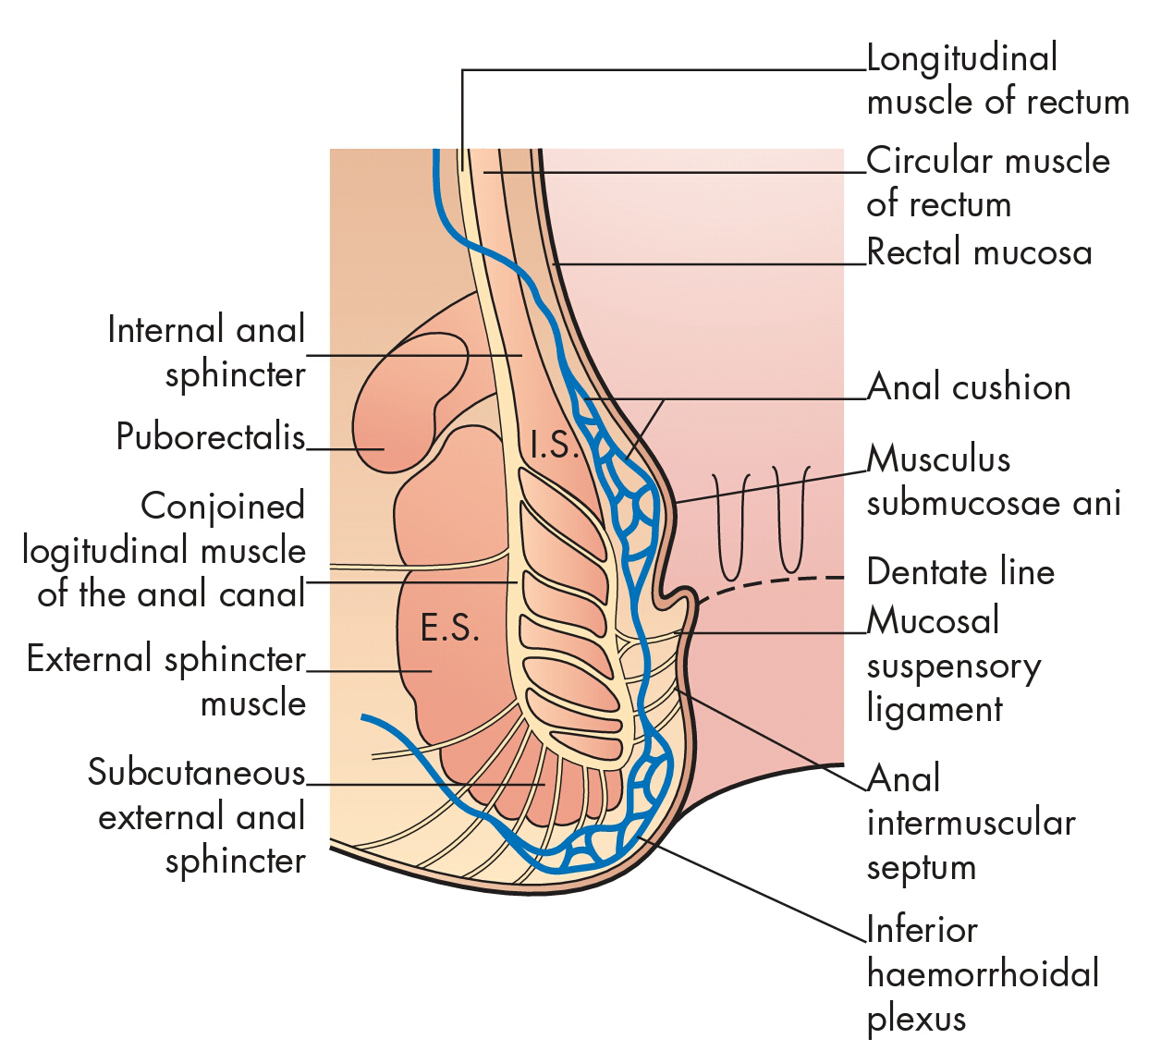

Slide 6
The pink columnar epithelium lining the rectum extends through the anorectal ring into the surgical anal canal.
Passing downwards, the mucous membrane becomes cuboidal and redder in color.
Just below the level of the anal valves there is an abrupt, wavy, transition to stratified squamous epithelium. This wavy junction constitutes the dentate line. Below the dentate line, the anoderm is lined by non-keratinised stratified squamous epithelium that is devoid of glands and hair but richly innervated by somatic sensory nerve endings

Slide 7
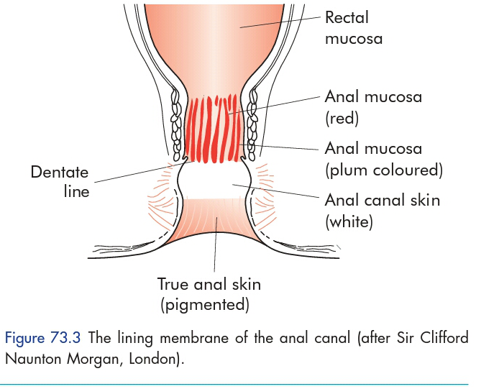

Slide 8
dentate line is a most important landmark both morphologically and surgically, considered to be the embryological junction between the endodermal and ectodermal parts of the anal canal, and the site of the crypts of Morgagni.

Slide 9
The mucosa and submucosa above the dentate line is uneven and thrown into folds, the so-called anal cushions. There are variations in the numbers and positions of these cushions, but there are usually three,

Slide 10
Blood supply
superior rectal artery into right and left branches and with subsequent division of the former into anterior and posterior divisions .
The anal veins are distributed in a similar fashion to the arterial supply.
The upper half of the anal canal is drained by the superior rectal veins, tributaries of the inferior mesenteric vein and the middle rectal veins, which drain into the internal iliac veins. The inferior rectal veins drain the lower half of the anal canal and the subcutaneous perianal plexus of veins: they eventually join the internal iliac vein on each side.

Slide 12
Lymph from the upper half of the anal canal flows upwards to drain into the post-rectal lymph nodes and from there goes to the para-aortic nodes via the inferior mesenteric chain.
Lymph from the lower half of the anal canal drains on each side first into the superficial and then into the deep inguinal group of lymph glands.

Slide 14
investigations
Proctoscopy
allows a detailed inspection of the distal
rectum and anal canal. Minor procedures can also be carried out through this instrument, e.g. treatment of haemorrhoids by injection or banding

Slide 17
Sigmoidoscopy
Although sigmoidoscopy is strictly an examination of the rectum, it should always be carried out even when an anal lesion has been confirmed.

Slide 18
SPECIAL INVESTIGATIONS
Anal continence and defaecation are highly complex processes that necessitate the structural and functional integrity of the cerebral, autonomic and enteric nervous systems, the gastrointestinal tract (especially the rectum) and the pelvic floor and anal sphincter complex, any of which may be compromised and lead to disturbances of function of varying severity.

Slide 19
The structural integrity of the sphincters can be visualised with endoluminal ultrasound
neuromuscular function can be measured by assessment of conduction velocity along the pudendal nerve on each side, or, more painfully, by needle Electromyogram (EMG) studies

Slide 20
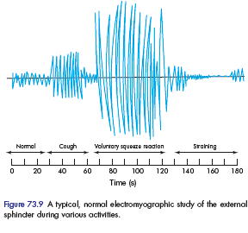
Endoanal ultrasonography. (a) External anal sphincter (EAS) defect caused by obstetric injury. (b) Internal anal sphincter (IAS) defect post-sphincterotomy.
A typical, normal electromyographic study of the external
sphincter during various activities

Slide 21
The dynamics of defaecation can also be assessed radiologically by evacuation proctography.
Proctography can be combined with synchronous EMG and pressure studies(Integrated dynamic proctography)

Slide 23
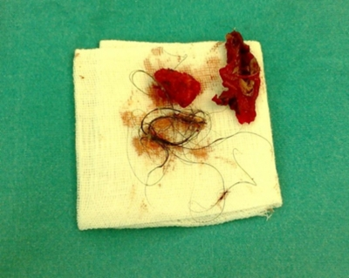
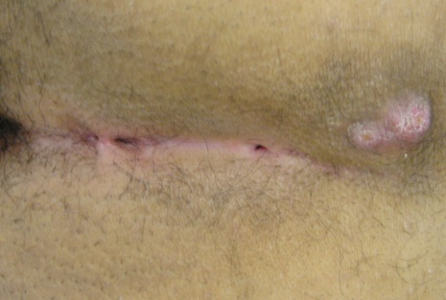
Pilonidal sinus
The term ‘pilonidal sinus’ describes a condition found in the natal cleft overlying the coccyx, consisting of one or more, usually non-infected, midline openings, which communicate with a fibrous track lined by granulation tissue and containing hair lying loosely within the lumen.

Slide 24
Clinical features
The condition is seen much more frequently in men than in women
usually after puberty and before the fourth decade of life, and is characteristically seen in dark-haired individuals rather than those with softer blond hair

Slide 25
Patients complain of intermittent pain, swelling, and discharge at the base of the spine,
There is often a history of repeated abscesses that have burst spontaneously or which have been incised, usually away from the midline

Slide 26
treatment
Conservative treatment
Simple cleaning out of the tracks and removal of all hair, with regular shaving of the area and strict hygiene, may be recommended.
Surgical treatment
Options include laying open all tracks with or without marsupialization, excision of all tracks with or without primary closure, and excision of all tracks with closure by some other means designed to avoid a midline wound (Limberg procedure, Z-plasty, Karydakis procedure. Bascom’s procedure involves an incision lateral to the midline to gain access to the sinus cavity, which is rid of hair and granulation tissue

Slide 27
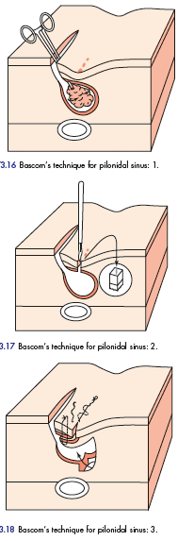

Slide 29
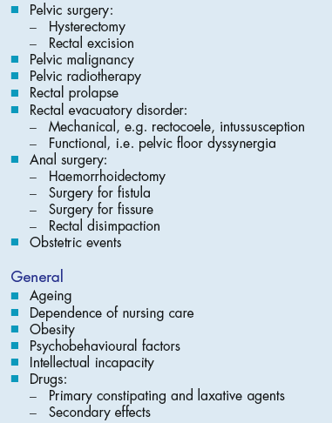
ANAL INCONTINENCE

Slide 30
In general, conservative measures to reduce symptoms are employed initially. These may be in the form of stool bulking
or constipating agents, nurse-led bowel retraining including
specific biofeedback programs, or anal plugs, which expand within and thus seal the anal canal. Failure of such measures and symptom severity may result in surgery selection.

Slide 31
Operations to reunite divided sphincter muscles
Operations to reef the external sphincter and puborectalis muscle
Operations to augment the anal sphincters

Slide 32
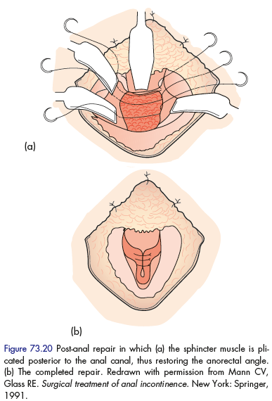

Slide 33
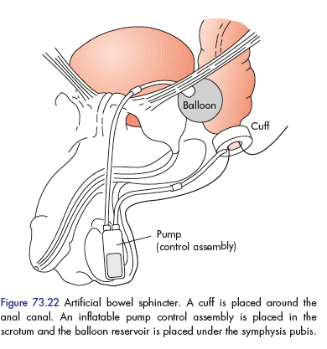

Slide 34
Anal fissure

Slide 35
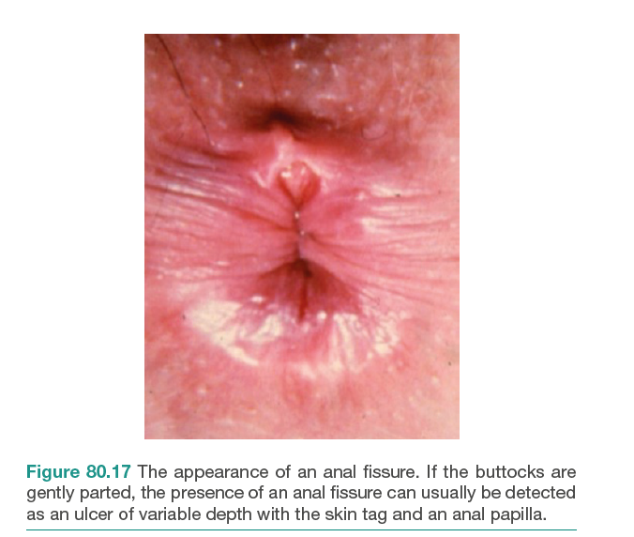
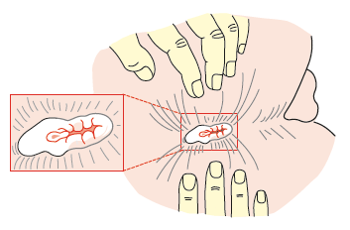
Definition
An anal fissure (synonym: fissure-in-ano) is a longitudinal split in the anoderm of the distal anal canal which extends from the anal verge proximally towards, but not beyond, the dentate line.
90% located in
Midline posterior

Slide 36
Aetiology
Classically, acute anal fissures arise from the trauma caused by the strained evacuation of a hard stool
or, less commonly, from the repeated passage of diarrhea.
The location in the posterior midline perhaps relates to the exaggerated shearing forces acting at that site at defecation, combined with a less elastic anoderm.
Anterior anal fissure is much more common in women and may arise following vaginal delivery.

Slide 37
Clinical features
Men and women are affected equally.
Anterior fissures account for about 10 percent of those encountered in women, but only 1 percent in men.
acute anal fissures are characterized by severe anal pain associated with defecation.
as well as the passage of fresh blood, normally noticed on the tissue after wiping.
When chronic, patients may also complain of itching secondary to irritation from the sentinel tag, discharge from the ulcer

Slide 39
Treatment
Emphasis must be placed on normalization of bowel habits
The addition of fiber to the diet to bulk up the stool, stool softeners and adequate water intake are simple and helpful measures.
Warm baths and topical local anesthetic agents relieve pain;

Slide 40
topical application of pharmacological agents that relax the internal sphincter, most commonly nitric oxide donors (by reducing spasm, pain is relieved, and increased vascular perfusion promotes healing).
Such agents include glyceryl trinitrate (GTN) 0.2 %applied four times per day to the anal margin (although this may cause headaches) and
diltiazem cream 2 % applied twice daily.

Slide 41
Operative measures
Lateral anal sphincterotomy
the internal sphincter is divided away from the fissure itself – usually either in the right or the left lateral positions
Anal advancement flap
After excision of the edges of the fissure, an inverted house-shaped flap of perianal skin is carefully mobilized on its blood supply and advanced without tension to cover the fissure, and then sutured

Slide 42
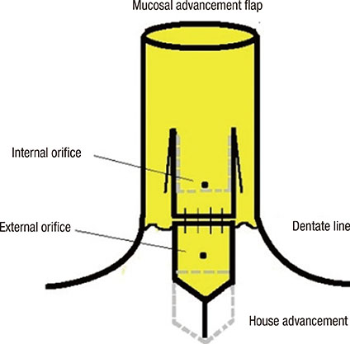

Slide 44
HAEMORRHOIDS
Internal haemorrhoids (Greek: haima, blood; rhoos, flowing; synonym: piles, Latin: pila, a ball) are symptomatic anal cushions and characteristically lie in the 3, 7 and 11 o’clock positions (with the patient in the lithotomy position).
External haemorrhoids relate to venous channels of the inferior haemorrhoidal plexus deep in the skin surrounding the anal verge

Slide 48
Theories of development
The internal hemorrhoidal plexus constitutes the submucosal component of the anal cushions that are important in sealing the anal canal. Man’s upright posture, the absence of valves in the portal venous system, and raised abdominal pressure due to pregnancy or particularly through straining during defecation contribute to venous plexus engorgement and development of varicosities. Shearing forces lead to mucosal trauma (bleeding) and caudal displacement of the anal cushions (prolapse). This, in turn, leads to impaired venous drainage, progressive venous engorgement, local stasis, and transudation of fluid (pruritus). With time, fragmentation of the supporting structures (a normal consequence of aging but perhaps accelerated in those with hemorrhoids) leads to a loss of elasticity of the cushions such that they no longer retract following defecation.

Slide 49
Clinical features
Bleeding, {usually painless} is the principal and earliest symptom. The nature of the bleeding is characteristically separate from the motion and is seen either on the paper on wiping or as a fresh splash in the pan. Sometimes , the bleeding may be sufficient to cause anaemia.
Piles associated with bleeding alone are called first-degree haemorrhoids

Slide 50
Patients may complain of true ‘piles’, lumps that appear at the anal orifice during defaecation and which return spontaneously afterwards (second-degree haemorrhoids),
piles that have to be replaced manually (third-degree haemorrhoids)
or piles that lie permanently outside (fourth-degree haemorrhoids).

Slide 52
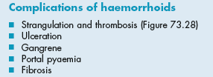

Slide 53
Management
Exclusion of other causes of rectal bleeding, especially colorectal malignancy, is the priority.
normalizing bowel and defecatory habits:
stool softeners and bulking agents.
In those with first- or second-degree piles whose symptoms are not improved by conservative measures, injection sclerotherapy the submucosal injection of 5 % phenol in arachis oil or almond oil, may be advised.

Slide 54
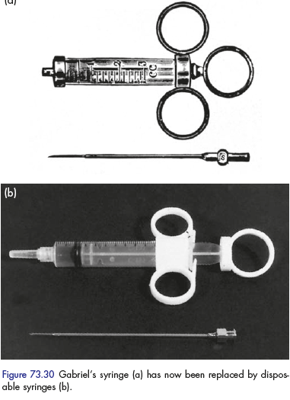
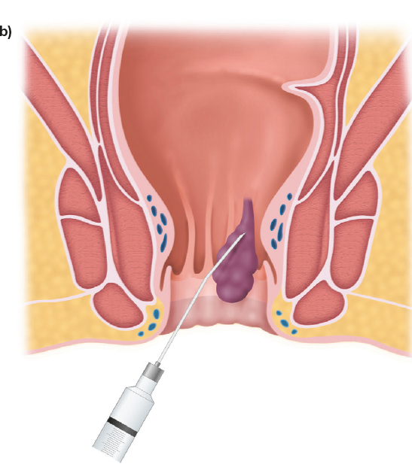
injection sclerotherapy

Slide 55
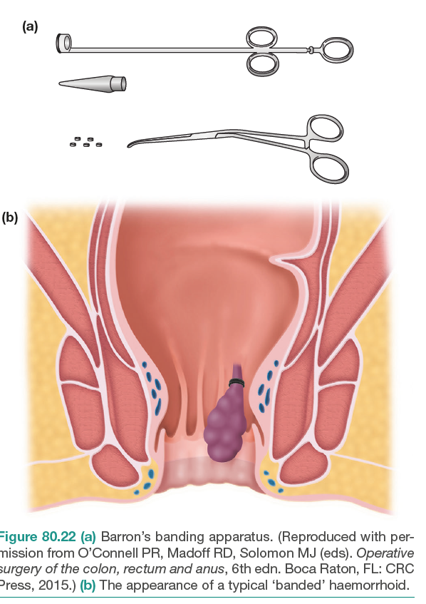
The Barron’ bander is a commonly available device used to slip tight elastic bands onto the base of the pedicle of each hemorrhoid The bands cause ischaemic necrosis of the piles{ 2nd degree hemorrhoid } .

Slide 56
Operation
The indications for haemorrhoidectomy include:
third- and fourth-degree haemorrhoids;
second-degree haemorrhoids that have not been cured by non-operative treatments;
fibrosed haemorrhoids;
interoexternal haemorrhoids when the external haemorrhoid is well defined.

Slide 57
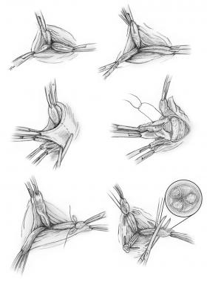
Open and closed hemorroidectomy
Closed
open

Slide 58
stapled haemorrhoidopexy
utilizes a purpose-designed stapling gun
This procedure excises a strip of mucosa and submucosa (together with the vessels traveling within them) circumferentially, well above the dentate line

Slide 60
Transanal haemorrhoidal ligation (HAL).
is used for the treatment of second- and third-degree haemorrhoids. Some have recently advocated transanal Doppler-guided ligation of those vessels feeding the haemorrhoidal masses, to which others have added suture ‘mucopexy’ to deal with any prolapse

Slide 62
External haemorrhoids
A thrombosed external haemorrhoid relates anatomically to the veins of the superficial or external haemorrhoidal plexus and is commonly termed a ‘perianal haematoma’.
It presents as a sudden onset, olive-shaped, painful blue subcutaneous swelling at the anal margin and is usually consequent upon straining at stool, coughing or lifting a heavy weight

Slide 63
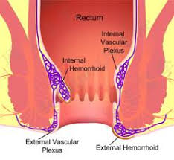

Slide 64
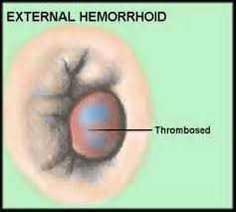
If the patient presents within the first 48 hours, the clot may be evacuated under local anaesthesia.

Slide 66
PRURITUS ANI
This is intractable itching around the anus, a common and embarrassing condition. Usually, the skin is reddened and hyperkeratotic and it may become cracked and moist.

Slide 67
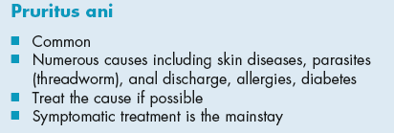
Causes
Lack of cleanliness,
anal or perianal discharge
Vaginal discharge
Parasitic causes. Threadworms should be excluded,
Epidermophytosis
Allergy
Skin diseases
psychoneurosis. And Diabetes

Slide 68
Treatment
The cause is treated. Symptomatic treatment includes the following:
Hygiene measures.
Hydrocortisone. In patients with dermatitis
Strapping the buttocks keeps moist opposing surfaces apart,
Operative treatment :This may be necessary for a concomitant lesion of the anorectum

Slide 69
ANORECTAL ABSCESSES

Slide 70
Acute sepsis in the region of the anus is common.
anorectal sepsis is more common in men than women,
The cryptoglandular theory of intersphincteric anal gland infection holds that, upon infection of a gland, pus, which travels along the path of least resistance

Slide 71
, may spread caudally to present as a perianal abscess, laterally across the external sphincter to form an ischiorectal abscess or, rarely, superiorly above the anorectal junction to form a supralevator intermuscular or pararectal abscess

Slide 72
Sepsis unrelated to anal gland infection may occur at the same or at other sites (including submucosal abscess (following haemorrhoidal sclerotherapy, which usually resolve spontaneously), mucocutaneous or marginal abscess (infected haematoma),

Slide 73
ischiorectal abscess (foreign body, trauma, deep skin-related infection) and pelvirectal supralevator sepsis originating in pelvic disease.

Slide 74
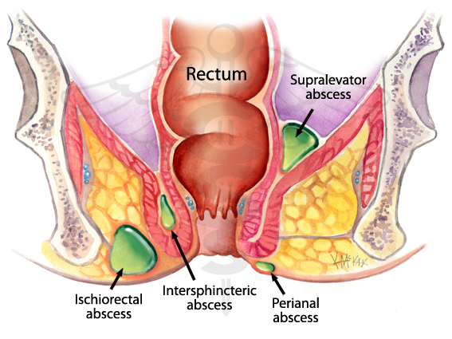

Slide 76
Presentation
usually associated with a short (2–3 day) history of increasingly severe, well-localised pain and a palpable tender lump at the anal margin.
Examination reveals an indurated hot tender perianal swelling.
constitutional upset and fever

Slide 77
Management
Management of acute anorectal sepsis is primarily surgical, including careful examination under anesthesia, sigmoidoscopy and proctoscopy, and adequate drainage of the pus

Slide 78
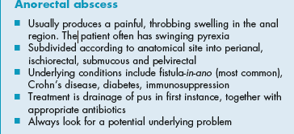
Incision of an ischiorectal abscess. The cavity is explored and, if septa exist, they should be broken down gently with a finger and the necrotic tissue lining the walls of the abscess removed by th finger wrapped in gauze. It is wise to biopsy the wall and send the pus for culture.

Slide 79
FISTULA-IN-ANO
A fistula-in-ano, or anal fistula, is a chronic abnormal communication, usually lined to some degree by granulation tissue, which runs outwards from the anorectal lumen (the internal opening) to an external opening on the skin of the perineum or buttock
Anal fistulae may be found in association with specific conditions, such as Crohn’s disease,
However, the majority are termed non-specific, idiopathic or cryptoglandular, and intersphincteric anal gland infection is deemed central to them.

Slide 80
Presentation
more common in men than women
The overall incidence is about nine cases per 100000 population per year
those in their third, fourth and fifth decades of life are most commonly affected.
Patients usually complain of intermittent purulent discharge, pain (which increases until temporary relief occurs when the pus discharges).

Slide 82
Classification

Slide 83
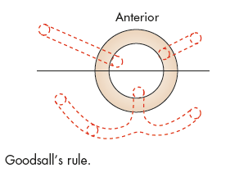
Goodsall’s rule
used to indicate the likely position of the internal opening according to the position of the external opening(s), is helpful but not infallible. The site of the internal opening may be felt

Slide 84
Special investigations
endoanal ultrasound
Fistulagram
Magnetic resonance imaging (MRI) is acknowledged to be the ‘gold standard’ for fistula imaging, but it is limited by availability and cost and is usually reserved for difficult recurrent cases.
computed tomography (CT)

Slide 85
Surgical management
Fistulotomy That the fistulous track must be laid open
Fistulectomy This technique involves coring out of the fistula
seton
Advancement flaps
Biological agents agents that essentially plug and seal the track and allow ingrowth of healthy tissue to replace it

Slide 87
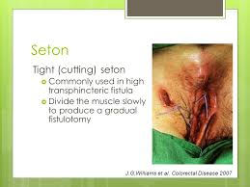

Slide 88
Ligation of intersphincteric fstula tract
LIFT involves disconnection of the internal opening from the fistula tract at the level of the intersphincteric plane and removal of the residual infected glands without dividing any part of the sphincter complex. The tract is then ligated and divided, the internal part is removed and the external part of the track is curetted and drained

Slide 90
Other techniques
Video-assisted anal fistula treatment (VAAFT) involves the introduction of a rigid fistuloscope into the tract through the external opening. The scope has a channel to accommodate a forceps, brush, or diathermy. The scope is passed into accessible tracks to allow lavage, curettage, cautery, or the introduction of setons. VAAFT represents a form of advanced track identification and preparation before a definitive technique is performed.

Slide 91
tract laser closure (FiLaC) uses radial emitting laser to obliterate the luminal aspect of the fstula to a known depth, throughout its length

Slide 92
ANAL INTRAEPITHELIAL NEOPLASIA
is a multifocal virally induced dysplasia of the perianal or intra-anal epidermis which is associated with the human papilloma virus
A high index of suspicion and targeted biopsy yields the diagnosis, whereas multiple (mapping) biopsies give an indication of the extent and overall severity of the disease.

Slide 93
Extensive anal intraepithelial neoplasia (AIN), which extends intra-anally.

Slide 94
NON-MALIGNANT STRICTURES – ANAL STENOSIS
Spasmodic An anal fissure causes spasm of the internal sphincter
Organic Anal stenosis is a rare but serious complication of anorectal surgery, Other causes include trauma, inflammatory bowel disease, radiation
Postoperative stricture
Irradiation stricture
Senile anal stenosis
Lymphogranuloma inguinale
Inflammatory bowel disease
Endometriosis
Neoplastic

Slide 95
Clinical features
Increasing difficulty in defaecation is the leading symptom.
if the stools are formed, they are ‘pipe-stem’ in
shape.
In cases of inflammatory stricture, tenesmus, bleeding and the passage of mucus are superadded.

Slide 96
Treatment
Before starting treatment, it is important to ascertain the cause of the stricture.
Non-operative treatment is recommended for mild stenosis.
The use of stool softeners and fibre supplements helps aid the passage of stools.

Slide 97
Prophylactic
The passage of an anal dilator during convalescence after haemorrhoidectomy greatly reduces the incidence of postoperative stricture.

Slide 98
Dilatation
Anal dilatation can be performed under general anaesthesia and then, by the patient, using an anal dilator.

Slide 99
Anoplasty
For severe anal stenosis, an anoplasty is used to replace loss of anal tissue.
The stricture is incised and a rotation or advancement flap of skin and subcutaneous tissue replaces the defect

Slide 100
Colostomy
Colostomy must be undertaken when a stricture is causing intestinal obstruction

Slide 101
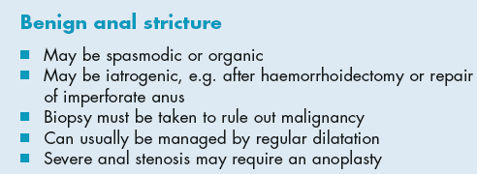
Rectal excision and coloanal anastomosis
When the strictures are at or just above the anorectal junction and are associated with a normal anal canal,

Slide 102
MALIGNANT TUMOURS
Anal malignancy is rare and accounts for less than 2 per cent of all large bowel cancers.
incidence rate is 0.65 per 100 000.
Those arising below the dentate line are usually squamous,
whereas those above are variously termed basaloid,cloacogenic or transitional. Collectively, they are known as epidermoid carcinomas,

Slide 103
A mass, pruritus or discharge is less common
Advanced tumours may cause faecal incontinence by invasion of the sphincters
in women, anterior extension may result in anovaginal fistulation.
primary treatment is by chemoradiotherapy

