Slide 1
Skin and subcutaneous tissue

Slide 2
Learning objectives
To understand:
•• The structure and functional properties of skin
•• The classification of vascular skin lesions
•• The cutaneous manifestations of generalised disease as
related to surgery
•• The classification of benign skin tumours
•• The management of malignant skin tumours

Slide 4
The skin is a large organ. In an adult it may have an area of 1–2 m2 and weigh 15–20 kg
The epidermis is 5% of the skin and is composed of five layers of keratinised, stratified squamous epithelium;
the strata: basalis (deep), spinosum, granulosum, lucidum and corneum (superficial).
Dermis comprises 95% of skin and is structurally divided into a superficial papillary layer , and a deeper reticular layer

Slide 5
Skin thickness varies with age, location and sun damage, in any given region it is thinner in children than adults. The dermis is between 15 and 40 times thicker than the epidermis, but starts to thin during the fourth decade.
Blood flow to the skin can vary between 5 and 100 mL/100 g/min in the temperature range 20–40°C.
The epidermis is thickest on the palms, soles, back and buttocks and thinnest on eyelid.

Slide 7
FUNCTION OF THE SKIN
● Barrier to the environment enveloping the body and protecting against trauma, radiation, and pathogens.
●Regulates temperature and water homeostasis.
● Organ of excretion for urea, sodium chloride, potassium, and water, as well as sulphur-containing metabolites from drugs (e.g., dimethyl sulphoxide) or food (garlic, cumin).
●The skin has significant endocrine and metabolic functions and interactions. Skin cells contain receptors for and respond to: peptides, steroid sex hormones, thyroid hormones and neurotransmitters and they both produce (cholecalciferol) and metabolise (androgens) hormones and precursors to activate, potentiate and inactivate their functions.
●Sensory organ with multiple receptors for pain, pressure, and movement.

Slide 8
Skin can tolerate long periods of ischaemia (allowing it both to be grafted and/or expanded for use in reconstruction
Ultraviolet radiation (UVR) and ionising radiation (IR) damage cellular deoxyribonucleic acid (DNA) via the tumour suppressor gene p53, inhibiting cellular repair and apoptotic mechanisms.
UVR Its effects are attenuated by melanin and there is an inverse relationship between melanin content and skin susceptibility to UV-induced neoplasia.

Slide 9
IR are dose, wavelength and time dependent. The skin with its rapid cellular turnover exhibits signs soon after exposure. High-frequency rays cause electron coupling at the molecular level, damaging proteins, polysaccharides and lipids

Slide 10
Congenital/genetic disorders neurofibromatosis
There are two distinct neurofibromatosis (NF) syndromes, where Schwann cells form tumours
70% are autosomal dominant and 30% arise from sporadic mutations.
NF 1 (Von Recklinghausen’s disease) is the commoner variant,
affecting approximately 1:4000 births. It arises from a gene mutation on chromosome (Ch.) 17.
Skin manifestations appear in early life, with the development of more than five smooth surfaced café-au-lait spots, subcutaneous neurofibromata, armpit or groin freckling and Lisch nodules.

Slide 11
Neurofibromatosis

Slide 12
Naevoid basal cell carcinoma (Gorlin’s) syndrome
This is an autosomal dominant inherited condition caused by an abnormal tumour suppressor gene on Ch. 9q 22-31 coding the ‘patched’ protein.
90% of patients develop multiple basal cell carcinomas (BCCs).
Patients may exhibit specific phenotypical characteristics including: over-developed supraorbital ridges; broad nasal roots; hyperteliorism; bifid ribs; scoliosis; brachymetacarpalism; palmar pits and molar odontogenic cysts.

Slide 13
Xeroderma pigmentosum
This syndrome is caused by an abnormality on the ‘patched’ gene of Ch. 9q resulting in aberrant nucleotide repair during cellular DNA maintenance.
It confers a >2000-fold increase in skin cancer risk and has autosomal recessive inheritance.
Sufferers are intolerant of UVR, leading to premature skin ageing and development of multiple neoplasms.
Most affected individuals die in early adulthood from metastatic disease (60% mortality by 20 years of age).

Slide 14
Cutaneous manifestations of generalised disease
Hyperhydrosis : This involves excessive eccrine sweating of the palms, soles of the feet, axillae and groins, causing functional and social problems.
It can be treated with antiperspirants or periodic local injections with botulinum toxin A. More resistant cases are treated by laparoscopic cervical sympathectomy
Lipodystrophy : Lipodystrophy (lipoatrophy) is a localised or generalised loss of fatty tissue, which can be primary or secondary. It can be a complication of long-term administration of insulin, following treatment of human immunodeficiency virus (HIV) with protease inhibitors or in transplant recipients. It can be treated in selected cases by autologous fat grafting, injections of poly-L-lactic acid and free tissue transfer.

Slide 15
Inflammatory conditions
HIDRADENITIS SUPPURATIVA (HS) :Follicular occlusion followed by folliculitis and secondary infection with skin flora (usually Staphylococcus aureus and Propionibacterium acnes) culminates in chronic suppurative, painful, skin abscesses, sinus tracts and scarring.
HS occurs in skin containing apocrine glands, commonly in the axillae and groins; but also the scalp, breast, chest and perineum.
It appears to have a genetic predisposition with variable penetrance, and is strongly associated with obesity and smoking and sex hormons . It affects four women for every man.

Slide 17
Management Patients should stop smoking and lose excess weight. Symptoms can be reduced by the use of antiseptic soaps, tea tree oil and wearing non-compressive and aerated underwear. Medical treatments include topical and oral antibiotics and antiandrogen drugs. In selected cases, patients require radical excision of the affected skin and subcutaneous tissue. Reconstruction after excision avoids contracture and functional impairment.

Slide 18
PYODERMA GANGRENOSUM (PG)
Characterised by cutaneous ulceration with purple undermined edges, PG is secondary to heightened immunological reactivity, usually from another disease process, such as inflammatory bowel disease, rheumatoid arthritis, non-Hodgkin’s lymphoma or Wegener’s granulomatosis
Ulcers generally respond to steroids; surgery is rarely indicated and may exacerbate the condition.

Slide 20
Infections
Impetigo is a superficial infection of skin with staphylococci, streptococci or both It is highly infectious, characterised by blisters that rupture and coalesce to form a honey-coloured crust and usually affects children. Treatment is directed at washing the affected areas and applying topical antistaphyloccocal treatments, and broad spectrum oral antibiotics if streptococcal infection is also implicated.
Erysipelas is a sharply demarcated streptococcal infection of the superficial lymphatics, usually associated with broken skin on the faceThe patient may be febrile and have a leucocytosis. Prompt administration of broad spectrum antibiotics after swabbing the area for culture and sensitivity is usually all that is necessary.

Slide 21
Erysipelas
Impetigo

Slide 22
Cellulitis/lymphangitis
This is a bacterial infection of the skin and subcutaneous tissue that is more generalised than erysipelas. It is usually associated with broken skin or pre-existing ulceration.
It is characterised by an expanding area of erythematous, oedematous tissue that is painful, in association with fever, malaise and leucocytosis. Erythema tracking along lymphatics may be visible (lymphangitis). The commonest causative organism is Streptococcus. Blood and skin cultures for sensitivity should be taken before prompt administration of broad spectrum, intravenous antibiotics and elevation of the affected extremity.

Slide 24
Necrotising fasciitis
Meleney’s synergistic gangrene and Fournier’s gangrene are variants of a similar disease process.
Necrotising fasciitis results from synergistic, polymicrobial infection; most commonly a streptococcal species (Group A β-haemolytic) in combination with Staphylococcus, Escherichia coli, Pseudomonas, Proteus, Bacteroides or Clostridia.
80% have a history of previous trauma/infection and over 60% commence in the lower extremities. Predisposing conditions include: diabetes mellitus; smoking; penetrating trauma ; pressure sores; immunosuppression; intravenous drug abuse; perineal infection (perianal abscess, Bartholin’s cysts); and skin damage/infection (abrasions, bites, boils).

Slide 25
Classical clinical signs include: oedema stretching beyond visible skin erythema; a woody-hard texture to the subcutaneous tissues; an inability to distinguish fascial planes and muscle groups on palpation; disproportionate pain in relation to the affected area, with associated skin vesicles and soft tissue crepitus .Lymphangitis tends to be absent.
Early on, patients may be febrile and tachycardic, with a very rapid progression to septic shock. Radiographs, that should not have delayed urgent treatment, may demonstrate air in the tissues. Management should commence with urgent fluid resuscitation, monitoring of haemodynamic status and administration of high-dose, intravenous broad spectrum, antibiotics

Slide 26
This is a surgical emergency and the diseased area should be debrided as soon as possible until viable, healthy, bleeding tissue is reached. Early surgical review and further debridement is advisable, together with the use vacuum-assisted dressings.
Early skin grafting in selected cases may minimise protein and fluid losses. Mortality of between 30% and 50% can be expected, even with prompt with operative intervention.

Slide 28
Purpura fulminans
This is a relatively rare condition in which intravascular thrombosis produces rapid skin necrosis and haemorrhagic infarction, which progresses rapidly to septic shock and disseminated intravascular coagulation.
Usually seen in children,it can occur in adults
It is associated a mortality rate of 40–50%, usually from multiorgan failure
and is secondary to either an acute bacterial (Neisseria meningitidis) or viral infection (varicella). It is most common in children under 7 years, following an upper respiratory tract infection, or in asplenia. Endotoxins produce an imbalance in procoagulant and anticoagulant endothelial activity, producing protein C deficiency; this gives the clinical picture of an initial petechial rash developing into confluent ecchymoses and haemorrhagic bullae, which necrose to form well demarcated
lesions that form hard eschars. Extensive tissue loss is common, which often culminates in limb amputation

Slide 29
Skin and soft tissue cysts
Milia are small, hard, keratin retention cysts seen both in babies and, after chronic sun exposure, in the elderly

Slide 30
Epidermal cysts
These cysts are lined with true, stratified-squamous epithelium, derived from hair follicle infundibuli or traumatic inclusion. Commonly known as sebaceous cysts, they can occur anywhere. They are fixed to the skin and usually have a central punctum .
Treatment depends on the clinical state of the cyst. When inflamed or infected, they should be incised and drained initially, and removed later once the inflammation and induration has subsided

Slide 32
It is important to excise the cyst in its entirety as failure to do so usually results in recurrence.
Meibomian cysts are epidermal cysts found on the free edge of the eyelid.
Tricholemmal (pilar/pilosebaceous) cysts are derived from the epidermis of the external root sheath of the hair follicle. 90% are found in the scalp and 70% are multiple; they are usually distinguished from epidermal cysts by pathologists, rather than clinically.

Slide 33
Benign lesions
Basal cell papilloma (seborrhoeic keratosis, senile keratosis, verruca senilis) These vary from macular to soft, excrescent, warty lesions, which are often pigmented and hyperkeratotic. They are formed from the basal layer of epidermal cells and contain melanocytes.
Papillary wart (verruca vulgaris) This is a benign skin tumour arising from infection with the human papilloma virus (HPV), which is also responsible for plantar warts and condylomata acuminata.

Slide 34
Moles/naevi
Moles/naevi Melanocytes migrate from the neural crest to the basal epidermis during embryogenesis. When melanocytes aggregate in the dermis or at the dermo-epidermal junction, they are called naevus cells.
junctional naevus is a dermo-epidermal proliferation of naevus cells, visible as deeply pigmented macules or papules that occur commonly in childhood or adolescence, usually progressing to form compound or intradermal naevi with advancing age.

Slide 35
Compound naevus This is a maculopapular, pigmented lesion that becomes most prominent during adolescence. It represents a junctional proliferation of naevus cells, with nests and columns in the dermis.
Intradermal naevus Intradermal naevi are faintly pigmented papules in adults showing no junctional proliferation, but a cluster of dermal melanocytes

Slide 36
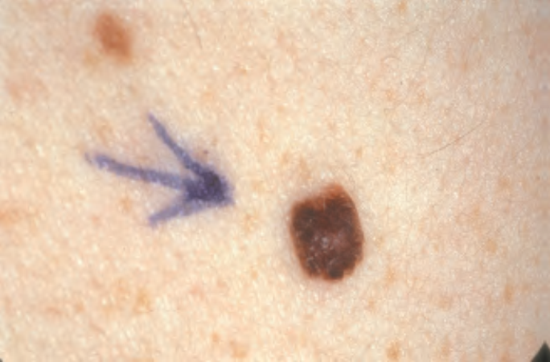
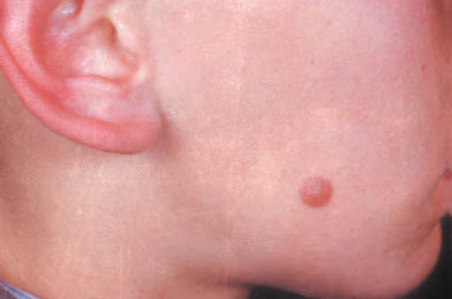
junctional naevus
Intradermal naevus
Compound naevus
Spitz naevus

Slide 37
Spitz naevus These are reddish brown (occasionally deeply pigmented) nodules, previously termed ‘juvenile melanoma They most commonly occur on the face and legs.
Café-au-lait spots These are coffee-coloured macules of variable size (from a few mm to 10 cm.Multiple lesions are associated with NF 1 and McCune–Albright syndromes. They are more common in dark-skinned races

Slide 38
Mongolian spot
Café-au-lait spots

Slide 39
Mongolian spot is a congenital blue grey macule found on the sacral skin Pigmentation initially deepens and then regresses completely by age 7 years.
Blue naevus This is a benign skin lesion that is four times more common in children, typically affecting the extremities and face
A naevus of Ota is a dermal, melanocytic hamartoma visible as a blue or grey macule in the trigeminal V1 and V2 dermatomes. It is four times more common in women and most frequently seen in Oriental and African races

Slide 40
Naevus of Ota
Blue naevus

Slide 41
Hair follicles
Trichoepithelioma These are small skin-coloured nodules, found most often in the nasolabial folds. It is clinically and histologically similar to a basal cell carcinoma.
Tricholemmoma (naevus sebaceous of Jadassohn) is a congenital hamartoma with the appearance of a linear verrucous naevus. 10% form a BCC life-long
Rhinophyma is the end-stage sequela of nasal acne rosacea
It is nasal sebaceous gland hypertrophy and tends to affect elderly men

Slide 42
Extramammary Paget’s disease involving the perineum
Rhinophyma

Slide 43
Premalignant lesions
Extramammary Paget’s disease (intraepidermal adenocarcinoma) This occurs in cutaneous sites rich in apocrine glands such as the axillae, genital and perianal regions. Approximately 25% are associated with an underlying in situ or invasive adenocarcinoma. Early skin changes are subtle and may present as an eczematous lesion or intertrigo. Surgical excision forms the basis of treatment, with up to 20% demonstrating invasive disease after pathology assessment

Slide 44
Giant congenital pigmented naevus (GCPN) or giant hairy naevus This naevus causes a great deal of confusion as its definition and management is contentious. It is a hamartoma of naevo- melanocytes that has a tendency to dermatomal distribution
Atypical (dysplastic) naevus To be ‘atypical naevi’, lesions must have three of the following characteristics: variegated pigmentation; ill-defined borders; undulating irregular surfaces; or measure >5 mm. Histologically, they are irregular proliferations of melanocytes at the basal layer of epidermis. They can be sporadic or familial

Slide 45
Giant congenital pigmented naevus
Dysplastic naevus

Slide 46
Malignant lesions
Annually, global figures reveal 33% of all recorded malignancy
affects the skin, with 2–3 million new non-melanoma
skin cancers and 132 000 new malignant melanomas diagnosed each year.

Slide 47
Basal cell carcinoma
This is usually a slow-growing, locally-invasive, malignant tumour of pluripotential epithelial cells arising from basal epidermis and hair follicles; hence, it affects the pilo-sebaceous skin.
The strongest predisposing factor to BCC is UVR. It occurs in the elderly or the middle-aged after excessive sun exposure, with 95% occurring between the ages of 40 and 80 years
Arsenical compounds, coal tar, aromatic hydrocarbons, ionising radiation and genetic skin cancer syndromes.
White-skinned people are almost exclusively affected. BCC is more common in men than women.

Slide 48
MACROSCOPIC
BCC can be divided into localised (nodular; nodulocystic; cystic; pigmented and naevoid) and generalised (superficial: multifocal and superficial spreading; or infiltrative: morphoeic,
ice pick and cicatrizing). Nodular and nodulocystic variants account for 90% of BCC.
MICROSCOPIC
Twenty-six histological subtypes have been described. The
characteristic finding is of ovoid cells in nests with a single
‘palisading’ layer. It is only the outer layer of cells that actively
divide, explaining why tumour growth rates are slower than their cell cycle speed would suggest, and why incompletely
excised lesions are more aggressive.

Slide 49
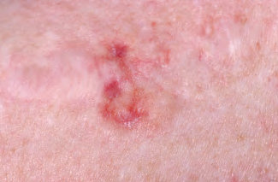
A nodulocystic basal carcinoma (BCC). Note the characteristic pearly surface with telangectasia. (b) An ulcerating
BCC on the lower eyelid. (c) A recurrent morphoeic BCC
A
B

Slide 50
PROGNOSIS
There are ‘high-risk’ and ‘low-risk’ BCCs. High-risk BCCs are: large (>2 cm); located at sites where direct invasion gives access to the cranium (near the eye, nose and ear); recurrent tumours; tumours forming in the presence of immunosuppression; or that have micronodular or infiltrating histological subtype
Treatment
can be surgical or non-surgical. Tumour and surrounding surgical margins should always be assessed , then either a two-stage surgical approach with subsequent reconstruction after confirmation of clear margins, or Mohs’ micrographic surgery is advisable.

Slide 51
Mohs’ micrographic surgery is a method used by dermatological surgeons dermatologists who have undergone extra training in techniques of cutaneous surgery and histopathology) to excise skin cancer under microscopic control.
In the elderly or infirm patients, radiotherapy produces similar recurrence rates to surgery; but with the risk of generating further malignancy after 1–2 decades. Biopsy-proven, superficial tumours can be treated with topical treatments (5-fluorouracil, imquimod).

Slide 52
Cutaneous squamous cell carcinoma
SCC is a malignant tumour of keratinising cells of the epidermis or its appendages. It arises from the stratum basalis of the epidermis and expresses cytokeratins 1 and 10.
Four BCCs occur for every SCC, which is the second most common form of skin cancer. It is strongly-related to cumulative sun exposure and damage, especially in white skinned individuals living nearer the equator.
it is more common in men than women. SCC is also associated with chronic inflammation (chronic sinus tracts, pre-existing scars, osteomyelitis, burns, vaccination points) and immunosuppression. When a SCC appears in a scar it is known as a Marjolin’s ulcer.

Slide 53
MACROSCOPIC
The appearance of SCC may vary from smooth nodular, verrucous, papillomatous to ulcerating lesions. All ulcerate eventually, as they grow. The ulcers have a characteristic everted edge and are surrounded by inflamed, indurated skin
MICROSCOPIC
Characteristic irregular masses of squamous epithelium are noted to proliferate and invade the dermis from the basal layer. The tumour stains positive for cytokeratins 1 and 10. SCC can be graded histologically according to Broder’s grading

Slide 55
PROGNOSIS
There are several independent prognostic variables for SCC:
Depth: the deeper the lesion, the worse the prognosis. For SCC <2 mm, metastasis is highly unlikely; whereas if >6 mm, 15% of SCC will have metastasised.
Surface size: lesions >2 cm have a worse prognosis than
smaller ones.
Histological grade: the higher the Broder’s grade, the worse the prognosis.
Microscopic invasion of lympho-vascular spaces or nerve tissue carries a high risk of metastatic disease.

Slide 56
Site: SCCs on the lips and ears have higher local recurrence
● Aetiology: SCCs that arise in burn scars, osteomyelitis skin sinuses, chronic ulcers and areas of skin that have been irradiated have a higher metastatic potential.
Immunosuppression: SCCs will invade further in those with impaired immune response.

Slide 57
Surgical excision is the only means of providing accurate information on histology and clearance. The margins for primary excision should be tailored to surface size in the first instance. This should ideally be assessed using surgical loupe magnification. A 4 mm clearance margin should be achieved if the SCC measures <2 cm across, and a 1-cm clearance margin if >2 cm. 95% of local recurrence and regional metastases occur within 5 years, thus follow-up beyond this period is not indicated

Slide 58
Cutaneous malignant melanoma
Melanoma is a cancer of melanocytes and can, therefore, arise in skin, mucosa, retina and the leptomeninges.
Cutaneous melanoma is caused by exposure to UVR. Its rise in incidence reflects increased recreational activity in the sun and emigration among white skinned races .It is the commonest cancer in young adults (20–39 years)

Slide 59
Macroscopic features in naevi suggestive of malignant
melanoma
●● Change in size
●● Shape
●● Colour
●● Thickness (elevation/nodularity or ulceration)
●● Satellite lesions (pigment spreading into surrounding area)
●● Tingling/itching /serosanguinous discharge (usually late signs)

Slide 60
MACROSCOPIC
Only 10–20% of MM form in pre-existing naevi, There are four common macroscopic variants of MM
Superficial spreading melanoma (SSM) This is the most common presentation (70%)
Nodular melanoma (NM) Nodular melanoma accounts for 15% of all MM and tends to be more aggressive than SS
Lentigo maligna melanoma
Acral lentigious melanoma (ALM) ALM affects the soles of
feet and palms of hands. It is rare in white-skinned individuals
but more common in the Afro-Caribbean,
Hispanic and Asian population

Slide 61
Superficial spreading melanoma

Slide 62
Nodular melanoma
Lentigo maligna melanoma

Slide 63
MICROSCOPIC
Malignant change occurs in the melanocytes in the basal epidermis
The greater the depth of invasion, the greater is the metastatic potential of the tumour

Slide 64
An excision biopsy with 2–3 mm margin of skin and a cuff of subdermal fat is acceptable
For in situ melanoma a wide excision of 5 mm is sufficient; for melanoma <1 mm deep, a 1 cm margin is sufficient; and for deeper lesions, a 2 cm only margin is recommended
Management of regional lymph nodes
ADJUVANT THERAPY

Slide 65
Acral lentiginous melanoma

Slide 66
Congenital: haemangiomata and vascular malformations
These can be subclassified biologically into vascular tumours or vascular malformations based on their endothelial characteristics,
or radiologically into haemangiomata, vascular and
lymphatic malformations based on their vascular dynamics.

Slide 67
Haemangiomata
These are benign endothelial tumours that affect three girls for every boy.
30% have a herald patch at birth, which then
grows rapidly in the first year of life and slowly involutes over several years, with 70% having resolved by 7 years of age.
Large hamangiomata can trap platelets leading to thrombocytopenia (Kasabach–Merritt syndrome).

Slide 68
Vascular malformations
Vascular malformations affect boys and girls equally and are associated with numerous syndromes. They are invariably
present at birth, but may be missed if deep to the skin.
Vascular malformations subsequently grow in proportion to the child’s growth.
Stasis can lead to a localised, consumptive coagulopathy in large venous malformations.
Low-flow malformations may cause skeletal hypoplasia, while high-flow malformations can cause hypertrophy.

Slide 69
Salmon patch
is a haemangioma that presents as a pinkish macule, usually at the nape of neck
. It is caused by an area of persistent fetal dermal circulation,
Which usually disappears at 1 year.

Slide 70
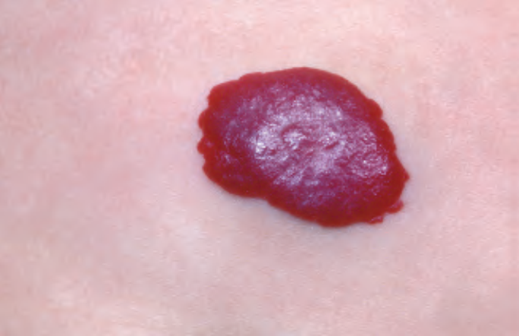
Capillary haemangioma (strawberry naevus)
This is the commonest ‘birth mark’, occurring most commonly on the head and neck).
90% appear at birth, and, as a consequence of intravascular thrombosis, fibrosis and mast cell infiltration, 10% resolve each subsequent year, with 70% resolved by 7 years old.
Whites skin is affected most commonly and girls are affected three times more than boys.

Slide 71
Capillary vascular malformations ‘port-wine’ stains
20 times less common than capillary haemangiomata and
result from defective maturation of cutaneous sympathetic innervation during embryogenesis, leading to localised intradermal capillary vasodilatation
They appear at birth as flat, smooth, intensely purple-stained areas, most frequently on the head and neck, often within the maxillary and mandibular dermatomes of the trigeminal nerve.
Treatment with intense pulsed light and pulse dye laser are successful

Slide 72
Spider naevi
These are angiomata that appear (and may disappear) spontaneously at puberty or in two-thirds of pregnant women, usually disappearing in the puerperium.
Spider naevi are also associated with chronic liver disease.
They can be treated with intense pulsed light or pulse dye laser.

Slide 73
Pressure sores
These begin with tissue necrosis at a pressure point and develop into a cone-shaped volume of necrotic loss.
As many as 10% of acute hospital in-patients will suffer some degree of pressure sore. The majority affect the elderly and patients with spinal injury or decreased sensibility; 80% of paraplegics will get a pressure sore and 8% die as a result.
an increase in local tissue pressure above that of perfusion pressure produces ischaemic necrosis that is directly proportional to the duration and degree of pressure and inversely proportional to the area over which it is applied. Muscle and fat are more susceptible to pressure than skin.

Slide 74
In a patient who has no predisposing factors management is aimed at debridement and repair of the defect,.
In the paraplegic patient recurrence is likely, so management should involve a multidisciplinary. Primary treatment involves relieving pressure (special mattress; nursing care; relief of muscle spasm and contractures); optimising nutrition; correcting anaemia; and preventing infection and dressings.
Surgery involves thorough debridement to promote healing and plastic surgery to reconstruct the defect.

Slide 75
Ulcers
An ulcer is a discontinuity of an epithelial surface. It is characterised by destruction of the surface epithelium and a granulating base.
Ulcers can be classified as non-specific, specific and malignant

Slide 76
Sinus
A sinus is a blind-ending tract connecting a cavity lined with granulation tissue (often an abscess cavity) to an epithelial surface
Sinuses may be congenital or acquired.
Congenital sinuses arise from the remnants of persistent embryonic ducts.
Acquired sinuses can result from: a retained foreign body (ingrown hair or suture material); chronic infection (tuberculosis); chronic inflammation ,malignancy; or inadequate surgical drainage of the cavity.
Treatment of a sinus is directed at removing the underlying cause. Biopsies should always be taken from the wall of sinus to exclude malignancy or specific infection

Slide 77
Fistula
A fistula is an abnormal communication between two epithelial-lined surfaces. This communication or tract may be lined by granulation tissue, but may become epithelialised in chronic cases.
Fistulas may be congenital or acquired
Management of a fistula is directed at the underlying aetiology

