Slide 1
Nutrition and fluid therapy
Dr. Hasanain Abdulameer JASIM

Slide 2
Learning objectives
To understand:
The causes and consequences of malnutrition in the surgical patient
Fluid and electrolyte requirements in the pre- and postoperative patient
The nutritional requirements of surgical patients and the nutritional consequences of intestinal resection
The different methods of providing nutritional support and their complications

Slide 3
INTRODUCTION
Malnutrition is common. It occurs in about 30% of surgical patients with gastrointestinal disease
up to 60% of those hospitalized because of postoperative complications.
Patients who suffer starvation or have signs of malnutrition have a higher risk of complications and an increased risk of death

Slide 4
Metabolic response to starvation
After a short fast, lasting 12 hours or less, most food from the last meal will have been absorbed.
Plasma insulin levels fall, and glucagon levels rise, which facilitates the conversion of liver glycogen (approximately 200 g) into glucose.
Additional stores of glycogen exist in muscle (500 g), but these cannot be utilised directly.

Slide 5
After 24 hr glycogen stores are depleted and de novo glucose production from non-carbohydrate precursors (gluconeogenesis) takes place, predominantly in the liver.
Most of this glucose is derived from the breakdown of amino acids, particularly glutamine and alanine as a result of catabolism of skeletal muscle (up to 75 g per day).
With more prolonged fasting, there is an increased reliance on fat oxidation to meet energy requirements.

Slide 6
after 48–72 hours of fasting, the central nervous system may adapt to using ketone bodies as their primary fuel source.
This conversion to a ‘fat fuel economy’ reduces the need for muscle breakdown by up to 55 g per day.
In addition , significant reduction in the resting energy expenditure, mediated by a decline in the conversion of inactive thyroxine (T4) to active tri-iodothyronine (T3). Despite these adaptive responses, there remains an obligatory glucose requirement of about 200 g per day

Slide 8
Metabolic response to trauma and sepsis
In contrast to simple starvation, patients with trauma have impaired formation of ketones
breakdown of protein to synthesize glucose (gluconeogenesis) cannot be entirely prevented by the administration of glucose.
reduced transport of glucose into muscle cells (the main tissue for uptake of insulin-mediated glucose) owing to reduced activation of the glucose transporter protein GLUT4.
although it is generally accepted that the metabolic response to trauma and sepsis is always associated with ‘hypermetabolism’ or hypercatabolism There is no evidence to show that the provision of high-energy intake is associated with an amelioration of the catabolic process and it may indeed be harmful; there is mounting evidence for the benefits of permissive underfeeding in critically ill surgical patients.

Slide 10
NUTRITIONAL ASSESSMENT
Laboratory techniques
There is no single biochemical measurement that reliably identifies malnutrition.
Albumin is not a measure of nutritional status, particularly in the acute setting
Measurement of lymphocyte count and skin testing for delayed hypersensitivity frequently reveal abnormalities in malnourished patients.
Haemoglobin levels can indicate the presence of anemia related to a lack of appropriate vitamins. Glycated Haemoglobin can reflect diabetes and blood glucose control

Slide 11
Body weight and anthropometry
A simple method of assessing nutritional status is to estimate weight loss. Unintentional weight loss of more than 10% of a patient’s weight in the preceding 6 months is a good prognostic indicator of poor outcome.
BMI, defined as body weight in kilograms divided by height in meters squared. A BMI of less than 18.5 indicates nutritional impairment, and a BMI below 15 is associated with significant hospital mortality.
Anthropometric techniques, incorporating measurements of skinfold thicknesses and mid-arm circumference, permit estimations of body fat and muscle mass
These are indirect measures of energy and protein stores

Slide 12
Clinical
A clinical assessment of nutritional status involves a focused history and physical examination,
an assessment of risk of malabsorption or inadequate dietary intake and selected laboratory tests aimed at detecting specific nutrient deficiencies. This is termed ‘subjective global assessment’

Slide 13
Malnutrition universal screening tool (MUST), which is a five-step screening tool to identify adults who are malnourished or at risk of undernutrition.

Slide 15
FLUID AND ELECTROLYTES
Fluid intake is derived from both exogenous (consumed liquids)
and endogenous (released during oxidation of solid foodstuffs) fluids.

Slide 16
1200

Slide 17
Fluid losses occur by four routes:
Lungs. About 400 mL of water is lost in expired air each 24 hours. This is increased in dry atmospheres or in patients with a tracheostomy, emphasizing the importance of humidification of inspired air.
Skin. In a temperate climate, skin (i.e. sweat) losses are between 600 and 1000 mL/day.
Faeces. Between 60 and 150 mL of water are lost daily inn patients with normal bowel function.
Urine. The normal urine output is approximately 1500 mL/ day and, provided that the kidneys are healthy, the specific gravity of urine bears a direct relationship to volume. A minimum urine output of 400 mL/day is required to excrete the end products of protein metabolism.

Slide 18
Maintenance fluid requirements are calculated approximately from an estimation of insensible and obligatory losses. Various formulae are available for calculating fluid replacement based on a patient’s weight or surface area. For example, 30–40 mL/kg gives an estimate of daily requirements.
The following are the approximate daily requirements of some electrolytes in adults:
●● sodium: 50–90 mM/day;
●● potassium: 50-60 mM/day;
●● calcium: 5 mM/day;
●● magnesium: 1 mM/day.

Slide 20
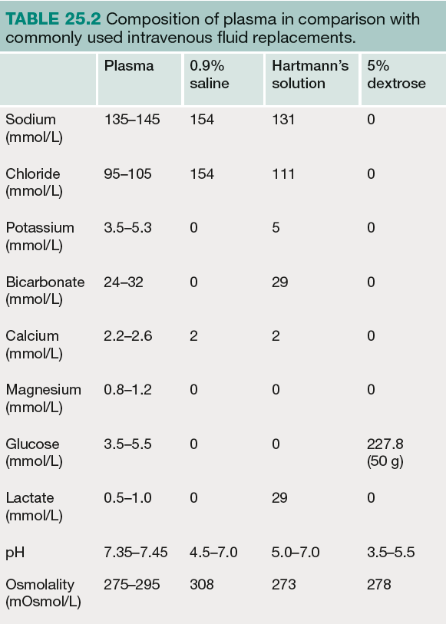

Slide 21
Dextrose solutions are also commonly employed. These provide water replacement without any electrolytes and with modest calorie supplements (1 litre of 5% dextrose contains 400 kcal).
A typical daily maintenance fluid regimen would consist of a combination of 5% dextrose with either Hartmann’s or normal saline to a volume of 2 litres.
If the haematocrit is below 21%, blood transfusion may be required.

Slide 22
In addition to maintenance requirements, ‘replacement’ fluids are required to correct pre-existing deficiencies and ‘supplemental’ fluids are required to compensate for anticipated additional intestinal or other losses. The nature and volumes of these fluids are determined by:
A careful assessment of the patient including pulse, blood pressure and central venous pressure, if available. examination to assess hydration status (peripheries, skin turgor, urine output and specific gravity of urine), urine and serum electrolytes and haematocrit.

Slide 23
Estimation of losses already incurred and their nature: for example, vomiting, ileus, diarrhoea, excessive sweating or fluid losses from burns or other serious inflammatory conditions
Estimation of supplemental fluids likely to be required in view of anticipated future losses from drains, fistulae,nasogastric tubes or abnormal urine or faecal losses.
When an estimate of the volumes required has been made,
the appropriate replacement fluid can be determined from a consideration of the electrolyte composition of gastrointestinal secretions. Most intestinal losses are adequately replaced with normal saline containing supplemental potassium

Slide 25
NUTRITIONAL REQUIREMENTS
Total enteral or parenteral nutrition necessitates the provision of the macronutrients, carbohydrate, fat and protein, together with vitamins, trace elements electrolytes and water.
When planning a feeding regime, the patient should be weighed and an assessment made of daily energy and protein requirements. Standard tables are available to permit these calculations.

Slide 26
Daily needs may change depending on the patient’s condition.
Overfeeding is the most common cause of complications,
regardless of whether nutrition is provided enterally or parenterally. It is essential to monitor daily intake to provide an assessment of tolerance. In addition, regular biochemical monitoring is mandatory

Slide 28
Macronutrient requirements
Energy
The total energy requirement of a stable patient with a normal is approximately 20–30 kcal/kg per day.
Very few patients require energy intakes over 2000 kcal/day.
Thus, in the majority of hospitalised patients in whom energy demands from activity are minimal, total energy requirements are approximately 1300–1800 kcal/day.
Nutrient requirements may increase to 30 kcal/kg ideal body weight per day under conditions of severe stress. However, the introduction of nutrition should be cautious in these patients as well as in those at risk of refeeding syndrome; nutrition should be started at no more than 50% of the estimated target energy needs. This can be increased to the full requirement over 24–48 hours, according to tolerance. Patients at risk of refeeding syndrome

Slide 29
Carbohydrate
There is an obligatory glucose requirement to meet the needs of the central nervous system and certain haematopoietic cells, which is equivalent to about 2 g/kg per day.
Provide energy as mixtures of glucose and fat. Glucose is
the preferred carbohydrate source.
physiological maximum to the amount of glucose
that can be oxidised, which is approximately 4 mg/kg per
minute (equivalent to about 1500 kcal/day in a 70-kg person), Dietary guidelines therefore recommend that carbohydrates form 45–65% of the total caloric intake per day.
With the nonoxidised glucose being primarily converted to
fat.

Slide 30
Fat
Dietary fat is composed of triglycerides of predominantly four
long-chain fatty acids. There are two saturated fatty acids (palmitic (C16) and stearic (C18)) and two unsaturated fatty acids (oleic (C18) and linoleic (C18)).
The unsaturated fatty acids are considered essential because they cannot be synthesised in vivo from non-dietary sources.
Safe and non-toxic fat emulsions based upon long-chain
triglycerides (LCTs) have been commercially available These emulsions provide a calorically dense product (9 kcal/g) and are now routinely used to supplement , recommended infusion rates (0.15 g/kg
per hour)

Slide 31
Energy during parenteral nutrition should be given as a mixture of fat together with glucose.
basal requirements for glucose (100–200 g/day)
and essential fatty acids (100–200g/week)

Slide 32
Protein
The basic requirement for nitrogen in patients without pre-existing malnutrition and without metabolic stress is 0.10–0.15 g/kg per day.
In hypermetabolic patients, the nitrogen requirements increase to 0.20–0.25 g/kg per day.
This is equivalent to a daily protein intake of 1.5 g/kg ideal body weight or around 20% of total energy requirements
Vitamins, minerals and trace elements
these are all essential components of nutritional regimes. The water-soluble vitamins B and C act as coenzymes in collagen formation and wound healing. Postoperatively, the vitamin C requirement increases to 60–80 mg/day.
vitamin B12 is often indicated in patients who have undergone intestinal resection or gastric surgery and in those with a history of alcohol dependence.

Slide 33
Surgical procedures or medical conditions associated with a reduction in pancreatic or biliary enzymes in the intestinal tract (e.g. obstruction of the biliary or pancreatic ducts) will result in malabsorption of the fat-soluble vitamins A, D, E and K.
Increased intestinal losses such as in chronic diarrhoea can cause hyponatraemia, hypokalaemia and hypophosphataemia, which will all need monitoring and replacement.
Trace elements such as magnesium, zinc and iron are important cofactors in metabolic processes and may be reduced as part of the inflammatory response. Replacement of these elements is necessary to ensure appropriate utilisation of amino acids and avoidance of refeeding syndrome.

Slide 34
FLUID AND NUTRITIONAL
CONSEQUENCES OF
INTESTINAL RESECTION
Up to 50% of the small intestine can be surgically removed or bypassed without permanent deleterious effects. With extensive resection (<150 cm of remaining small intestine), metabolic and nutritional consequences arise, resulting in the disease entity known as short bowel syndrome.

Slide 35
Small bowel motility
Motility slower in ileum with more fluid and sodium absorption ability than jejunum .
Absorption of bile salt and vitamin B12 occur at ileum
Colon ability to absorb water reach 90% ( transit time 24 to 150 hr) in addition fragment carbohydrate to produce short chain fatty acid
Another important colonic function is the fermentation of carbohydrates to produce short-chain fatty acids. They enhance , water and salt absorption from the colon and, second, they are trophic to the colonocyte.

Slide 36
Effects of resection
Resection of proximal jejunum results in no significant alterations in fluid and electrolyte levels
Resection of ileum results in a significant enhancement
of gastric motility and acceleration of intestinal transit. Following ileal resection, the colon receives a much larger volume of fluid and electrolytes and it also receives bile salts, which reduce its ability to absorb salt and water, resulting in diarrhoea.
The ileum is responsible for bile salt reabsorption and loss of
Even 100 cm of ileum may cause steatorrhoea, which can be
treated by the administration of cholestyramine for bile salt
binding.

Slide 37
Complications of short bowel syndrome include
peptic ulceration related to gastric hypersecretion,
Cholelithiasis because of interruption of the enterohepatic cycle of bile salts
hyperoxaluria as a result of the increased absorption of oxalate in the colon predisposing to renal stones.

Slide 38
ARTIFICIAL NUTRITIONAL
SUPPORT
Any patient who has sustained 5 days of inadequate intake or who is anticipated to have no or inadequate intake for this period should be considered for nutritional support.

Slide 40
Enteral nutrition
means delivery of nutrients into the gastrointestinal tract.
This can be achieved with normal food, oral supplements (sip feeding) or with a variety of tube feeding techniques delivering food into the stomach, duodenum or jejunum.
A variety of nutrient formulations are available for enteral feeding.
preferred route of administration of nutrition where possible. Benefts of enteral nutrition include preservation of the gut mucosal barrier and immunity and prevention of gut atrophy. The use of enteral nutrition is also associated with reduced infection rates, better wound healing, and a reduced length of stay compared with parenteral nutrition.

Slide 41
Sip feeding
Commercially available supplementary sip feeds are used in
patients who can drink but whose appetites are impaired or
in whom adequate intakes cannot be maintained with adlibitum intakes. These feeds typically provide 200 kcal and
2 g of nitrogen per 200 mL carton.

Slide 42
Tube-feeding techniques
Enteral nutrition can be achieved using conventional nasogastric tubes (Ryle’s), fine-bore feeding tubes inserted into the stomach, surgical or percutaneous endoscopic gastrostomy (PEG) or, finally, postpyloric feeding utilising nasojejunal tubes or various types of jejunostomy
Conventionally, 20–30 mL are administered per hour initially, gradually increasing to goal rates within 48–72 hours. In most units, feeding is discontinued for 4–5 hours overnight to allow gastric pH to return to normal

Slide 43
aspirates are performed on a regular basis, and if they exceed 200 mL in any 2-hour period, then feeding is temporarily discontinued to reduce the risk of nosocomial aspiration pneumonia
Tube blockage is common. All tubes should be flushed with water at least twice daily.
Nasogastric tubes are appropriate in the majority of patients. For longer term feeding, a finebore feeding tube is preferable (8–12Fr) may be preferable to minimise the risk of rhinitis, pharyngitis and gastric and oesophageal erosions. These tubes are also less likely to interfere with eating and drinking and are often better tolerated by patients.

Slide 44
Abdominal radiograph confrming that the position of the tip of a nasojejunal feeding tube is past the duodenojejunal fexure
A fne-bore feeding tube with its guidewire

Slide 45
Gastrostomy
Gastrostomy insertion can be endoscopic
(percutaneous endoscopic gastrostomy [PEG]), radiological (radiologically inserted gastrostomy [RIG]) or surgical(percutaneous endoscopic gastrostomy . Complications of a gastrostomy, regardless of the technique
of placement, include perforation, bleeding and peritonitis.
Localised sepsis around the insertion site is very common and
may require systemic antibiotics
Jejunostomy
This can be achieved using nasojejunal tubes
or by placement of needle jejunostomy at the time of laparotomy.

Slide 46
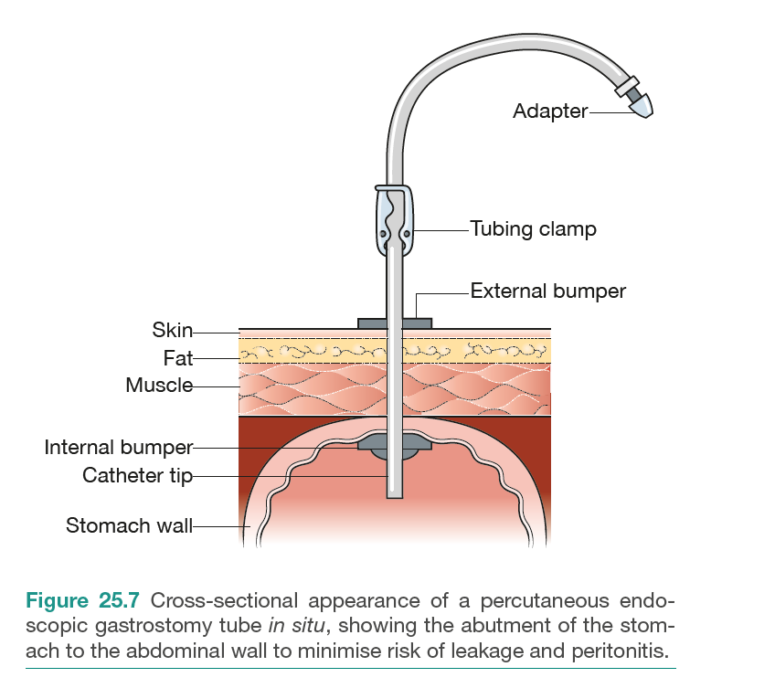

Slide 48
Parenteral nutrition TPN
is defined as the provision of all nutritional requirements by means of the intravenous route and without the use of the gastrointestinal tract
Parenteral nutrition is indicated when energy and protein needs cannot be met by the enteral administration of these
substrates.
The most frequent clinical indications relate to
those patients who have undergone massive resection of the
small intestine, who have intestinal fistula or who have prolonged intestinal failure for other reasons.

Slide 49
TPN can be administered either by a catheter inserted in the central vein or via a peripheral line.
Peripheral feeding is appropriate for short-term feeding of up to 2 weeks.
central venous route the catheter can be inserted via the subclavian or internal or external jugular vein.

Slide 53
Refeeding syndrome
This syndrome is characterised by severe fluid and electrolyte shifts in malnourished patients undergoing refeeding.
occur with either enteral or parenteral nutrition, but is more common with the latter.
It results in hypophosphataemia, hypocalcaemia and hypomagnesaemia.
can result in altered myocardial function, arrhythmias,
deteriorating respiratory function, liver dysfunction, seizures, confusion, coma, tetany and death.
Calorie delivery should be increased slowly and vitamins administered regularly. Hypophosphataemia and hypomagnesaemia require treatment.

