Slide 1
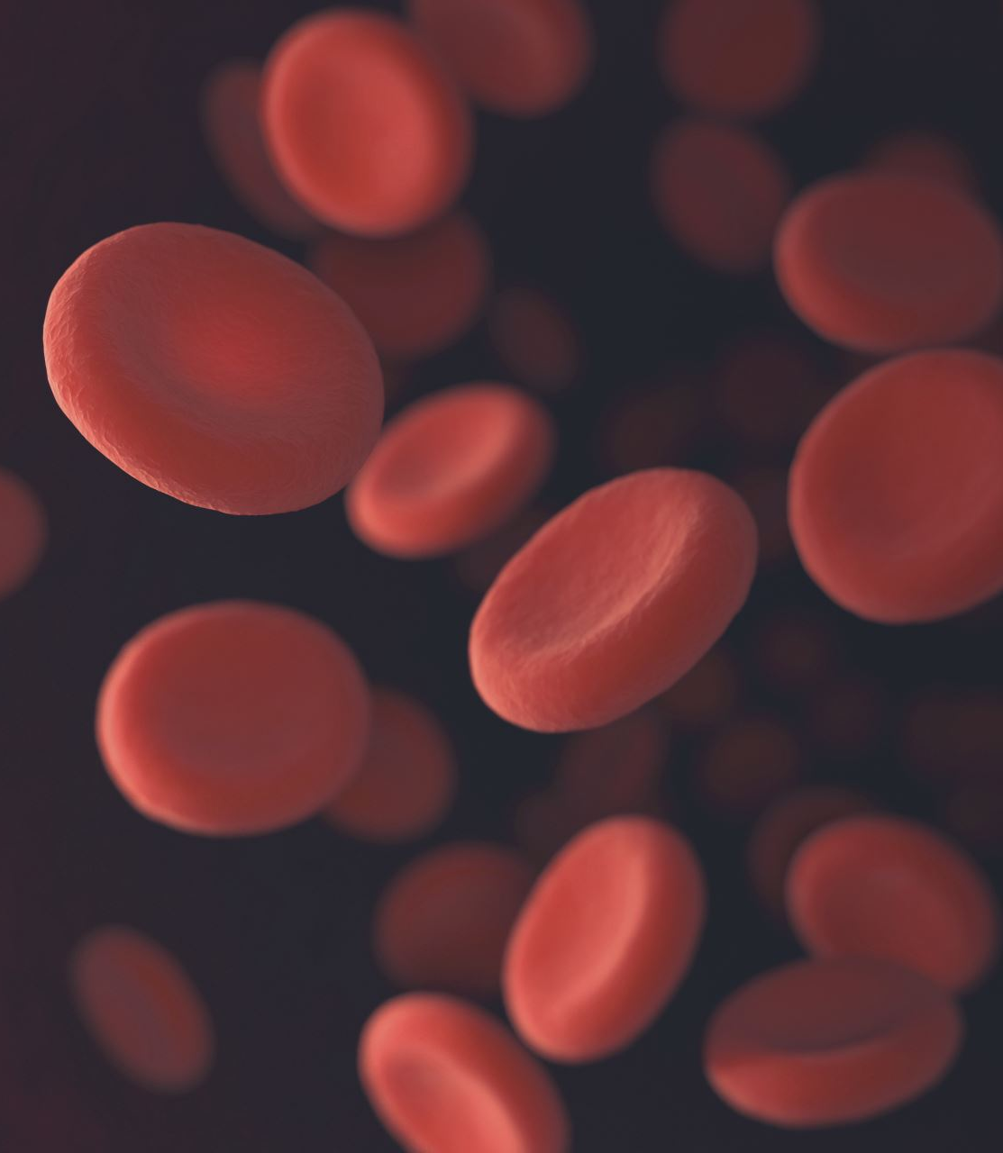
Blood components and their preparation
Prof. Dr. Israa M. Al-Bayaa
MBChB
FIBMS (Hematopathology)
Department of pathology and Forensic science/Al-Mustanseria University

Slide 2
objectives
Identify the main blood components prepared from whole blood.
Recognize the storage conditions, shelf life , indications and transfusion requirement for blood components.

Slide 3
A single blood donation can provide transfusion therapy to multiple patients in the form of red blood cells (RBCs), platelets, fresh-frozen plasma, and cryoprecipitate.
Other products such as derivatives of plasma (e.g., immune serum globulin) also benefit patients with various diseases or conditions.

Slide 4
Blood components
Components may be prepared either by collecting whole blood and transforming into components using centrifugation or by collecting targeted components using apheresis, which involves centrifugation of whole blood at the donor’s bedside and the return of blood fractions that are not collected, Often, more of the target component can be collected by a single apheresis donation than can be obtained from collecting whole blood.

Slide 5
Components collected by apheresis
apheresis platelets (one donation can collect up to three adult doses of platelets, or 18 times the quantity that can be harvested from a single whole blood donation).
apheresis plasma (one donation can collect up to 1 L of plasma, which is approximately three to four times the volume that can be harvested from a single whole blood donation).
apheresis double-red blood cells (one donation can collect up to 2 units of red blood cells, double what can be harvested from a single whole blood donation)

Slide 6
Whole blood
Whole blood is collected in a ratio of 14 mL of anticoagulant-preservative for every 100 mL of whole blood targeted for collection.
Depending on the collection system used, a whole blood component typically contains either 450 mL (±10%) of whole blood with 63 mL of anticoagulant-preservative or 500 mL (±10%) of whole blood with 70 mL of anticoagulant-preservative, collected from blood donors with a minimum hematocrit of 38%.
Currently it is not widely used as it has been replaced by packed RBC and plasma expanders. Mainly used in military for trauma and also can be used for civilian trauma.

Slide 7
By far, most whole blood donations are manufactured into components
If the donation remains as whole blood, it must be stored at 1° to 6°C, and the shelf life is dependent on the anticoagulant/preservative used

Slide 8
RBC (packed RBC)
RBCs are separated from whole blood by centrifugation, apheresis, or less commonly, sedimentation.
they are typically prepared shortly after donation to allow the manufacture of platelet concentrates, frozen plasma, or cryoprecipitate, which must be prepared within designated time periods after collection, usually 8 to 24 hours.
If additive solutions (AS) are employed, as much of the plasma is removed as possible, and the AS must be added to the RBC component within 3 days of collection, resulting in a finished product with a hematocrit of 55% to 65%

Slide 9
RBC components typically have a final red cell volume of 160 to 275 mL or 50 to 80 g of hemoglobin suspended in the residual plasma and/or additive solution.
Red blood cells must be stored at 1° to 6°C. In the absence of additive solution, RBCs have the same shelf life as whole blood, either 21 (CPD, CP2D, ACD-A) or 35 (CPDA-1) days. The addition of additive solution to the prepared RBCs extends the shelf life to 42 days.

Slide 10
Platelets
Platelet components can be produced from whole blood donations and by apheresis.
Whole blood used to prepare platelet concentrates must be drawn by a single nontraumatic venipuncture, and the concentrate must be prepared within 8 hours of collection.
platelets derived from whole blood are typically called random-donor platelets (RDPs) the platelet product obtained from an apheresis donation is referred to as single-donor platelets (SDPs).
platelet storage container must be made of a plastic that allows for oxygen exchange to maintain the appropriate pH throughout the storage period.

Slide 11
Single Donor versus random donor platelets
Single donor platelets
very expensive.
indicated for patients who are unresponsive to random platelets due to HLA alloimmunization or to limit the platelet exposure from multiple donors.
contain very few RBCs.
single-donor platelets contain at least 3 × 10¹¹ platelets.
Random donor platelets.
Less expensive.
RDPs are prone to RBC contamination.
RDPs may be maintained as individual components for small-volume transfusions or pooled together for adult transfusions.
Whole blood–derived platelet concentrates should contain at least 5.5 × 10¹⁰ platelets

Slide 12
Platelets are stored at 20° to 24°C with constant agitation, and therefore, they are the blood component that is most likely to grow bacteria if contaminated.
Bacteria may be introduced into a platelet product either by ineffective skin cleaning prior to phlebotomy or a low-level donor bacteremia that is not identified during health history.
the AABB Standards for Blood Banks and Transfusion Services requires blood banks and transfusion services to have methods in place to detect bacteria (ex: BacT/ALERT 3D) or use pathogen reduction technology (PRT) in all platelet components

Slide 13
Leukoreduction
Leukocyte reduction, or leukoreduction, is the removal of white blood cells (WBCs) from blood or blood components prior to transfusion.
Leukoreduced blood components were to contain less than 5.0 × 10⁶ residual white blood cells per each whole blood, red blood cells, or apheresis platelet, and less than 8.3 × 10⁵ residual WBCs per each platelets derived from whole blood , in addition at least 85% of the original component must be recovered after leukoreduction.

Slide 14
Why we need leukoreduction?
reduce recurrent febrile non-hemolytic transfusion reactions.
reduce alloimmunization to leukocyte antigens that may complicate care of patients who undergo transplantation or chronic transfusion therapy.
protect against transmission of cytomegalovirus (CMV) to patients at increased risk of CMV disease

Slide 15
Leukoreduction may be performed:
Within 72 hours of blood collection (pre storage leukoreduction).
at the patient’s bedside by passing the component through a filter during infusion.
Pre storage is more preferable than patient’s bedside as biological response modifiers (BRMs) released from leukocytes during storage of the component that were found to promote febrile transfusion reactions. Examples of BRMs include proinflammatory cytokines (interleukin-1, interleukin-6, and tumor necrosis factor) and complement fragments (C5a and C3a), also Bedside filtration has been associated with precipitous hypotension in the transfusion recipient, particularly in patients on medications that inhibit the angiotensin-converting enzyme (ACE inhibitors).

Slide 16
Leukoreduced RBCs and whole blood are prepared using special filters that achieve at least a 99.9% (a 2 to 4 log) removal of leukocytes by employing multiple layers of polyester or cellulose acetate nonwoven fibers that trap leukocytes and platelets but allow RBCs to flow through.

Slide 17
Plasma
Plasma from a whole blood donation can be manufactured into a variety of different components:-
plasma may be frozen within 8 hours and labeled as fresh-frozen plasma (FFP).
frozen within 24 hours and labeled as plasma frozen within 24 hours (PF24).
Plasma frozen within 8 hours can be further manufactured into cryoprecipitate and cryo-poor plasma.

Slide 18
plasma is stored at –18°C or colder for 1 year or at –65°C or below for 7 years.
Plasma from whole blood donations may also remain in a liquid state, stored at 1° to 6°C, and be labelled as liquid plasma (LP). LP expires 5 days after the whole blood shelf life from which it was collected (ex: CPD whole blood has a 21-day shelf life, therefore CPD LP has a shelf life of 26 days).

Slide 19
FFP will contain the maximum levels of both stable and labile clotting factors, about 1 international unit (IU) per milliliter. PF24 contains all stable proteins found in FFP, has normal levels of factor V, and has only slightly reduced levels of factor VIII. Factor levels in LP are poorly characterized in this product and will vary depending on when and how it was manufactured.
One unit of plasma contains approximately 300 mg fibrinogen per 100 mL and 1 unit of activity per millilitre of each of the stable clotting factors. FFP also contains the same level (1 unit/mL) of factors V and VIII, PF24 is known to have reduced levels of labile clotting factors, especially factor VIII.

Slide 20
Cryoprecipitated Antihemophilic Factor/ Cryo-Poor Plasma
It is the cold-precipitated concentration of factor VIII, also known as the antihemophilic factor.
The process for isolating factor VIII also harvests fibrinogen, factor XIII, von Willebrand factor (vWF), cryoglobulin, and fibronectin.
Cryoprecipitate-reduced plasma (cryo-poor plasma or CPP) is the plasma from which the cryoprecipitate concentrate has been harvested. After removing the cryoprecipitate, CPP contains the residual albumin; factors II, V, VII, IX, X, XI; and ADAMTS13. CPP cannot be used as a substitute for FFP, PF24, or thawed plasma

Slide 21
Cryoprecipitate and CPP are prepared from FFP that is thawed at 1° to 6°C, which prevents resuspension of cold-insoluble clotting factor proteins. The thawed plasma is centrifuged at 4°C at a hard-spin setting, then the super-natant plasma is expressed, leaving a button of cryoprecipitate in 10 to 25 mL of plasma it must refrozen within 1 hour.
CPP may be refrozen up to 24 hours after harvesting.
Both cryoprecipitate and CPP are stored at –18°C or below for up to 1 year from the whole blood collection date.

Slide 22
Cryoprecipitate should be thawed quickly at 30° to 37°C and stored at room temperature (22° to 24°C) until transfused. Once thawed, must be transfused within 6 hours.

Slide 23
Cryoprecipitate used in:
treatment of factor XIII deficiency.
as a source of fibrinogen for hypofibrinogenemia.
as a secondary line of treatment for classical haemophilia (haemophilia A) and von Willebrand’s disease.
used to make fibrin glue, a substance composed of cryoprecipitate (fibrinogen) and topical thrombin
Cryoprecipitate should not be used to treat hemophilia A or von Willebrand’s disease if virus-inactivated or recombinant factor preparations are available

Slide 24
CPP is most often used for transfusion or plasma exchange in patients with Thrombotic Thrombocytopenia Purpura (TTP) who have been initially treated using FFP without an adequate response

Slide 25
Both PF24 and FFP are thawed at temperatures between 30° and 37°C, Once thawing is complete, the product may be stored at 1° to 6°C for up to 24 hours. If not transfused within the initial 24-hour period, the thawed plasma may be stored for up to 5 days, but the product label must be changed to “thawed plasma” because it can not maintain therapeutic levels of the labile clotting Factor V and Factor VIII.

Slide 26
Plasma derivatives
They differ from blood components because they are prepared by further manufacture of pooled human source collected by apheresis, recovered plasma or by recombinant technology , of these derivatives:
Activated Factor VII (Factor VIIa).
Factor VIII Concentrates (FVIII).
Factor IX Concentrates.
Factor XIII Concentrates.
Immune Serum Globulin.
Normal Serum Albumin (NSA).
Rho(D) Immune Globulin.
Antithrombin III Concentrates

Slide 27
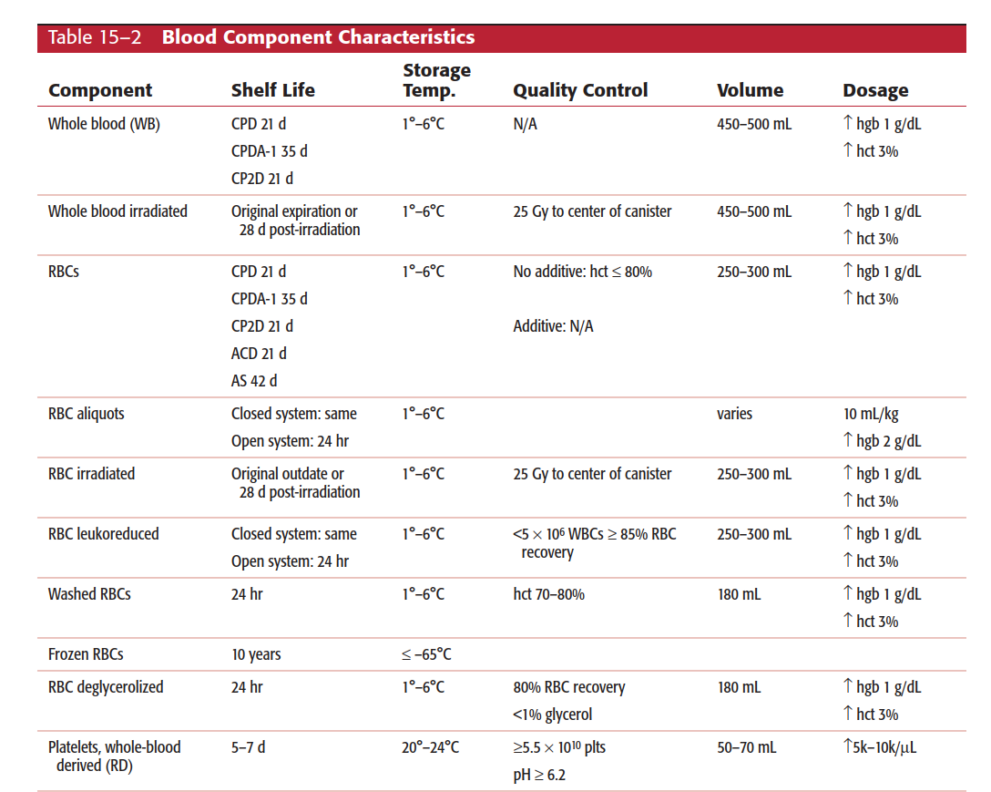

Slide 28
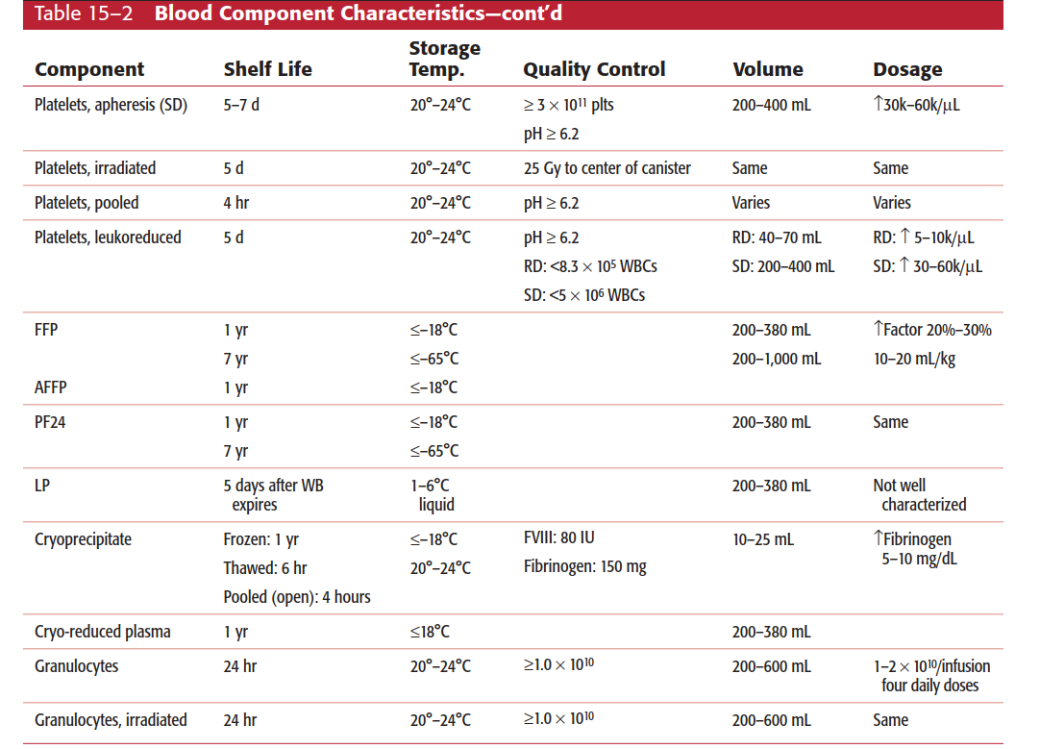

Slide 29
Thank you

