Slide 1
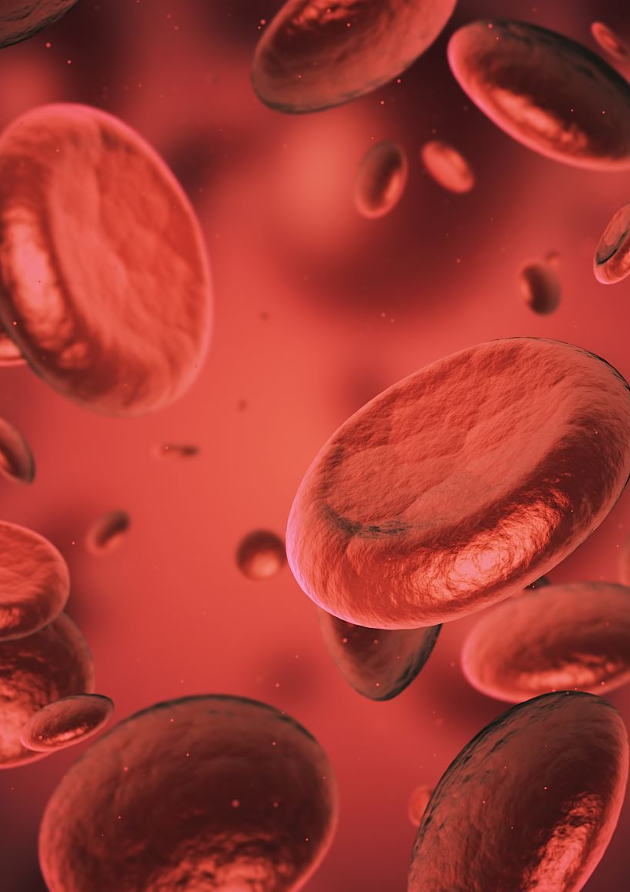
ABO System
Prof. Dr. Israa M. Al-Bayaa
MBChB
FIBMS (Hematopathology)
Department of pathology and Forensic science/Al-Mustanseria University

Slide 2
Objectives
By the end of this lecture students should be able to
Identify the difference between naturally occurring and immune mediated antibodies.
recognize the ABO system as a major blood group system in blood transfusion practice.
Explain the relationship between the H , Se, and the ABO blood group systems.
Recognize the characteristics of ABO system Antibodies and their clinical significance

Slide 3
ABO blood group system was the first Ag system to be discovered by the scientist Karl Landsteiner.
ABO grouping is the most frequently performed test in the blood bank. Both ABO forward and reverse grouping tests must be performed on all donors and patients.

Slide 4
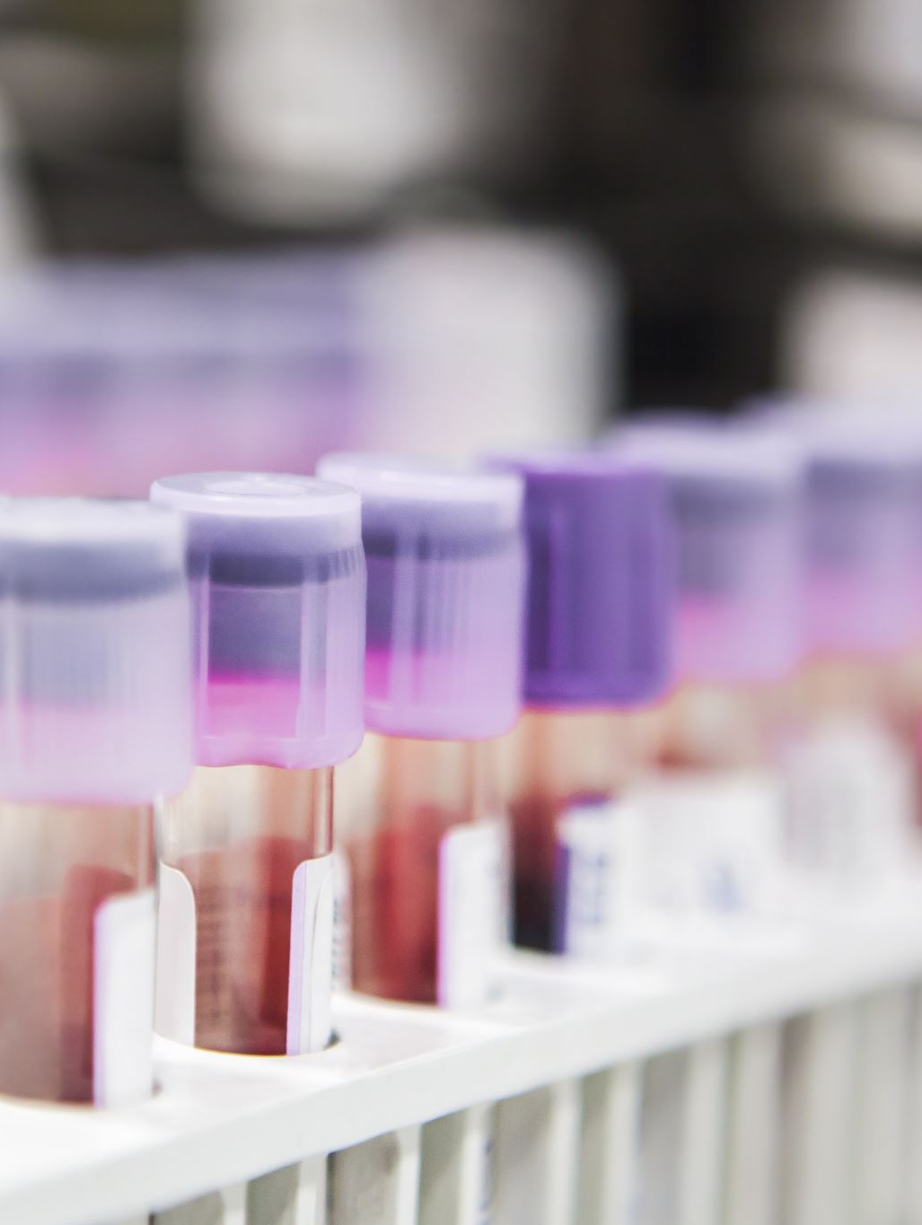
There are more than 400 Ag system on the RBC why ABO system is by far the most important clinically?
This is due to the fact that antibodies directed against those Ag are already present in persons lacking the corresponding Ag (naturally occurring) and they are capable of causing serious and fatal transfusion reactions when wrongly transfused.

Slide 5
Antibodies in blood banking are of 2 types
Naturally occurring Antibodies
They are found naturally in the plasma of individuals lacking the corresponding Ag without the need for previous exposure to the Ag by blood transfusion or through pregnancy.
They are usually IgM in type
Optimally reactive at room temperature although reactive at 37.
The most important are Anti-A and Anti-B
Other Antibodies that are naturally occurring are antibodies against Hh, MNS system , Ii system
Immune Antibodies
they develop in response to transfusion or pregnancy.
They best react at 37.
Commonly IgG Although some IgM Abs may also develop usually in the early phase of an immune response.
The most important immune Ab is the Rh Ab (anti-D)

Slide 6
Why the antibodies against ABO system are naturally occurring antibodies?
It has been postulated that bacteria, pollen particles, and other substances present in nature are chemically similar to A and B antigens. Bacteria are widespread in the environment so that individuals are constantly exposes to A-like and B-like antigens. This exposure serves as a source of stimulation of anti-A and anti-B.
Because of that reverse grouping or serum grouping is unique to the ABO system and serve as a confirmatory test to the forward grouping..

Slide 7
Inheritance of the ABO system
The inheritance of ABO genes, follows simple Mendelian genetics. ABO, like most other blood group systems, is codominant in expression.
One position, or locus, on each chromosome 9 is occupied by an A, B, or O gene, The O gene is considered an amorph, as no detectable antigen is produced in response to the inheritance of this gene.
The group O phenotype is an autosomal recessive trait with the inheritance of two nonfunctional O genes.

Slide 8
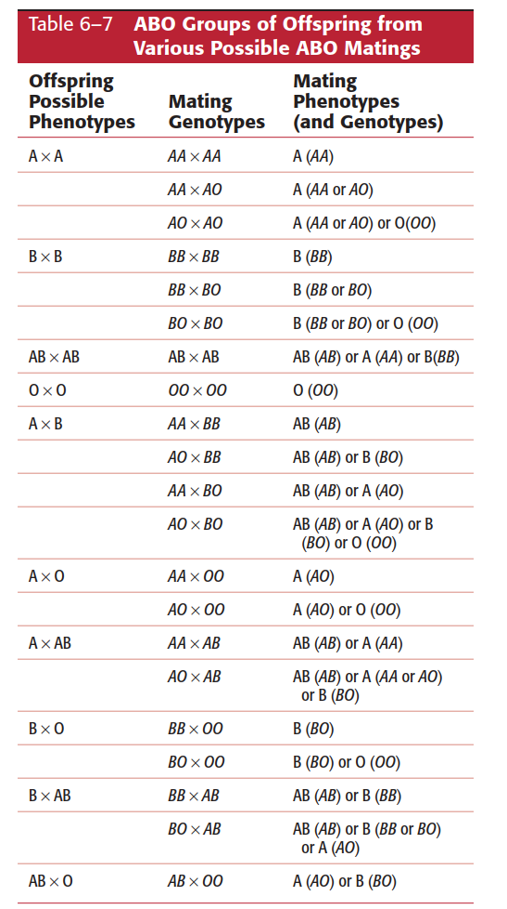

Slide 9
Serologically, it is not possible to determine the genotype from the phenotype of an A or B individual. Family studies or molecular assays would need to be performed to determine the exact genotype.
The phenotype and genotype are the same in an AB individual because of the inheritance of both the A and B gene.
O individual, both phenotype and genotype are the same because that individual would have to be homozygous for the O gene

Slide 10
Formation of A, B, and H Red Blood Cell Antigens
The formation of ABH antigens results from the interaction of genes at three separate loci (ABO, Hh, and Se). These genes do not actually code for the production of antigens but rather produce specific glycosyltransferases that add sugars to a basic precursor substance.
A paragloboside is the same basic precursor material from which A, B, and H antigens all originate. Specific enzyme transferases elicited by an inherited gene attach sugars to the paragloboside/glycan.

Slide 11
The H antigen is the precursor structure on which A and B antigens are made. Inheritance of the H gene results in formation of the H antigen.
The H and Se genes are closely linked and located on chromosome 19, in contrast to the ABO genes located on chromosome 9.
H and Se genes are not part of the ABO system; yet, their inheritance influences A and B antigen expression. The H gene must be inherited to form ABO antigens on the RBCs, and the Se gene must be inherited to form ABO antigens in secretions.

Slide 12
The ABH antigens develop early in fetal life and do not increase much in strength during the gestational period. The RBCs of the newborn have been estimated to carry anywhere from 25% to 50% of the number of antigenic sites found on the adult RBC (and that is why reactions of newborns to reagent antisera are weaker than the adults.
The expression of A and B antigens on the RBCs is fully developed by 2 to 4 years of age and remains constant throughout life.
the phenotypic expression of ABH antigens may vary with race, genetic interaction, and disease states

Slide 13
The A, B, and H antigens are present on most body cells including white blood cells and platelets.
These antigens are also found in soluble form in secretions and body fluids (e.g. plasma, saliva, semen, and sweat).

Slide 14
Interaction of Hh with ABO Genes and the Bombay phenotype
The H gene is present in more than 99.99% of the random population. Its allele, h, is quite rare, and the genotype hh is extremely rare.
The H gene codes for the production of an enzyme that transfers the sugar L-fucose to an oligosaccharide chain on the terminal galactose of type 2 chains. The H substance (L-fucose) must be formed for the other sugars to be attached in response to an inherited A and/or B gene.
The O gene at the ABO locus does not elicit the production of active polypeptide transferase; therefore, the H substance remains unmodified Consequently, the O blood group has the highest concentration of H antigen.

Slide 15
The term Bombay has been used to refer to the phenotype that lacks normal expression of the ABH antigens because of the inheritance of the hh genotype.
The hh genotype does not elicit production of the enzyme needed for the addition of L-fucose to the type 2 chain and H substance is not expressed on the RBC. Even though Bombay (hh) individuals may inherit ABO genes, normal expression, as reflected in the formation of A, B, or H antigens, does not occur.

Slide 16
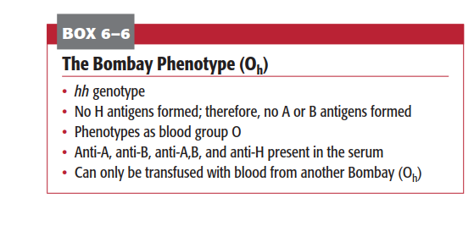

Slide 17
the A gene (AA or AO) codes for production of α-3-N-acetylgalactosaminyltransferase, which transfers an N-acetyl-D-galactosamine(GalNAc) sugar to the H substance. This sugar confers A specificity.
the B gene (BB or BO) that codes for the production of α-3-D-galactosyltransferase and attaches D-galactose (Gal) sugar to the H substance This sugar is responsible for B specificity (blood group B).
The A gene tends to elicit higher concentrations of transferase than the B gene, leading to conversion of nearly all of the H antigen on the RBCs to A antigen sites .

Slide 18
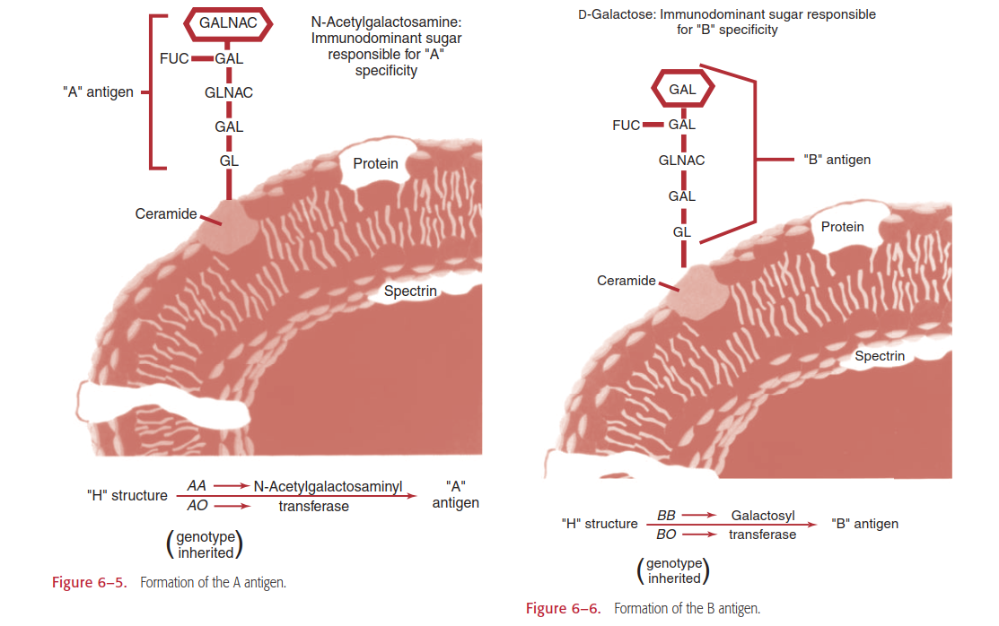

Slide 19

When both A and B genes are inherited, the B enzyme (α-3-D-galactosyltransferase) seems to compete more efficiently for the H substance than the A enzyme (α-3-N acetylgalactosaminyltransferase). As a result of this enzyme competition, the average number of A antigens on an AB adult cell is approximately 600,000 sites, compared with an average of 720,000 B antigen sites.

Slide 20
The A subgroups
The A subgroups are more common than B subgroups. The weaker serologic reactivity of ABO subgroups is attributed to the decreased number of A and B antigen sites on their red blood cells.
Classification into A1 and A2 phenotypes accounts for 99% of all group A individuals.
The cells of approximately 80% of all group A (or AB) individuals are A1 (or A1B), and the remaining 20% are A2 (or A2B) or weaker subgroups. The differences between A1 and A2 are both quantitative and qualitative

Slide 21
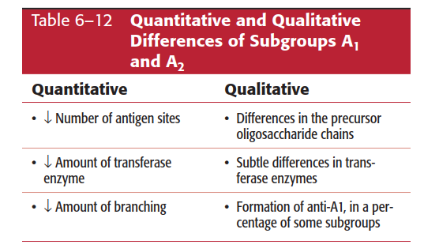

Slide 22
Differentiation of A₁ and A₂ phenotypes can be determined by using anti-A₁ lectin.
Anti-A₁ lectin does not agglutinate A₂ (or A₂B cells).
The difference is in part quantitative as the A1 gene very potent gene creates between 810,000 and 1,170,000 antigen sites on the adult A1 RBC, whereas inheriting an A2 gene results in production of only 240,000 to 290,000 antigen sites on the adult A2 RBC.
Qualitative differences also exist, since 1% to 8% of A2 individuals produce anti-A1 in their serum and 22% to 35% of A2B individuals produce anti-A1.

Slide 23
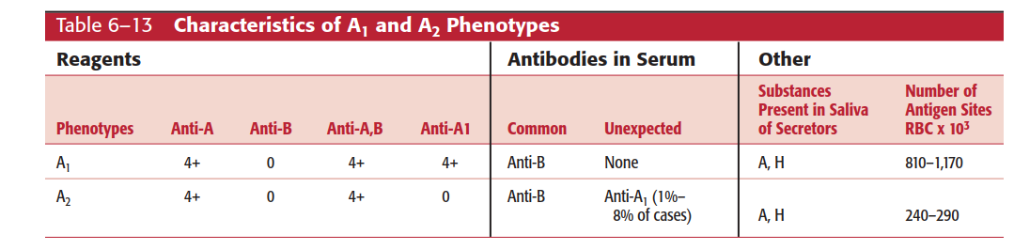

Slide 24
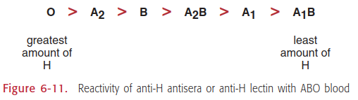
There is reciprocal relationship between the expression of H Ag on the RBC and the potency of the transferase enzymes encoded by the A and B genes , therefore the highest amount of H Ag can be found on the O RBC and the least on the A1B RBC.

Slide 25
Weak A subgroups (A₃, A_{x}, A_{end})
Subgroups weaker than A2 occur infrequently and are most often recognized through an ABO discrepancy (unexpected reactions in the forward and reverse grouping).
Characteristics of weak A subgroups include the following:
Decreased number of A antigen sites per RBC (resulting in weak or no agglutination with human polyclonal anti-A.
Varying degrees of agglutination by human anti-A,B.
Increased variability in the detectability of H antigen.
Presence or absence of anti-A1 in the serum.

Slide 26
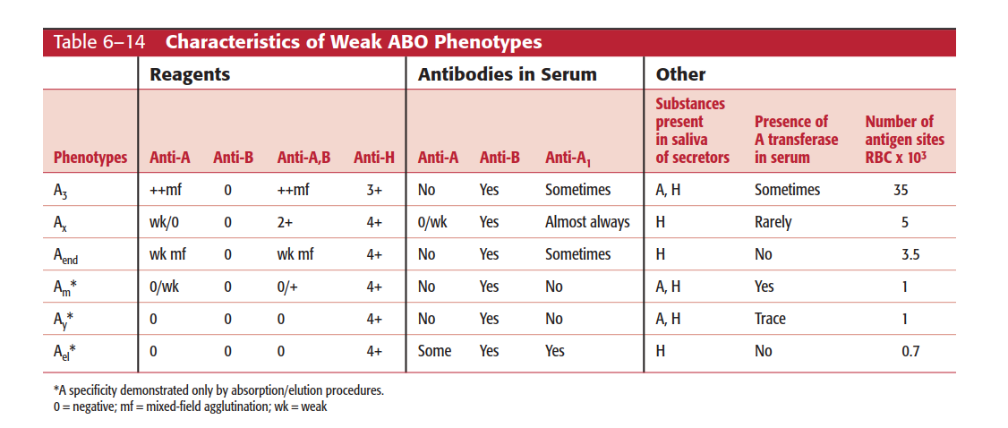

Slide 27
ABO antibodies
Individuals normally produce antibodies directed against the A and/or B antigen(s) absent from their RBCs.
They are naturally occurring because they are produced without any exposure to RBCs.
The ABO antibodies are predominantly IgM, activate complement, and react at room temperature or colder.
ABO antibodies produce strong direct agglutination reactions during ABO testing.
ABO antibody production is initiated at birth, but titers are generally too low for detection until infants are 3 to 6 months old.

Slide 28
most antibodies found in cord blood serum are of maternal origin.
Results of serum ABO testing before 3 to 6 months of age cannot be considered valid because some or all of the antibodies present may be IgG maternal antibodies that crossed the placenta. As a result, it is logical to perform only forward grouping on cord blood from newborn infants.
Antibody production peaks between 5 and 10 years of age and declines later in life. Elderly people usually have lower levels of anti-A and anti-B; therefore, antibodies may be undetectable in the reverse grouping.

Slide 29
ABO antibodies can cause rapid intravascular haemolysis if the wrong ABO group is transfused, potentially resulting in patient death.
Serum from group O individuals contains anti-A, anti-B, and anti-A,B.
Anti-A,B reacts with both A and B cells. Anti-A,B antibody activity, originally thought to be just a mixture of anti-A and anti-B, cannot be separated into a pure specificity when adsorbed with either A or B cells.

Slide 30
Anti-A,B antibody is not a combination of anti-A and anti-B but is a separate “cross-reacting” antibody that is usually IgG in nature.
IgG anti-A, anti-B, or anti-A,B in a woman’s serum are the cause behind ABO haemolytic disease of the newborn.
ABO antibodies are predominantly IgM antibody, small quantities of IgG may also present

Slide 31
Anti H antibody
Anti-H is a naturally occurring IgM cold agglutinin that reacts best below room temperature (RT).
As can be expected, this antibody is formed in response to a natural substance and reacts most strongly with cells of group O individuals (which have the greatest amount of H substance on their RBCs) and weakly with the RBCs of A1B individuals.
It is an insignificant antibody in terms of transfusion purposes because it has no reactivity at body temperature (37°C).

Slide 32
high-titered anti-H may react at room temperature and present a problem in antibody screening procedures because reagent screening cells are group O.
This high-titered anti-H may also present a problem with compatibility testing.
Anti-H lectin, Ulex europaeus, closely parallels the reactions of human anti-H. Both antisera agglutinate RBCs of group O and A2 and react very weakly or not at all with groups A1 and A1B.
Group B cells give reactions of variable strength

Slide 33
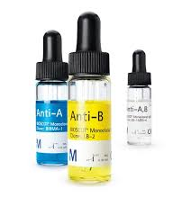
Thank you

