Slide 1
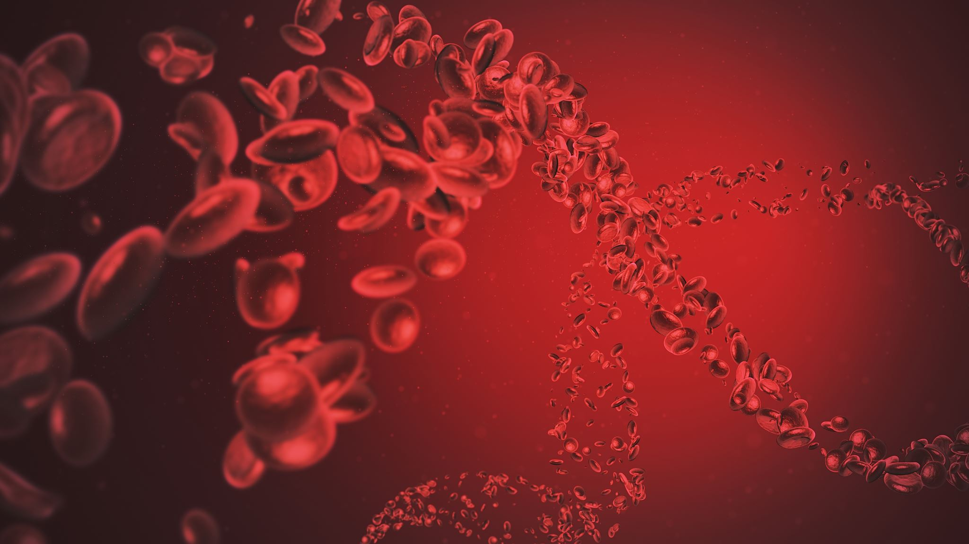
The Rh blood group
System
Prof. Dr. Israa M. Al-Bayaa
MBChB
FIBMS (Hematopathology)
Department of pathology and Forensic science/Al-Mustanseria University

Slide 2
Objectives
Identify the clinical importance of the Rh system in transfusion practice.
Recognize the mode of inheritance and the interaction of the Rh system with RHAG.
Identify the Antigens of the Rh system.
Understand the terminology used for the Rh system.
Recognize the weak forms of RhD and the partial D.
Recognize The significance of antibodies to the Rh system Ah in clinical practice.
Carecterize some of the other significant systems in blood transfusion practice.

Slide 3
Rh system
Rh is the second in importance only to ABO blood group system in terms of transfusion, as the Rh system antigens are very immunogenic.
Unlike ABO antibodies, Rh antibodies are produced only after exposure to foreign red blood cells in a person who lacks the corresponding Ag.
Once present, they can produce significant hemolytic disease of the fetus and newborn (HDFN) as well as hemolytic transfusion reactions.
The terms Rh-positive and Rh-negative are used to describe the presence or absence of the D antigen

Slide 4
Rh genes
RHD and RHCE are two closely linked genes located on chromosome 1 that control expression of Rh proteins.
The gene RHD codes for the presence or absence of the RhD protein, and the second gene RHCE codes for either RhCe, RhcE Rhce, or RhCE proteins .
RHD and RHCE are codominant, which means that all products inherited typically produce antigens detectable on RBCs.

Slide 5
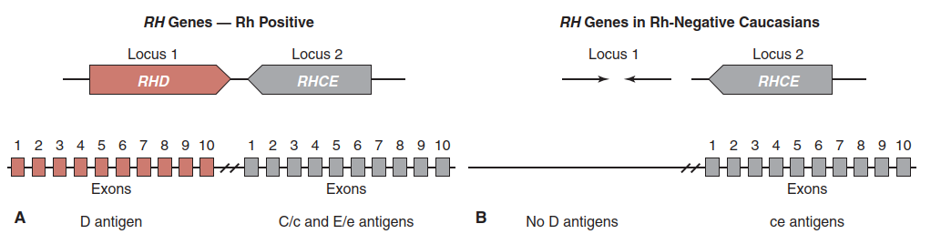

Slide 6
Rh-Associated Glycoprotein (RHAG)
Another gene important to Rh antigen expression is RHAG,
it resides on chromosome 6.
The product of this gene is Rh-associated glycoprotein (RHAG). This polypeptide is very similar in structure to the Rh proteins, with the difference being that it is glycosylated.
Within the RBC membrane, it forms complexes with the Rh proteins. RhAG is termed a coexpressor and must be present for successful expression of the Rh antigens.
When mutations in the RHAG gene occur, it can result in missing or significantly altered RhD and RhCE proteins,

Slide 7
Rh positive phenotype
RH genes are inherited as codominant alleles. Rh-positive individuals inherit one or two RHD genes, which result in expression of RhD antigen and are typed Rh-positive. In addition to the RHD gene(s), two RHCE genes are inherited, one from each parent.
Numerous mutations in the RHD gene have been discovered that cause weakened expression of the RhD antigen detected in routine testing. This is generally termed weak D

Slide 8
Rh negative phenotype
Rh-negative phenotypes are so called because the RBCs lack detectable D antigen. Rh-negative individuals can arise from several pathways. The most common Rh-negative phenotype results from the complete deletion of the RHD gene—that is the individuals possess no RHD gene but have inherited RHCE genes.

Slide 9
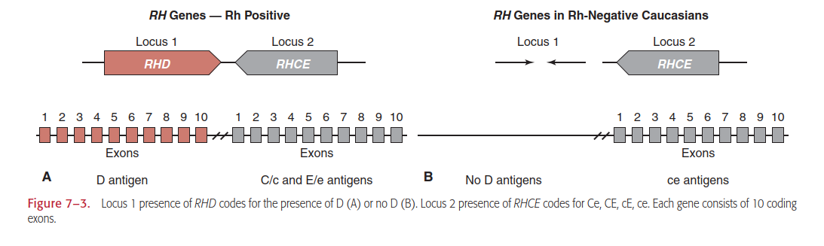

Slide 10
Rh Terminology
There are four terminologies used to describe the Rh system.
Two are based on postulated genetic theories of Rh inheritance. The third common terminology used describes only the presence or absence of a given antigen.
The fourth was established by the International Society of Blood Transfusion (ISBT) Committee on Terminology for Red Cell Surface Antigens.

Slide 11
Fisher-Race: DCE Terminology
According to the Fisher-Race theory, an individual inherits a set of RH genes from each parent (i.e., one D or d, one C or c, and one E or e).
The combination of genes inherited from one parent is called a haplotype. For example, if one parent has the genes D, C, and e, then the haplotype is written as DCe. The pairing of maternal and paternal haplotypes determines the offspring’s genotype (the RH genes inherited from each parent). The genotype is written as two haplotypes separated by a / (i.e., DCe/Dce).

Slide 12
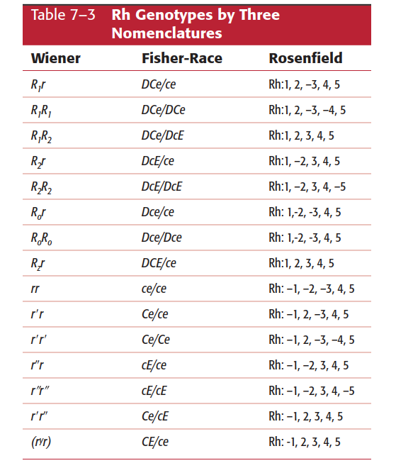

Slide 13
RhD and RhCE proteins and RhAG are exclusively on red blood cells. As they are transmembrane, it is not surprising they play a role in maintaining the structural integrity of red blood cells. Based on their structure, it appears they may also be transporters. they may have a role in transporting ammonia. An alternative hypothesis is that they may be CO2 transporters.
The Rh antigens are well developed at birth, and as such can cause hemolytic disease of the fetus and newborn (HDFN).
They vary in terms of immunogenic potency.

Slide 14
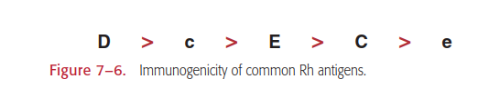
The most potent immunogenic Ag of the Rh system is D Ag while e is the least potent

Slide 15
Weak D: Variations of D Antigen Expression
When Rh-positive RBC samples are typed for the D antigen, they are expected to show strong positive reactivity with anti-D reagents. However, some individuals have RBCs that possess variations in the quantity of D antigen or the specificity of D antigen epitopes, resulting in weakened expression of the D antigen when tested with serologic methods.
Individuals with RBCs carrying weaker D antigen (historically called Du type) can produce anti-D if they are missing epitopes of the D antigen.

Slide 16
Mechanisms of weak D
Weak D types can be separated into three categories:
position effect
quantitative
partial-D antigen (missing one or more alleles)

Slide 17
Position Effect: C in Trans to D
The allele carrying RHD is trans (or in the opposite haplotype) to the allele carrying C.
The Rh antigen on the RBC is normal, but the steric arrangement of the C antigen in relationship to the D antigen appears to interfere with the expression of D antigen, This interference with D expression does not occur when the C gene is inherited in the cis position to RHD.
the D antigen is structurally complete. These individuals can receive D-positive RBCs with no adverse effects.

Slide 18
Weak D: Quantitative Changes Due to Fewer D
Antigen Sites
The D antigens expressed appear to be complete but fewer in number.
Individuals with weak D phenotype rarely make anti-D, since the RhD antigens are present as expected, but protein changes occur “inside” the red blood cell.

Slide 19
D_{el}
phenotype occurring in individuals whose red blood cells possess an extremely low number of D antigen sites that most reagent anti-D are unable to detect.
Adsorbing and eluting anti-D from the individual’s red blood cells is often the only way to detect the D antigen.
This phenotype occurs most often in individuals of Southeast Asian descent, occurring in up to 30% of that population. It is rare in Caucasians.
Del individuals of Southeast Asian descent have not been reported to make anti-D in response to transfusion or pregnancy, but there have been a few instances of anti-D production in Caucasian individuals

Slide 20
Partial D or D Mosaic
The third mechanism in which D antigen expression can be weakened is when one or more D epitopes within the entire D protein is either missing or altered, termed partial D (sometimes called “D Mosaic”).
The D antigen is not complete because one or more epitopes are missing.
The serologic detection of the D antigen varies greatly for partial-D individuals. Some individuals have red blood cells with partial-D antigens that may type weaker than expected or that may not react at all when routine procedures are used with most commercial anti-D reagents. Others have partial-D types that may show normal typing with reagent anti-D.

Slide 21
If an individual lacks one (or more) pieces, or epitopes, of the total D antigen, alloantibody can be made to the missing epitope(s) if exposed to RBCs that possess the complete D antigen.
Partial-D antigens can be classified on a molecular level and are attributed to hybrid genes resulting from portions of the RHD gene being replaced by portions of the RHCE gene.
The resulting protein contains a portion of RHD and RHCE in various combinations, depending on the hybrid gene’s makeup.

Slide 22
Anti-D made by individuals expressing partial D can cause hemolytic disease of the fetus and newborn (HDFN) or transfusion reactions.
Once anti-D is identified, Rh-negative blood should be used for transfusion

Slide 23
Rh Antibodies
most Rh antibodies are IgG immunoglobulins and react optimally at 37°C or after antiglobulin testing.
They are immune Ab produced after exposure to the Ag through transfusion or pregnancy.
Rh antibodies may show dosage, reacting preferentially with RBCs possessing double-dose Rh antigen.
Rh antibodies are enhanced when testing with enzyme-treated RBCs

Slide 24
IgG1, IgG2, IgG3, and IgG4 subclasses of Rh antibodies have been reported. IgG1 and IgG3 are of the greatest clinical significance because the reticuloendothelial system rapidly clears RBCs coated with IgG1 and IgG3 from the circulation. IgA Rh antibodies have also been reported.
Rh antibodies often persist in the circulation for years. An individual with low-titer Rh antibody may experience an anamnestic (secondary) antibody response if exposed to the same sensitizing antigen.

Slide 25
Rh antibodies do not bind complement. Therefore, intravascular, complement-mediated hemolysis does not occur. RBC destruction resulting from Rh antibodies is primarily extravascular.
Because Rh antibodies are primarily IgG and can traverse the placenta and because Rh antigens are well developed early in fetal life, so they can lead to HDFN.
HDFN due to anti-D can be prevented with the use of Rh-Immune Globulin,

Slide 26
Rh_{null}
Rare individuals have Rh deficiency or Rh_{null} syndrome and fail to express any Rh antigens on the RBC surface. Rh_{null} syndrome is inherited in one of two ways
Amorphic-type:- a mutation in each of the RHCE genes inherited from each parent as well as the deletion of the RHD gene found in most D-negative individuals. The RHAG gene is normal
Regulator type:- a mutation occurs in the RHAG gene. This results in no RhAG protein expression and subsequently no RhD or RhCE protein expression on the RBCs, even though these individuals usually have a normal complement of RHD and RHCE genes. These individuals can pass normal RHD and RHCE genes to their children.

Slide 27
Individuals with Rh_{null} syndrome demonstrate a mild compensated hemolytic anemia, reticulocytosis, stomatocytosis, a slight-to-moderate decrease in hemoglobin and hematocrit levels, an increase in hemoglobin F, a decrease in serum haptoglobin, and possibly an elevated bilirubin level.
Rh_{null} individuals, if exposed to normal Rh cells through transfusion or pregnancy, can produce a potent antibody, anti-Rh, which reacts with all cells except for those that are Rh_{null}.

Slide 28
Some significant blood group Ag

Slide 29
Kell Ag (K and k)
Excluding ABO Ag the Kell Ag is the second to D Ag in respect to immunogenicity.
anti-K appear to be induced by pregnancy and transfusion.
the prevalence of K antigen is low (9% in whites), and the chance of receiving a K+ unit is small.
if anti-K develops, compatible units are easy to find.
Antibodies to k antigen are seldom encountered. Only 2 in 1,000 individuals lack k and are capable of developing the antibody.

Slide 30
The Duffy system (Fyª and Fy^{b} )
The Duffy antigens are of most important in routine blood bank
serology .
They can be identified on fetal RBCs as early as 6 weeks gestational age and are well developed at birth.
The antigens have not been found on platelets, lymphocytes, monocytes, or granulocytes, but they have been identified in other body tissues, including brain, colon, endothelium, lung, spleen, thyroid, thymus, and kidney cells.

Slide 31
Anti-Fyª is a common antibody and is found as a single specificity or in a mixture of antibodies. Anti-Fyª occurs three times less frequently than anti-K. Anti-Fy^{b} is 20 times less common than anti-Fyª and often occurs in combination with other antibodies.
The antibodies are usually IgG and react best at the antiglobulin phase.

Slide 32
The Kidd system (Jkª and Jk^{b} )
Jka and Jkb are antigens commonly found on RBCs of most individuals.
There are notable differences in antigen frequency among various races: 91% of blacks and 77% of whites are Jk(a+); 57% of blacks and only 28% of whites are Jk(b–).
Jkª and Jk^{b} antigens are well developed on the RBCs of neonates. Jkª has been detected on fetal RBCs as early as 11 weeks. However anti-Jkª and anti-Jk^{b} are only rarely responsible for severe HDFN as The Kidd antigens are not very immunogenic.
The anti-gens are not found on platelets, lymphocytes, monocytes, or granulocytes.

Slide 33
Anti-Jkª is more frequently encountered than anti-Jk^{b}, but neither antibody is common. The antibodies are usually IgG (antiglobulin reactive) but may also be partly IgM and are made in response to pregnancy or transfusion.
They demonstrate dosage (which makes their detection rather difficult), are often weak, and are found in combination with other antibodies.
The titer of anti-Jkª or anti-Jk^{b} quickly declines in vivo. A strong antibody identified following a transfusion reaction may be undetectable in a few weeks or months.

Slide 34
The decline in antibody reactivity and the difficulty in detecting Kidd antibodies are reasons why they are a common cause of HTRs especially of the delayed type.
Contrary to their hemolytic reputation in transfusion, most Kidd antibodies are only rarely associated with severe cases of HDFN

Slide 35
Thank you

