Slide 1
Pupillary Reactions
2025
Mohammed Suhail Al-Salam

Slide 2
Objectives
By the end of this session, the students will be able to:
Identify anatomy of iris and nerve control
Identify the light reflex pathway
Identify and perform pupillary examination in a systematic way
Describe afferent pupillary defects and possible causes
Describe efferent pupillary defects and possible causes
Identify the effects of some topical and systemic drugs in the pupil
Describe pupillary abnormalities in coma

Slide 3
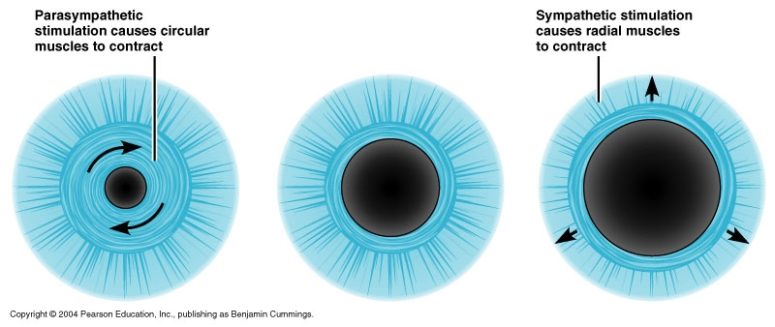
Pupillary Reactions

Slide 4
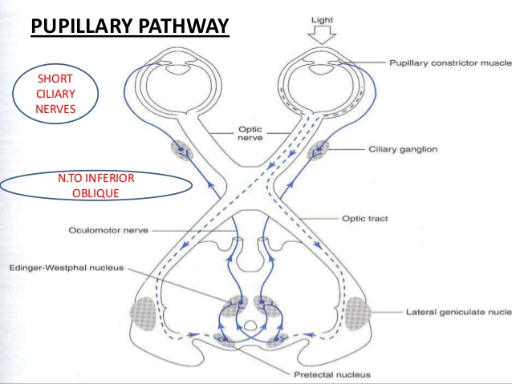
Pupillary Reflex Pathway

Slide 5
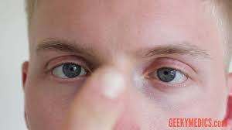
NEAR REFLEX
Convergence
Accommodation
Miosis

Slide 6
Pupil Testing
Purpose
  To examine the afferent and efferent neurological pathways responsible for pupillary function

Slide 7
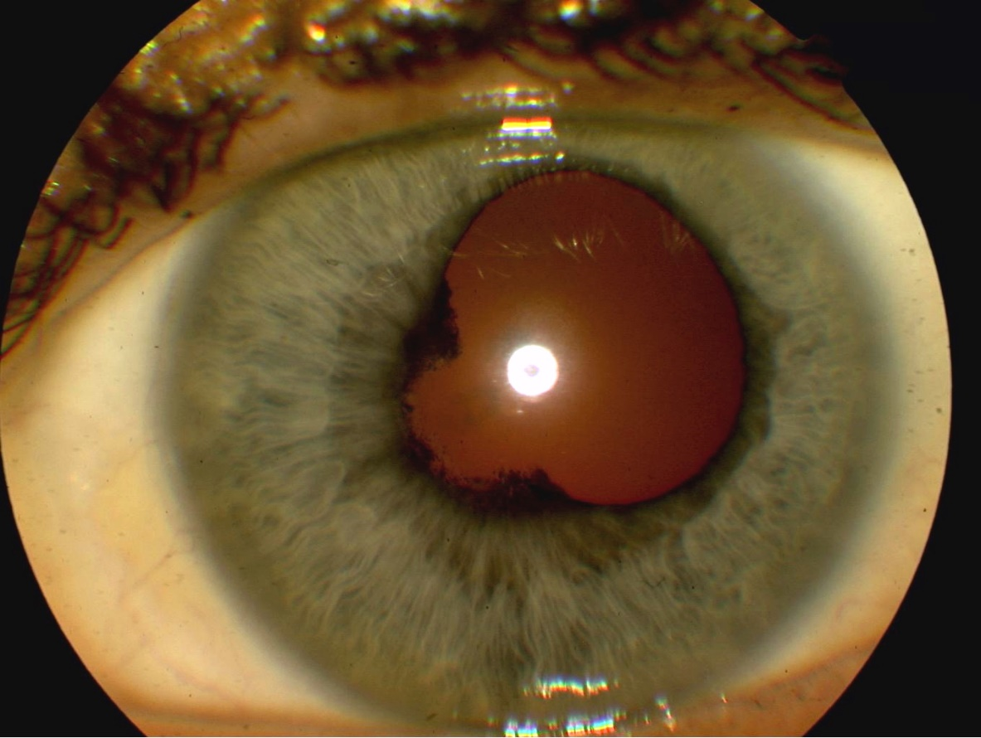
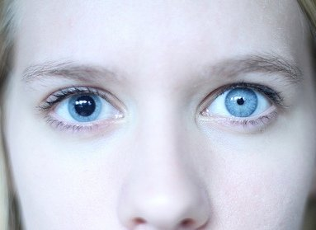
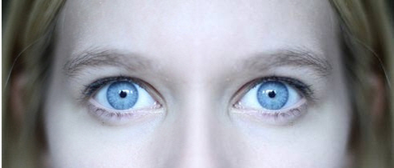
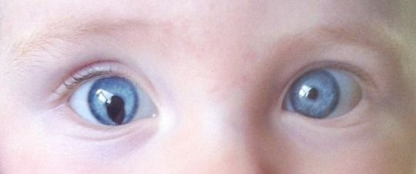
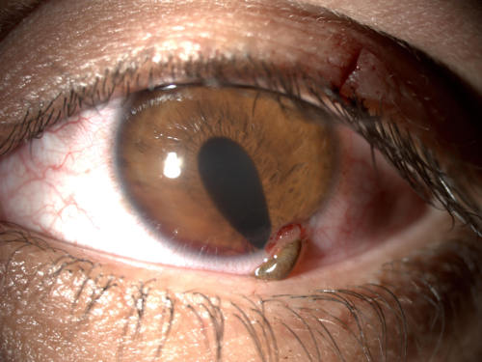
Pupil Testing
Procedure consists of four steps
  Observation (shape, symmetry)
  Direct and consensual response
  Swinging flashlight test
  Near reflex test

Slide 8
Pupil Testing
The first three steps should be performed on every patient
The last step should be done when a relative afferent pupillary defect (RAPD) is found in the third step

Slide 9
Afferent & Efferent Pupillary Defects

Slide 10
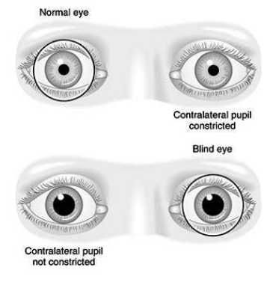
Afferent Pupillary Defect
Absolute Afferent Pupillary Defect (amaurotic pupil)
Complete optic n. lesion
No light perception
Both pupils are equal in size
When the affected eye is stimulated by light neither pupils react
When the normal eye is stimulated both pupils react normally
The near reflex is normal in both eyes

Slide 11
Afferent Pupillary Defect
Relative Afferent Pupillary Defect (RAPD)- Marcus Gunn Pupil
Incomplete optic n. lesion or severe retinal disease
Never caused by a dense cataract
The difference in pupillary reaction between the two eyes is highlighted by ‘Swinging Flashlight Test’

Slide 12
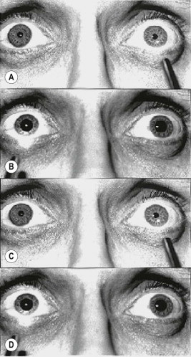
Swinging flashlight test

Slide 13
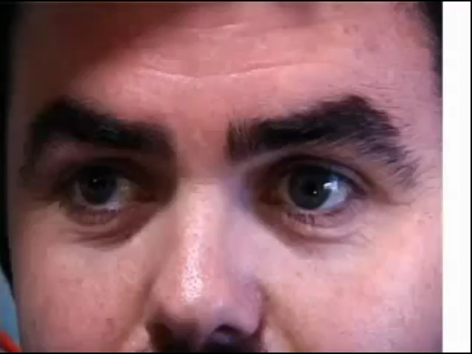
Swinging flashlight test

Slide 14
NOTE
It should be emphasized that in afferent (sensory) lesions, the pupils are equal in size.
Anisocoria (inequality of pupillary size) implies disease of the efferent (motor) nerve, iris or muscles of the pupil.

Slide 15
Efferent Pupillary Defect
Anisocoria

Slide 16
Anisocoria
Physiological anisocoria (20% of population have inequality of pupil size but it is usually < 1mm difference)
Sympathetic tract lesion (Horner’s syndrome)
Parasympathetic tract lesion (oculomotor n. palsy, Adie’s pupil)
Pharmacological
Iris damage (traumatic mydriasis, iritis, angle closure glaucoma)

Slide 17
The important step of examination in anisocoria
Examine the patient in a dim room then turn on the light of the room
Look for the difference in the size of the pupils of both eye
Anisocoria increasing in dark or light??

Slide 18
Examination in bright room
Case 1

Slide 19
Examination in dark room

Slide 20
Examination in bright room
Case 2

Slide 21
Examination in dark room

Slide 22
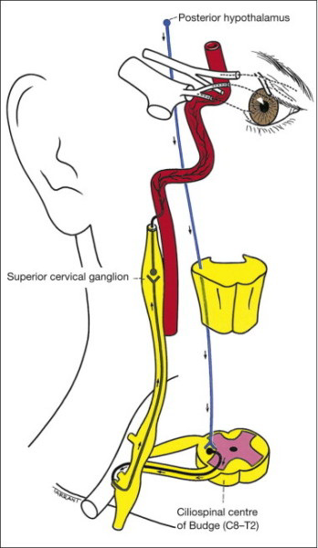
Oculosympathetic pathway

Slide 23
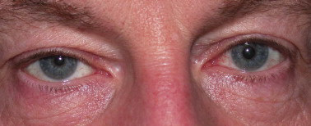
Horner’s Syndrome
Central
Preganglionic
Postganglionic
Miosis is accentuated in dim light
Normal pupillary reactions to light and near.

Slide 24
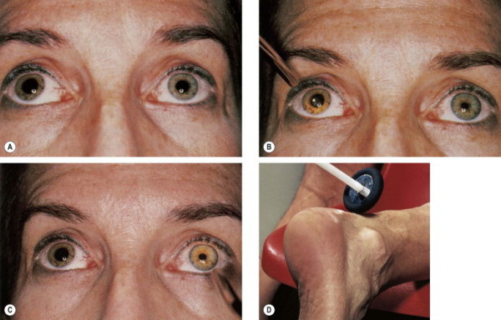
Adie pupil
denervation of the postganglionic supply to the sphincter pupillae and the ciliary muscle, which may follow a viral illness.
Direct light reflex is absent or sluggish
Consensual light reflex is absent or sluggish

Slide 25
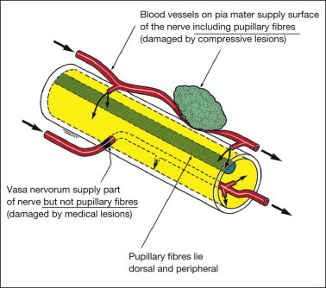
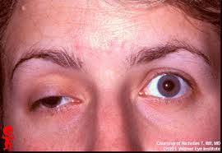
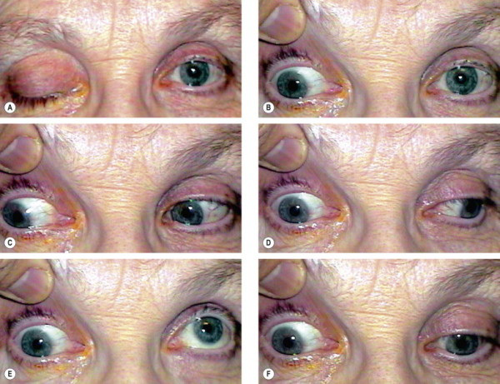
Oculomotor nerve palsy

Slide 26
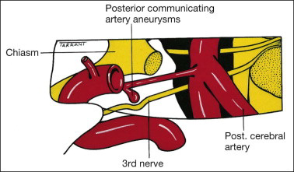
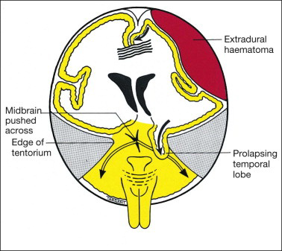
Oculomotor Nerve Palsy
Causes:
Medical (pupil sparing)
Hypertension
Diabetes
Surgical (pupillary involvement)
Aneurysm
Trauma
Uncal herniation

Slide 27
Pharmacological
Miosis
Pilocarpine
Mydriasis
Anticholinergic (tropicamide, cyclopentolate, atropine)
Sympathomimetic (phenylephrine)

Slide 28
Pupil in coma
Hypothalamic damage Horner’s syndrome
Midbrain lesion Mid-dilated, non-reactive, round regular pupils
Pontine lesion pinpoint pupils with retained light reflex
Uncal herniation compression of third n. (fixed dilated pupil non-reacting)

Slide 29
Drug overdose
sedative-hypnotic overdose preservation of pupillary light reflex
Opiods pupillary constriction
Organophosphorus poisoning pupillary constriction

Slide 30
Differential diagnosis of a fixed dilated pupil
Oculomotor nerve palsy
Pharmacologic blockade
Adie’s tonic pupil
Traumatic iris sphincter rupture
Angle closure glaucoma

Slide 31
Thank You

