Slide 1
CUTANEOUS AND MUCOSAL
LEISHMANIASIS

Slide 2
Definition
A polymorphic protozoan disease of skin and mucous membranes caused by several species of the genus Leishmania.
Lesions may heal spontaneously, may disseminate to cause mucosal lesions
Notes:
1. Identification—A polymorphic protozoan disease of skin and
mucous membranes caused by several species of the genus Leishmania.
These protozoa exist as obligate intracellular parasites in humans and
other mammalian hosts. The disease starts with a macule then a papule
that enlarges and typically becomes an indolent ulcer in the absence of
bacterial infection. Lesions may be single or multiple, occasionally nonulcerative
and diffuse. Lesions may heal spontaneously within weeks to
months, or last for a year or more. In some individuals, certain strains
(mainly from the Western Hemisphere) can disseminate to cause mucosal
lesions (espundia), even years after the primary cutaneous lesion has
healed. These sequelae, which involve nasopharyngeal tissues, are characterized
by progressive tissue destruction and often scanty presence of
parasites and can be severely disfiguring. Recurrence of cutaneous lesions
after apparent cure may occur as ulcers, papules or nodules at or near the
healed original ulcer.

Slide 3
1. IDENTIFICATION
Parasitological Diagnosis
Microscopy– amastigote
Culture— promastigote
An intradermal (Montenegro) test with leishmanin.
Serological (IFA or ELISA) testing.
Notes:
Diagnosis is through microscope identification of the nonmotile, intracellular
form (amastigote) in stained specimens from lesions, and through
culture of the motile, extracellular formom (promastigote) on suitable media.
An intradermal (Montenegro) test with leishmanin, an antigen derived
from the promastigotes is usually positive in established disease; it is not
helpful with very early lesions, anergic disease or immunosuppressed
patients. Serological (IFA or ELISA) testing can be done, but antibody
levels typically are low or undetectable; this may not be helpful in
diagnosis (except for mucosal leishmaniasis). Species identification is
based on biological (development in sandflies, culture media and animals),
immunological (monoclonal antibodies), molecular (DNA techniques) and
biochemical (isoenzyme analysis) criteria. The WHO operational case
definition is “a person showing clinical signs [of leishmaniasis] with
parasitological confirmation and/or, for mucosal leishmanaisis only,
serological diagnosis”.

Slide 4
1. IDENTIFICATION
The WHO operational case definition is “a person showing clinical signs [of leishmaniasis] with parasitological confirmation and/or, serological diagnosis”.

Slide 5
2. INFECTIOUS AGENTS
Eastern hemisphere: Leishmania tropica,
L. major, L. aethiopica;
Western hemisphere: L. braziliensis and
L. mexicana complexes.
Notes:
2. Infectious agents—Eastern hemisphere: Leishmania tropica,
L. major, L. aethiopica; western hemisphere: L. braziliensis and
L. mexicana complexes. Members of the L. braziliensis complex are more
likely to produce mucosal lesions; L. tropica is the usual cause of
“leishmaniasis recidivans” cutaneous lesions. Members of L. donovani complex usually cause visceral disease in the eastern hemisphere; in the
western hemisphere the responsible organism is L. infantum/chagasi
Both may cause cutaneous leishmaniasis without concomitant visceral
involvement, as well as post-kala-azar dermal leishmaniasis cases, which
are considered residual reservoirs for the maintenance and dissemination
of the parasite.

Slide 6
3. OCCURRENCE
2 million new cases per year
In some areas in the eastern hemisphere, urban population groups, including children, are at risk for anthroponotic cutaneous leishmaniasis due to L. tropica.
In rural areas, people are at risk for zoonotic cutaneous leishmaniasis due to L. major.
Notes:
3. Occurrence—2 million new cases per year: China (recently), India
and Pakistan; south-western Asia, including Afghanistan and the Islamic
Republic of Iran; southern regions of former Soviet Union, the Mediterranean
littoral; the sub-Saharan African savanna and Sudan, the highlands of
Ethiopia and Kenya, Namibia; the Dominican Republic, Mexico (especially
Yucatan), south central Texas, all of central America and every country of
South America except Chile and Uruguay; leishmania have recently been
reported among kangaroos in Australia. A nonulcerative, keloid-like form
due to L. infantum/chagasi (atypical cutaneous leishmaniasis) has been
observed with increasing frequency in central America, especially Honduras
and Nicaragua. Numerous cases of diffuse cutaneous leishmaniasis
have been reported in the past from the Dominican Republic and Mexico.
In some areas in the eastern hemisphere, urban population groups,
including children, are at risk for anthroponotic cutaneous leishmaniasis
due to L. tropica. In rural areas, people are at risk for zoonotic cutaneous
leishmaniasis due to L. major. In the western hemisphere, disease is
usually restricted to special groups, such as those working in forested
areas, those whose homes are in or next to a forest, and visitors to such
areas from nonendemic countries. Generally more common in rural than
urban areas.

Slide 7
3. OCCURRENCE
In the western hemisphere, disease is usually restricted to special groups, such as those working in forested areas, those whose homes are in or next to a forest, and visitors to such areas from nonendemic countries.
Generally more common in rural than urban areas.

Slide 8
4. RESERVOIR
Locally variable; humans (in anthroponotic cutaneous leishmaniasis), wild rodents and domestic dogs;
Notes:
4. Reservoir—Locally variable; humans (in anthroponotic cutaneous
leishmaniasis), wild rodents (gerbils), hyraxes, edentates (sloths), marsupials
and domestic dogs (considered victims more than real reservoirs);
unknown hosts in many areas.

Slide 9
5. MODE OF TRANSMISSION
In zoonotic foci, from the animal reservoir through the bite of infective female phlebotomines (sandflies).
In anthroponotic foci, person-to person
transmission occurs through sandfly bites and, very rarely, through transfusion.
Notes:
5. Mode of transmission—In zoonotic foci, from the animal reservoir
through the bite of infective female phlebotomines (sandflies). Motile
promastigotes develop and multiply in the gut of the sandfly after it has fed
on an infected mammalian host; in 8–20 days, infective parasites develop
and are injected during biting. In humans and other mammals, the
organisms are taken up by macrophages and transform into amastigote
forms, which multiply within the macrophages until the cells rupture,
enabling spread to other macrophages. In anthroponotic foci person-toperson
transmission occurs through sandfly bites and, very rarely, through
transfusion.

Slide 10
6. INCUBATION PERIOD
At least a week, up to many months.
7. PERIOD OF COMMUNICABILITY
Not directly transmitted from person to person, but infectious to sandflies as long as parasites remain in lesions in untreated cases, usually a few months to 2 years
Notes:
6. Incubation period—At least a week, up to many months.
7. Period of communicability—Not directly transmitted from person
to person, but infectious to sandflies as long as parasites remain in
lesions in untreated cases, usually a few months to 2 years. Eventual
spontaneous healing occurs in most cases. A small proportion of patients
infected with L. amazonensis or L. aethiopica may develop diffuse
parasite-rich cutaneous lesions that do not heal spontaneously. Infections
with parasites of the L. braziliensis complex can heal spontaneously, but
a small proportion (3%–5%) are followed, months or years later, by
metastatic mucosal lesions.
8. Susceptibility—Susceptibility is probably general. Lifelong immunity
may be present after lesions due to L. tropica or L. major heal but may
not protect against other leishmanial species. Factors responsible for late
mutilating disease, such as espundia, are still partly unknown; occult
infections may be activated years after the primary infection. The most
important factor in immunity is the development of an adequate cellmediated
response.

Slide 11
8.SUSCEPTIBILITY
Susceptibility—Susceptibility is probably general. Lifelong immunity may be present after lesions due to L. tropica or L. major.
Notes:
8. Susceptibility—Susceptibility is probably general. Lifelong immunity
may be present after lesions due to L. tropica or L. major heal but may
not protect against other leishmanial species. Factors responsible for late
mutilating disease, such as espundia, are still partly unknown; occult
infections may be activated years after the primary infection. The most
important factor in immunity is the development of an adequate cell mediated
response.

Slide 12
A-Preventive measures:
Currently no vaccine available.
Control measures include the following
1) Case management
2) Vector control
3) Eliminate rubbish heaps and other breeding places for eastern hemisphere phlebotomines.
Notes:
9. Methods of control—
A. Preventive measures: Currently no vaccine available. Control
measures vary according to the habits of mammalian hosts and
phlebotomine vectors; they include the following:
1) Case management: Detect cases systematically and treat
rapidly. This applies to all forms of leishmaniasis and is one
of the important measures to prevent development of destructive
mucosal lesions in the western hemisphere and
“recidivans form” in the eastern hemisphere, particularly
where the reservoir is largely or solely human.
2) Vector control: Apply residual insecticides periodically. Phlebotomine
sandflies have a relatively short flight range and are
highly susceptible to control by systematic spraying with
residual insecticides. Spraying must cover exteriors and
interiors of doorways and other openings if transmission
occurs in dwellings. Possible breeding places of eastern
hemisphere sandflies, such as stone walls, animal houses and
rubbish heaps, must be sprayed.
Exclude vectors by screening with a fine mesh screen
(10–12 holes per linear cm or 25–30 holes per linear inch, an
aperture not more than 0.89 mm or 0.035 inches). Insecticide-
treated bednets are a good vector control alternative,
especially in anthroponotic foci. In the focus of Aleppo
(Syrian Arab Republic), they appeared particularly efficient in
reducing the yearly incidence drastically (by 50% to 75%).
3) Eliminate rubbish heaps and other breeding places for eastern
hemisphere phlebotomines.
4) Destroy gerbils (and their burrows) implicated as reservoirs
in local areas by deep ploughing and removal of plants they
feed on (chenopods).
5) In the western hemisphere, avoid sandfly infested and thickly
forested areas, particularly after sundown; use insect repel-
lents and protective clothing if exposure to sandflies is
unavoidable.
6) Apply appropriate environmental management and forest
clearance.

Slide 13
A. Preventive measures:
4) Destroy rodents and stray dogs
5)personal protection: use insect repel-
lents and protective clothing
6) environmental management and forest
clearance.

Slide 14
B. CONTROL OF PATIENT, CONTACTS AND THE IMMEDIATE ENVIRONMENT
1) Report to local health authority:
2)Concurrent disinfection,
3) Investigation of contacts, source of infection, local transmission cycle (interrupt this in most practical fashion).
4) Specific treatment: Mainly pentavalent antimonials (sodium stibogluconate).
Pentamidine is used as a second line drug for cutaneous leishmaniasis.
Notes:
Control of patient, contacts and the immediate environment:
1) Report to local health authority: Official report not ordinarily
justifiable, Class 5 (see Reporting).
2) Isolation: Not applicable, only of theoretical value.
3) Concurrent disinfection: Not applicable.
4) Quarantine: Not applicable.
5) Immmunization of contacts: Not applicable.
6) Investigation of contacts, source of infection, local transmission
cycle (interrupt this in most practical fashion).
7) Specific treatment: Mainly pentavalent antimonials, either
sodium stibogluconate, (available in USA from CDC) or
meglumine antimonate, used in South America and some
other areas. Pentamidine is used as a second line drug for
cutaneous leishmaniasis. The imidazoles, ketoconazole and
itraconazole may have moderate antileishmanial activity
against some leishmanial species. Amphotericin B may be
required in South American mucosal disease if this does not
respond to antimonial therapy. An alkylphospholipid, the
first oral drug active on visceral leishmaniasis, is currently
tested for cutaneous leishmaniasis in Colombia and Guatemala.
Topical formulations of 15% aminosidine (paramomycin)
plus 10% urea have reduced the time of cure in
cutaneous leishmaniasis cases due to L. major. Although
spontaneous healing of simple cutaneous lesions occurs,
infections acquired in geographic regions where mucosal
disease has been reported should be treated promptly.

Slide 15
C. Epidemic measures
C. Epidemic measures: In areas of high incidence, use intensive efforts to control the disease by provision of diagnostic facilities and appropriate measures directed against phlebotomine sandflies and the mammalian reservoir hosts.
Notes:
C. Epidemic measures: In areas of high incidence, use intensive
efforts to control the disease by provision of diagnostic facilities
and appropriate measures directed against phlebotomine sandflies
and the mammalian reservoir hosts.
D. Disaster implications: None.

Slide 16
II. Visceral Leishmaniasis
(Kala-azar)

Slide 17
Definition
protozoa of the genus Leishmania. The disease is characterized by fever,hepatosplenomegaly, lymphadenopathy, anemia, leukopenia, thrombocytopenia and progressive emaciation and weakness.
Post kala azar dermal leishmaniasis
Notes:
protozoa of the genus Leishmania. The disease is characterized by fever,
hepatosplenomegaly, lymphadenopathy, anemia, leukopenia, thrombocytopenia
and progressive emaciation and weakness. Untreated clinically
evident disease is usually fatal. Fever is of gradual or sudden onset,
persistent and irregular, often with two daily peaks, alternating periods of
apyrexia and low-grade fever. Post-kala-azar dermal lesions may occur after
apparent cure of systemic disease. They are particularly frequent in Sudan
(up to 50% of visceral leishmaniasis cases). Leishmania/HIV co-infection is
a well-known entity in southern Europe, and is currently emerging in
eastern Africa and in Asia.
Parasitological diagnosis, based on invasive methods, is based preferably
on culture of the organism from a biopsy specimen or aspirated material,
or on demonstration of intracellular amastigotes in stained smears from
bone marrow, spleen, liver, lymph nodes or blood (the latter is preferable
in HIV-co-infected patients). The PCR technique is the most sensitive but
remains expensive.

Slide 18
1.IDENTIFICATION
Parasitological diagnosis
culture of the organism from a biopsy specimen or aspirated material,
demonstration of intracellular amastigotes in stained smears from bone marrow, spleen, liver, lymph nodes or blood (the latter is preferable)
Notes:
Parasitological diagnosis, based on invasive methods, is based preferably
on culture of the organism from a biopsy specimen or aspirated material,
or on demonstration of intracellular amastigotes in stained smears from
bone marrow, spleen, liver, lymph nodes or blood (the latter is preferable
in HIV-co-infected patients). The PCR technique is the most sensitive but
remains expensive.

Slide 19
1.IDENTIFICATION
Serological diagnosis is traditionally based on IFA and ELISA, tests.
PCR :The technique is the most sensitive but remains expensive.
Notes:
Serological diagnosis is traditionally based on IFA and ELISA, tests that
are expensive and difficult to decentralize. Recently, inexpensive, easy to
use and reliable fieldtests such as freeze-dried antigen (DAT) and dipsticks
(k39/k26) have become available. They are currently under comparative
evaluation with an antigen detection test in urine that should be particularly
relevant for Leishmania/HIV co-infected patients.

Slide 20
2. INFECTIOUS AGENTS
Leishmania donovani
L. infantum
L. chagasi.
Notes:
2. Infectious agents—Typically Leishmania donovani, L. infantum
and L. infantum/chagasi.
.

Slide 21
3. OCCURRENCE
Visceral leishmaniasis occurs in 62 countries, with a yearly incidence of 500 000 cases and a population at risk of 120 million.
A rural disease
scattered cases among infants, children and adolescents but occasionally epidemic waves.
Notes:
3. Occurrence—Visceral leishmaniasis occurs in 62 countries, with a
yearly incidence of 500 000 cases and a population at risk of 120 million.
A rural disease, occurring in foci in Bangladesh, China, India, Nepal,
Pakistan, southern regions of the former Soviet Union, Middle East
including Turkey, the Mediterranean basin, Mexico, central and South
America (mostly Brazil), and in Ethiopia, Kenya, Sudan, Uganda and
sub-Saharan savanna parts of Africa. In many affected areas, the disease
occurs as scattered cases among infants, children and adolescents but
occasionally in epidemic waves. Incidence is modified by the use of
antimalarial insecticides. Where dog populations have been drastically
reduced (e.g. China), human disease has also been reduced.

Slide 22
3. OCCURRENCE
Incidence is modified by the use of antimalarial insecticides.
Where dog populations have been drastically reduced (e.g. China), human disease has also been reduced.
Notes:
3. Occurrence—Visceral leishmaniasis occurs in 62 countries, with a
yearly incidence of 500 000 cases and a population at risk of 120 million.
A rural disease, occurring in foci in Bangladesh, China, India, Nepal,
Pakistan, southern regions of the former Soviet Union, Middle East
including Turkey, the Mediterranean basin, Mexico, central and South
America (mostly Brazil), and in Ethiopia, Kenya, Sudan, Uganda and
sub-Saharan savanna parts of Africa. In many affected areas, the disease
occurs as scattered cases among infants, children and adolescents but
occasionally in epidemic waves. Incidence is modified by the use of
antimalarial insecticides. Where dog populations have been drastically
reduced (e.g. China), human disease has also been reduced.

Slide 23
4.RESERVOIR
Known or presumed reservoirs include
humans,
wild Canidae (foxes and jackals)
domestic dogs.
Notes:
4. Reservoir—Known or presumed reservoirs include humans, wild
Canidae (foxes and jackals) and domestic dogs. Humans are the only
known reservoir in Bangladesh, India and Nepal.

Slide 24
5. MODE OF TRANSMISSION
Through bite of infected phlebotomine sandflies.
In foci of anthroponotic visceral leishmaniasis person to person through the sandfly bite.
In foci of zoonotic visceral leishmaniasis, dogs, the domestic
animal reservoir, constitute the main source of infection for sandflies.
Notes:
5. Mode of transmission—Through bite of infected phlebotomine
sandflies. In foci of anthroponotic visceral leishmaniasis, humans are the
sole reservoir and transmission occurs from person to person through the
sandfly bite. In foci of zoonotic visceral leishmaniasis, dogs, the domestic
animal reservoir, constitute the main source of infection for sandflies.
Person-to-person transmission has been reported in Leishmania/HIV co-
infected intravenous drug users through exchange of syringes. Co-infected
patients infect sandflies, acting as human reservoirs even in zoonotic foci.

Slide 25
6. INCUBATION PERIOD period—Generally 2–6 months; range is 10 days to years.
7. Period of communicability—Not usually transmitted from person to person, but infectious to sandflies as long as parasites persist in the circulating blood or skin of the mammalian reservoir host.
Notes:
6. Incubation period—Generally 2–6 months; range is 10 days to
years.
7. Period of communicability—Not usually transmitted from person
to person, but infectious to sandflies as long as parasites persist in the
circulating blood or skin of the mammalian reservoir host. Infectivity for
phlebotomines may persist after clinical recovery of human patients.
8. Susceptibility—Susceptibility is general. Kala-azar apparently induces
lasting homologous immunity. Evidence indicates that asymptomatic
and subclinical infections are common and that malnutrition predisposes
to clinical disease and activation of inapparent infections. Manifest
disease occurs among AIDS patients, presumably as reactivation of latent
infections.

Slide 26
A. PREVENTIVE MEASURES:
Dog control in zoonotic foci remains an unanswered question.
In industrialized countries, dogs are usually treated but they often relapse.
In many developing countries, massive culling of leishmanin-positive dogs has failed, except in China.
A recent approach based on insecticide impregnated
collars has proved effective in the Islamic Republic of Iran, reducing canine and human incidence of visceral leishmaniasis.
Notes:
9. Methods of control—
A. Preventive measures: See corresponding section I, 9A for
cutaneous leishmaniasis. Dog control in zoonotic foci remains an
unanswered question. In industrialized countries, dogs are usually
treated but they often relapse. In many developing countries,
massive culling of leishmanin-positive dogs has failed,
except in China. A recent approach based on insecticide impregnated
collars has proved effective in the Islamic Republic of Iran,
reducing canine and human incidence of visceral leishmaniasis.

Slide 27
B. CONTROL OF PATIENT, CONTACTS AND THE IMMEDIATE ENVIRONMENT:
1) Report to local health authority: In selected leishmaniasis endemic areas.
2) Isolation: Blood and body fluid precautions.
Notes:
B. Control of patient, contacts and the immediate environment:
1) Report to local health authority: In selected leishmaniasisendemic
areas, Class 3
2) Isolation: Blood and body fluid precautions.
3) Concurrent disinfection: Not applicable.
4) Quarantine: Not applicable.
5) Immmunization of contacts: Not applicable.
6) Investigation of contacts and source of infection: Ordinarily
none.

Slide 28
B. CONTROL OF PATIENT, CONTACTS AND THE IMMEDIATE ENVIRONMENT:
3) Specific treatment:
Pentavalent antimonials (Sb5) and meglumine antimonate are effective.
Cases that do not respond to antimony may be treated with amphotericin B or pentamidine; however these are not used
routinely because of toxicity.
Notes:
7) Specific treatment: Pentavalent antimonials (Sb5) remain
the first-line drugs in most countries. Sodium stibogluconate,
available from CDC, and meglumine antimonate are effective.
Cases that do not respond to antimony may be treated with
amphotericin B or pentamidine; however these are not used
routinely because of toxicity.

Slide 29
SPECIFIC TREATMENT
Some new drugs are available and/or are under development:
- - An alkylphospholipid, the first oral drug active on visceral
leishmaniasis, has been licensed in India.
Notes:
In India, the disease is less and
less responsive to first-line drugs (62% of visceral leishmaniasis
patients do not respond to pentavalent antimonials) and
requires alternative treatment. Some new drugs are available
and/or are under development:
- Amphotericin B included in liposomes is most efficient but
its price restricts use to industrialized countries.
- Aminosidine (paramomycin), a good candidate for combination
therapy with Sb5, still requires a completed dossier
for registration and a producer.
- An alkylphospholipid, the first oral drug active on visceral
leishmaniasis, has been licensed in India (phase IV development).
- Sitamaquine, a lepidine, is still under phase III development.

Slide 30
C. EPIDEMIC MEASURES
Effective control must include an understanding of the local ecology and transmission cycle, followed by
adoption of practical measures to reduce mortality, stop transmission
and avoid geographic extension of the epidemic, specially in anthroponotic foci.
Notes:
C. Epidemic measures: Effective control must include an understanding
of the local ecology and transmission cycle, followed by
adoption of practical measures to reduce mortality, stop transmission
and avoid geographic extension of the epidemic, specially
in anthroponotic foci.

Slide 31
Laboratory tests
Anemic, with a hemoglobin level of 10 g/dl.
Leukopenia and thrombocytopenia.
Liver enzyme levels are slightly elevated.
Giemsa-stained buffy coat smears: a few macrophages containing oval, nonflagellated protozoan forms, about 2 to 3 μm long(Fig.1).

Slide 32
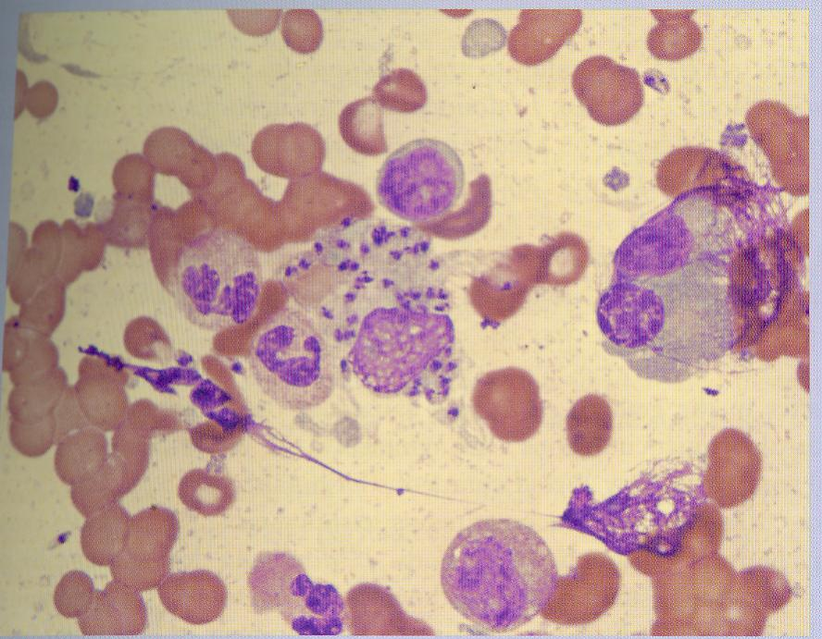
Fig.15.1

Slide 33
Leishmaniasis
Intracellular amastigotes in macrophages of humans and other mammalian hosts .
Extracellular promastigotes in the gut of sandfly vectors.

Slide 34
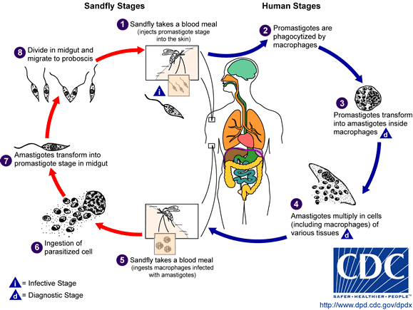
The life cycle of Leishmania

Slide 35
Leishmania Parasites and Diseases
Disease | SPECIES
Cutaneous leishmaniasis | Leishmania tropica* Leishmania major* Leishmania aethiopica Leishmania mexicana
Mucocutaneous leishmaniasis | Leishmania braziliensis
Visceral leishmaniasis | Leishmania donovani* Leishmania infantum* Leishmania chagasi
* Endemic in Saudi Arabia & IRAQ

Slide 36
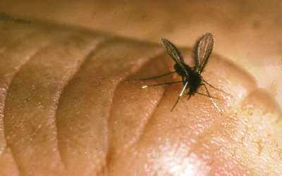
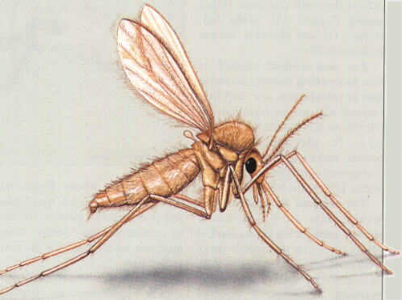
Sand fly

Slide 37

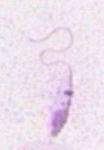
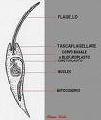
promastigotes

Slide 38
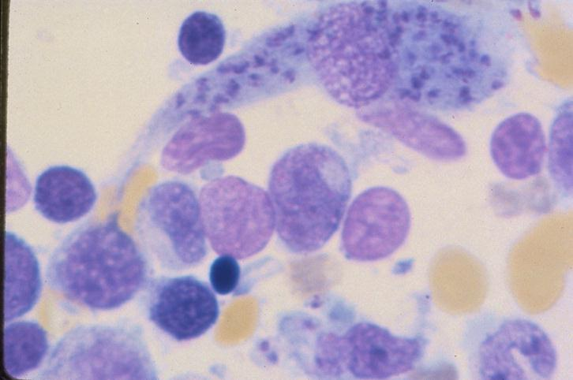
Morphology and Life Cycle
Amastigotes measure 2-3 micrometers, with a large nucleus and kinetoplast.
Amastigotes mainly live within cells of the RE system, but have been found in nearly every tissue and fluid of the body.
Amastigotes in bone marrow.

Slide 39
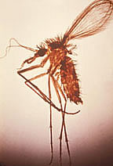
Morphology and Life Cycle Continued
L. donovani is primarily a visceral infection.
Vector – Sand fly of genus Phlebotomus.
Not all strains of L. donovani are adapted to all species and strains of Phlebotomus.

Slide 40
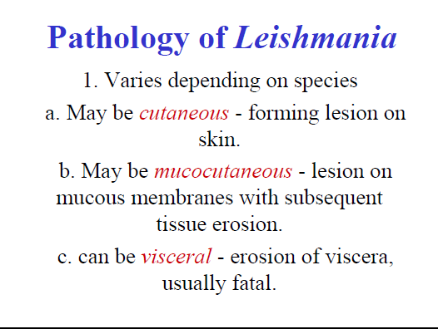

Slide 41
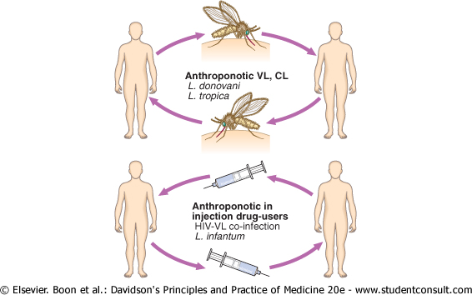
LEISHMANIASIS:

Slide 42
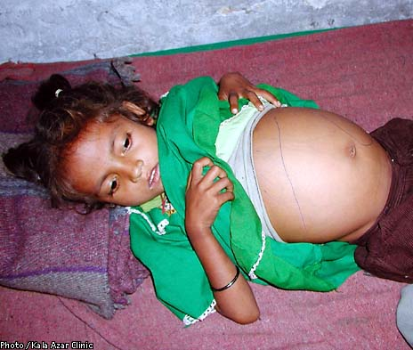
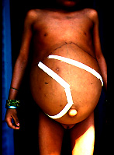
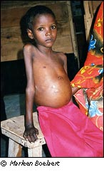
Hepatosplenomegaly and emaciation.

Slide 43
Clinical types of cutaneous leishmaniasis
Leishmania major: Zoonotic cutaneous leishmaniasis: wet lesions with severe reaction
Leishmania tropica: Anthroponotic cutaneous leishmaniasis: Dry lesions with minimal ulceration
Oriental sore (most common) classical self-limited ulcer

Slide 44
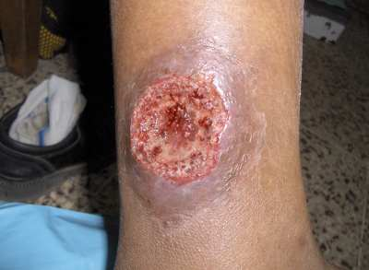
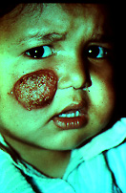
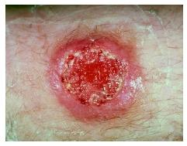

Slide 45
Visceral leishmaniasis
Diagnosis
Parasitological diagnosis: METHOD
  Bone marrow aspirate 1. microscopy
  Splenic aspirate 2. culture in NNN medium
  Lymph node
  Tissue biopsy

Slide 46
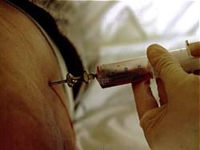
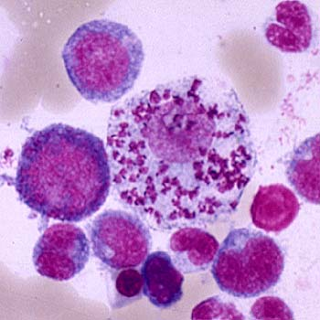
Bone marrow aspiration
Bone marrow amastigotes

Slide 47
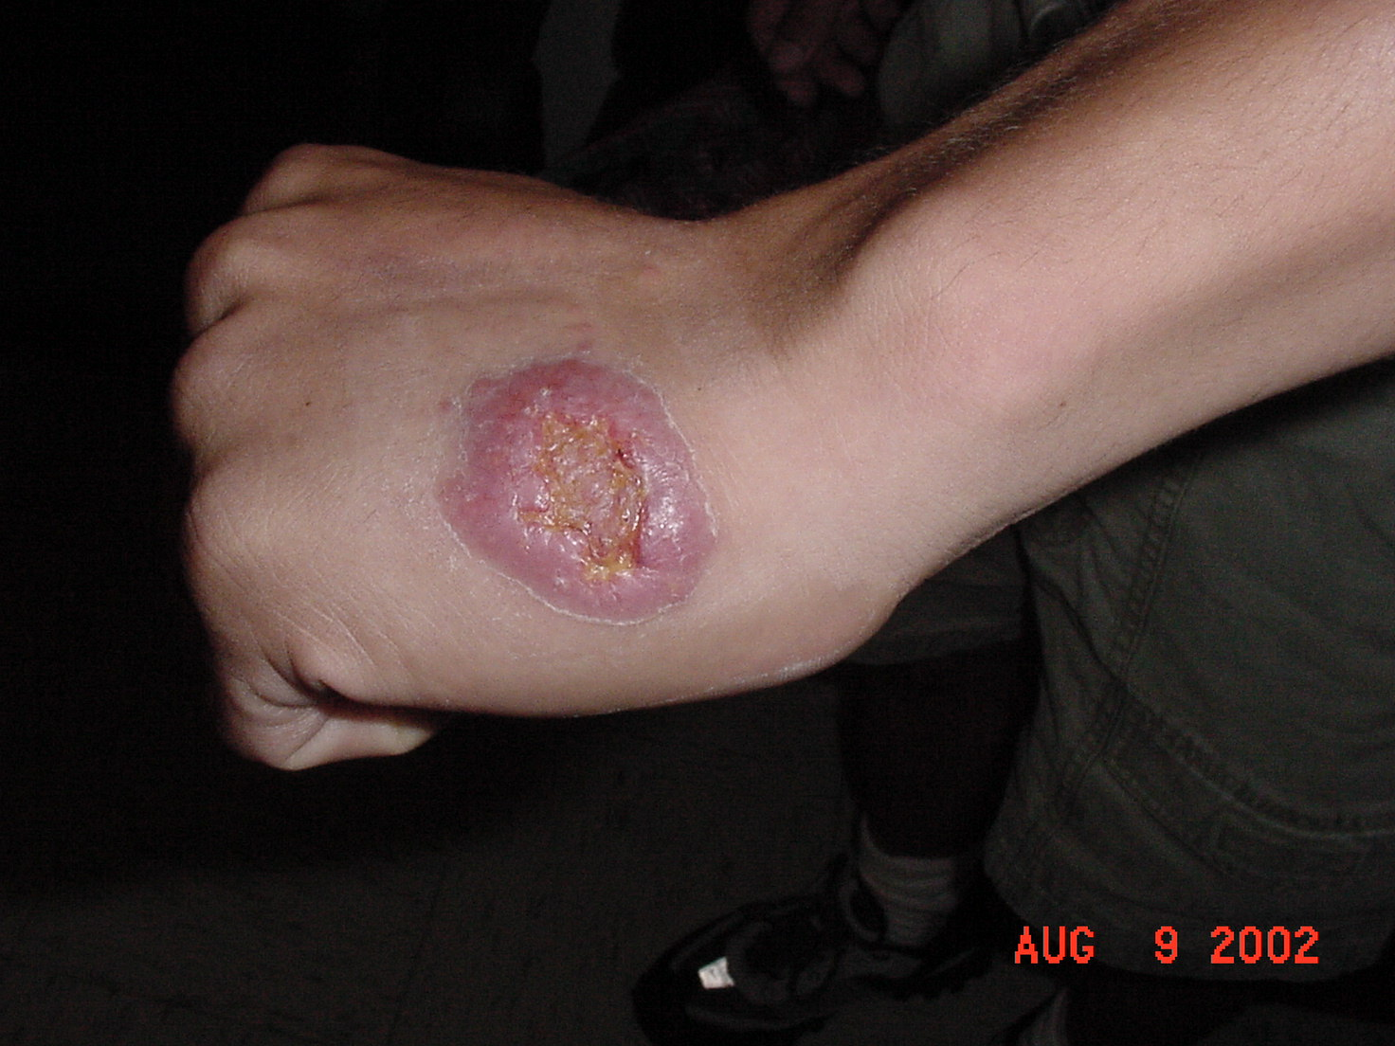

Slide 48
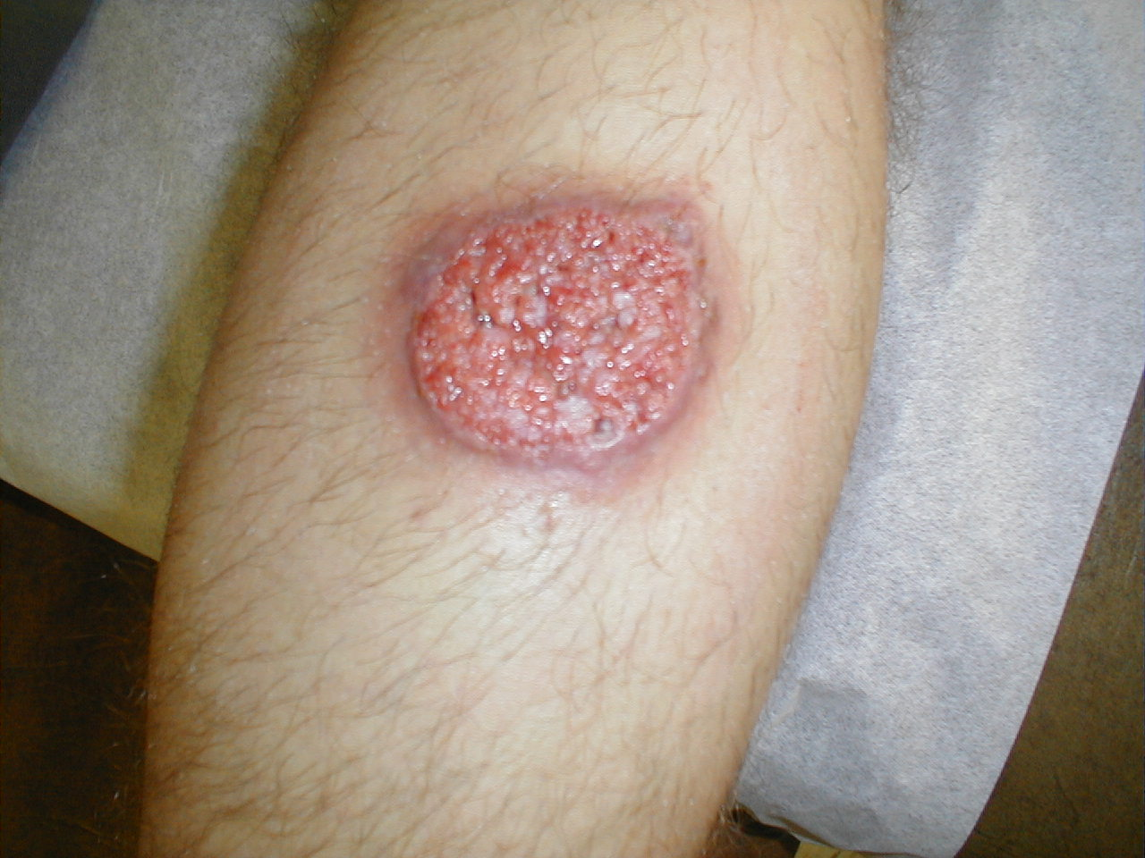

Slide 49
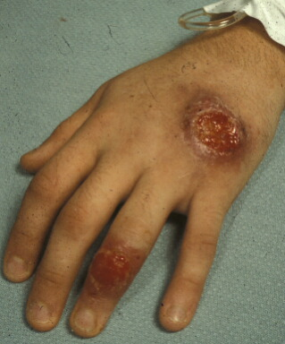

Slide 50
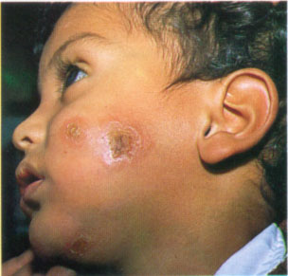
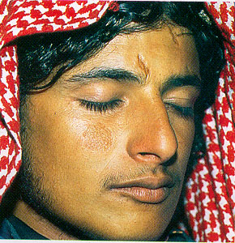
Cutaneous Leishmaniasis is usually self-limiting
Old world oriental sore is caused by parasites of the L. tropica complex. (similar disease in the new world is caused by L. mexicana)
A chronic but self-limiting dry ulceration at the site of the bite
Ulceration start months after infection
Parasites are not found outside the lesion
Nearly absolute resistance to reinfection (however, there is long term persistence and persistence is required for resistance)

