Slide 1
Virus Genetic

Slide 2

Genetic analysis
The study of viral genetics falls into two general areas:
(1) mutations and their effect on replication and pathogenesis and
(2) the interaction of two genetically distinct viruses that infect the same cell.
Naturally occurring genetic mutations create viral variants with different biological properties.

Slide 3
This variation is medically important:
  Viruses with stable antigens (e.g., polio, measles) can be effectively controlled by vaccination.
  Viruses with many or changing antigens (e.g., rhinoviruses, influenza A) are difficult to control with vaccines; viral genetics research may lead to better vaccines.
Genetic analysis can identify unique processes used by viruses, which can then be targeted to develop effective and specific antiviral drugs.

Slide 4
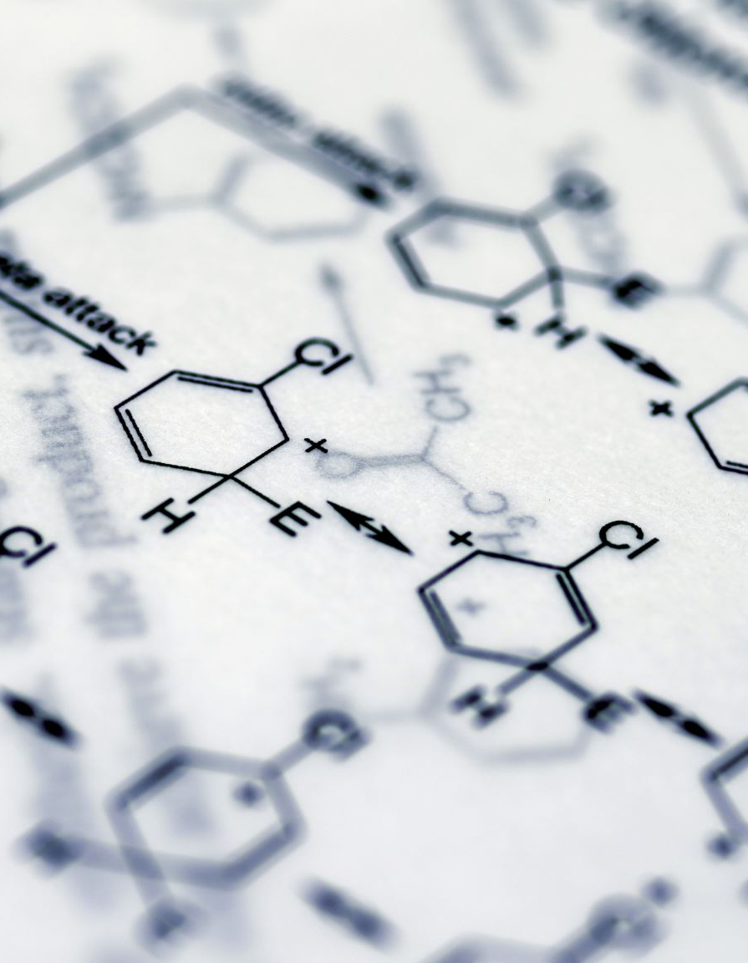
An understanding of genetics is built upon these essential terms
Genotype: The genetic code of an organism.
Phenotype: The observable traits, formed by the genotype and environment.
Mutation: A heritable change in the genotype.
Genome: The complete set of an organism's genes.
Wild-type Virus: A laboratory reference virus from which mutants are derived.
Field Isolate: A virus sample taken directly from a natural host.

Slide 5
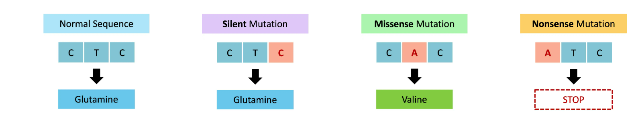
Type of Mutation

Slide 6
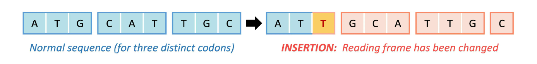
Frameshift Mutation

Slide 7
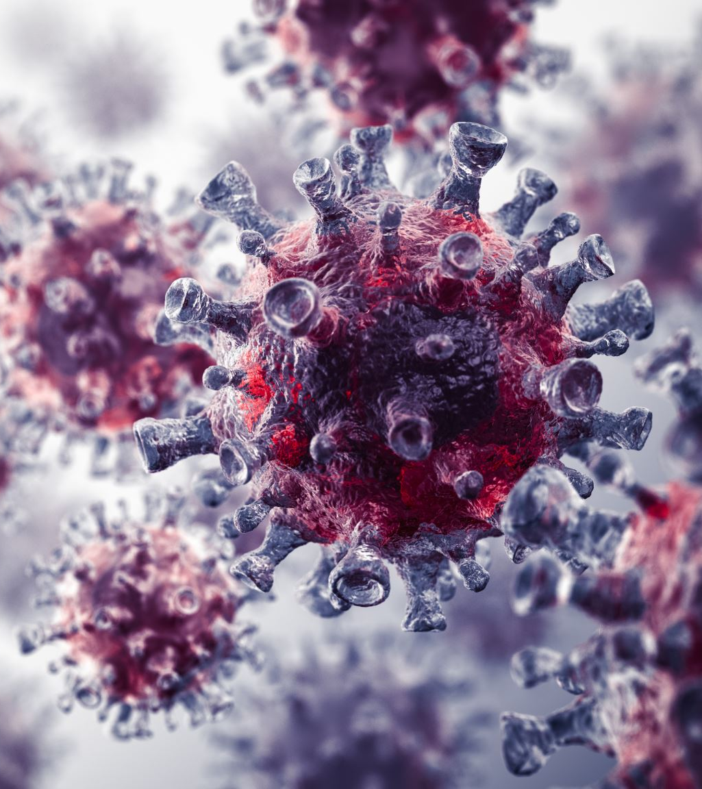
Viral Mutation Rates and Their Implications
Mutation Rates Vary by Virus Type
Viral mutation rates span a wide range, from 10⁻³ to 10⁻⁴ per base pair (e.g., HIV) to 10⁻⁸ to 10⁻¹¹ (e.g., herpesviruses).
  RNA viruses (using RNA-dependent RNA polymerases) generally have high mutation rates because these enzymes typically lack proofreading functions.
  DNA viruses (using DNA-dependent DNA polymerases) generally have low mutation rates due to the proofreading ability of these enzymes.

Slide 8
2. Causes and Visibility of Mutations
Causes: Mutations can occur:
Spontaneously.
Due to selection pressure.
From exposure to antivirals, chemicals, or physical agents (e.g., UV light).
Visibility: Although mutations are common, they only become apparent when they cause an observable change or affect the virus's survival.

Slide 9
Consequences of Mutations
Survival Advantages: Mutations can be beneficial, providing abilities such as:
  Generating antigenic variants that escape the host's immune response and vaccine-induced immunity (e.g., the SARS-CoV-2 Omicron variant).
Negative Consequences: Mutations can also be harmful, producing defective particles with deleterious effects.

Slide 10
Quasispecies Concept
The high error rate in viruses like RNA viruses often leads to the production of a mixture of closely related genetic variants, known as a quasispecies.

Slide 11
Type of Virus mutants:
Conditional-Lethal Mutants are viruses that only reproduce under specific "permissive" conditions but not under "nonpermissive" conditions. This category includes two main types:
Temperature-Sensitive Mutants: Grow at low temperatures but not at high ones.
Host-Range Mutants: Grow in one cell type but not in another.

Slide 12
Interactions Among Viruses
When two or more closely related virus particles infect the same host cell, they can interact. These interactions fall into two main categories based on the outcome for the progeny viruses:
Genetic Interaction: Produces progeny viruses that are heritably (genetically) different from either parent.
Non-genetic Interaction: Produces progeny viruses that are similar to the parent viruses.

Slide 13
Viral Recombination
Definition and Outcome
Recombination is a process that produces a progeny virus (recombinant) which carries a combination of traits not found together in either parent.
Classic Mechanism
The standard mechanism involves the breaking of nucleic acid strands, where a part of one parent's genome is joined to a part of the second parent's genome.
The resulting recombinant virus is genetically stable and will produce similar progeny when it replicates.
Frequency and a Special Case: Segmented Genomes
For viruses with segmented genomes (e.g., influenza virus), recombination happens through a different, highly efficient process called reassortment.

Slide 14
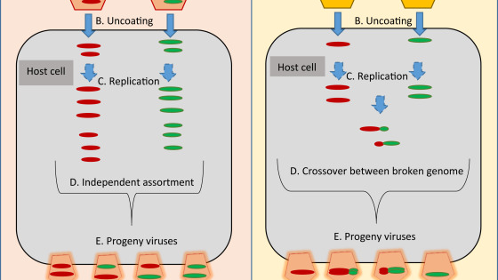

Slide 15
Viral Complementation
Definition
Complementation is a phenomenon where two different viruses infect the same host cell, and one virus provides a functional product that the other virus lacks, allowing both to replicate
Mechanism: A virus with a functional gene (e.g., for a capsid protein) supplies the necessary product to a second virus that has a defective version of that same gene.
Crucial Outcome: This interaction is nongenetic. The genomes of the two viruses do not change; each retains its original genotype. The helper virus simply provides a functional protein to enable replication.

Slide 17
Phenotypic Mixing
Phenotypic mixing occurs when the genome of one virus becomes enclosed within the structural proteins (capsid or envelope) of a different, co-infecting virus. This results in a virus particle with a mismatched genotype and phenotype.
Key Point: This is a non-genetic, temporary change. When the mixed virus replicates, its progeny will have structural proteins that match its own genome.

Slide 18
Mechanisms and Types
A. Mixing of Capsid Proteins
Process: The genome of Virus A is packaged into a capsid made entirely of Virus B's proteins, or into a hybrid capsid containing proteins from both viruses.
Viral Relationship Requirement: Typically requires viruses to be closely related (usually within the same family) so their capsid proteins can interact to form a functional structure.
Extreme Case: When the genome is in a completely foreign capsid, it is specifically called Phenotypic Masking or Transcapsidation.

Slide 19
Mixing Envelope Proteins (Pseudotype Formation)
Process: The nucleocapsid (genome + core protein shell) of one virus becomes encased within an envelope derived from a different, co-infecting virus.
Viral Relationship Requirement: The viruses do not need to be closely related for this to occur.
Example: The nucleocapsid of Vesicular Stomatitis Virus (VSV) is well-known for frequently forming pseudotypes with envelopes from unrelated viruses. RNA tumor viruses are also common examples.

Slide 20
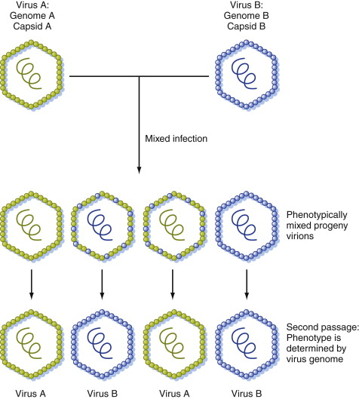

Slide 21
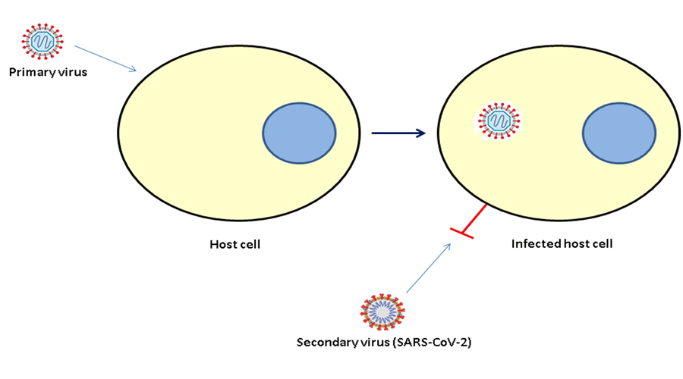
Viral Interference
Definition
Interference is a phenomenon where the infection of a cell or an animal with one virus leads to the inhibition of a second virus, preventing it from multiplying.

Slide 22
B. Mechanisms of Interference
Receptor Blockade or Destruction:
  The first virus may block the cell receptors needed for the second virus to adsorb (e.g., retroviruses, enteroviruses).
  Alternatively, it may destroy the receptors altogether (e.g., orthomyxoviruses).
Competition for Cellular Resources:
  The first virus may compete with the second for essential components of the host cell's replication machinery, such as polymerases or translation initiation factors.
Induction of a Cellular Inhibitor:
The first virus may stimulate the infected cell to produce a protein called interferon, which creates an antiviral state that prevents the replication of the second virus

Slide 23
Viral Vectors:
Principle: Viral genomes can be engineered to serve as vectors—vehicles that replicate and express foreign genes (both viral and cellular).
Feasibility: Almost any virus can be converted into a vector if its replication functions, transcription controls, and packaging signals are sufficiently understood.

Slide 24

Types and Design of Viral Vectors
Diverse Platforms: Viral vector technology is based on both:
DNA viruses (e.g., Adenovirus, Herpesvirus, Vaccinia virus).
RNA viruses (e.g., Poliovirus, Retroviruses).
Each system has distinct advantages and disadvantages.
A typical eukaryotic expression vector contains:
Regulatory Elements: Viral promoters or enhancers to control transcription.
Processing Signals: Sequences for efficient transcription termination and polyadenylation.
Splicing Signals: An intronic sequence with splice donor and acceptor sites.
Optional Elements: Sequences that can enhance translation or direct expression to a specific cell type.

