Slide 1
Host Defense Against Viruses

Slide 2
Host defense against viruses
Early host defense eliminates many viruses before infections are established while clearing others, so they remain subclinical or cause only mild disease.
The activation of different immune functions & the duration and magnitude of the immune response depend on how the virus interacts with host cells

Slide 3
Host defenses against viruses fall into two major categories:
(1) nonspecific, of which the most important are interferons and natural killer cells (Innate immunity),
(2) specific, including both humoral and cell-mediated immunity (adaptive immunity).

Slide 4
Innate Immunity: First Line of Defense & Early Response:

Slide 5
Innate Immunity:
Innate immunity protects against viruses through the first line of physical and chemical barriers, followed by a rapid cellular and molecular response.
The innate defense as well as physical and chemical barriers includes
(1) phagocytic cells (macrophages, dendritic cells, and neutrophils) that engulf invading viruses,
(2) natural killer (NK) cells that lyse infected cells,

Slide 6
Innate Immunity
3) Activation of pattern recognition receptors (PRRs) that induce inflammatory mediators to stimulate the maturation of innate immune cells and their recruitment to the site of infection. This also induces the interferon response with direct antiviral activity and contributes significantly to the development of an adaptive immune response several days later,
(4) Induction of apoptosis (programmed cell death) that leads to elimination of infected cells.
.

Slide 7
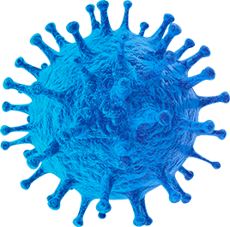
Interferons (IFNs)
Interferons are cytokines that are released by cells infected with a virus, leukocytes, and other immune cells. To limit the infection.
Responses of cells to interferon include inhibition of protein synthesis, activation of immune cells, and induction of apoptosis.

Slide 8
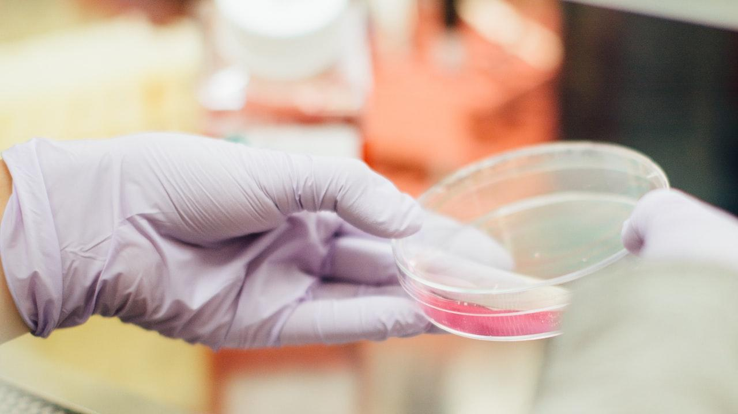
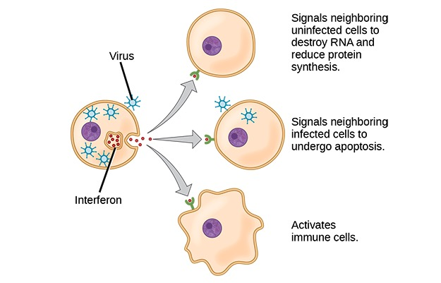

Slide 9
Types of IFNs:
  Type I (Viral IFNs): Include IFN-α and IFN-β.
  Type II (Immune IFN): IFN-γ.
Inducers:
  IFN-α/β: Potently induced by viral infections (especially RNA viruses), double-stranded RNA, and bacterial endotoxin.
  IFN-γ: Induced by mitogen stimulation, not typically by viruses.

Slide 10
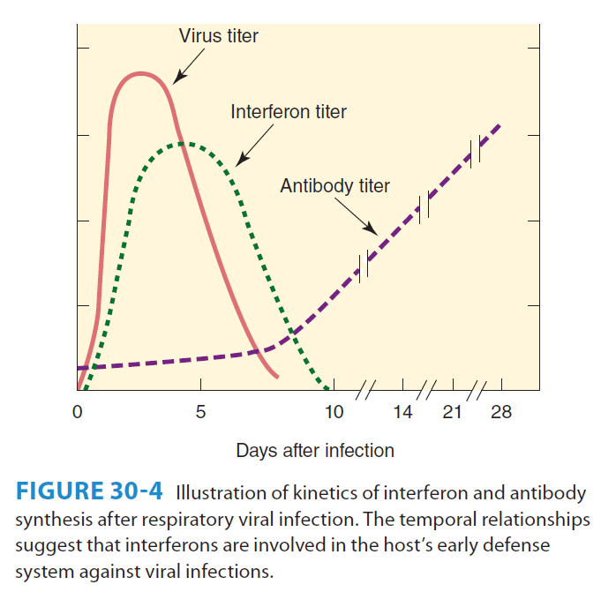

Slide 11
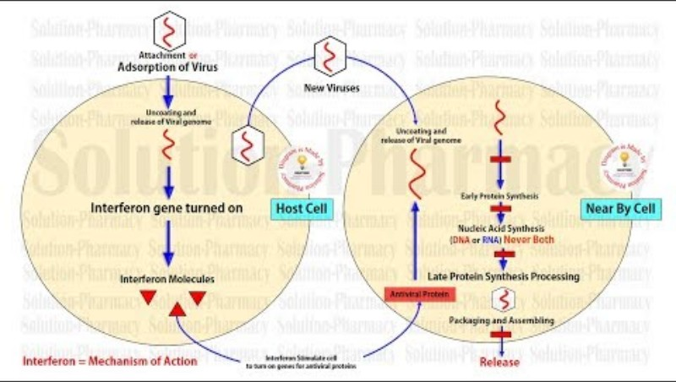
https://www.youtube.com/watch?v=lFlUpDuL9rk

Slide 12
Pathways that Inhibit Viral Replication
  Protein Kinase R (PKR) Pathway:Activated by double-stranded RNA (dsRNA), Phosphorylates and inactivates a cellular protein called eIF-2.This prevents the initiation of viral protein synthesis.
  2'-5' Oligoadenylate Synthetase (2-5A) Pathway :Activated by dsRNA.Produces a compound that activates a cellular enzyme, RNase L. RNase L degrades viral and cellular mRNA, halting protein production.

Slide 13
Pathways that Inhibit Viral Replication
Phosphodiesterase Pathway: Inhibits peptide chain elongation, directly blocking the production of new viral proteins.
Nitric Oxide Synthetase Pathway: Specifically induced by IFN-γ in macrophages. Produces nitric oxide, which has antimicrobial and antiviral effects.

Slide 14
Viral evasion activity of IFNs
Evasion Strategy | Mechanism | Viral Examples
Block IFN Production | Prevent the initial expression of IFN genes. | Herpesvirus, HPV, Hepatitis C
Inhibit PKR Pathway | Directly block or activate cellular inhibitors of PKR. | Adenovirus, Herpes, Influenza, Polio
Block IFN Signaling | Disrupt the signal transduction pathway inside the cell. | Adenovirus, Herpes, Hepatitis B
Neutralize IFN | Secrete a decoy receptor that binds and inactivates IFN. | Myxoma Virus

Slide 15
Role of Adaptive Immunity in Viral Infections

Slide 16
Role of Adaptive Immunity in Viral Infections
Both humoral (antibody-mediated) and cellular (T-cell mediated) components of the adaptive immune system are essential for controlling viral infections.

Slide 17
Difference in Inflammatory Cell Response
The type of white blood cells that infiltrate infected tissue differs significantly between viral and bacterial infections:
Response to Viruses: Characterized by an infiltration of mononuclear cells and lymphocytes (such as macrophages and T-cells). This is the typical cellular profile in uncomplicated viral lesions.

Slide 18
Adaptive Immune Response to Viruses
Viral Proteins as Targets: Proteins encoded by the virus itself are the key targets recognized by the adaptive immune system (both antibodies and T cells).

Slide 19
Cellular Immunity (Cytotoxic T Cells)
Mechanism: Virus-infected cells are identified and lysed (destroyed) by cytotoxic T lymphocytes (CTLs).
Recognition: CTLs recognize fragments of viral polypeptides (antigens) presented on the surface of the infected cell.

Slide 20
Humoral Immunity (Antibodies)
Role in Protection: Antibodies are crucial for protecting against reinfection by the same virus.
Neutralizing Antibody:
  Directed against viral capsid or envelope proteins.
  Blocks the initiation of infection by preventing viral attachment, entry, or uncoating.

Slide 21
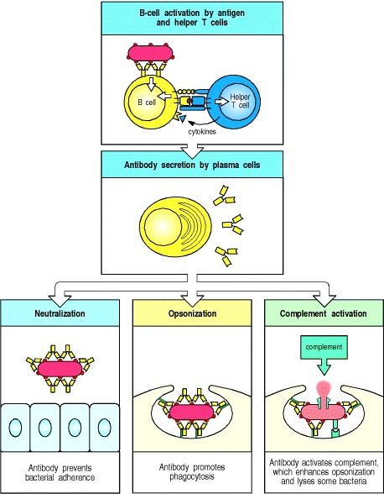
Notes:
Antigen that binds to the B-cell antigen receptor signals B cells and is, at the same time, internalized and processed into peptides that activate armed helper T cells. Signals from the bound antigen and from the helper T cell induce the B cell to proliferate and differentiate into a plasma cell secreting specific antibody (top two panels). These antibodies protect the host from infection in three main ways. They can inhibit the toxic effects or infectivity of pathogens by binding to them: this is termed neutralization (bottom left panel). By coating the pathogens, they can enable accessory cells that recognize the Fc portions of arrays of antibodies to ingest and kill the pathogen, a process called opsonization (bottom center panel). Antibodies can also trigger activation of the complement system. Complement proteins can strongly enhance opsonization, and can directly kill some bacterial cells (bottom right panel).

Slide 22
Humoral Immunity (Antibodies)
Secretory IgA: This type of antibody is particularly important for mucosal immunity in the respiratory and gastrointestinal tracts, providing the first line of defense at common entry points.

Slide 23
Viral Evasion of the Immune Response

Slide 24
Mechanism | Description | Viral Examples
1. Infecting Immunoprivileged Cells | Infects cells that don't display viral antigens, hiding from T cells. | Herpesvirus (neurons)
2. Destroying Immune Cells | Infects and kills the immune system's own cells. | HIV (T lymphocytes)
3. Blocking Immune Signaling | Viral proteins inhibit MHC presentation or cytokine activity. | Adenovirus, Herpesvirus (MHC); Poxvirus, Measles (Cytokines)
4. Antigenic Variation | Mutates surface proteins to escape existing antibodies and T cells. | Influenza virus, HIV
5. Downregulating Surface Proteins | Reduces the display of viral proteins on infected cells to evade detection. | Herpesvirus
6. Using Viral MicroRNAs | Small RNAs suppress host proteins needed for the innate immune response. | Polyomavirus, Herpesvirus
7. Blocking IFN Pathways | Inhibits the initial antiviral interferon response at various stages. | Herpesvirus, Adenovirus, Hepatitis C

Slide 25
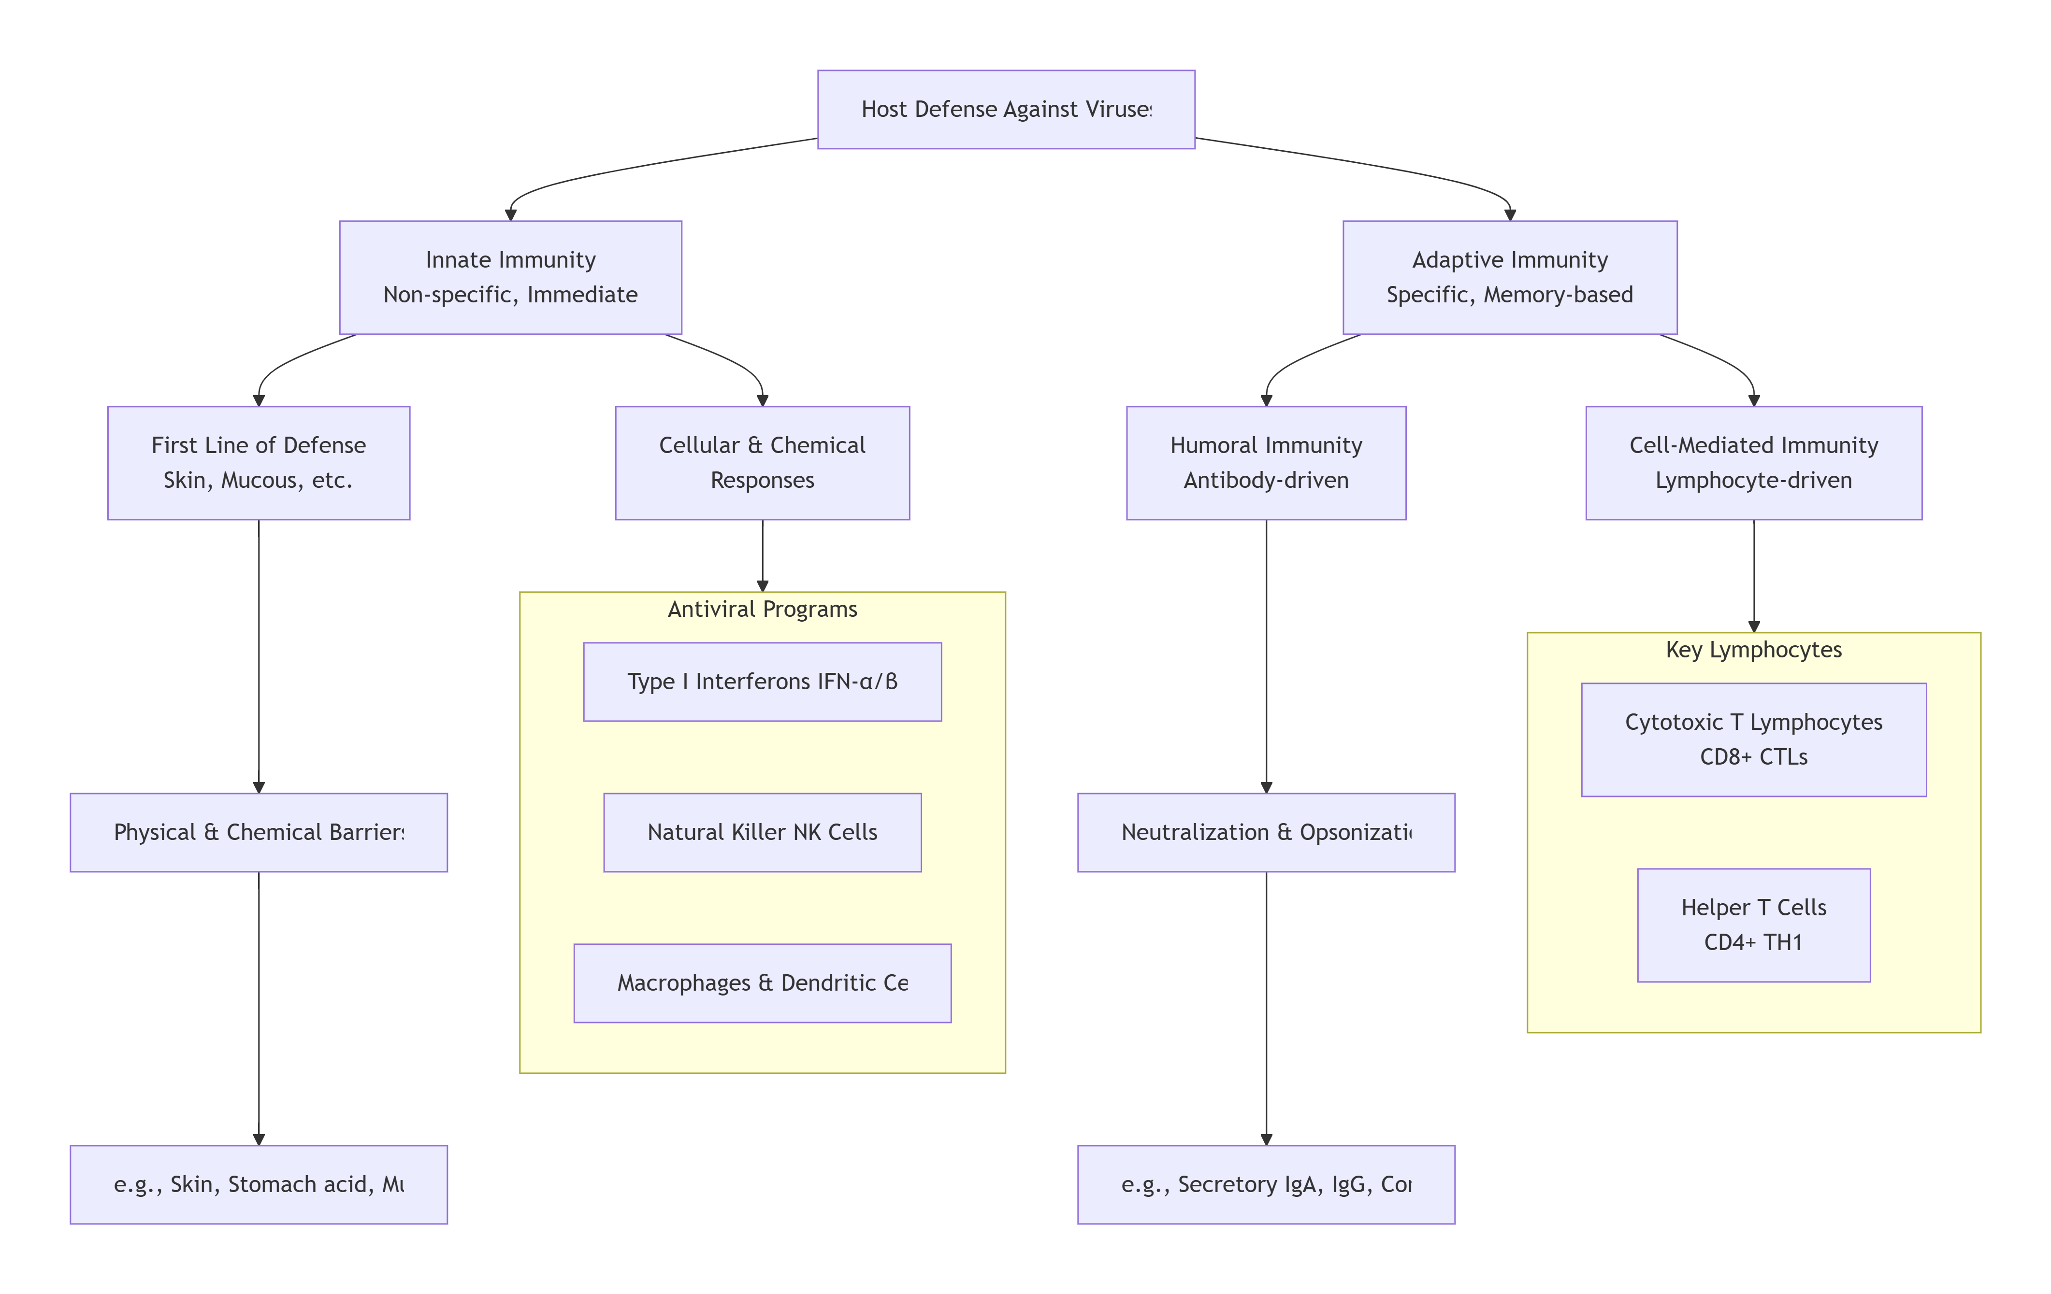

Slide 26


