Slide 1
Tuberculosis

Slide 2
Introduction
TB is One of the oldest diseases known.
Usually a respiratory disease , due to infection by Mycobacterium tuberculosis
preventable infectious disease in the world.
yet it still kills and sickens millions each year

Slide 3
TB transmission
TB is spread through tiny drops sprayed into the air when an infected person coughs, sneezes, or speaks, or another person breathes the air into their lungs containing the TB bacteria.
TB droplets are more easily spread in areas with poor air ventilation
TB is highly contagious

Slide 4
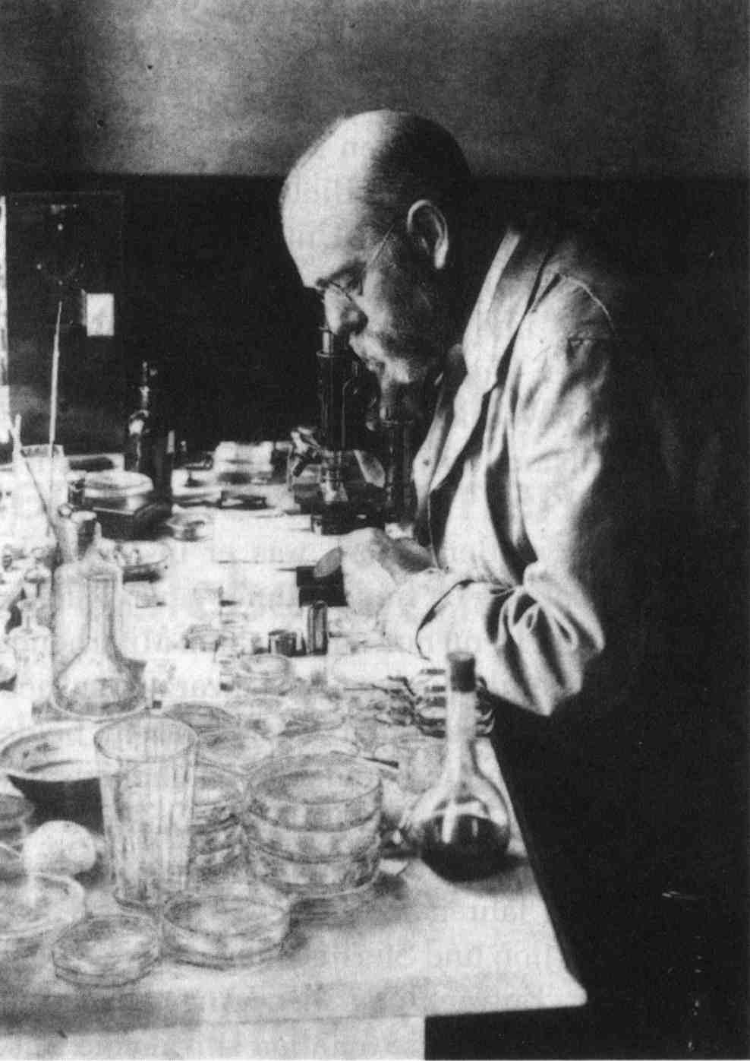
M tuberculosis as causative agent for tuberculosis
small, aerobic , non motile bacilli
Robert Koch
24 March 1882

Slide 5
Why worry about TB?
* Worldwide, one person in three is infected with TB.
* In 2013 there were between 1.3 and 1.5 million associated deaths,
* in 2013, an estimated 9 million new cases occurred
* Yet it is completely curable and is (relatively) inexpensive to cure.

Slide 6
TB Incidence & HIV Prevalence, Botswana,1990-2006
Source: BNTP Annual Reports and ANC Sentinel Surveillance Reports
Notes:
This graph more specifically compares trends in TB incidence with trends in HIV prevalence (among pregnant women) in Botswana
TB case rates are shown in dark blue from 1990 to 2006 with the rate per 100,000 population represented on the right-sided y-axis
The prevalence of HIV among pregnant women attending antenatal clinics is shown in pink as a percentage on the left-sided y-axis
After the establishment of a national TB program in 1975, TB rates declined until 1989. Since that time, they have increased simultaneously with rising rates of HIV. A recent study demonstrated that among Registered Tb Patients with HIV test results the proportion infected with HIV was 84%
This data demonstrates the effect of HIV on TB and that the increase of TB incidence is a result of the increasing prevalence of HIV in Botswana
Source: BNTP Annual Reports and ANC Sentinel Surveillance Reports

Slide 7
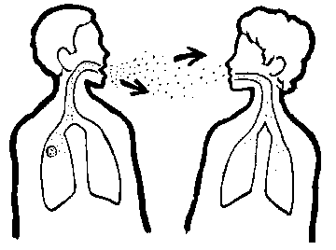
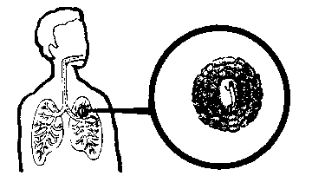

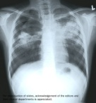
Natural History of TB Infection
Exposure to TB
No infection
(70-90%)
Infection
(10-30%)
Latent TB
(90%)
Active TB
(10%)
Never develop
Active disease
Untreated
Treated
Die within 2 years
Survive
Die
Cured

Slide 8
Risk factors
Who are most at risk?
1- Malnourished , elderly , poor .
2- Migrants, refugees, travelers.
3- Smokers, chronic alcoholics.
4- Those with co-morbidity :
( diabetes , HIV/AIDS , silicosis)
5- Certain medications, such as corticosteroids and infliximab

Slide 9
Signs & symptoms
        persons with active TB disease usually have some of the following symptoms : cough
        ( 3 weeks or more) , feel weak , have a fever, weight loss , experience night sweats, cough up blood , or have chest pain when coughing, loss of appetite .

Slide 10
Even if a Skin Test is Negative…..
THINK TB!
FFever
Coughing
up Blood
Anorexia
Chills
Chiclls
Fatigue
Loss
of Appetite
Difficulty
in
Breathing
Night sweats

Slide 11
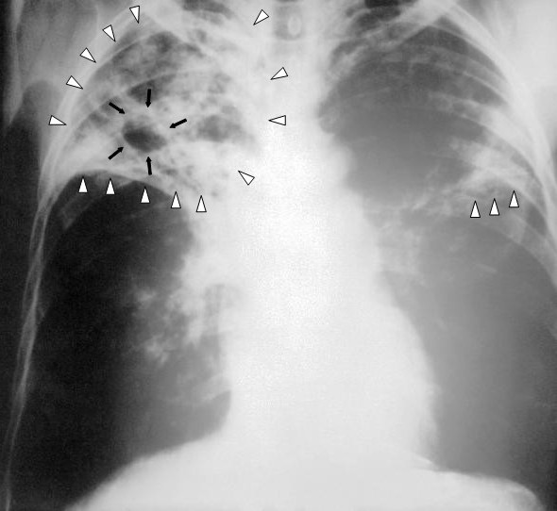
Tools for Diagnosing TB Infection
* Mantoux
Tuberculin skin
Test ( PPD )
*Chest x-ray
*Sputum
Examination for
Acid-fast bacilli

Slide 12
Treatment
Most TB are curable , but :
  Four or more drugs required for the simplest regimen
  ( Isoniazid , Rifampicin , Pyrazinamide , Ethambutol , Streptomycin)
  6-9 or more months of treatment required
  Person must be isolated until become non-infectious
  Directly observed therapy to assure adherence/completion recommended

Slide 13
Treatment
  Side effects and toxicity are common
    Major adverse effects include exanthema, vertigo, psychosis, and hepatotoxicity (vomiting , alteration in liver function tests , and hepatitis ) which May prolong treatment and prolong infectiousness .
  Other medical conditions ( HIV , DM ) complicate therapy
    TB may be more severe
    Drug-drug interactions are common

Slide 14

What is DOTS?
DOTS= Directly Observed Therapy- Short Course
  *Implemented in 1990s by WHO with help of World Bank
  *one of the most cost-effective public health investments
  *Most reliable way to ensure that patients take their drugs as prescribed
    Patient swallows his/her TB medicines in the presence of another person called a DOT supporter
    A DOT supporter can be anyone who assumes
    co-responsibility for TB treatment
*
Source: World Health Organization, 2008.
Notes:
Ask participants to define and describe DOTS
DOTS is the programme, DOT is the act of watching the patient swallow every pill, each day for the entire length of treatment
Therefore, DOT is a part of DOTS
Clarify information as needed
Source: World Health Organization [homepage on the Internet]. c2008 [updated 2008, cited 2008 Jan 22]. The Stop TB Strategy; [1 screen]. Available from: http://www.who.int/tb/strategy/en/

Slide 15
TB Control and Prevention
Main strategies include :
BCG vaccination
Case finding
Effective chemotherapy
Health Education
Chemoprophylaxis

Slide 16
Fundamentals of TB
Infection Control Practices
* Identify persons with active TB early.
* Initiate effective and appropriate isolation of known or suspected TB cases .
* Initiate effective anti-TB treatment promptly
* Screen persons at high risk for preventative therapy if infected ,
Screen all HIV+ patients for TB
Test all TB patients for HIV

Slide 17
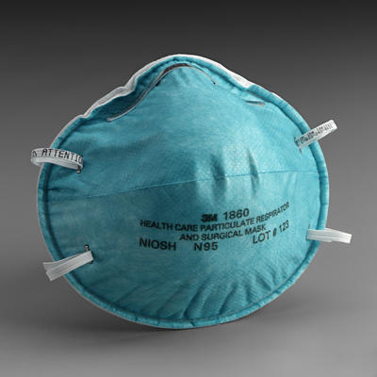
Fundamentals of TB
Infection Control Practices
* Employees should use N95 respirators for any contact with patients suspected of having TB.
* Confidently discuss with patient any issues relating to TB, HIV and AIDS

Slide 18
Fundamentals of TB
Infection Control Practices
* Identify and evaluate persons and health care workers exposed to infectious TB
* Screen health care workers for skin test conversions
* Conduct surveillance for TB cases among patients and healthcare workers

Slide 19
What factors contribute to TB outbreaks in healthcare facilities?
* Lack of compliance with infection control practices to control the transmission of TB.
* Healthcare facilities which are providing services to increased numbers of people with TB and HIV infection .
* Multi-drug resistant TB cases are on the rise.

Slide 20
What factors contribute to TB outbreaks in healthcare facilities?
* Lack of using a respirator mask when taking care of patients with active TB.
* Lack of suspicion that some patients are at risk for TB

