Slide 1
Pediatric rheumatology
Juvenile idiopathic arthritis
Dr. Farah Jaafar
MBCHB , FIBMS (Rheumatology and Rehab)

Slide 2
Affect 1 : 1000 children
Arthritis at age up to 16 years of age for at least 6 weeks (persistant)
strong association with uveitis

Slide 3
Oligoarticular JIA
is the most common form of JIA,60% of cases. It is more common in females and tends to affect large joints in an asymmetrical pattern. Most commonly in knee ankle and wrist
If fingers involved think about PSA
Strongest association with uveitis and many patients are ANA-positive.
. Two types persistant and extended (30-50%) types ….after 6m
Any fever IDA or significantly high ESR CRP think in septic IBD or malignancy

Slide 4
enthesitis-related arthritis (ERA)
are likely to be self-limiting forms of spondyloarthritis. ERA can progress over time into a more obviously defined spondyloarthropathy.

Slide 5
Polyarticular JIA
is heterogeneous: some patients are RF- and/or ACPA-positive, while others are negative for autoantibodies
Worst prognosis is seropositive type

Slide 6
Systemic juvenile idiopathic arthritis
formerly known as Still’s disease
is characterised by fever, rash, arthritis, hepatosplenomegaly and serositis in association with anaemia and a raised ESR and CRP.
Autoantibody tests are negative.
Important diffrential is infection and malignancy

Slide 7
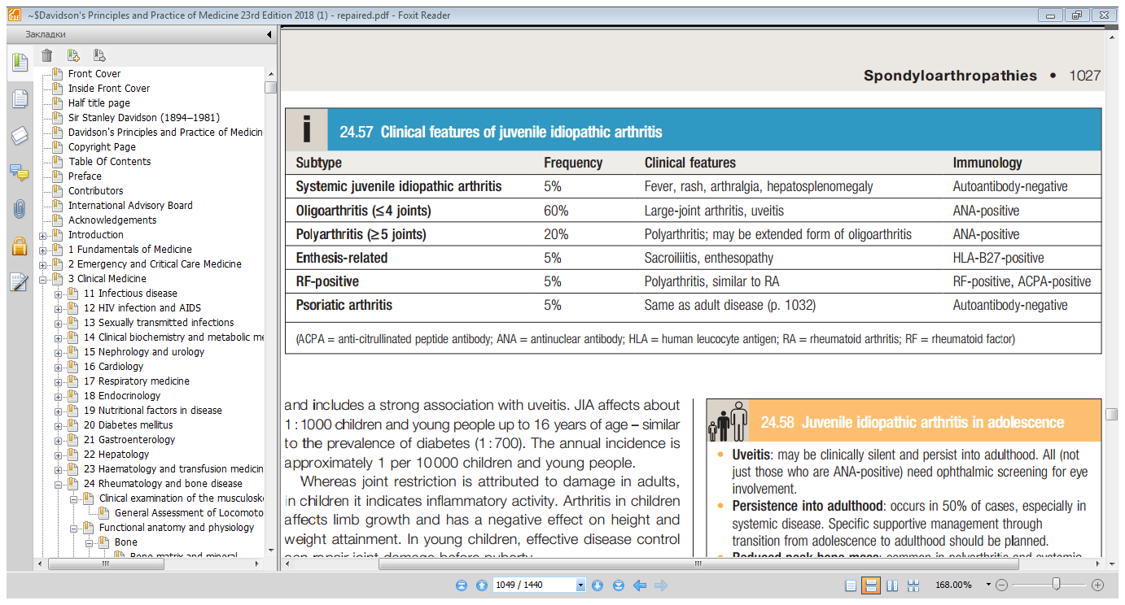

Slide 8
investigations
ESR and CRP do not correlate well with the extent or severity of inflammation and may be normal.
A very high ESR may indicate the presence of inflammatory bowel disease or (very rarely) leukaemia.
Anemia of chronic disease
A positive ANA occurs in 40–75% of cases of JIA and indicates an increased risk of eye disease.
Ultrasound is the radiological investigation of choice to confirm synovitis or tenosynovitis.
Synovial fluid aspiration is essential when considering sepsis and tuberculosis.

Slide 9
treatment
The key approach is to gain early rapid control of inflammation
The standard immunotherapy is methotrexate subcutaneous methotrexate ?
Alternative treatment includes leflunomide, sulfasalazine and hydroxychloroquine.
Azathioprine and ciclosporin can be used to treat JIA with uveitis.
Mycophenolate and tacrolimus are considered to have a specific role in treatment

Slide 11
Uveitis: may be clinically silent and persist into adulthood. All (not just those
who are ANA-positive) need ophthalmic screening for eye involvement.
 Persistence into adulthood: occurs in 50% of cases, especially in systemic
disease. Specic supportive management through transition from adolescence
to adulthood should be planned.
 Reduced peak bone mass: common in polyarthritis and systemic juvenile
idiopathic arthritis but there are few data on fracture risk and the evidence base
for treatment is poor.

