Slide 1
Vasculitis part i
Dr.Farah Jaafar
MBCHB. FIBMS
Rheumatology and medical rehabilitation

Slide 2
ANCA associated vasculitis:
ANCA? C-ANCA (PR3 )…..P-ANCA (MPO)
ANCA associated vasculitis:
Granulomatosis with polyangitis…. CANCA (PR3)
Eosinophilic Granulomatosis with polyangitis
Microscopic polyangitis PANCA (MPO)

Slide 3
Microscopic polyangiitis
rapidly progressive glomerulonephritis, often in association with alveolar haemorrhage. Cutaneous and gastrointestinal involvement is common and other features include neuropathy (15%) and pleural effusions (15%). Patients are usually (MPO) antibody-positive.

Slide 4
granulomatosis with polyangiitis
Nose+eye+ear+lung+kidney
The most common presentation upper airway disease.
Deafness may be a feature due to inner ear involvement
proptosis.
Migratory pulmonary infiltrates and nodules occur in 50% of patients (as seen on high-resolution CT of lungs).
Patients with active disease usually have a leucocytosis with elevated CRP, ESR and PR3.

Slide 5
diagnosis
confirmed by biopsy of the kidney or lesions in the sinuses and upper airways.
Management for organ-threatening or acute–severe disease is with high-dose glucocorticoids and intravenous cyclophosphamide followed by maintenance therapy with lower-dose glucocorticoids and azathioprine, methotrexate or MMF.
Plasmapheresis should be considered for fulminant lung disease.
Rituximab in combination with high-dose glucocorticoids is equally effective as oralcyclophosphamide at inducing remission in AAV.
Glucocorticoids and methotrexate are an effective
combination for treating limited AAV where there is indolent sinus, lung or skin disease.

Slide 6
Eosinophilic granulomatosis with polyangiitis (Churg–Strauss syndrome)
It is associated with eosinophilia. Some patients have a prodromal period for many years, characterised by allergic rhinitis, nasal polyposis and late-onset asthma that is often difficult to control.
The typical acute presentation is with a triad of skin lesions (purpura or nodules), asymmetric mononeuritis multiplex and eosinophilia.
Pulmonary infiltrates and pleural or pericardial effusions due to serositis may be present.
antibodies to MPO or PR3 can be detected in up to 60% of cases.
Diagnosis by Biopsy
Management is with high-dose glucocorticoids and cyclophosphamide, followed by maintenance therapy with low-dose glucocorticoids and azathioprine, methotrexate or MMF.

Slide 7
Large vessel vasculitis
Giant cell arteritis
Takayasu arteritis

Slide 8
Takayasu arterits
affects the aorta, its major branches and occasionally the pulmonary arteries.
The typical age at onset is 25–30 years, with an 8 : 1 female-to-male ratio.
most common in Asia.

Slide 9
It presents with claudication, fever, arthralgia and weight loss.
Clinical examination may reveal loss of pulses, bruits, hypertension and aortic incompetence.
the diagnosis is based on angiography, which reveals coarctation, occlusion and aneurysmal dilatation.
Treatment is with high-dose glucocorticoids and immunosuppressants

Slide 10
Giant cell arteitis and PMR
Both diseases are rare under the age of 60 years. The average age at onset is 70, with a female-to-male ratio of about 3 : 1.
It is commonly associated with polymyalgia rheumatica (PMR), which presents with symmetrical, neck and shoulder girdle pain and stiffness.

Slide 11
Clinical features
The cardinal symptom of GCA is headache
Jaw pain develops in some patients, brought on by chewing or talking.
Visual disturbance can occur (most specifically amaurosis)
On fundoscopy, the optic disc may appear pale and swollen with haemorrhages, but these changes may take 24–36 hours to develop and the fundi may initially appear normal
With PMR, there may be stiffness and painful restriction of active shoulder movements on waking. Muscles are not otherwise tender, and weakness and muscle-wasting are absent.

Slide 12
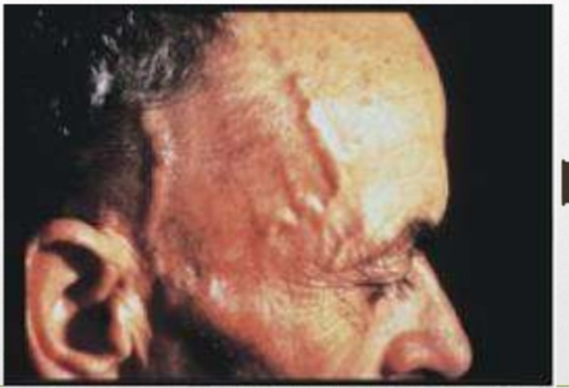

Slide 13
Investigations
elevated ESR, often with a normochromic, normocytic anaemia. CRP may also be elevated
consider: temporal artery biopsy, ultrasound of the temporal arteries and fluorodeoxyglucose positron emission tomography (19FDG PET scan).
A negative biopsy does not exclude the diagnosis bec of skip lesion.
On ultrasound examination, affected temporal arteries show a ‘halo’ sign.

Slide 14
Management
Medical emergency once u suspect give rx
Prednisolone should be commenced urgently in suspected GCA because of the risk of visual loss . Response is dramatic, such that symptoms will completely resolve within 48–72 hours of starting therapy in virtually all patients.
Most patients need glucocorticoids for an average of 12–24 months.

