Slide 1
Osteoarthritis
Dr. Farah Jaafar
MBCHB. FIBMS

Slide 2
introduction
Osteoarthritis (OA) is by far the most common
age
hip OA is lower in Africa, China, Japan and the Indian subcontinent than in European countries, and that of knee OA is higher
Family-based studies have estimated that the heritability of OA ranges from about 43% at the knee to between 60% and 65% at the hip and hand, respectively.

Slide 3
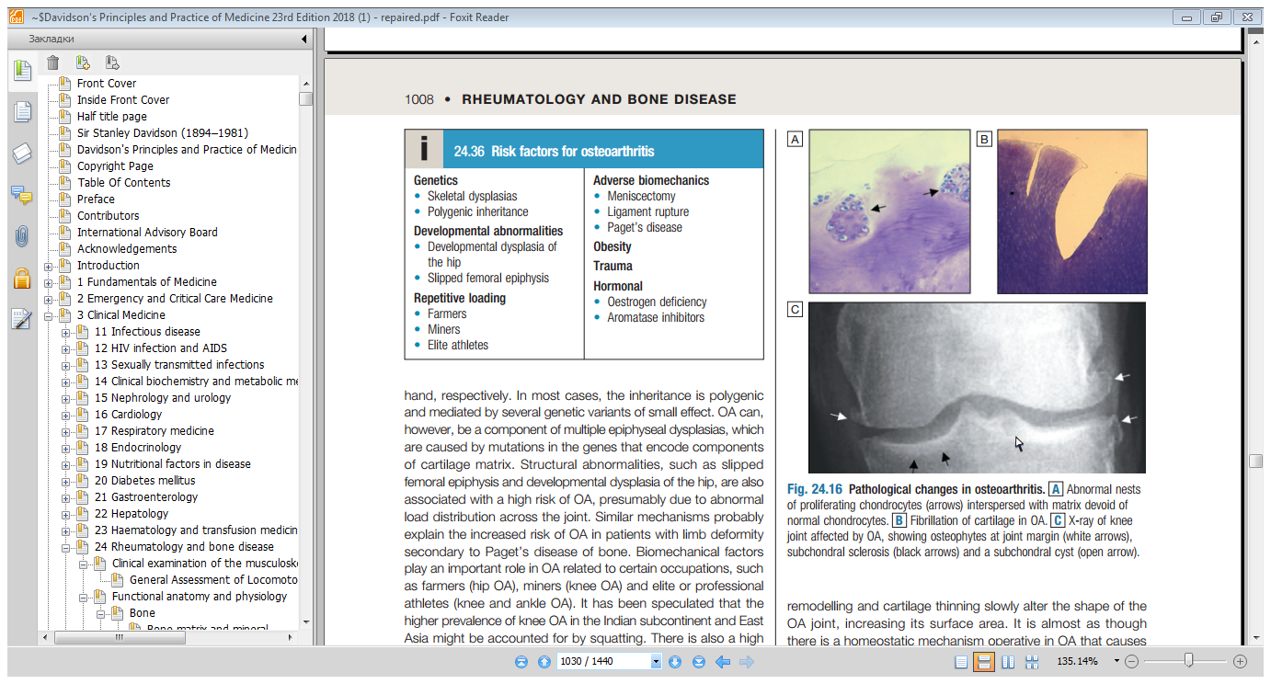

Slide 4
Biomechanical factors
farmers (hip OA), miners (knee OA) and elite or professional athletes (knee and ankle OA).
For most individuals, however, participation in recreational sport does not appear to increase the risk significantly.

Slide 5
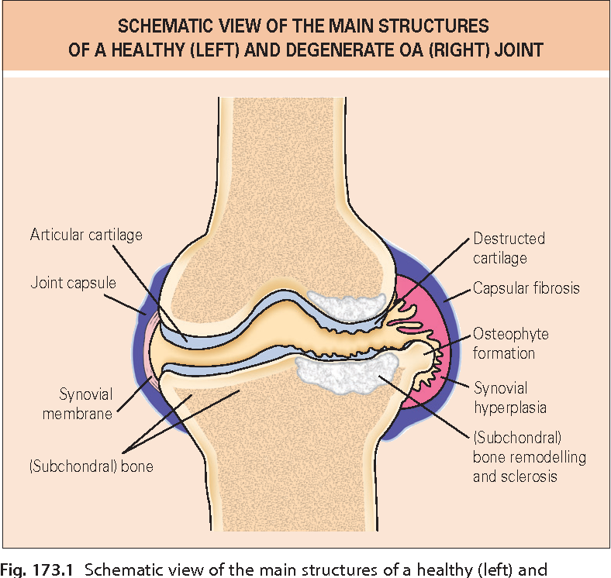

Slide 6
Clinical features
mainly targeting the hips, knees, PIP and DIP joints of the hands, neck and lumbar spine .The main presenting symptoms are pain and functional restriction.

Slide 7
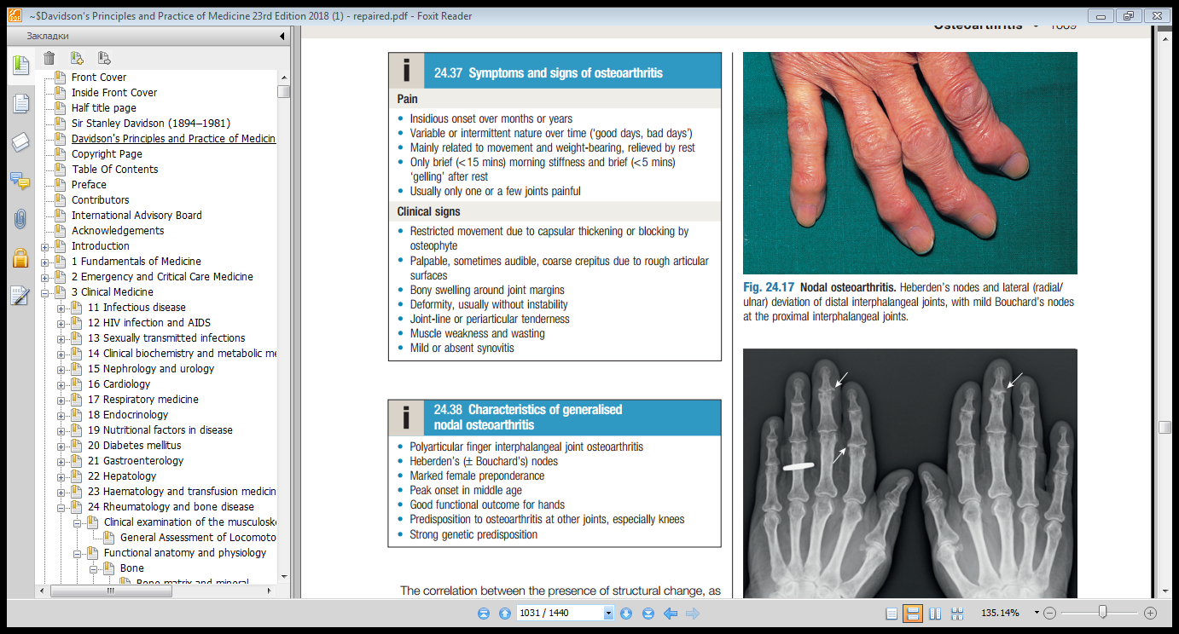

Slide 9
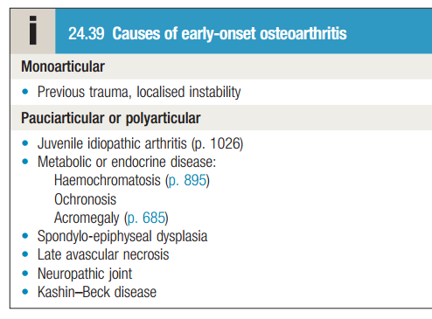

Slide 10
Investigations
plain X-ray
standing anteroposterior X-rays ….tibio-femoral cartilage loss,
Bld tests are usually normal
Unexplained early-onset OA requires additional investigation

Slide 11
management
  Education
Lifestyle advice
Weight loss
Quadriceps strengthening exercises
Shock-absorbing footwear, pacing of activities, use of a walking stick
Non-pharmacological therapy
Acupuncture and transcutaneous electrical nerve stimulation (TENS) have been shown to be effective in knee OA.
Local
physical therapies, such as heat or cold, can sometimes give temporary relief.

Slide 12
Pharmacological therapy
paracetamol. Addition of a topical NSAID, and
then capsaicin
Oral NSAIDs
Strong opiates may occasionally be required.

Slide 13
Intra-articular injections
Effective but . The duration of effect is usually short but trials of serial glucocorticoid injections every 3 months in knee OA have shown efficacy for up to 1 year.
Intra-articular injections of hyaluronic acid?

Slide 14
Neutraceuticals
Chondroitin sulphate and glucosamine sulphate
Surgery
Indications
Optimal timing

Slide 15
Thank you

