Slide 1
osteoporosis
Dr.farah jaafar
Mbchb fibms

Slide 2
Osteoporosis is the most common bone disease. most of fractures occur in patients with osteopenia or osteoporosis.
About one-third of all women and one-fifth of men aged 50 and above suffer fractures at some point in life.
Its underdiagnosed and under-treated throughout Asia, particularly in rural areas, due to low provision of technologies like DXA.
Osteoporosis-related fractures can affect any bone, but common sites are the forearm (Colles’ fracture), spine (vertebral fractures), humerus and hip.
.Hip fractures are the most serious complication of osteoporosis and have an immediate mortality of about 12% and a continued increase in mortality of about 20% when compared with age-matched controls.

Slide 3
Pathophysiology
The defining feature of osteoporosis is reduced bone density, which causes micro-architectural deterioration of bone tissue and leads to an increased risk of fracture, in response to minor trauma.
The risk of fracture increases markedly with age in both genders
This is mostly attributable to an increased risk of falling with age, but is also due in part to an age-related decline in bone density, especially in women

Slide 4
Bone mass increases during growth to reach a peak between the ages of 20 and about 45 years, but falls thereafter in both genders with an accelerated phase of bone loss after the menopause in women due to oestrogen deciency.
The loss of bone with ageing is caused by an imbalance in the bone remodelling cycle, whereby the amount of new bone formed by osteoblasts cannot keep pace with the amount that is removed by osteoclasts . The reduction inbone formation is thought to be partly due to differentiation of bone marrow stem cells to adipocytes, as opposed to osteoblasts. Osteoporosis sometimes occurs because of failure to attain adequate levels of peak bone mass, but is more commonly due to age-related bone loss.
. Genetic factors account for up to 80% of variation in bone density and genome-wide association studies have shown that susceptibility is determined in part by a large number of common variants, some of which are involved in the RANK and Wnt signalling pathways. Rarely, osteoporosis may be caused by mutations in single genes.
Environmental factors, such as exercise and calcium intake during growth and adolescence,

Slide 5
are important in maximising peak bone mass and in regulating rates of post-menopausal bone loss.
Smoking has a detrimental effect on BMD and is associated with an increased fracture risk, partly because female smokers have an earlier menopause than non-smokers.
Heavy alcohol intake is a recognised cause of osteoporosis and fractures, but moderate intake does not substantially alter risk.
Idiopathic osteoporosis
The term idiopathic osteoporosis is frequently used to describe the occurrence of osteoporosis in patients with no specifc underlying cause. It is slightly misleading, since most, if not all, patients in this category have age-related osteoporosis or osteoporosis associated with inheritance of genetic variants that regulate bone density.

Slide 6
Secondary osteoporosis
Osteoporosis can occur in association with a variety of diseases and rug treatments, and in many cases more than one disease or risk factor is operative. Secondary causes of osteoporosis are particularly common in men, occurring in up to 50% of patients. Hypogonadism, glucocorticoid use and alcohol excess are the most important predisposing factors Glucocorticoid-induced osteoporosis
Glucocorticoid-induced osteoporosis is a common problem in patients with systemic inammatory and chronic pulmonary diseases. The risk of osteoporosis is related to dose and duration of glucocorticoid therapy and increases substantially in patients who have taken more than 7.5mg of prednisolone daily for more than 3 months (or an equivalent dose of another glucocorticoid). Inhaled glucocorticoids can reduce bone density, but the risk of osteoporosis is much lower than with systemic therapy. Glucocorticoids mainly cause osteoporosis by inhibiting bone formation and causing apoptosis of osteoblasts and osteocytes. Other contributory mechanisms include inhibition of intestinal calcium absorption, increased renal excretion of calcium and secondary hyperparathyroidism, which stimulates osteoclastic bone resorption.
Pregnancy-associated osteoporosis
This is a rare form of osteoporosis that typically presents with back pain
and multiple vertebral fractures usually during the third trimester or puerperium.

Slide 7
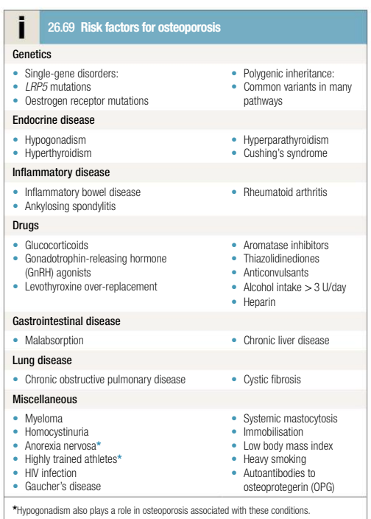

Slide 8
Clinical features
Osteoporosis does not cause symptoms until a fracture occurs. Nonvertebral fractures are almost always caused by a traumatic event, most usually a simple fall. The term ‘fragility fracture’ is used to describe a fracture that occurs as the result of a fall from standing height or less. These are typical of osteoporosis.
It is important to remember that the majority of people who suffer a fragility fracture do not have osteoporosis; some have normal BMD, but most have osteopenia.
In hip fracture, the patient is (with rare exceptions) unable to weight-bear and has a shortened and externally rotated limb on the affected side. The presentation of vertebral fractures is variable. Some patients present with acute severe back pain. This may radiate to the anterior chest or abdominal wall and be mistaken for a myocardial infarction, aortic dissection or intra-abdominal pathology. In others the presentation is with height loss and kyphosis in the absence of pain or with chronic back pain.

Slide 9
history
A history should be taken to identify any predisposing causes, such as
early menopause, excessive alcohol intake, smoking and glucocorticoid
therapy. Signs of endocrine disease, neoplasia and inammatory disease should be sought on clinical examination.
A falls history should be taken and screening tests performed to assess the risk of falls.
Screening for secondary causes of osteoporosis should be performed,

Slide 10
Investigations
The most important investigation is DXA.
risk assessment tool has returned an elevated value. Other indications for DXA are in patients under 50 years who have very strong risk factors, such as premature menopause or high-dose glucocorticoids.

Slide 11
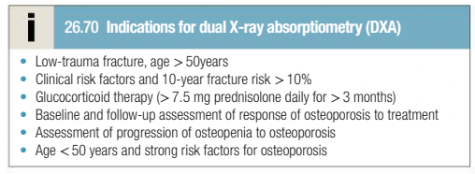

Slide 12
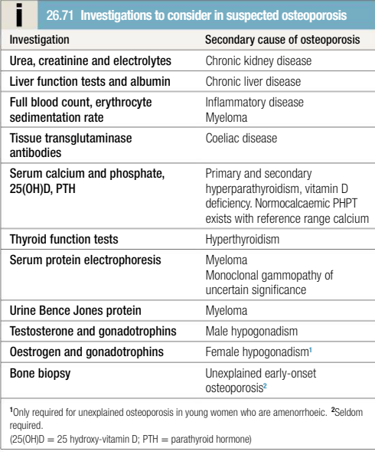

Slide 13
Management
The aim of treatment is to reduce the risk of fracture and this can be achieved by a combination of approaches.
Non-pharmacological interventions
Advice on smoking cessation, moderation of alcohol intake, adequate dietary calcium intake and exercise should be given.
Those with recurrent falls or unsteadiness on a ‘get up and go’ test should be referred to a multidisciplinary falls-prevention team. Hip protectors can reduce the risk of hip fracture in selected patients, but adherence is often poor

Slide 14
Pharmacological interventions
Bisphosphonates are the first-line treatment for osteoporosis. Following administration, they target bone surfaces and are ingested by osteoclasts during the process of bone resorption. The bisphosphonate is released within the osteoclast, causing cell death and thereby bone resorption. This in turn causes an increase in bone density, but this is principally due to increased mineralization of bone, rather than an increase in bone mass. Bisphosphonates reduce the risk of fractures in osteoporosis, but do not completely prevent the occurrence of fractures.
Oral bisphosphonates are typically given for a period of 5 years, at which point the need for continued therapy should be evaluated, with a repeat DXA if possible. If patients have remained free of fractures after 5 years and if BMD levels have increased and no longer remain in the osteoporotic range, it is usual to instigate a 5-year spell off therapy. Treatment may be continued for up to 10 years in patients whose BMD levels remain in the osteoporotic range after 5 years and in those with pre-existing vertebral fractures. A change in treatment should be considered in patients who have lost BMD despite oral bisphosphonates (more than 4% at any site). Most commonly, this will be a switch to parenteral zoledronic acid which is often given by annual infusion of 5 mg for 3 consecutive years follby a spell of 2 years without treatment. Infusions every 18 months over a spell of 6 years have also been found to be effective for fracture prevention. Oral bisphosphonates are poorly absorbed from the gastrointestinal tract and should be taken on an empty stomach with plain water; no

Slide 15
food should be eaten for 30–45 minutes after administration.
contraindicated in patients with oesophageal stricture or achalasia, since tablets may stick in the oesophagus, causing ulceration and perforation. Upper gastrointestinal upset occurs in about 5% of cases. Oral bisphosphonates can be used in patients with gastro-oesophageal reux disease, but may cause worsening of symptoms.
The most common adverse effect with intravenous bisphosphonates is a transient infuenza-like illness with fever, malaise, anorexia and generalised aches, which occurs 24–48 hours after administration. This is self-limiting, but can be treated with paracetamol or NSAIDs if necessary. It predominantly occurs after the first exposure and tolerance develops thereafter. Osteonecrosis of the jaw is characterised by the presence of necrotic bone in the mandible or maxilla, typically occurring after tooth extraction when the socket fails to heal. This complication is very rare in osteoporosis, but patients receiving bisphosphonates should be advised to pay attention to good oral hygiene.
There is no evidence that temporarily stopping bisphosphonates for tooth extraction alters the risk of osteonecrosis of the jaw. Atypical subtrochanteric fractures have been described in patients who have received long-term bisphosphonates and appear to be the result of over-suppression of normal bone remodelling. In the vast majority, the benets of bisphosphonate therapy far outweigh the risks, but it is important for treatment to be targeted to patients with low BMD who are most likely to benet.

Slide 16
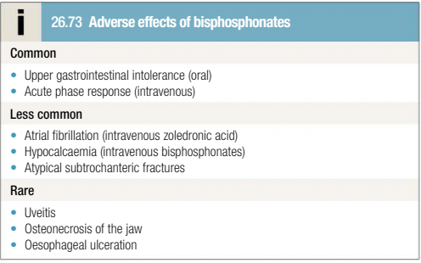

Slide 17
Denosumab
Denosumab is a monoclonal antibody that inhibits bone resorption by neutralising the effects of RANKL . It is administered by subcutaneous injection of 60 mg every 6 months in the treatment of osteoporosis and has similar effcacy to zoledronic acid.
adverse effect is hypocalcaemia, but this can be mitigated by calcium and vitamin D supplements. Denosumab may rarely cause osteonecrosis of the jaw and atypical subtrochanteric fractures. When denosumab is stopped, there is a rebound increase in bone turnover that can be associated with an increased risk of vertebral fracture and even hypercalcaemia. Because of this denosumab needs to be continued on a long-term basis; if it has to be stopped for any reason, bisphosphonate therapy should be given to inhibit the rebound increase in bone turnover.Calcium and vitamin D Combined calcium and vitamin D supplements have limited efcacy in the prevention of osteoporotic fractures when given alone, but are widely used as an adjunct to other treatments. A typical daily dosage is 1000 mg calcium and 800 IU vitamin D. Vitamin D supplements alone do not prevent fractures in osteoporosis, but there is evidence that the response to bisphosphonates is blunted in patients with vitamin D deciency. If the patient’s dietary calcium is sufcient, stand-alone vitamin D supplements (800 IU daily) can be prescribed as an adjunct to anti-osteoporosis therapies.
Calcitriol (1,25(OH)2D3), the active metabolite of vitamin D, is licensed or treatment of osteoporosis but it is seldom used because the data on fracture prevention are less robust than for other agents.

Slide 18
Teriparatide
1-34 fragment of human PTH. It is an effective treatment for osteoporosis, which works by stimulating new bone formation. Although TPTD also stimulates bone resorption, the increase in bone formation is greater, resulting in increased bone density, particularly at sites rich in trabecular bone such as the spine. It is given by a self-administered subcutaneous injection in a dose of 20 µg daily for 2 years. At the end of this period, bisphosphonate therapy or another inhibitor of bone resorption should be administered to maintain the increase in BMD. Oral bisphosphonates and TPTD should not be given in combination, however, since the bisphosphonate blunts the anabolic effect.
The efcacy of TPTD for prevention of non-vertebral fractures is similar to that of bisphosphonates, but it is superior to oral bisphosphonates in preventing vertebral fractures. The most common adverse effects are headache, muscle cramps and dizziness. Mild hypercalcaemia may occur, but it is usually asymptomatic and does not require discontinuation of treatment. Monitoring of serum calcium is not required during TPTD treatment.

Slide 19
Abaloparatide
1-34 fragment of PTH-related protein which has effects similar to those of TPTD. It is given as a self-administered injection of 80 μg daily for 18 months. At the end of this period an inhibitor of bone resorption should be given to maintain the increase in bone mass. Effcacy has been demonstrated for the prevention of vertebral fractures.

Slide 20
Romosozumab
This is a neutralising antibody to sclerostin, which is produced by osteocytes and acts to inhibit bone formation
Romosozumab is a highly effective treatment for osteoporosis and works by inhibiting bone resorption and stimulating bone formation.
It is indicated for the treatment of severe osteoporosis, where it is given by self-administered subcutaneous injection 210 mg once a month for 12 months. Following completion of treatment, an inhibitor of bone resorption should be given to maintain the increase in bone density.

Slide 21
Its more effective than oral alendronic acid at preventing fractures of all types and it is one of the most effective treatments for osteoporosis currently available.
Adverse effects are uncommon, although a slight excess of cardiovascular events was observed in some clinical trials and because of that it is contraindicated in patients with a previous history of myocardial infarction or stroke.

Slide 22
Hormone replacement therapy
Cyclical HRT with oestrogen and progestogen prevents post-menopausal bone loss and reduces the risk of vertebral and non-vertebral fractures in post-menopausal women.
It is primarily indicated for the prevention of osteoporosis in women with an early menopause and for treatment of women with osteoporosis in their early fifties who have troublesome menopausal symptoms.
It is not recommended above the age of 60 because of an increased risk of breast cancer, cardiovascular disease and venous thromboembolism.

Slide 23
Raloxifene
selective oestrogen receptor modulator (SERM) that acts as a partial agonist at oestrogen receptors in bone and liver, but as an antagonist in breast and endometrium. It is effective in reducing the risk of vertebral fractures, but does not influence the risk of non-vertebral fracture and is seldom used.
Adverse effects include muscle cramps, worsening of hot flushes and an increased risk of venous thromboembolism. Bazedoxifene is a related SERM that has similar effects to raloxifene.

Slide 24
Tibolone
Tibolone has partial agonist activity at oestrogen, progestogen and androgen receptors. It has been shown to prevent vertebral and non-vertebral fractures in post-menopausal osteoporosis. Treatment is associated with a slightly increased risk of stroke, but a reduced risk of breast cancer.

Slide 25
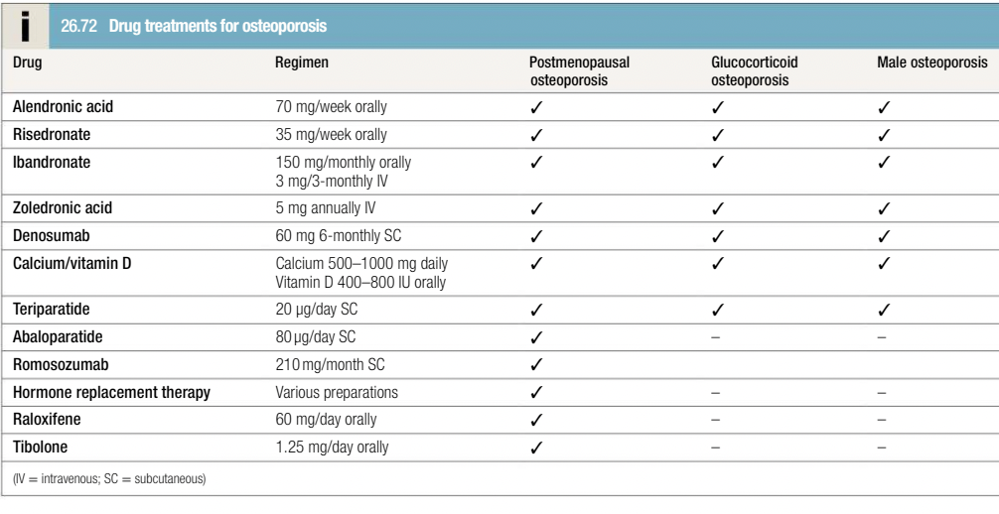

Slide 26
Surgery
to reduce and stabilise osteoporotic fractures. Patients with intracapsular fracture of the femoral neck generally need hemi-arthroplasty or total hip replacement in view of the high risk of osteonecrosis.
Vertebroplasty is sometimes used in the treatment of painful vertebral compression fractures. It involves injecting methyl methacrylate (MMA) into the affected vertebral body under sedation and local anaesthesia.
Randomised trials have not shown convincing evidence of benet as compared with a sham procedure.
Kyphoplasty is used under similar circumstances, but in this case a needle is introduced into the affected vertebral body and a balloon is inflated, which is then filled with MMA. It has similar efcacy to vertebroplasty. Serious adverse effects may occur with both procedures, including spinal cord compression due to leakage of MMA and fat embolism.

Slide 27
The end

