Slide 1
Covid 19
ا.م.د بيداء نجم عبيد
طب الاسرة والمجتمع

Slide 2
Definition
Coronaviruses are a large family of viruses that usually cause mild to moderate upper-respiratory tract illnesses, like the common cold. while more lethal varieties can cause SARS, MERS, and COVID-19. In cows and pigs they cause diarrhea, while in mice they cause hepatitis and encephalomyelitis.

Slide 3
Classification
Coronaviruses constitute
family Coronaviridae
subfamily Orthocoronavirinae
order Nidovirales They are divided into the four genera Alphacoronavirus, Betacoronavirus, Gammacoronavirus and Deltacoronavirus. Alphacoronaviruses and betacoronaviruses infect mammals, while gammacoronaviruses and deltacoronaviruses primarily infect birds

Slide 4
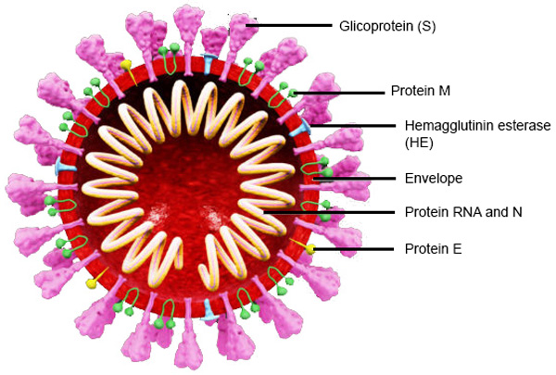
They are enveloped viruses with a positive-sense single-stranded RNA genome and a nucleocapsid of helical symmetry. The genome size of coronaviruses ranges from approximately
26 to 32 kilobases(largest
among RNA viruses)
They have characteristic
club-shaped spikes that
project from their surface
from which their name derives

Slide 5
Replication cycle
Infection begins when the viral spike protein attaches to its complementary host cell receptor.
-The virus enter the host cell by endocytosis or direct fusion of the viral envelope with the host membrane
-On entry into the host cell, the virus particle is uncoated, and its genome enters the cell cytoplasm. The coronavirus RNA genome has a 5′ methylated cap and a 3′ polyadenylated tail, which allows it to act like a messenger RNA and be directly translated by the host cell's ribosomes and involved in the replication and transcription of RNA.

Slide 6
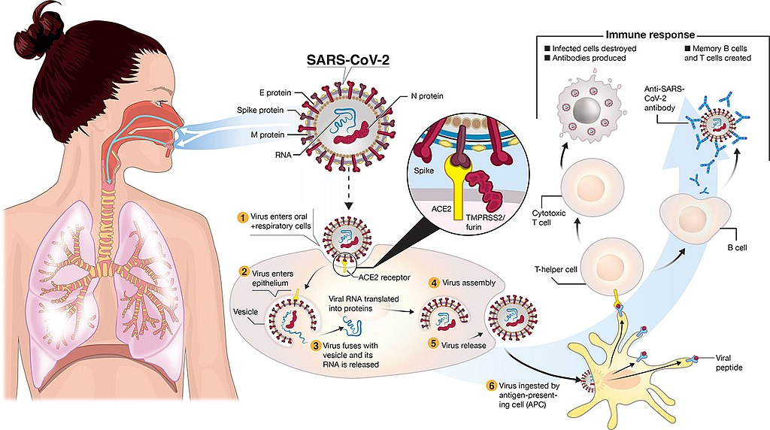

Slide 7
Infection in humans
Three human coronaviruses produce severe symptoms
Middle East respiratory syndrome-related coronavirus (MERS-CoV), β-CoV
Severe acute respiratory syndrome coronavirus (SARS-CoV), β-CoV
Severe acute respiratory syndrome coronavirus 2 (SARS-CoV-2), β-Co

Slide 8
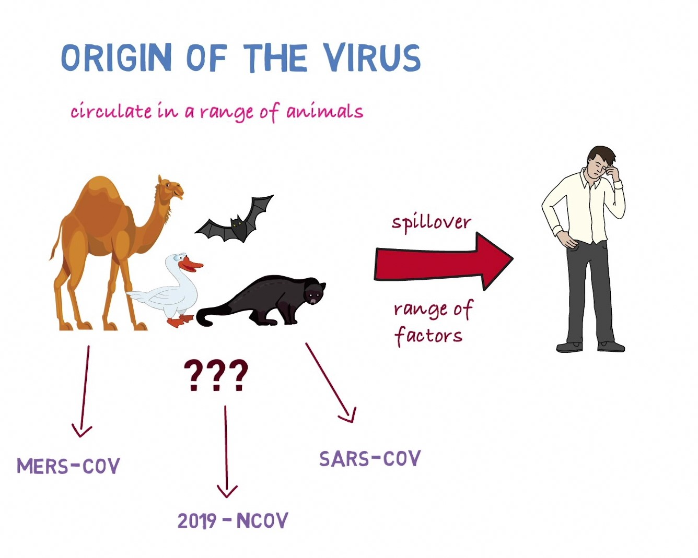

Slide 9
Characteristics of zoonotic coronavirus strainsMERS-CoV, SARS-CoV, SARS-CoV-2,and related diseases
 | MERS-CoV | SARS-CoV | SARS-CoV-2
Disease | MERS | SARS | COVID-19
Outbreaks | 2012, 2015, 2018 | 2002–2004 | 2019–2020 pandemic
Epidemiology
Date of first identified case | June 2012 | November 2002 | December 2019
Location of first identified case | Jeddah, Saudi Arabia | Shunde, China | Wuhan, China
Age average | 56 | 44 | 56
Symptoms
Fever | 98% | 99–100% | 87.9%
Dry cough | 47% | 29–75% | 67.7%
Dyspnea | 72% | 40-42% | 18.6%
Diarrhea | 26% | 20–25% | 3.7%
Sore throat | 21% | 13–25% | 13.9%
Ventilatory use | 24%[ | 24–20% | 4.1%

Slide 10
Severe acute respiratory syndrome (SARS)
(SARS) is a viral respiratory disease caused by SARS coronavirus (SARS-CoV), first identified at the end 2003 during an outbreak that emerged in China.
-airborne virus and can spread through small droplets of saliva in a similar way to the cold and influenza.
also spread indirectly via contaminated surfaces
-flu-like signs and symptoms — fever, chills, muscle aches, headache and occasionally diarrhea
-complicated cases may develop pneumonia, and breathing problems can become so severe that a mechanical respirator is needed. SARS is fatal in some cases, often due to respiratory failure. Other possible complications include heart and liver failure
-several types of vaccines for SARS, but none has been tested in humans

Slide 11
Middle East respiratory syndrome ((MERS
(MERS) is a viral respiratory disease caused by (MERS‐CoV) that was first identified in Saudi Arabia in 2012.
Typical MERS symptoms include fever, cough and shortness of breath. Pneumonia is common, but not always present.
Gastrointestinal symptoms, including diarrhea, have also been reported. Approximately 35% of reported patients with MERS-CoV infection have died.
camels are a major reservoir host for MERS-CoV
The virus does not seem to pass easily from person to person unless there is close contact, such as occurs when providing unprotected care to a patient..

Slide 12
Severe acute respiratory syndrome coronavirus 2 (SARS-CoV-2)
major health concern and can be worrying, especially for the elderly. COVID-19 is the disease caused by the SARS-CoV-2 virus.
Stage 1: Asymptomatic state (initial 1–2 days of infection)
The inhaled virus SARS-CoV-2 likely binds to epithelial cells in the nasal cavity and starts replicating. ACE2 is the main receptor for both SARS-CoV2 and SARS-CoV. In vitro data with SARS-CoV .
the ciliated cells are primary cells infected in the conducting airways There is local propagation of the virus but a limited innate immune response. At this stage the virus can be detected by nasal swabs. Although the viral burden may be low, these individuals are infectious. The RT-PCR value for the viral RNA might be useful to predict the viral load and the subsequent infectivity and clinical course. Perhaps super spreaders could be detected by these studies. the sample collection procedure would have to be standardised.
Nasal swabs might be more sensitive than throat swabs.

Slide 13
Stage 2: Upper airway and conducting airway response (next few days)
The virus propagates and migrates down the respiratory tract along the conducting airways. At this time, the disease COVID-19 is clinically manifest. Viral infected epithelial cells.
For about 80% of the infected patients, the disease will be mild and mostly restricted to the upper and conducting airways .These individuals may be monitored at home with conservative symptomatic therapy.

Slide 14
Stage 3: Hypoxia, ground glass infiltrates, and progression to ARDS
Unfortunately, about 20% of the infected patients will progress to stage 3 disease and will develop pulmonary infiltrates and some of these will develop very severe disease. Initial estimates of the fatality rate are around 2%, but this varies markedly with age .
The virus now reaches the gas exchange units of the lung and infects alveolar type II cells. Both SARS-CoV and influenza preferentially infect type II cells
The infected alveolar units tend to be peripheral and subpleural
large number of viral particles are released, and the cells undergo apoptosis and die.
The end result is likely a self-replicating pulmonary toxin as the released viral particles infect type II cells in adjacent units and the lung will likely lose most of their type II cells, and secondary pathway for epithelial regeneration will be triggered

Slide 15
pathology
The pathological result of SARS and COVID-19 is diffuse alveolar damage with fibrin rich hyaline membranes and a few multinucleated giant cells The aberrant wound healing may lead to more severe scarring and fibrosis than other forms of ARDS( Acute respiratory distress syndrome is a type of respiratory failure characterized by rapid onset of widespread inflammation in the lungs. Symptoms include shortness of breath (dyspnea), rapid breathing (tachypnea), and bluish skin coloration (cyanosis).
Recovery will require a vigorous innate and acquired immune response and epithelial regeneration.
Elderly individuals are particularly at risk because of their diminished immune response and reduced ability to repair the damaged epithelium. The elderly also have reduced mucociliary clearance, and this may allow the virus to spread to the gas exchange units of the lung more readily.

Slide 16
Prevention
Wash your hands. Clean your hands frequently with soap and hot water or use an alcohol-based hand rub containing at least 60% alcohol.
Wear disposable gloves. If you have contact with the person's body fluids or feces, wear disposable gloves. Throw the gloves away immediately after use and wash your hands thoroughly.
Wear a surgical mask. When you're in the same room as a person with SARS, cover your mouth and nose with a surgical mask. Wearing eyeglasses also may offer some protection.
Wash personal items. Use soap and hot water to wash the utensils, towels, bedding and clothing of someone with SARS.
Disinfect surfaces. Use a household disinfectant to clean any surfaces that may have been contaminated with sweat, saliva, mucus, vomit, stool or urine. Wear disposable gloves while you clean and throw the gloves away when you're done.

Slide 17
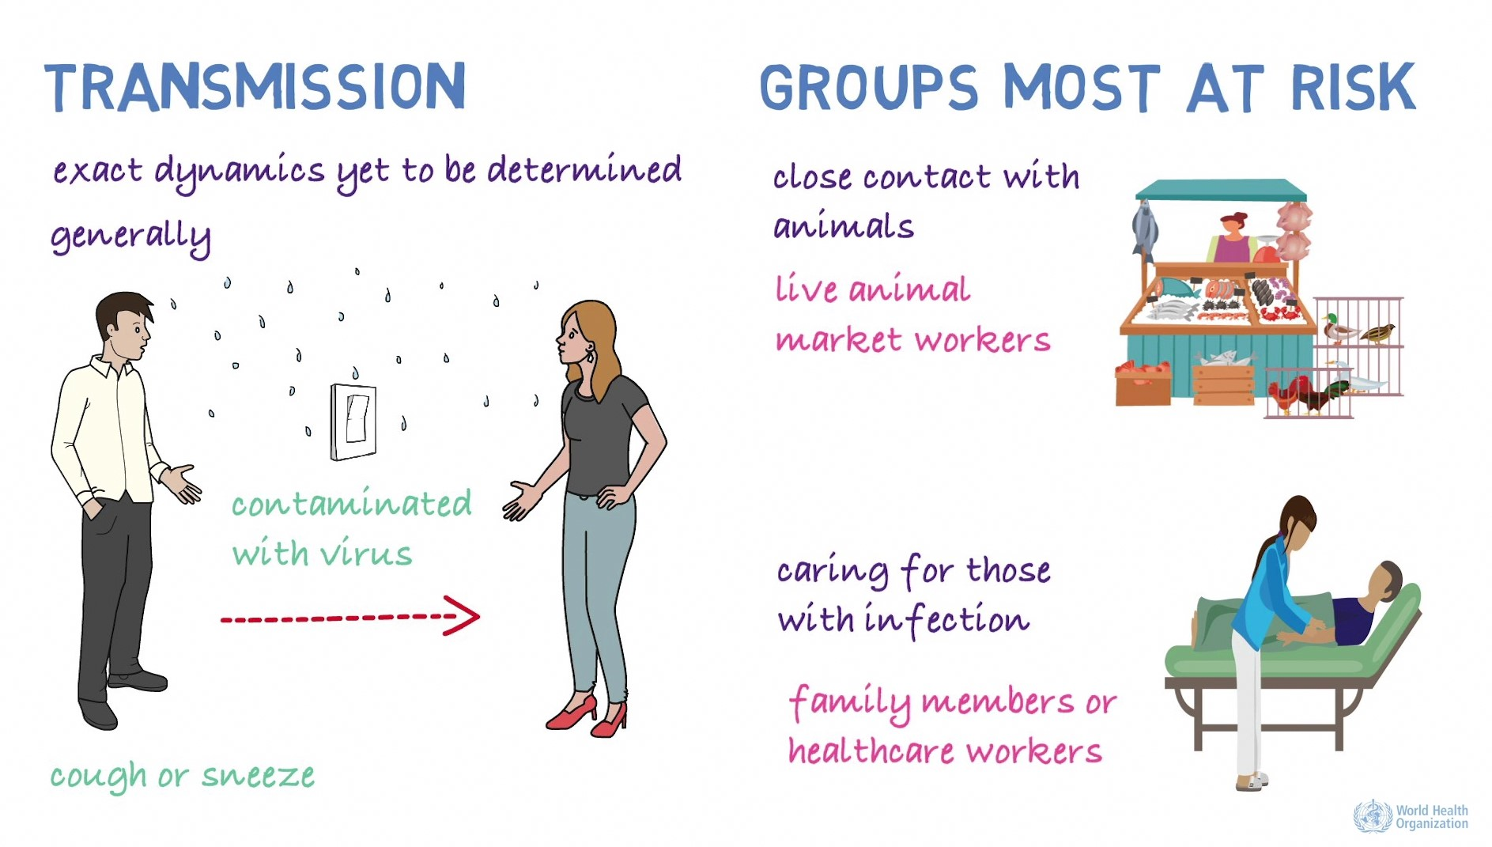

Slide 18
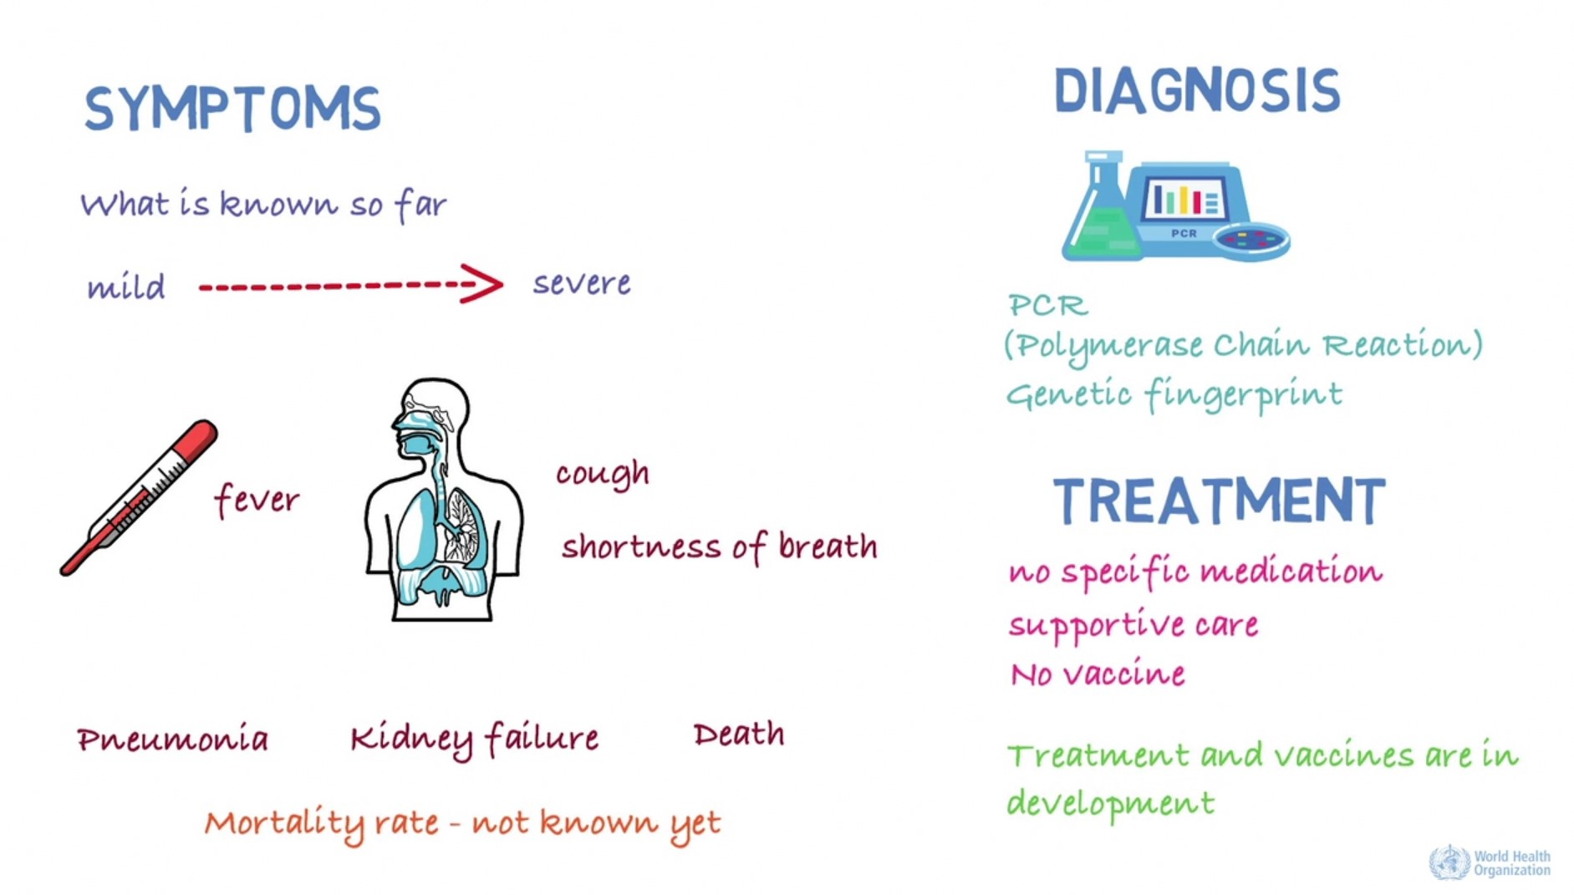

Slide 19
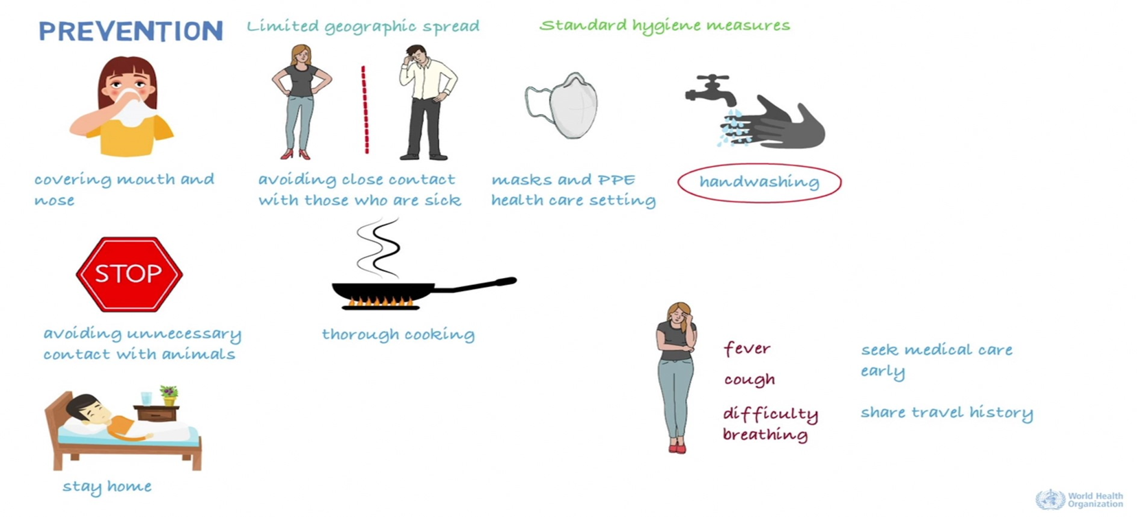

Slide 20
FOUR MAIN TYPES OF COVID-19 VACCINE
There are four categories of vaccines in clinical trials:
Whole VIRUS
PROTEIN SUBUNIT
VIRAL VECTOR
NUCLEIC ACID (RNA AND DNA).

Slide 21
Whole VIRUS VACCINE
Many conventional vaccines use whole viruses to trigger an immune response. There are two main approaches. Live attenuated vaccines
use a weakened form of the virus that can still replicate without causing illness, may risk causing disease in people with weak immune systems and often require careful cold storage, making their use more challenging in low-resource countries.
Inactivated vaccines
use viruses whose genetic material has been destroyed so they cannot replicate, but can still trigger an immune response.
can be given to people with compromised immune systems but might also need cold storage.

Slide 22
PROTEIN SUBUNIT Vaccine
Subunit vaccines use pieces of the pathogen - often fragments of protein - to trigger an immune response. Doing so minimises the risk of side effects, but it also means the immune response may be weaker.
This is why they often require adjuvants, to help boost the immune response.
An example of an existing subunit vaccine is the hepatitis B vaccine.

Slide 23
NUCLEIC ACID (RNA AND DNA).
Nucleic acid vaccines use genetic material – either RNA or DNA – to provide cells with the instructions to make the antigen. In the case of COVID-19, this is usually the viral spike protein. Once this genetic material gets into human cells, it uses our cells' protein factories to make the antigen that will trigger an immune response.
The advantages of such vaccines are that they are easy to make, and cheap. Since the antigen is produced inside our own cells and in large quantities, the immune reaction should be strong. A downside, however, is that so far, no DNA or RNA vaccines have been licensed for human use, which may cause more hurdles with regulatory approval. In addition, RNA vaccines need to be kept at ultra-cold temperatures, -70C or lower, which could prove challenging for countries that don’t have specialised cold storage equipment, particularly low- and middle-income countries

Slide 24
VIRAL VECTOR vaccine
Viral vector vaccines work by giving cells genetic instructions to produce antigens. But they differ from nucleic acid vaccines in that they use a harmless virus, different from the one the vaccine is targeting, to deliver these instructions into the cell. One type of virus that has often been used as a vector is adenovirus, which causes the common cold. As with nucleic acid vaccines, our own cellular machinery is hijacked to produce the antigen from those instructions, in order to trigger an immune response. Viral vector vaccines can mimic natural viral infection and should therefore trigger a strong immune response. However, since there is a chance that many people may have already been exposed to the viruses being used as vectors, some may be immune to it, making the vaccine less effective.

Slide 25
The big three - Pfizer/BioNtech, Moderna and Oxford/AstraZeneca
Pfizer and Moderna
have both developed RNA vaccines - a new approach that is incredibly quick to design.
They inject a tiny fragment of the virus's genetic code into the body, which starts producing part of the coronavirus and pushes the body to mount a defense.
The Oxford vaccine
is subtly different as it uses a harmless virus to carry the same genetic material into the body. This has been approved in the UK and Europe.
It is the easiest of the three to use as it can be stored in a fridge, rather than needing very cold temperatures.
All three are supposed to be given as two doses, but the UK is prioritising giving as many people as possible the first dose and delaying the second

Slide 26
