Slide 1
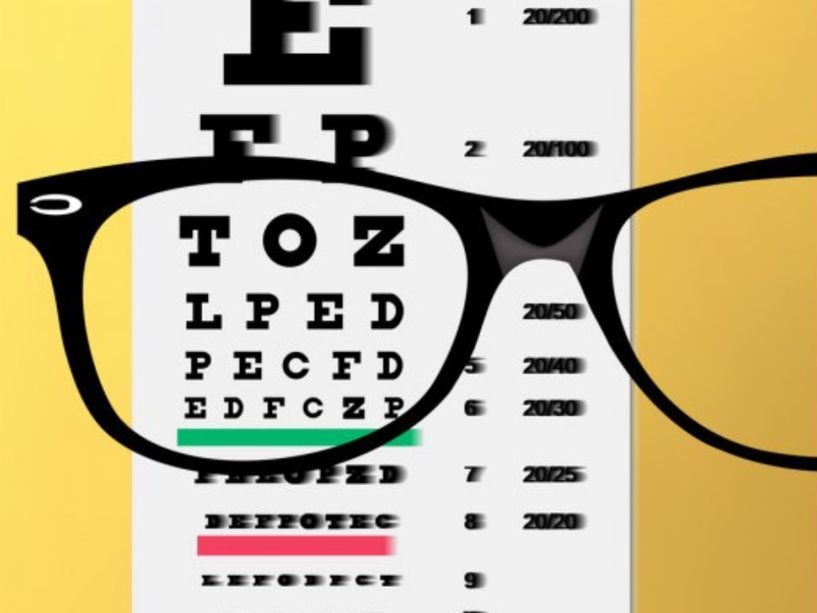
Vision loss
By Mohammed suhail AlSalam

Slide 2

Visual acuity measurement

Slide 3
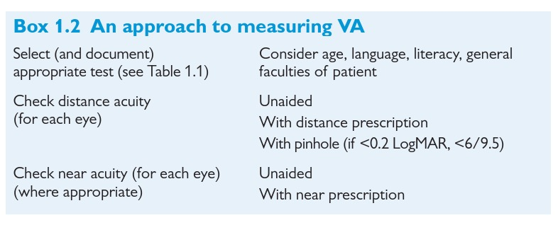
Visual acuity measurement
Acuity
Acuity

Slide 4




Slide 5

Visual acuity is recorded as:
Numerator
Denominator

Slide 6
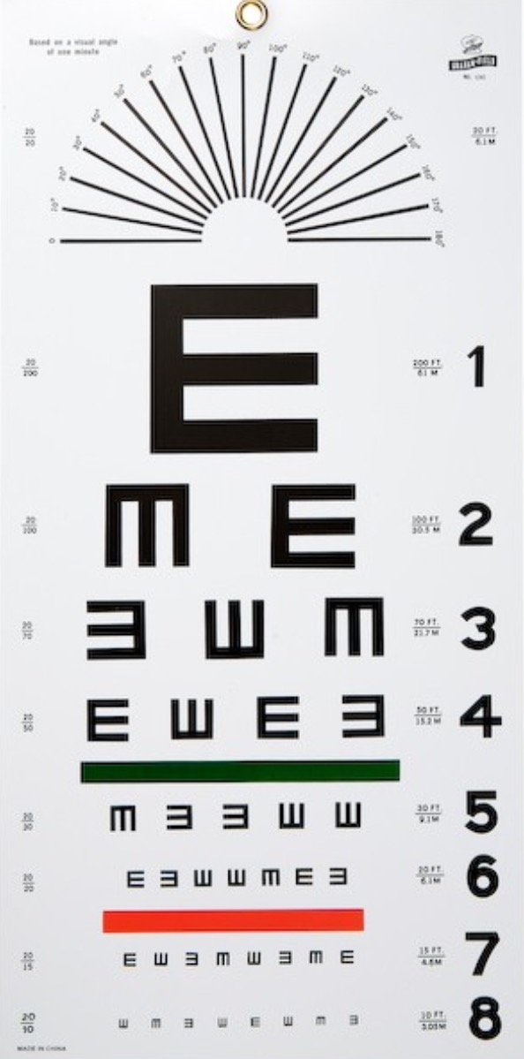
Distance between the patient and the chart
Visual acuity is recorded in :
Numerator
In METERS

Slide 7
Visual acuity is recorded in :
Denominator
The Smallest Raw seen

Slide 8
If the pat. can't see the largest symbol on the chart then:
bring the chart closer to the patient to 1 Meter
Counting Finger
Hand movements
light perception and projection

Slide 9
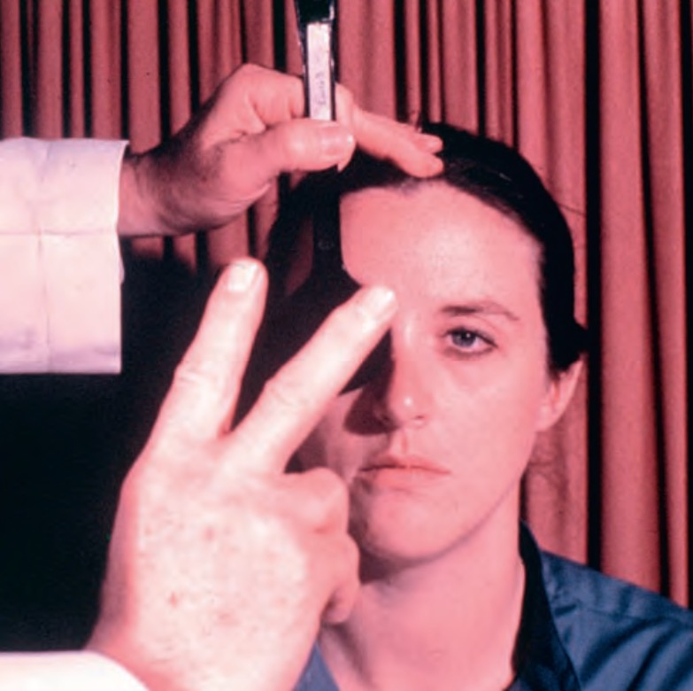
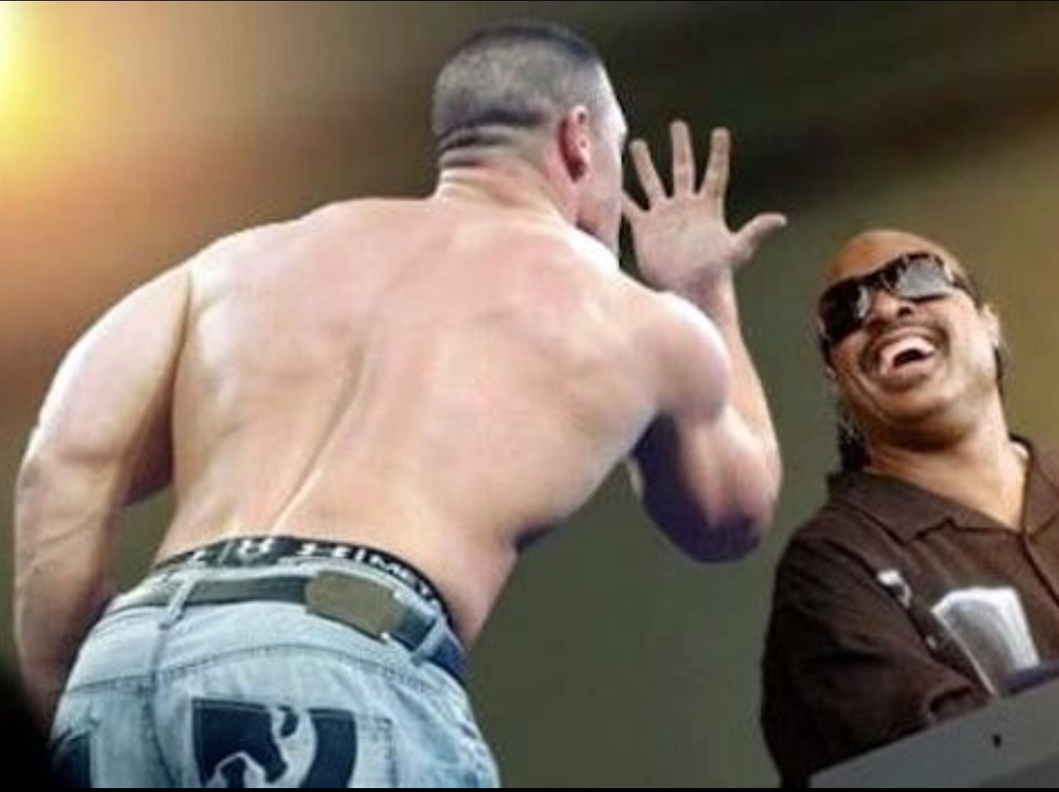
Counting Finger
How many fingers do I hold ??
Hand movements
Do you see anything moving ??

Slide 10


What do we mean by the followings :
The patient is placed 6 meters from the chart
V.A 6\60
The smallest symbol seen is 60

Slide 11

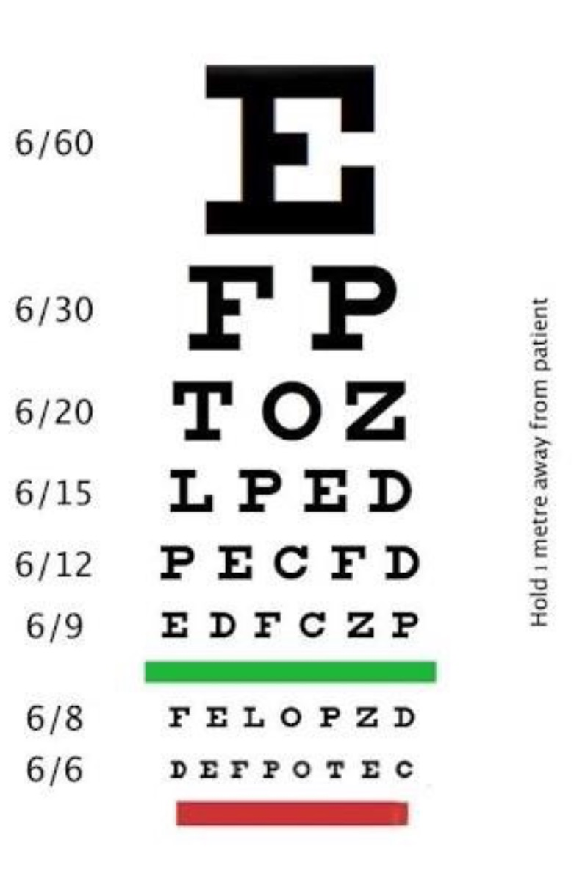
V.A 6\60

Slide 12
V.A 6\12

Slide 13
V.A
H.M 1M
The patient is only able to see Hand moving at one meter distance

Slide 14
Causes of visual loss
Sudden
Gradual

Slide 15
Causes of visual loss
Sudden
Painless
Painful
Vitreous haemorrhage
Central retinal artery occlusion
Central retinal vein occlusion
Retinal detachment
Acute angle closure glaucoma
Keratitis
Optic neuritis

Slide 16
Causes of visual loss
Gradual
Progressive Pterigium
Acquired Cataract
Diabetic maculopathy
Age related macular degeneration
Optic atrophy

Slide 17
References:
Kiniski clinical ophthalmology
Oxford handbook of ophthalmology

Slide 18
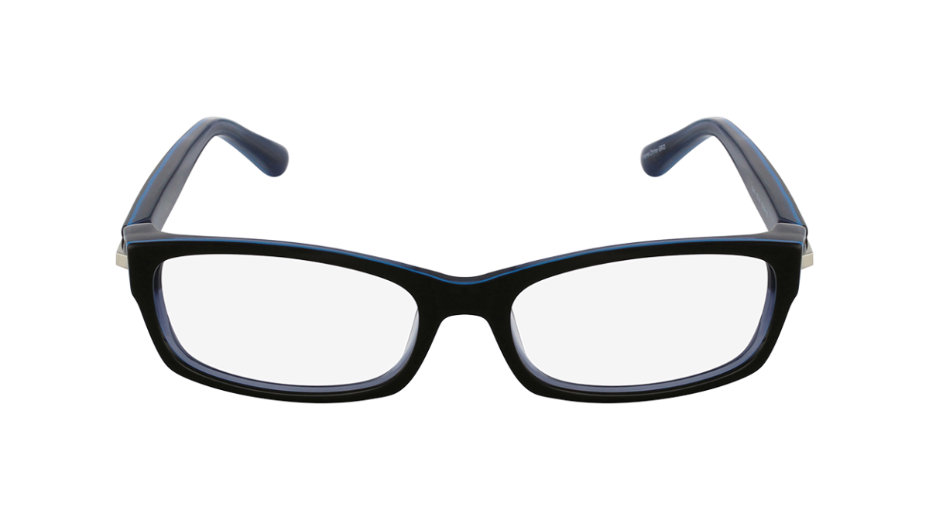

THANK YOU

