Slide 1

Epidemiology of Non-Communicable Diseases of the Respiratory System
Lecture for PhD Students of Community Medicine
Dr: Thiya k, Joda
Mbchb,AMC,FRACGP

Slide 2
Learning Objectives
Describe the global and regional burden of major respiratory NCDs
Interpret key epidemiological measures used in respiratory NCDs, including prevalence, incidence, mortality, case-fatality, DALYs, YLDs, and YLLs.
Analyse the contribution of major risk factors, particularly tobacco smoking, air pollution, biomass fuel exposure, and occupational hazards, to the development of respiratory NCDs.
Compare the main epidemiological study designs used in respiratory research and identify common sources of bias such as confounding, recall bias, and the healthy worker effect.
Evaluate strategies for the prevention and control of respiratory NCDs at the primary, secondary, and tertiary levels.

Slide 3
The Four Major Groups of Non-Communicable Diseases
Cardiovascular Diseases
Heart attack, hypertension, stroke
Cancers
Malignant neoplasms of various organs
Chronic Respiratory Diseases
COPD, asthma, occupational lung diseases, interstitial lung diseases, bronchiectesis
Diabetes
Mainly type 1 and type 2 diabetes mellitus
Together, these four groups account for more than 80% of premature deaths from
NCDs worldwide.

Slide 4
Introduction: Chronic Respiratory Diseases
Major Chronic Respiratory Diseases
  • Chronic obstructive pulmonary disease (COPD)
  • Asthma
  • Lung cancer
  • Occupational lung diseases
  • Interstitial lung diseases
  • Bronchiectasis and chronic airway disorders
Key Characteristics
  • Prolonged duration
  • Incomplete reversibility
  • Recurrent exacerbations
  • Interaction with environmental and behavioural risk factors
CRDs are one of the four principal groups of non-communicable diseases worldwide.

Slide 5
Global Burden of Disease: Key Measures
Epidemiological Measures
  • Prevalence
  • Incidence
  • Mortality rate
  • Case-fatality rate
  • DALYs (disability –adjusted life years)
  • YLDs (years lived with disease)
  • YLLs ( years of life lost)
Which Metric Best Captures Burden?
  • Asthma → high prevalence and morbidity
  • COPD → high mortality and DALYs
  • Lung cancer → high mortality and case-fatality
  • No single metric tells the whole story

Slide 6
Current Global Estimates of Major Respiratory NCDs
Disease | Estimated Global Prevalence | Annual Deaths | Major Burden
COPD | ~390 million | ~3.5 million | Mortality + DALYs
Asthma | ~350 million | ~455,000 | Morbidity + hospitalisation
Lung cancer | ~2.5 million new cases/year | ~1.8 million | High fatality
Occupational lung disease | Underestimated | Variable | Long latency
Asthma fills the prevalence column, COPD dominates mortality, and lung cancer, with rather ruthless efficiency, manages both.

Slide 7
Distribution of Respiratory NCDs by Income Group
Low- and Middle-Income Countries (LMICs)
  • >90% of premature COPD deaths occur in LMICs
  • Asthma mortality is higher because of underdiagnosis and limited access to inhaled therapy
  • Occupational lung disease is frequently underreported
  • Weak surveillance and limited healthcare access increase burden
High-Income Countries (HICs)
  • Asthma prevalence is often higher
  • Earlier diagnosis and better access to inhaled therapy reduce mortality
  • Occupational disease is more likely to be recognised and reported
  • Better surveillance systems provide more accurate estimates
The burden does not simply follow where disease is most common. It follows where diagnosis, treatment, and surveillance are least available.

Slide 8
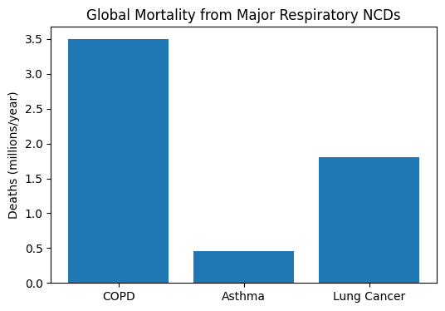
Global Burden of Disease

Slide 9
Epidemiologic Transition and Respiratory NCDs
Decline of infectious
respiratory disease
Increase in tobacco use
and industrialisation
Urbanisation and
air pollution
Population ageing
Coexistence of communicable
and non-communicable disease
Iraq and Other LMICs: An Incomplete Transition
  • Tuberculosis and recurrent respiratory infections still coexist with COPD and asthma
  • Smoking, war-related dust exposure, traffic pollution, and occupational hazards overlap
  • Several risk factors may occur in the same patient at the same time
In many low- and middle-income countries, the epidemiologic transition is less a neat sequence and more a rather untidy pile-up.

Slide 10
Air Pollution and Respiratory NCDs: Outdoor Air Pollution
Important Pollutants
  • PM2.5
  • PM10
  • Nitrogen dioxide
  • Sulfur dioxide
  • Ozone
Associated Health Effects
  • COPD exacerbation
  • Asthma attacks
  • Reduced lung function
  • Lung cancer
  • Increased mortality
→
Outdoor air pollution is one of the few risk factors that affects nearly everyone, whether they agreed to the exposure or not. The lungs, predictably, were not consulted.

Slide 11
Occupational Respiratory Disease
High-risk occupations include:
Mining
Construction
Cement industry
Oil and gas
Agriculture

Slide 12
Indoor Air Pollution and Respiratory NCDs
Major Sources in Low-Income Settings
  • Biomass fuel
  • Poor ventilation
  • Tobacco smoke
  • Generator fumes
Who Is Most Exposed?
  • Women and children
  • Households using indoor cooking fires
  • Homes with poor ventilation
  • Families relying on generators during electricity shortages
Indoor air pollution is often invisible in statistics because it happens quietly at home—which, inconveniently, is where people spend most of their lives.

Slide 13
Occupational Respiratory Diseases
Major Occupational Conditions
  • Pneumoconiosis
  • Silicosis
  • Asbestosis
  • Occupational asthma
  • Coal worker’s pneumoconiosis
  • Chronic chemical inhalation injury
Most occupational lung diseases appear only after years of exposure. The workplace keeps the receipt, even when the lungs have long since forgotten where the dust came from.

Slide 14
Epidemiological Challenges in Occupational Respiratory Disease
Major Challenges
  • Long latency periods
  • Healthy worker effect
  • Exposure misclassification
  • Underreporting
Healthy Worker Effect
  Workers healthy enough to remain employed may make a hazardous workplace appear safer than it truly is.
  As a result, occupational studies may underestimate the real risk.
A factory may look harmless on paper simply because the sickest workers have already left it. Epidemiology, annoyingly, notices these things.

Slide 15
Study Designs in Respiratory Epidemiology
Design | Use | Limitation
Cross-sectional | Prevalence | No temporality
Case-control | Rare disease | Recall bias
Cohort | Exposure-outcome | Expensive
Time-series | Air pollution | Seasonal confounding

Slide 16
Important Biases in Respiratory Epidemiology
Common Sources of Bias
  • Selection bias
  • Recall bias
  • Survival bias
  • Confounding
  • Healthy worker effect
  • Misclassification bias
Bias rarely announces itself politely. It usually slips into a study quietly, then spends the next ten pages pretending the results were its idea.

Slide 17
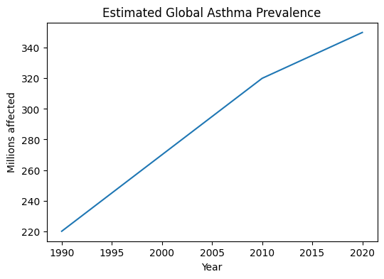
Asthma Epidemiology

Slide 18
Asthma Epidemiology
Epidemiologic Characteristics
  • Commonest chronic disease in children
  • High prevalence in urban areas
  • Increasing prevalence in many countries over the last 30 years
  • Considerable geographic variation
Asthma is common, especially in children and cities. The puzzle is not whether it exists, but why some places seem determined to collect more of it than others.

Slide 19
Important Epidemiologic Hypotheses in Asthma
Hygiene Hypothesis
  Reduced exposure to microbes in early childhood may increase allergic sensitisation and asthma.
Urbanisation Hypothesis
  Urban residence, pollution, traffic density, housing quality, and sedentary indoor lifestyles may contribute.
Gene–Environment Interaction
  Genetic susceptibility interacts with allergens, viral infections, tobacco smoke, and pollution.
None of these hypotheses explains asthma completely. Asthma, inconveniently, prefers to behave like several diseases wearing the same name tag.

Slide 20
Asthma and Social Inequality
Factors in Deprived Populations
  • Overcrowding
  • Poor housing
  • Indoor smoke exposure
  • Reduced access to medication
Consequences
  • Worse asthma outcomes
  • More frequent hospitalisation
  • Higher mortality
  • Greater long-term disability
Asthma is not distributed equally. Poverty has a habit of turning an ordinary disease into a much harsher one.

Slide 21
COPD Epidemiology
Most common after age 40 years
Smoking explains >70% of COPD in many countries
More than 90% of premature COPD deaths occur in LMICs
Biomass fuel and occupational exposure remain important in Iraq and the Middle East

Slide 22
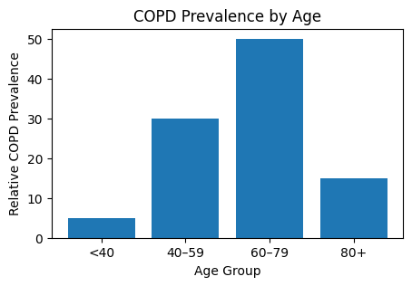
COPD Epidemiology: Descriptive Features
Key Epidemiologic Features
  • Most common after age 40 years
  • Historically more common in men
  • Gender gap is narrowing because smoking among women has increased
  • Higher prevalence in smokers and workers exposed to dust or fumes
COPD remains closely linked to smoking and occupational exposure—two habits the lungs continue to object to with remarkable consistency.

Slide 23
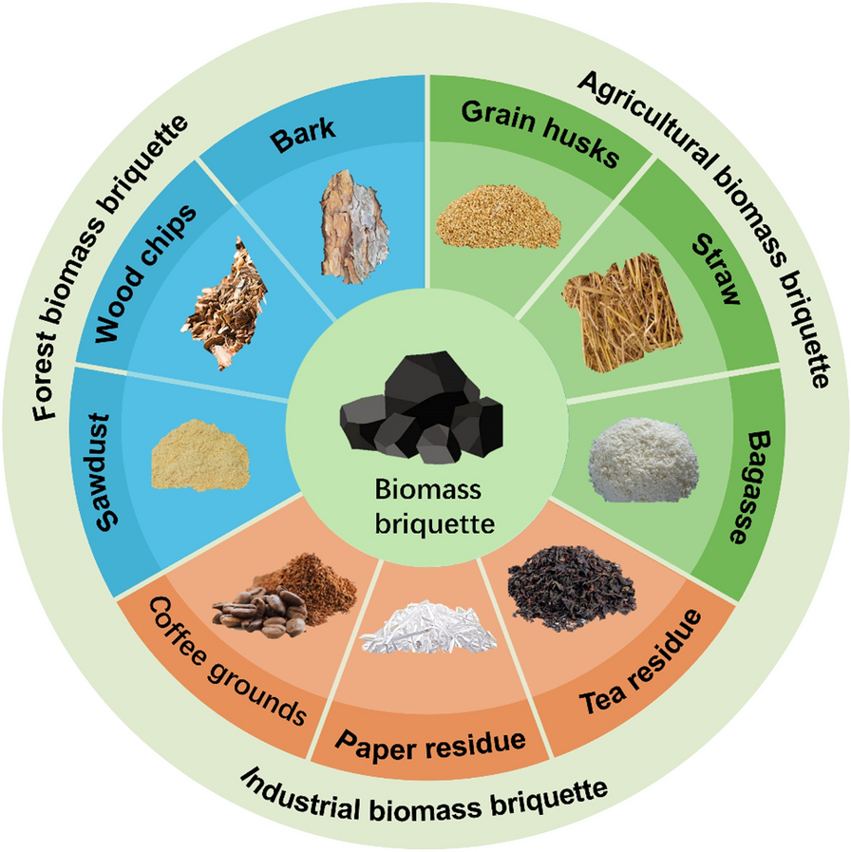
Biomass fuel

Slide 24
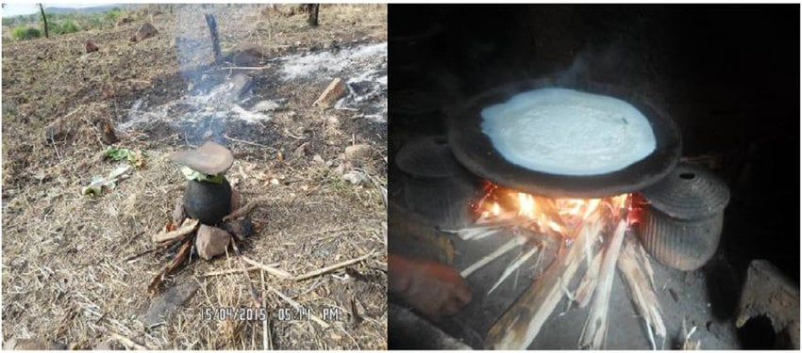
Agriculture biomass

Slide 25
Causal Pathway of COPD
Smoking/pollution
Chronic inflammation
Airflow limitation
Disability/Mortality

Slide 26
COPD: Major Risk Factors
Modifiable Risk Factors
  • Tobacco smoking
  • Indoor biomass fuel exposure
  • Occupational dust and chemicals
  • Outdoor air pollution
  • Poor socioeconomic status
Non-modifiable Risk Factors
  • Age
  • Genetic predisposition (e.g. alpha-1 antitrypsin deficiency)
  • Early-life lung growth impairment
Some risk factors can be changed; others arrive uninvited and stay. Epidemiology spends much of its time trying to separate the two.

Slide 27
COPD: Attributable Risk and Conceptual Causal Pathway
Population attributable fraction for smoking in COPD exceeds 70% in many high-income countries. In Middle Eastern and South Asian populations, indoor biomass exposure and occupational dusts also contribute substantially.
Smoking /
Biomass /
Occupational Exposure
Chronic Airway
Inflammation
Airflow
Limitation
Disability,
Exacerbations,
Mortality
→
→
→
COPD rarely appears from nowhere. It usually arrives after years of exposure, quietly collecting damage before it finally introduces itself.

Slide 28
Lung Cancer Epidemiology
Key Features
• One of the leading causes of cancer death worldwide
• About 2.5 million new cases and 1.8 million deaths each year
• Strongly associated with cigarette smoking and passive smoking
• Other risk factors: air pollution, asbestos, silica, diesel exhaust, and radon
• More common after age 50–60 years
• Mortality is high because diagnosis is often late

Slide 29
Pneumoconiosis
Major Types and Features
• Silicosis
• Coal worker’s pneumoconiosis
• Asbestosis
• Caused by long-term inhalation of mineral dust
• Leads to progressive fibrosis, chronic breathlessness, disability, and increased mortality

Slide 30
Silicosis
High-Risk Occupations
• Mining
• Construction
• Stone cutting
• Sandblasting
• Cement and quarry work
Important Features
• Caused by inhalation of crystalline silica dust
• May progress even after exposure stops
• Increases risk of COPD, tuberculosis, and lung cancer
• Frequently underdiagnosed in developing countries

Slide 31
Respiratory NCDs in Iraq and the Middle East
Regional determinants:
Smoking and waterpipe use
Dust storms and traffic pollution
Generator emissions
Occupational exposure in oil, cement and construction sectors
Limitation of spirometry availability.

Slide 32
Prevention and control
Primary Prevention
Tobacco control policies
Air quality regulation
Occupational safety measures
Vaccination against influenza and pneumococcal disease
Public health education

Slide 33
Secondary Prevention:
Early detection by spirometry
Screening of occupationally exposed workers
Risk-factor surveillance

Slide 34
Tertiary prevention:
Pulmonary rehabilitation
Long-term treatment adherence
Prevention of exacerbations
Community-based chronic disease management

Slide 35
Key References
World Health Organization. Chronic respiratory diseases. Geneva: WHO; 2025.
Global Burden of Disease Study 2023. Global, regional, and national burden of chronic respiratory diseases. Lancet Respir Med. 2025.
Murray CJL, Lopez AD. The global burden of disease. Cambridge (MA): Harvard University Press; 1996.
Burney P, Patel J, Newson R, Minelli C, Naghavi M. Global and regional trends in COPD mortality. Eur Respir J. 2024.
Asher MI, Rutter CE, Bissell K, et al. Worldwide trends in asthma prevalence. Lancet. 2024.
Checkoway H, Pearce N, Kriebel D. Research methods in occupational epidemiology. 2nd ed. New York: Oxford University Press; 2004.
Gordis L. Epidemiology. 6th ed. Philadelphia: Elsevier; 2020.
World Bank. Air pollution and health in the Middle East and North Africa. Washington DC: World Bank; 2024.

