Slide 1
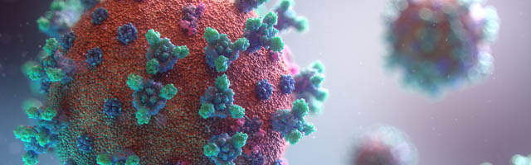
1
Emerging and Re-emerging Infectious Diseases
Dr. Dheyaa Jouda,
MBChB, AMC, FRACGP Aus.
Family & Community Medicine

Slide 2
2
Learning Objectives
Define emerging and re-emerging infectious diseases
Recognize recent examples of emerging diseases
Identify epidemiologic factors contributing to emergence
Understand surveillance, prevention, and control strategies

Slide 3
3
Why Emerging Diseases Matter
Disease burden is enormous
Cause mortality, disability, and economic loss
May result in widespread epidemics and pandemics
Disrupt international trade and development

Slide 4
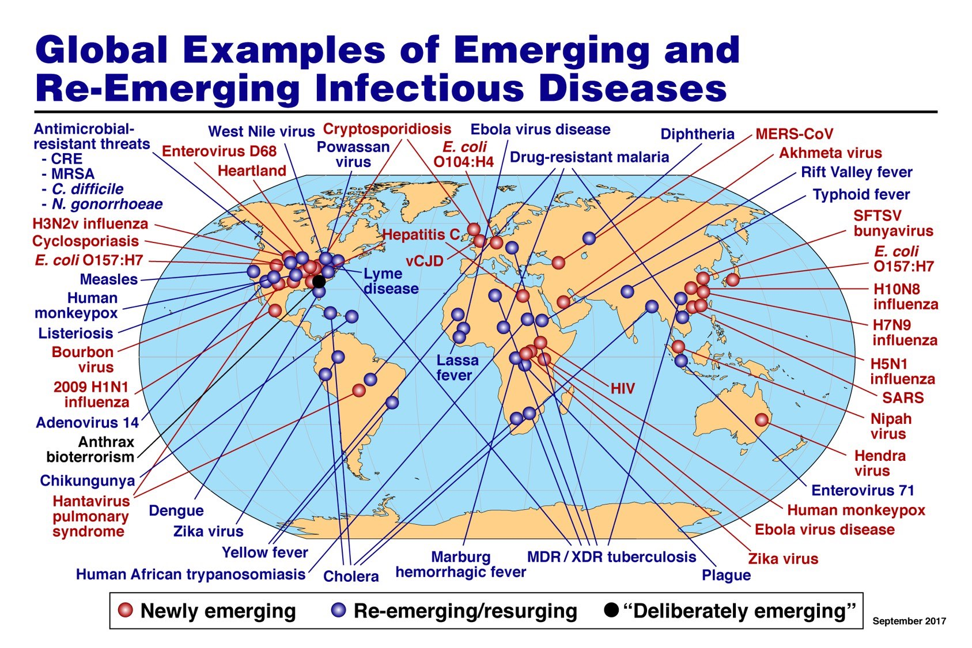
Global Map of Emerging Diseases

Slide 5
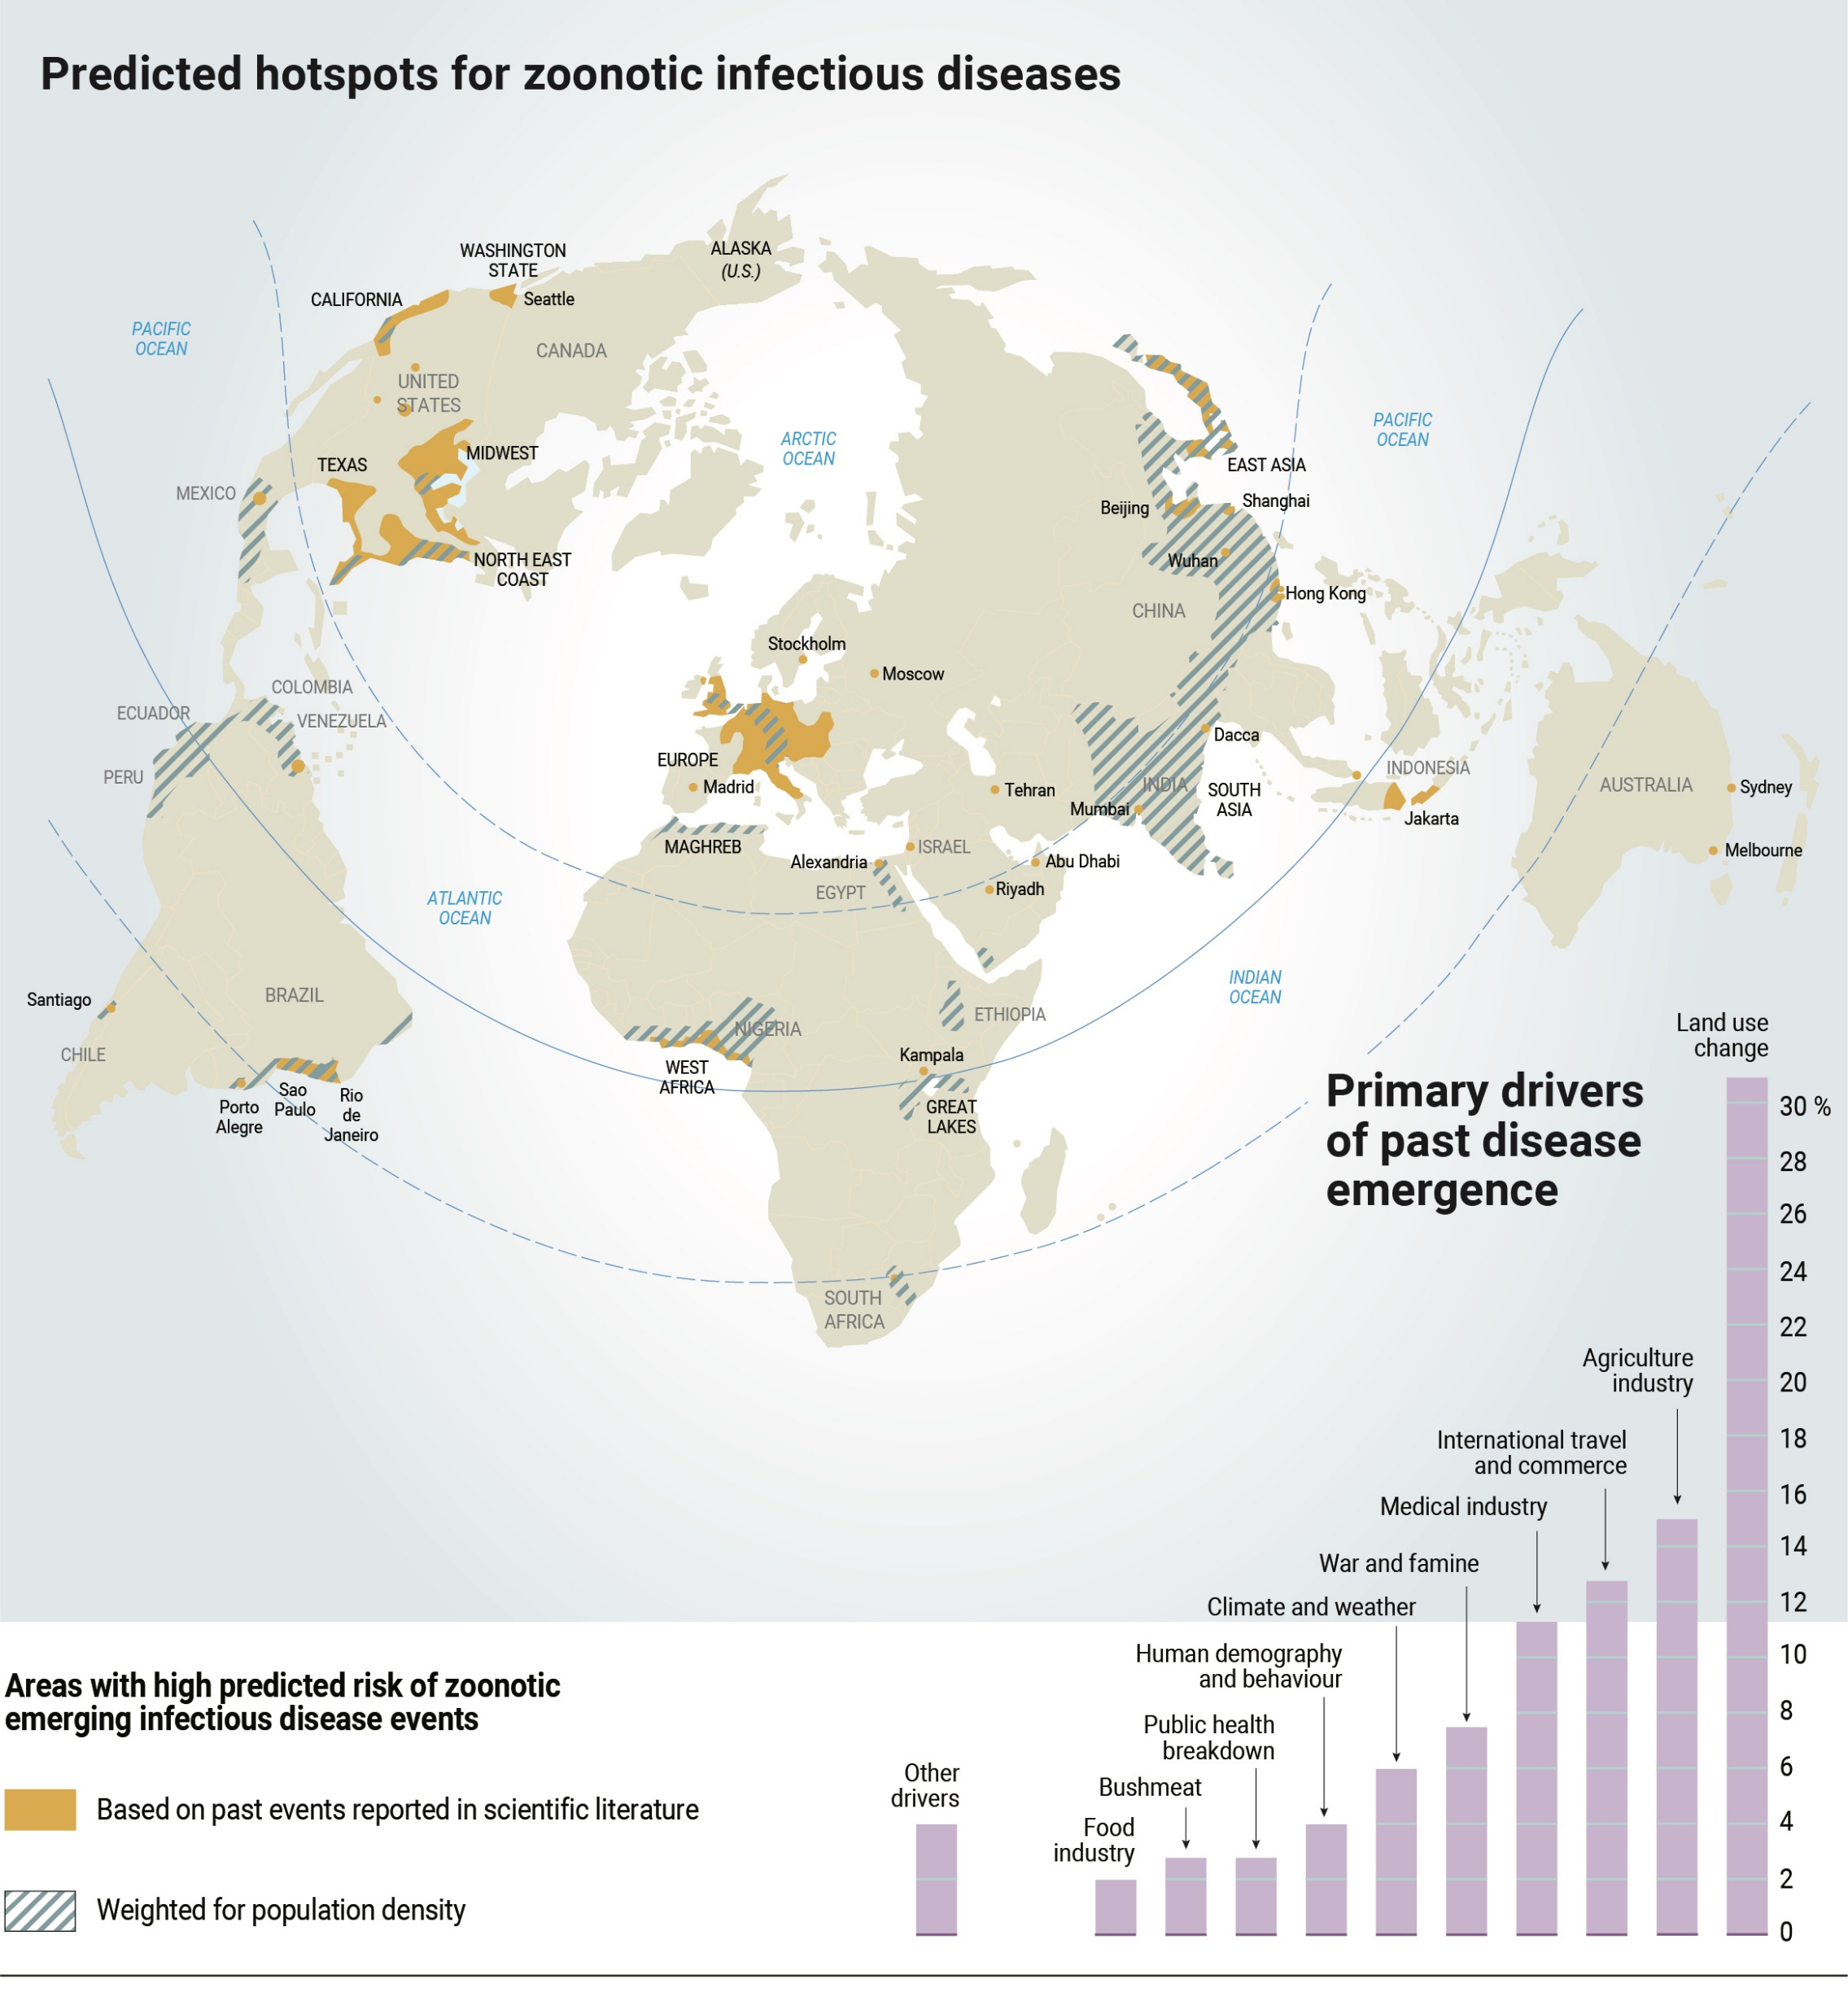
Hotspots: Africa, Asia, Middle East
Link to biodiversity + human activity

Slide 6
4
Definitions
Emerging disease: a newly recognized disease or a known disease increasing rapidly in incidence or geographic range
Re-emerging disease: a previously controlled disease that has returned as a major public health problem

Slide 7
5
Examples Through Time
1981: HIV
2003: SARS
2009: H1N1 influenza
2012: MERS
2014: Ebola outbreak in West Africa
2019: COVID-19
2022: Mpox resurgence

Slide 8
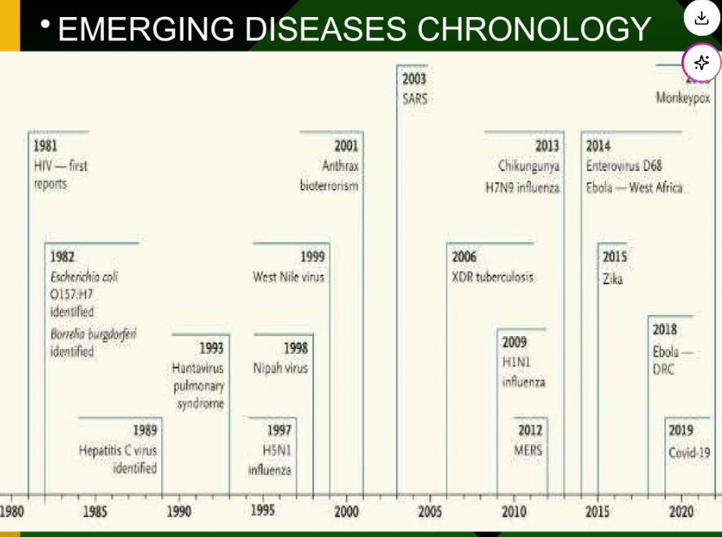

Slide 9
6
Major Factors Contributing to Emergence
Microbial mutation and adaptation
Antimicrobial resistance
Zoonotic spillover from animals
Urbanization, overcrowding, and poor sanitation
International travel and migration
Climate change and vector spread

Slide 10
7
Agent Factors
Increased virulence and infectivity
Development of drug resistance
Mutation and strain variation
Iatrogenic and hospital-acquired transmission
Resistance of vectors to pesticides

Slide 11
8
Host and Environmental Factors
Unsafe sexual practices and behavioral changes
Human migration and travel
Immunosuppression and increased susceptibility
Poverty, war, displacement, and breakdown of public health systems
Overcrowding, inadequate housing, and unsafe water

Slide 12
9
Transmission of Communicable Diseases
Direct transmission: person-to-person contact
Indirect transmission: via vectors, food, water, or fomites
Outcome depends on pathogen factors and host immunity

Slide 13
10
Antibiotic Resistance
Emerges because of inappropriate antibiotic use
Enhanced by poor adherence, counterfeit drugs, and misuse in animals
Requires antibiotic stewardship and infection control

Slide 14
11
Control of Emerging and Re-emerging Diseases
Control the reservoir
Interrupt transmission
Protect susceptible hosts through vaccination
Strengthen surveillance systems
Support research, diagnostics, and new control measures

Slide 15
12
Role of Doctors
Educate the public
Promote multidisciplinary teamwork
Support legislation and infection-control policies
Participate in research and public health advocacy

Slide 16
13
Role of Public Health Authorities and WHO
Develop national prevention programs
Improve community awareness
Report cases rapidly
Coordinate global and regional responses
Support funding, surveillance, and task forces

Slide 17
14
Solutions
Migration → screening and vaccination
Travel → immunization and infection-control measures
Urbanization → sanitation and adequate housing
Human behavior → education and behavior change
Antibiotic misuse → rational prescribing

Slide 18
What is an Outbreak?
Increase in cases above expected level
Depends on population, place, and time
Example: Food poisoning cluster vs seasonal flu
Single case of eradicated disease = outbreak

Slide 19
Reasons to Investigate an Outbreak
Identify and eliminate source
Prevent future outbreaks
Evaluate prevention strategies
Learn about diseases
Address public concern
Professional responsibility

Slide 20
When to Investigate
Severity of illness
Transmissibility
Unanswered questions
Ongoing exposure
Public concern

Slide 21
Environmental Investigation
Vital part of outbreak investigation
Includes food, water, environment
Should complement epidemiology, not replace it

Slide 22
Environmental Sampling
Guided by epidemiologic findings
Often done simultaneously
Results can be misleading
Interpret cautiously

Slide 23
Principles of Investigation
Be systematic
Use case definitions
Ask consistent questions
Reassess frequently
Coordinate with teams

Slide 24
10 Steps of Outbreak Investigation
1. Identify team
2. Establish outbreak
3. Verify diagnosis
4. Case definition
5. Find cases
6. Descriptive epidemiology
7. Test hypotheses
8. Control measures
9. Communicate
10. Surveillance

Slide 25
Verify Diagnosis
Obtain medical records
Review lab results
Rule out errors
Consult specialists if needed

Slide 26
Case Definition
Person: clinical features
Place: location
Time: period
Standardized criteria for cases

Slide 27
Line Listing
Clinical information
Demographics
Exposure history
Summarizes outbreak data

Slide 28
Descriptive Epidemiology
Analyze person, place, time
Identify patterns
Generate hypotheses

Slide 29
Epidemic Curves
Graph of cases over time
Point source vs propagated
Helps identify exposure type

Slide 30
Final Summary
Systematic and structured process
Multidisciplinary teamwork
Focus on control and prevention
Protect population health

Slide 31
Step 7: Evaluate Hypotheses
Perform additional studies if needed
Types: Cohort, Case-control
Compare exposures among ill and non-ill

Slide 32
Additional Studies
Cohort studies
Case-control studies
Assess exposures in ill vs non-ill

Slide 33
Cohort Studies
Include all exposed individuals
Use when full list available
Measure: Relative Risk (RR)

Slide 34
Relative Risk (RR)
RR = 1 → no difference
RR > 1 → higher risk in exposed
RR < 1 → lower risk in exposed

Slide 35
Case-Control Studies
Compare cases vs controls
Used when full list unavailable
Measure: Odds Ratio (OR)

Slide 36
Odds Ratio (OR)
OR = 1 → no association
OR > 1 → higher exposure in cases
OR < 1 → lower exposure in cases

Slide 37
Step 8: Control Measures
Isolation, cohorting, product recall
Can occur at any stage
Guided by epidemiology

Slide 38
Step 9: Communication
Inform public and media
Address public concerns
Use clear communication strategy

Slide 39
Step 10: Surveillance
Ensure outbreak is over
Monitor effectiveness of control
Prevent recurrence

Slide 40
Conclusion
Epidemiologic investigation identifies source
Be systematic
Follow structured steps

Slide 41
15
Key Takeaways
Most emerging diseases are zoonotic
Human activity drives emergence
Early surveillance is essential
Global cooperation is necessary to prevent future epidemics

Slide 42


