Slide 1


Ministry of higher education and scientific research / Iraq
Al-Mustansiriya University –Collage of Medicine

Slide 2

Obstetrical Care
Presented by:
Dr.Duaa Ali
AlMustansiryiah University- Collage of Medicine

Slide 3
Title
Obstertical Care
Designed for:
Medical students-Forth grade
Presented by:
Dr.Duaa Ali

Slide 4
Methods and activities
Active learning- brainstorming –Discussions-Flipped classroom-Feedbackِ
Tools
Display screen –computer-Educational platforms and tools
Prepared by
Dr.Duaa Ali
Prepared by : Dr. Duaa Ali

Slide 5
Lecture content: 1 hours
Introduction to Obstetrical care 5 min
Objective 5 min
Levels of care 10 min
Time of visits 10 min
Schedule of vaccine and investigations 15 min
Danger sign and referral 10 min
Discussions 5 min

Slide 6

Objectives:
At the end of the lecture ,the students may be able :
To remember the definition of obstetrical care.
To understand the differences between levels.
To Know the importance of routinely visits and essentials investigations .
To assess the danger sign if occur.
To deal with the complications .

Slide 7

Obstetrical Care

Slide 8

Obstetrical care in PHC
Is the integrated health supervision for the pregnant woman and the mother to provide protection and care and to promote the health of the mother, the fetus, and the newborn child.
It focuses on ensuring maternal and fetal well-being through standardized medical practices across different healthcare settings.
t includes the provision of health care for pregnant women at different health levels.

Slide 9
Objectives:
To improve the quality of antenatal care services.
To reduce maternal and fetal morbidity and mortality.
To ensure early detection of pregnancy-related complications.
To provide evidence-based care throughout pregnancy.

Slide 10

Pregnancy care is provided across different levels depending on the risk status

Slide 11
Levels of care For pregnant women
Secondary
(Hospital)
Tertiary
(High risk )
Primary
(PHC)

Slide 12
Primary Care Level:
Routine antenatal visits .
Basic screening (Blood group RH , blood pressure, urine test, weight, BMI, Virology , VDRL) .
Nutritional counseling .
Iron and folic acid supplementation .
Health education .

Slide 13
Secondary Care Level:
Management of moderate-risk pregnancies .
Ultrasound examinations .
Laboratory investigations .
Referral system coordination.

Slide 14
Tertiary Care Level:
Management of high-risk pregnancies .
Specialized obstetric care .
Intensive monitoring .
Surgical interventions if needed .

Slide 15
Antenatal Care Visits
1st visit | Before 12 weeks
2nd visit | 18 weeks
3th visit | 24 weeks
4th visit | 28 weeks
5th visit | 32 weeks
6th visit | 36 weeks
7th visit | 38 weeks
8Th visit | 40 weeks

Slide 16
First Visit (Before 12 Weeks) – Booking Visit
This is the most important visit in early pregnancy.
Main components:
Confirmation of pregnancy .
Full medical and obstetrical history.
Family history.
Calculation of gestational age (based on LMP)
Ultrasound between(10-14 weeks).
General physical examination:
  Blood pressure
  Weight
Laboratory investigations:
  Complete Blood Count (CBC)
  Blood group and Rh factor
  Urine analysis
  Blood glucose test
Start folic acid supplementation(400 micro or 5 mg).

Slide 17
Second visit (18 weeks)
Ask about fetal movement.
Is there any bleeding or any other complications.
Do U/S
Referred for documented US to exclude any congenital anomaly (18-22 weeks).
Do Investigations.
Give iron (Ferofolic cap 60 mg daily )for a month.
Give vaccine according to the international schedule.

Slide 18


Slide 19
Third visit (24 weeks)
Same as mentioned.
Do glucose blood test (24-28 weeks).

Slide 20
Fourth visit(28-32 weeks)
Same as mentioned.
Check for RH- for giving anti –D.
Talk about mode and place of delivery .
Talk about importance of breast feeding.
Talk about Family planning.

Slide 21
Fifth visit (36-40)
Same As motioned.
Check for fetal presentation and lie.
Referral if need any surgical interventions.

Slide 22


Slide 23

At each visit
Check :
  Blood pressure .
  Weight gain .
  Fetal growth .
  Fetal heart rate .

Slide 24


Slide 25
What are the essential investigations
That routinely should be done for each
Pregnant woman ?

Slide 26
Essential Investigations:
Complete blood count (CBC).
Blood group and Rh factor .
Urine analysis .
Blood glucose test at 24-28 weeks.
Screening for infections .

Slide 27

Health Education:
Importance of proper nutrition.
Warning signs in pregnancy .
Importance of regular follow-up.
Birth preparedness.

Slide 28


Slide 29


Slide 30

Pregnant women should seek immediate medical care if they experience:
Vaginal bleeding.
Severe headache .
Blurred vision .
Swelling of face and hands .
Decreased fetal movement .
Severe abdominal pain.
Convulsions.

Slide 31

Gestational DM

Slide 32
Gestational DM
Is high blood sugar (glucose) diagnosed during pregnancy, typically developing in the second or third trimester due to placental hormones causing insulin resistance.
It usually resolves after birth but requires management by diet, exercise, and sometimes medication to prevent high birth weight, birth complications, and future Type 2 diabetes for both mother and child.

Slide 33
Symptoms: Most commonly, there are no symptoms. If they occur, they can include increased thirst, frequent urination, fatigue, and blurred vision.
Risk Factors: Increased risk factors include being overweight or obese (BMI above 30), sedentary lifestyle, age over 40, previous gestational diabetes, a family history of diabetes, and having polycystic ovary syndrome (PCOS).

Slide 34
Diagnosis and Management
Screening: Pregnant individuals are generally tested for gestational diabetes between the 24th and 28th week of pregnancy.
Treatment: The main goals are to manage blood sugar levels through healthy eating, consistent exercise, and in some cases, insulin or oral medication.

Slide 35
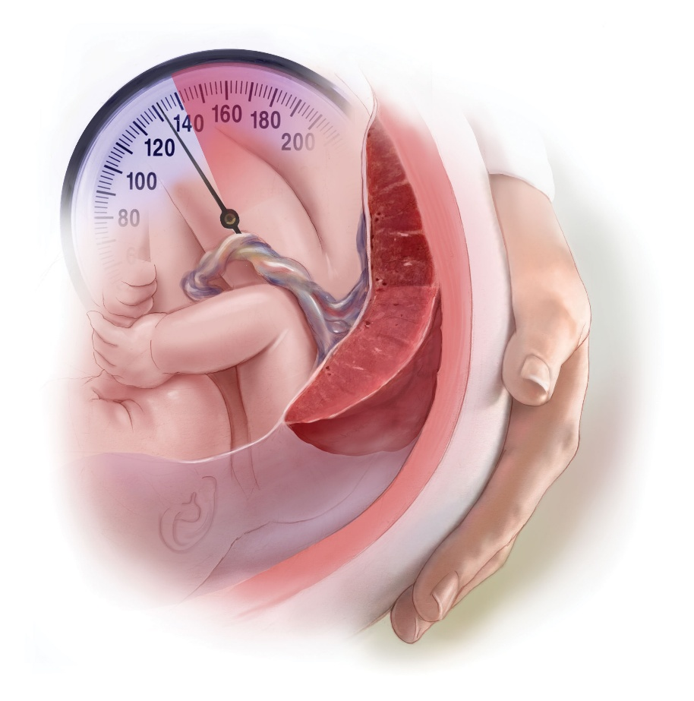
Hypertension disorders in pregnancy

Slide 36
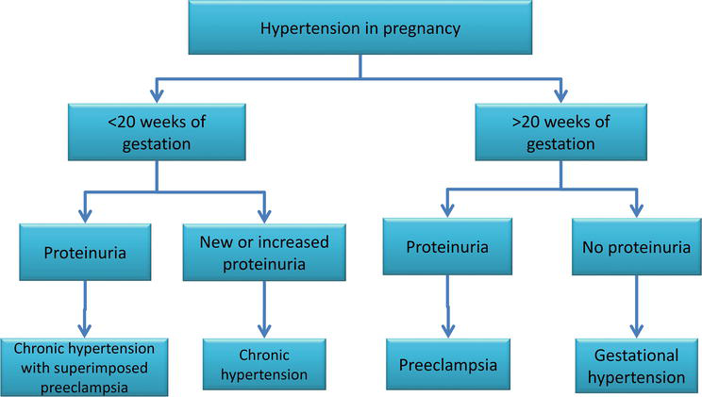
Hypertension in Pregnancy :

Slide 37
Chronic Hypertension in pregnancy :
For pregnant women with chronic hypertension (high blood pressure before pregnancy or diagnosed before 20 weeks of pregnancy), the new guideline recommends treatment with certain medications when systolic blood pressure reaches 140 mm Hg or higher and/or diastolic blood pressure reaches 90 mm Hg or higher.

Slide 38
Gestational hypertension : is defined per ACOG guidelines as blood pressure greater than or equal to 140mmHg systolic or 90mmHg diastolic on 2 separate occasions at least 4 hours apart after 20 weeks of pregnancy when previous blood pressure was normal without proteinuria .
Preeclampsia : is defined as gestational hypertension with proteinuria ( defined as urinary albumin excretion in a 24 h urine sample >0.3 g/day or urinary albumin to creatinine ratio >30 mg/mmol).

Slide 39
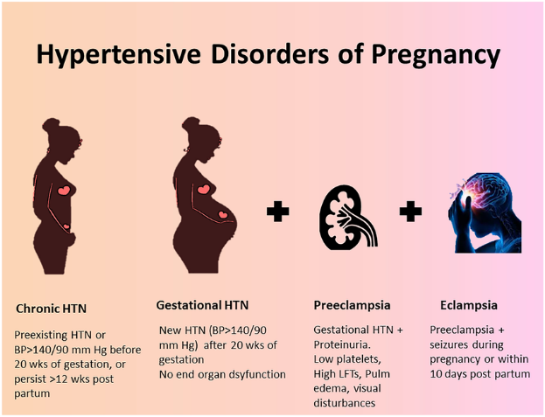

Slide 40
Diagnostic Criteria for Preeclampsia
Diagnostic Criteria for Preeclampsia
Blood pressure
AND
Proteinuria
OR
Other Criteria
Either of the following:
SBP≥140 mmHg AND/OR DBP≥90 mmHg on 2 occasions 4 hours apart >20 weeks gestation in a woman with previously normal BP
SBP ≥160 mmHg OR DBP ≥110 mmHg (confirmed over 15 min)
Any of the following:
≥300mg per 24 h urine collection
Protein/creatinine ratio ≥0.3
Dipstick reading of 2+ (if other quantitative methods not available)
Any of the following:
Thrombocytopenia (platelet count <100k)
Reduced kidney function (serum creatinine>1.1 mg/dL or 2x baseline creatinine)
Impaired liver function (transaminases >2x ULN)
Pulmonary edema
New-onset headache unresponsive to medication OR visual symptoms
Abbreviations: BP indicates blood pressure; DBP, diastolic blood pressure; SBP, systolic blood pressure; and ULN, upper limit of normal.

Slide 41
Hypertension and Pregnancy
Individuals with hypertension who are planning a pregnancy or become pregnant
Pregnant individuals
Labetalol and extended-release nifedipine are preferred
to minimize fetal risk and treat hypertension
Class 1
Should be counseled about the benefits of
low-dose (81mg/day) aspirin to reduce the risk of preeclampsia and its sequelae
Class 1
Should not be treated with atenolol, ACEi, ARBs, direct renin inhibitors, nitroprusside, or MRAs to avoid fetal harm
Class 3: Harm
With SBP ≥160 mmHg or DBP ≥ 110 mm Hg confirmed on repeat measurement within 15 minutes, lower BP to <160/<110 mm Hg within 30-60 minutes to prevent adverse events
Class 1
With Chronic hypertension,
treat to achieve BP <140/90 mm Hg to prevent maternal and perinatal morbidity and mortality
Class 1
Abbreviations: ACEi indicates Angiotensin Converting Enzyme inhibitors; ARB, Angiotensin Receptor Blocker; BP, blood pressure;
DBP, diastolic blood pressure; HTN, hypertension; MRA, mineralocorticoid receptor antagonist; SBP, systolic blood pressure; and TX, treatment.

Slide 42

Any Question ?

Slide 43

Any Questions

Slide 44

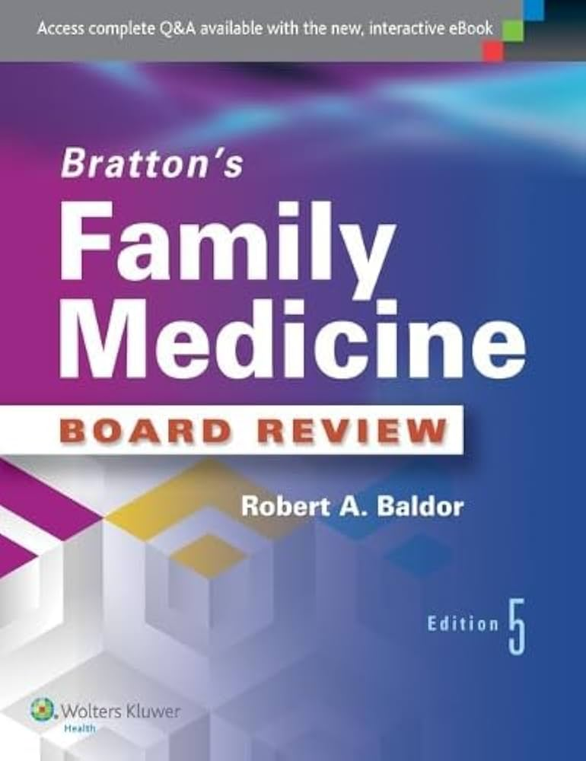
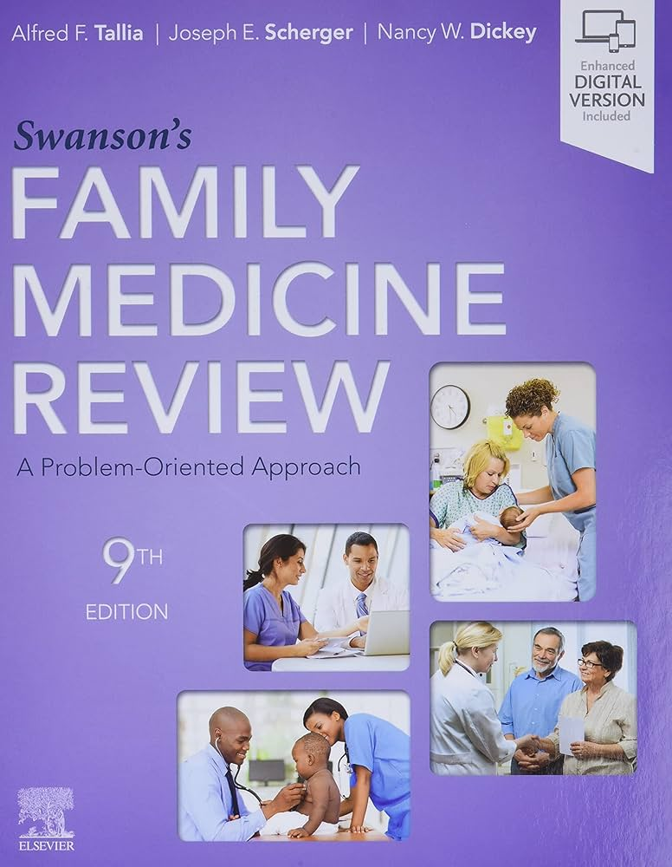

References:
Ministry of Health guidelines for prenatal care.
Gynecology by Ten Teachers 21st edition.
Swanson's Family medicine Text Book.
Family practice Text Book.
.

