Slide 1


Mustansyriah University College of Medicine
Department of Chemistry & Biochemistry
Organic Compounds
Functional Group Identification

Slide 2
Functional Group Identification
Many organic compounds contain an atom or group of atoms that substitute for hydrogen or carbon in a basic hydrocarbon. These atom or group of atoms is called functional group.
Each imparts characteristic chemical properties to the substituted hydrocarbon.

Slide 3

The Aim of this experiment :
To study the chemical properties of several
functional groups:
Alcohols
Carboxylic Acids.
Phenols
Aldehydes & Ketones

Slide 4
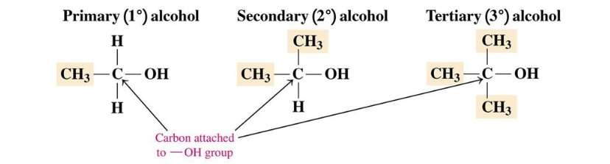
Alcohols :
Hydrocarbons in which an (-OH) replaces a hydrogen atom.
Alcohols are classified as:

Slide 5
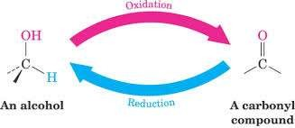
Oxidation:
All alcohols (except tertiary alcohols) are oxidized by potassium permanganate (KMnO₄) & potassium dichromate (K₂Cr₂O₇) to give aldehydes or ketones.

Slide 6
phenols:
aromatic hydrocarbons consisting of a benzene ring attached to –OH group.
They are more reactive than alkanes but less reactive than alkenes and alkynes.
Soluble in 5% sodium hydroxide, but insoluble in 5% NaHCO3. .
They react with a solution of bromine in carbon tetrachloride by substitution and an equivalent quantity of hydrogen bromide is evolved.
They yield intense coloration (blue, green, red, or purple) when treated with a solution of ferric –chloride.

Slide 7
Carboxylic acids :
Organic acids are prepared by the oxidation of primary alcohols or aldehydes
with strong oxidizing agent e.g. KMnO₄.
Soluble in 5% NaOH & 5% NaHCO₃ (The latter reaction is accompanied by the evolution of CO₂).
Non-reactive towards a solution of bromine in CCL₄.
Give positive test with ferric chloride FeCL₃ solution.

Slide 8
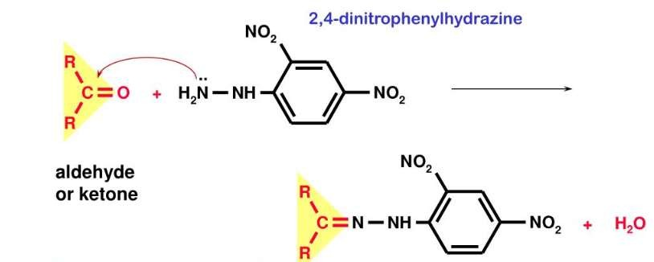
Aldehydes and Ketones
Both aldehydes & ketones contain the carbonyl group.
A general test for carbonyl compounds will immediately characterize both classes of compounds.
The preferred reagent is 2.4- dinitrophenyl hydrazine which give insoluble phenyl hydrazone with carbonyl compounds.

Slide 9
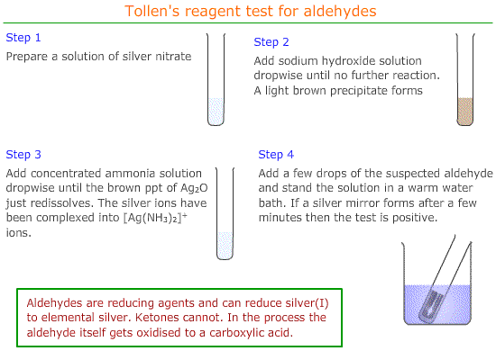
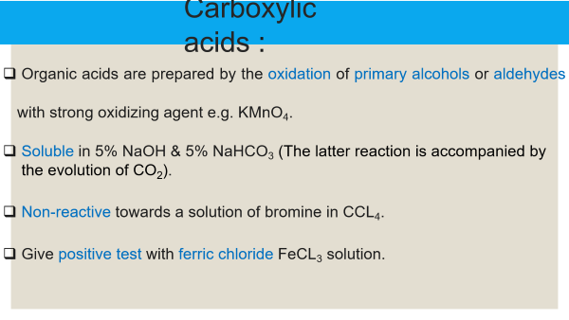
Tollen’s test

Slide 10
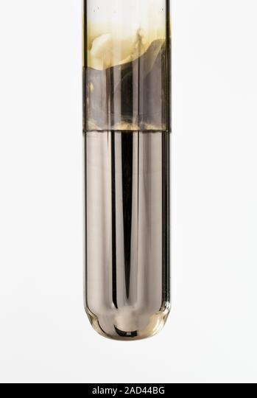
Tollen’s test
Procedure:
1-Add few drops of aldehyde sample to Tollen’s reagent.
2-Warm in hot water bath for about (2-5) min.
3-A silver mirror is deposited on the walls of the tube.
R-CHO + 2 [Ag (NH₃)₂] ⁺ + 3OH⁻ R-COO⁻ + 2Ag + 2H₂O + 4NH₃
(silver mirror)

Slide 11


