Slide 1



Mustansyriah University
College of Medicine
Department of Chemistry & Biochemistry
Chemical Reactions of Group I Ions
Hg₂⁺²
Aims
Hg₂⁺²
Hg₂⁺²
Group I Cations

Slide 2
Cations are typically divided into five Groups, where each group shares a common reagent that can be used for selective precipitation. The classic qualitative analysis scheme used to separate various groups of cations.

Slide 3
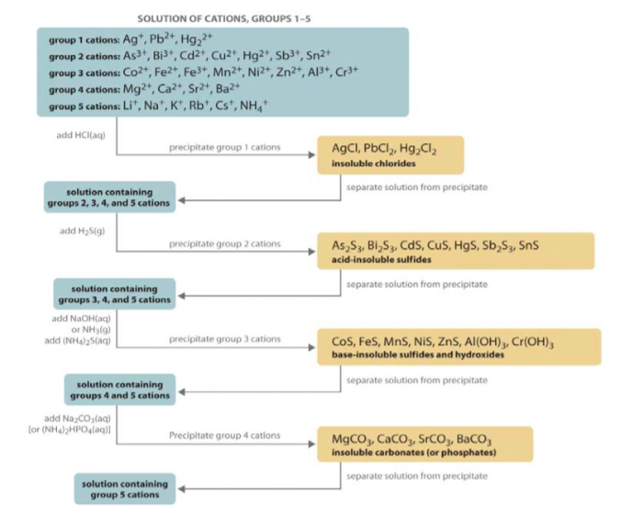

Slide 4
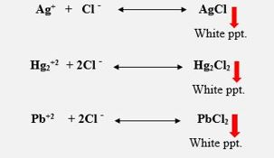
The group I ions are: Silver Ag⁺, Mercury Hg₂⁺² and Lead Pb⁺²
Note that Ag+, Pb2+ and Hg2+2 are called the Group I cations since they are the first group separated from the larger mixture.
The chloride salts of these ions are insoluble, therefore, to prevent any interference with the cations of group II, hydrochloric acid (HCl) is added to remove them as the chlorides:
Hg₂⁺²
Aims
Hg₂⁺²
Hg₂⁺²
Group I Cations

Slide 5
The Aim is :
To teach students how to deal with lab glassware’s, chemical reagents & observation of common colored products of chemical reactions.
Hg₂⁺²
Aims
Hg₂⁺²
Hg₂⁺²
Group I Cations

Slide 6
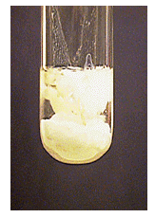
Reactions of the Aqueous Solution of Hg₂⁺² :
1)HCl (diluted acid):
Put few drops of the sample solution in a test tube, add dilute HCl drop by drop till a white precipitate of Hg₂Cl₂ is formed.
Hg₂⁺²
Aims
Hg₂⁺²
Hg₂⁺²
Group I Cations

Slide 7

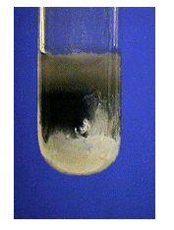
This white precipitate of Hg₂Cl₂ is:
a) Insoluble in hot water and cold diluted acids.
b)Turns black when ammonia solution is added.
Aims
Hg₂⁺²
Hg₂⁺²
Hg₂⁺²
Group I Cations

Slide 8
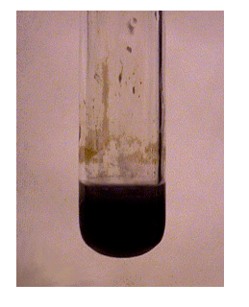
2) Potassium chromate solution (K₂CrO₄):
Add few drops of K₂CrO₄ to few drops of the sample in a test tube, Hg₂CrO₄ will formed as a brown precipitate which turns to red crystals on boiling.
3) Ammonia solution:
When ammonia solution is added to aqueous solution of Hg₂⁺² a black precipitate will be formed which consists of the ammoniacal mercuric salt and fine powder of mercury.
Hg₂⁺²
Hg₂⁺²
Aims
Hg₂⁺²
Group I Cations

Slide 9

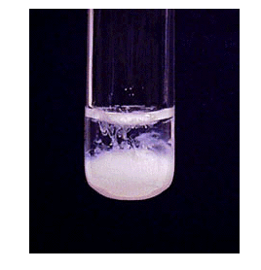
Reactions of the Aqueous Solution of Pb⁺²
HCl (diluted):
On addition of diluted HCl to the aqueous solution of Pb⁺² , a white precipitate will be formed only when the solution is cold.
This precipitate dissolves in hot water but separates again as needle-like crystals when the solution is re-cooled
Ag⁺
Ag⁺
Ag⁺
Pb⁺²
Pb⁺²
Pb⁺²

Slide 10
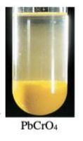
2) Potassium chromate solution:
It forms a yellow precipitate of PbCrO₄ which is insoluble in acetic acid & ammonia solution but soluble in hydroxides & in HNO₃.
Pb⁺²
Pb⁺²
Ag⁺
Pb⁺²
Ag⁺
Ag⁺

Slide 11
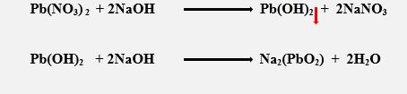
3) Sodium hydroxide:
It forms a white precipitate of Pb(OH)₂ which dissolves on adding excess of NaOH to form Na₂(PbO₂).
Ag⁺
Pb⁺²
Ag⁺
Ag⁺
Pb⁺²
Pb⁺²

Slide 12
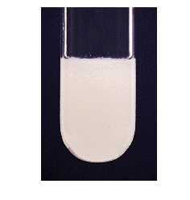
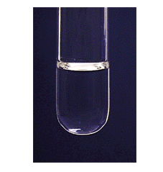
Reactions of the Aqueous Solution of Ag⁺ :
HCl (diluted):
A cloudy white precipitate of AgCl is formed,
this precipitate is insoluble in water and acids
including HNO₃
But Soluble in ammonia solution because it
forms a complex ion.
Pb⁺²
Pb⁺²
Ag⁺
Ag⁺
Pb⁺²
Ag⁺

Slide 13
2) Potassium chromate:
Red precipitate of Ag₂CrO₄ is formed, insoluble in acetic acid (diluted), but soluble in diluted HNO₃ and ammonia solution.
Pb⁺²
Ag⁺
Pb⁺²
Ag⁺
Ag⁺
Pb⁺²

Slide 14
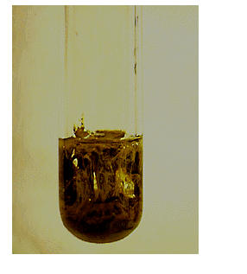
3) Sodium hydroxide:
Brown precipitate of Ag₂O is formed,
insoluble on addition of excess of the precipitant (NaOH solution).
Pb⁺²
Pb⁺²
Ag⁺
Pb⁺²
Ag⁺
Ag⁺

Slide 15

Pb⁺²
Pb⁺²
Ag⁺
Pb⁺²
Ag⁺
Ag⁺

