Slide 1




Mustansyriah University
College of Medicine
Department of Chemistry & Biochemistry
Qualitative Analysis of a Mixture of Group I Ions (Ag⁺ , Hg₂⁺² , Pb⁺² )

Slide 2



Analysis
Analysis means the separation and identification of a substance in a mixture.
Analysis could be either Quantitative or Qualitative.
.

Slide 3

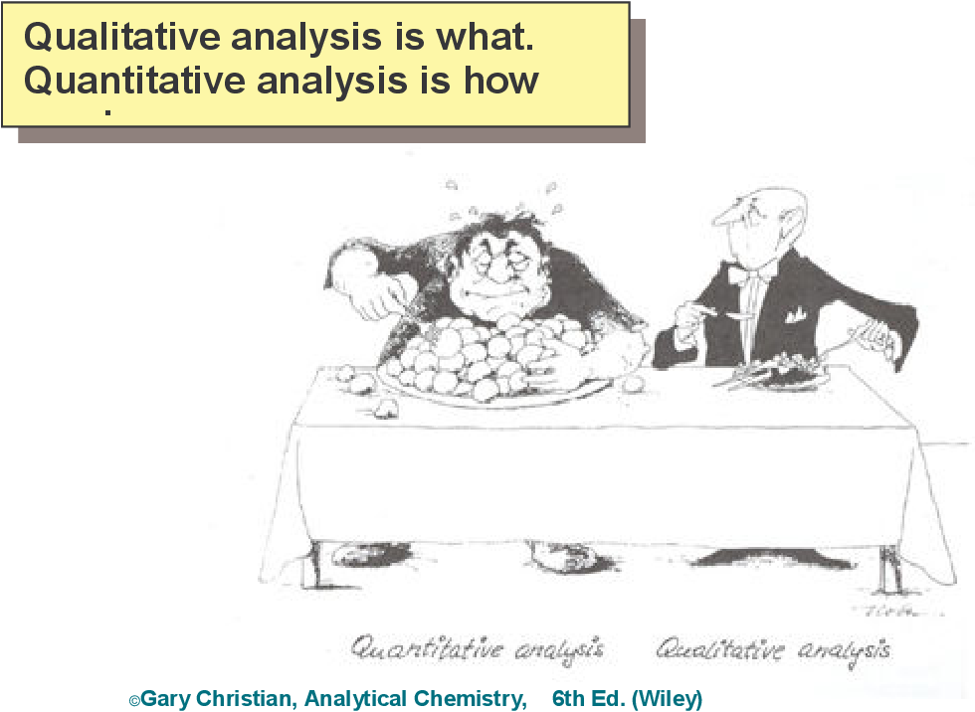
Quantitative analysis means the determination of the actual amount of the substance in a measured volume of unknown sample.
Its units are gm/100ml, meq/L, mmol/L or I.U/L.
Qualitative analysis is used to detect whether a particular substance is present in an unknown sample or not.
it is yes or no test.

Slide 4
Analytical Methods
There are many analytical methods used to separate a substance from a mixture.
The simplest one is based on the solubility behavior of that substance in different solutions (which depend on the ionic equlibria).
So that by adding a precipitating agent and filtration you can separate a particular substance and by knowing its reactional behavior with a second agent you identify it.

Slide 5

The aim of this experiment is :
To learn a systematic procedure to separate ions and then to identify them.

Slide 6
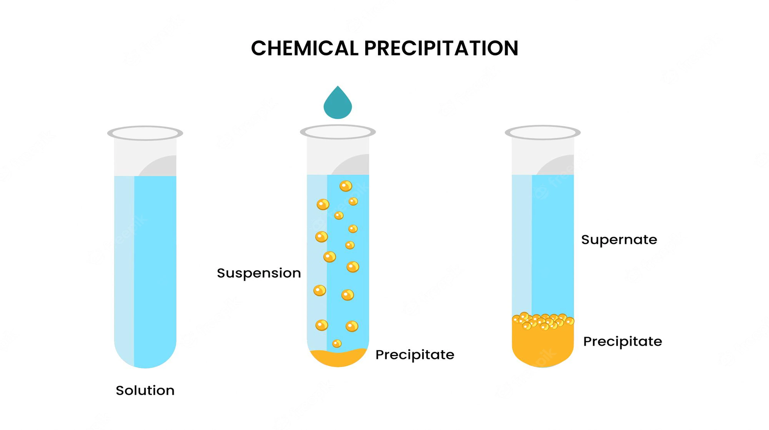

Slide 7


Separation and Confirmation of Group I Cations
Lead(II) chloride can be separated from the other two chlorides based on its increased solubility at higher temperatures. This means that lead(II) chloride will dissolve in hot water, leaving the mercury(I) chloride and the silver chloride in solid form:
The presence of Pb2+ in the aqueous solution can then be confirmed by the formation of a yellow precipitate of PbCrO4 upon the addition of aqueous K2CrO4:

Slide 8

Next, Hg2+2and Ag+ cations can be separated by adding 6 M NH3 (aq) to the solid mixture of the two chlorides.
Silver chloride will dissolve since it forms a soluble complex ion with ammonia:
However, mercury(I) chloride reacts with the ammonia yielding what appears to be a gray solid which is actually a mixture of black Hg (l) and white HgNH2Cl (s). The presence of this gray solid is confirmation of the presence of Hg2+2.

Slide 9
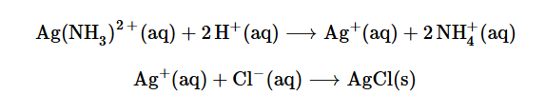
The presence of Ag+ can be confirmed by the appearance of a white precipitate upon adding 6 M HNO3 (aq) to the solution.
The nitric acid reacts with the ammonia and thus destroys the complex ion containing the silver cation. Once in solution again the silver cation precipitates with the chloride as indicated by the following reactions:

Slide 10
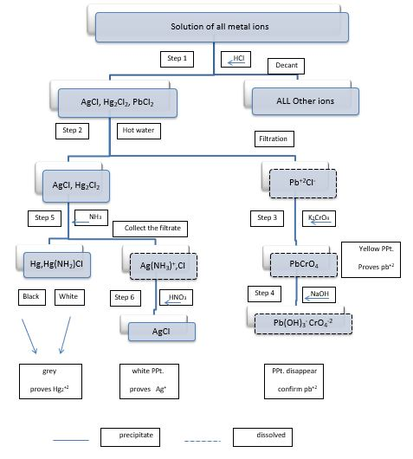

Slide 11





Thank You

