Slide 1


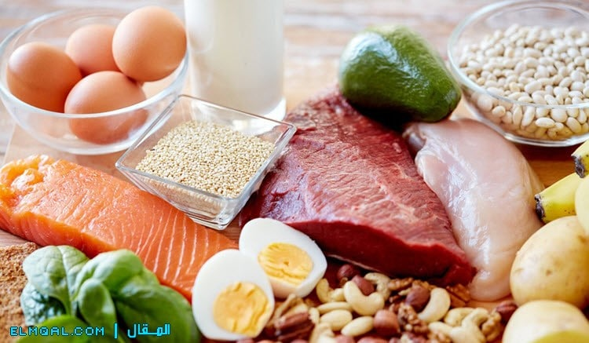
Mustansyriah University
College of Medicine
Department of Chemistry & Biochemistry
Color Test For Proteins
And
Amino Acid(ll)

Slide 2
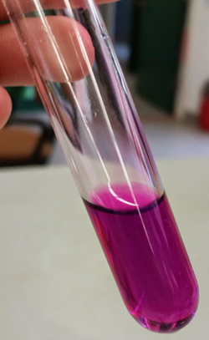
2. Ninhydrin test:
Ninhydrin is a powerful oxidizing agent which causes oxidative decarboxylation of alpha – amino acids producing CO_{2,} NH₃ and an aldehyde. The liberated ammonia reacts with two equivalents of ninhydrin to produce a blue or a purple colored product.

Slide 3
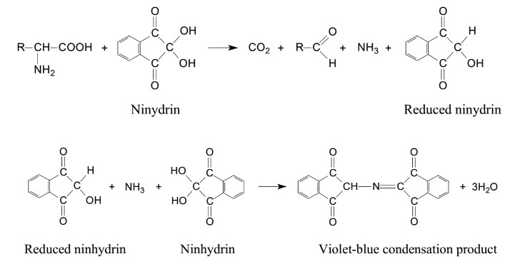

Slide 4
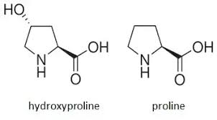
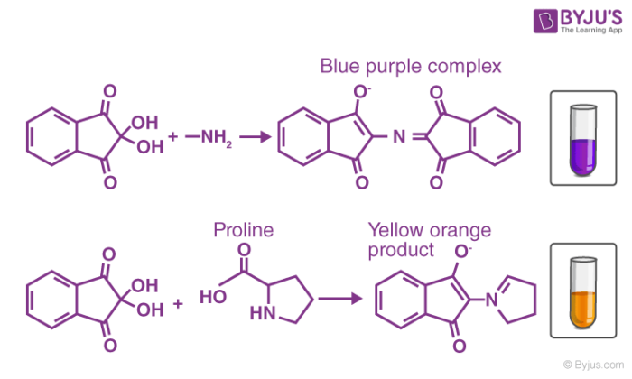
The reaction depends on presence of free amino group so Proline and hydroxyproline which lack a free amino group yield a yellow color with ninhydrin. Peptides and proteins, owing to their free terminal amino groups yield a positive test.

Slide 5
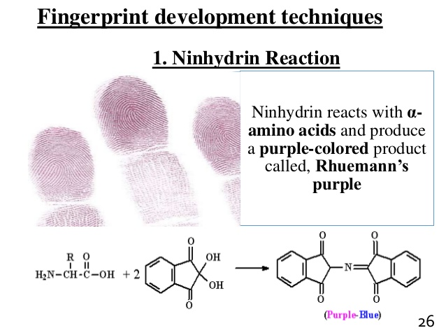

Slide 6
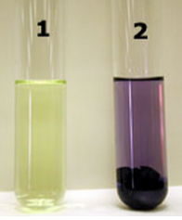
Procedure of Ninhydrin test:
Samples: albumin,tryptophan,Proline.

Slide 7
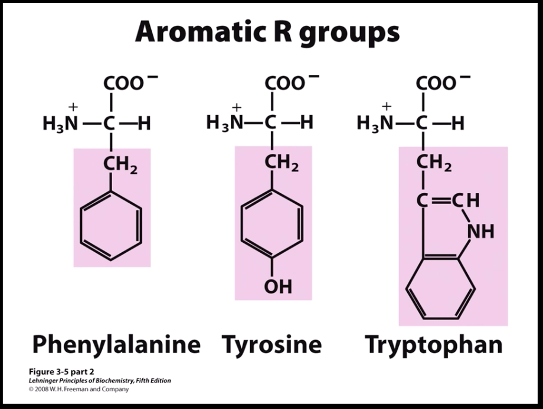
3. Xanthoproteic test:
Nitration of the aromatic ring of an amino acid by hot concentrated nitric acid produce a yellow color so tyrosine and tryptophan give a positive test.

Slide 8
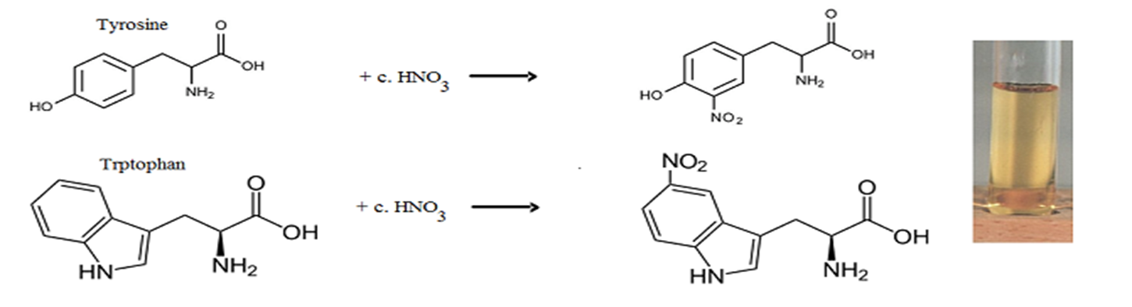
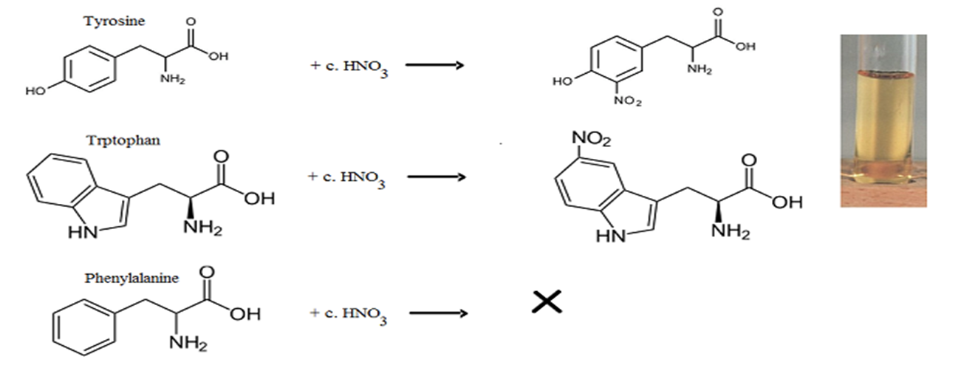
Under the conditions of the test, phenylalanine doesn’t produce the color. However, if one adds a small amount of concentrated sulfuric acid together with the nitric acid one will obtain a positive result.

Slide 9
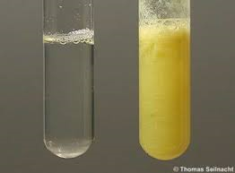
Procedure of Xanthoproteic test:
Samples: albumin, tryptophan, proline.

Slide 10
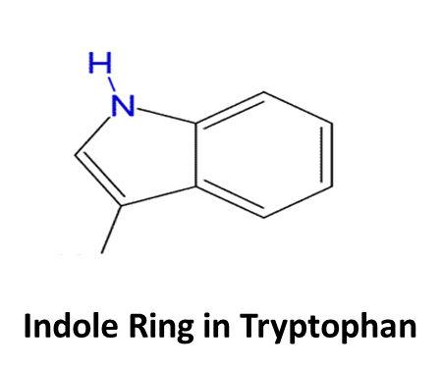
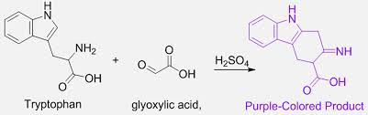
4. Hopkins-cole test for tryptophane:
Tryptophan, due to its indole ring, condenses with the aldehyde glyoxylic acid (CHO-COOH) in presence of concentrated H₂SO₄ to produce a purple to blue color.

Slide 11
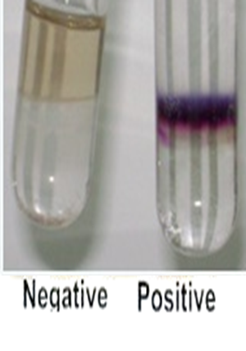
Procedure of Hopkins-cole test:
Samples: albumin, tryptophan, Proline.

Slide 12
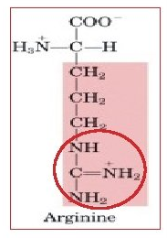
5.Sakaguchi test for arginine
The only amino acid containing the guanidine group is arginine and this reacts with alpha-naphthol and an oxidizing agent such as bromine to give a red color.
This is a sensitive test for free and complex arginine.

Slide 13


