Slide 1
Acute leukaemia
Prof. Dr. Israa M. Al-Bayaa

Slide 2

objectives
By the end of this lecture students should be able to:-
understand the sequence of WBC genesis.
understand the aetiology and definition of acute leukaemia.
Recognize the different schemes for leukaemia classification.
Recognize the clinical manifestations and laboratory findings of AML and ALL.

Slide 3
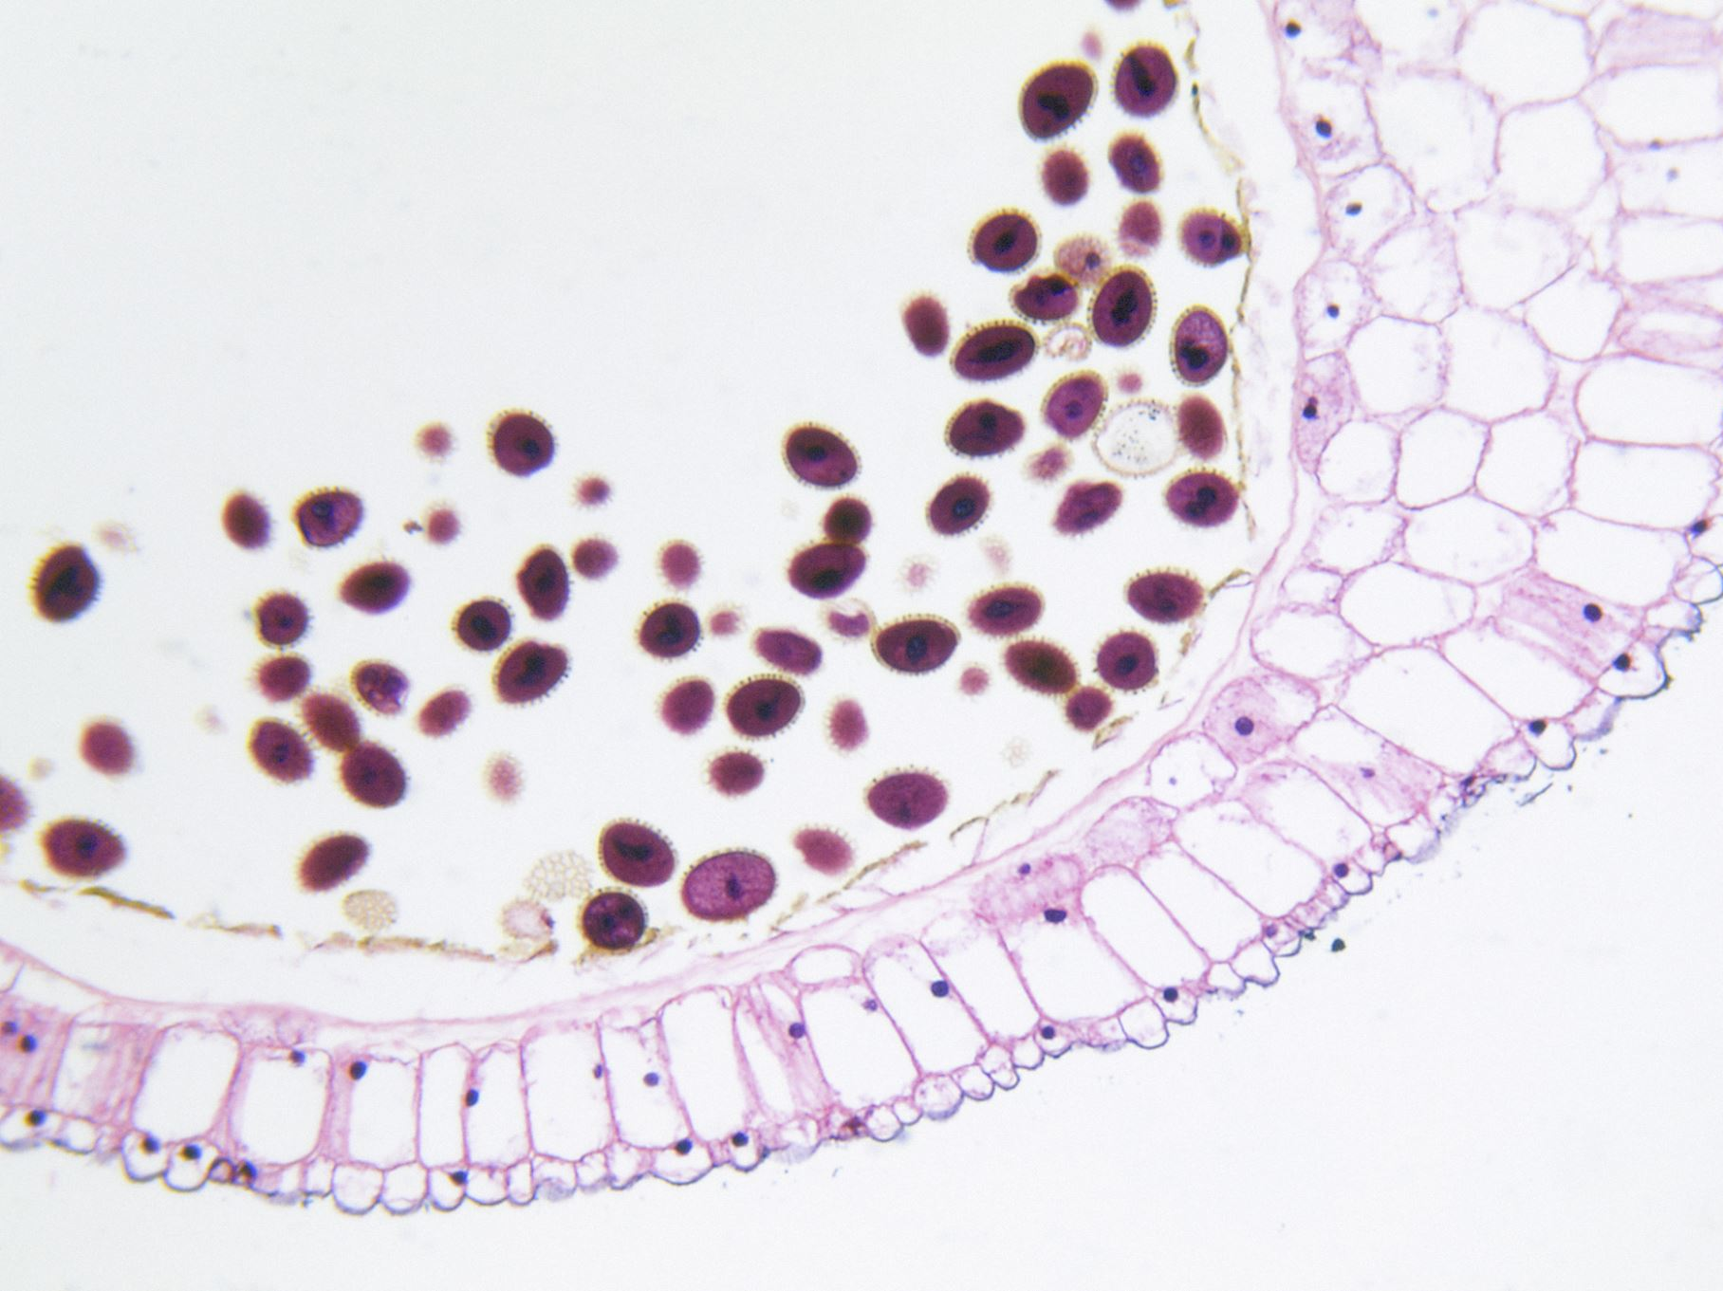
Genesis of the White Blood Cells
All blood cells arise from the pluripotential hematopoietic stem cell.
Early in hematopoiesis the pluripotential stem cell will give rise to a multipotent stem cell that will differentiates along one of two pathways
The common myeloid progenitor cells lose their self renewal capacity and under the effect of appropriate growth factor they will differentiate into the corresponding cell type.

Slide 4
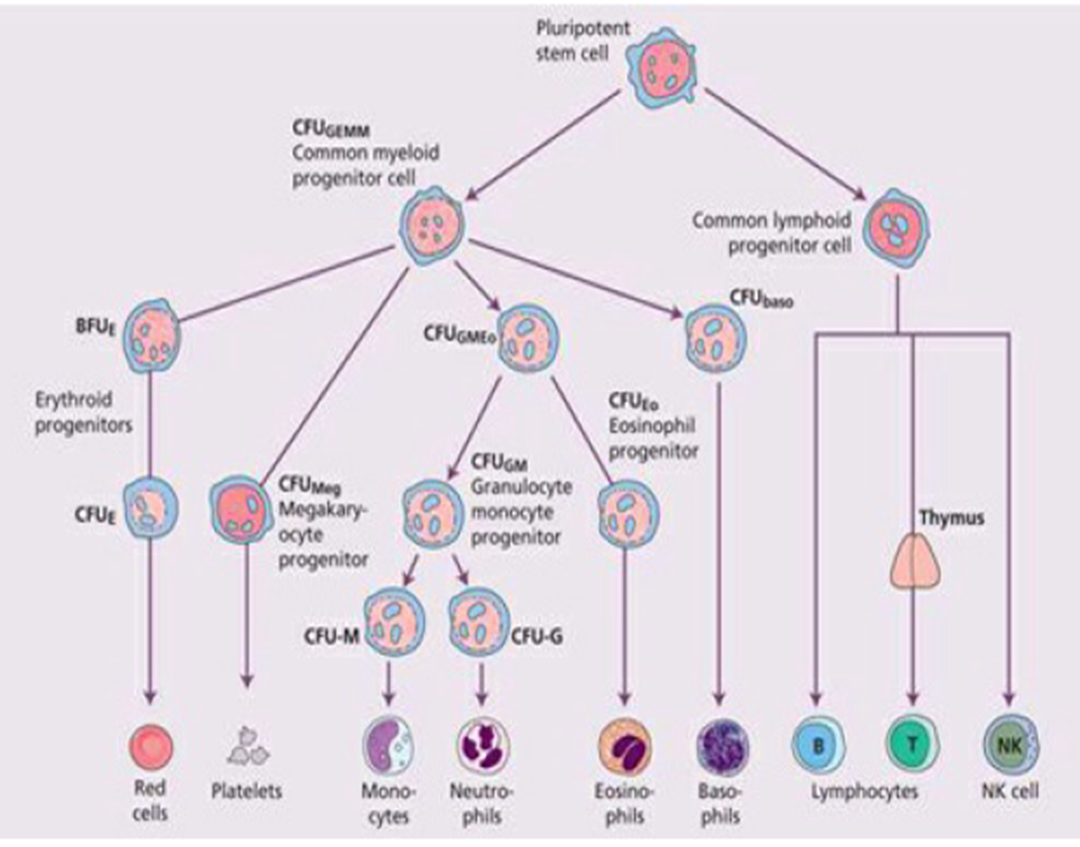

Slide 5
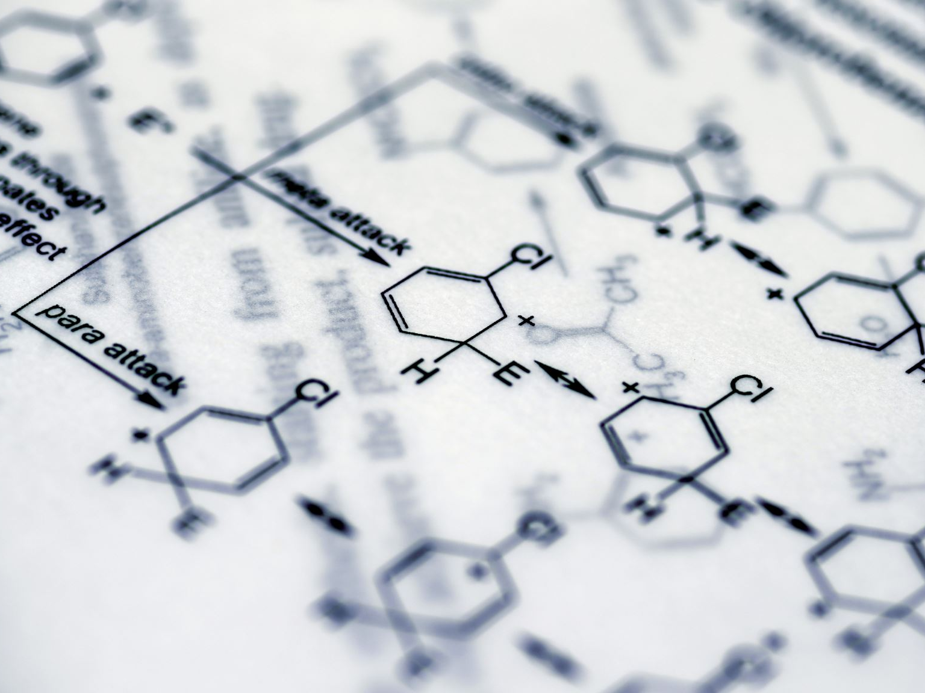
The earliest recognized precursor of the granulocyte is known as the myeloblast that will pass into number of intermediate stages before they differentiate into mature end granulocytes (neutrophils, eosinophils and basophils), those intermediate forms are:-
myeloblast→ promyelocyte →myelocyte → metamyelocyte → band stage → mature cell

Slide 6
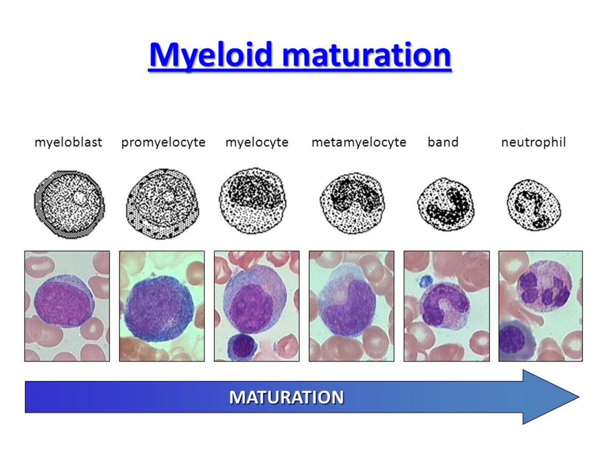

Slide 7
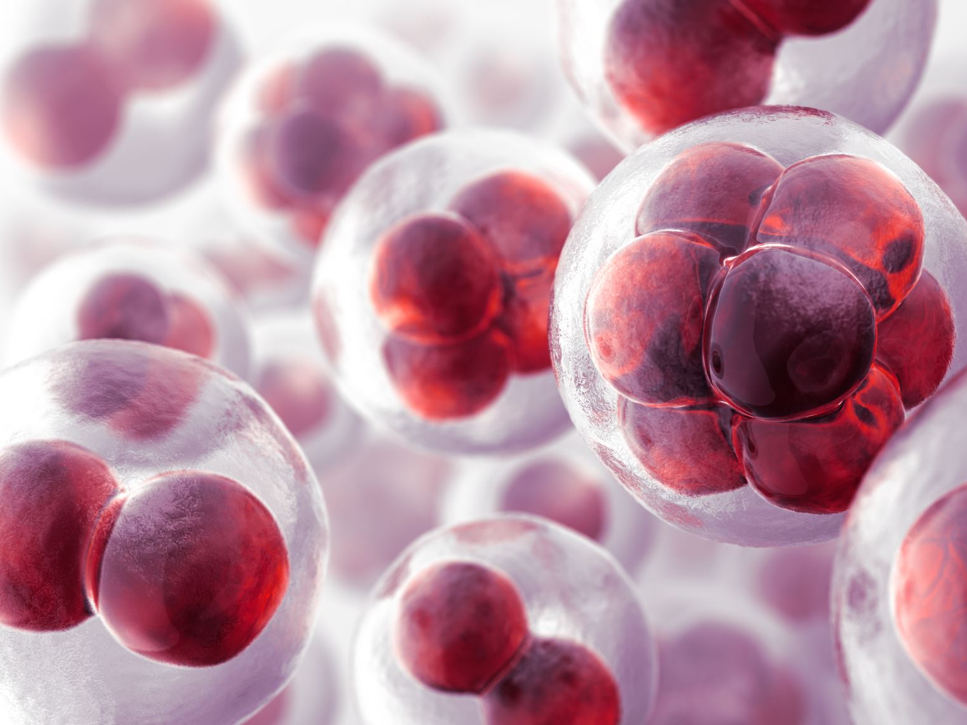
Acute leukaemia
Acute leukemia is a clonal disorder, characterized by abnormal proliferation in the bone marrow of blast cells, with resultant progressive infiltration of the marrow and a variable number of other organs, and spillage into the peripheral blood.
Usually there is a series of genetic alterations rather than a single event and these alterations may involve a proto-oncogen or a tumor suppressor gene resulting in the abnormal uncontrollable proliferation of the malignantt cells (blasts) in the bone marrow and in other sites of the body.

Slide 8
These genetic alterations can result from many different factors like:-
Exposure to radiation (it has been noticed that there is increased incidence of all types of leukemia in the survivors of atomic bombing in Japan).
Chemicals (chronic exposure to benzene)
Drugs like Alkylating agents (chlorambucil & mustine ) especially combined with radiotherapy .
Infections :- viral infection as HTLV-1 is a cause of adult T cell leukemia / lymphoma , EBV is associated with endemic form (African type )of Burkitt lymphoma
AIDS is also associated with increase incidence of lymphoma.

Slide 9
Genetic factors :- there is increase in incidence of leukemia in some genetic diseases as Down syndrome ,Blooms syndrome, Fanconi anemia ,Ataxia telangectasia ,klinefilter syndrome.
AML can develop in the course of other hematological diseases such as chronic myeloid leukaemia (CML), Polycythemia rubra vera(PRV), myelodysplastic syndromes (MDS ), idiopathic myelofibrosis(MF)

Slide 10
Pathogenesis :-
Acute leukemia is an aggressive disease in which the malignant transformation occurs in the pluripotential haemopoietic stem cell or very early progenitors. the genetic damage may involve different key steps in cell proliferation and differentiation resulting in ;-
Increase rate of proliferation .
Reduced apoptosis.
Block in cellular differentiation.

Slide 11
Classification :-
Acute leukaemia is broadly classified into;-
acute myeloid leukemia (AML).
acute lymphoid leukemia (ALL) whether T- ALL or B-ALL
acute leukaemia of ambiguous linage with markers of both myeloid and lymphoid cells, or lacking definite linage markers.

Slide 12

Clinical manifestations :-
Acute leukemia could develop at any age and we can classify them into 2 distinct types:-
childhood leukaemia affecting children less than 15 years old. 80% of the cases are usually ALL .
adult leukaemiia affecting adults > 15years the majority of the cases are AML.
As a clinical presentation there is a great degree of overlap between AML and ALL requiring many investigation for accurate categorization.

Slide 13
Generally speaking : the clinical features of Acute Leukemia are due directly or indirectly to the proliferation of the leukemic cells and their infiltration into normal tissues.

Slide 14

Clinically the patients presented with
features of bone marrow failure ( pallor& lethargy due to anemia , fever ,malaise , infections due to neutropenia , spontaneous bruises & bleeding gums , menorrhagia due to thrombocytopenia .
features of organ infiltration :- tender bones , lymphadenopathy, spleenomegally ,hepatomegally, signs of meningeal involvement (headache , nausea, vomiting, blurring of vision ),gum hypertrophy in monocytic leukaemia , testicular swelling.

Slide 15
Patients with high WBC count may present with symptoms of leukostasis secondary to hyperleukocytosis. Which is deﬁned as a blast count of greater than 100 x 10⁹/l, With hyperleukocytosis, blasts pack and plug blood vessels, leading to leukostasis and thrombus formation. Specific signs and symptoms can include shortness of breath, hypoxia, diffuse pulmonary infiltrates, headache and blurring of vision.

Slide 16
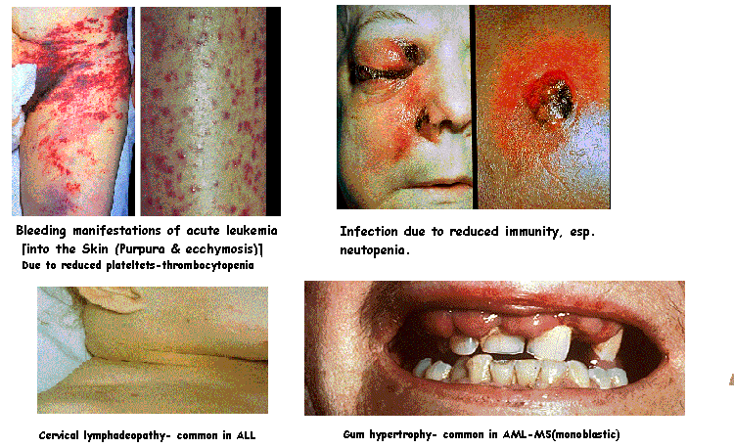

Slide 17
Investigation in Acute leukaemia:-

Slide 18
1- Blood Picture in Acute Leukemia
Hemoglobin is usually reduced. (Anemia)
Platelets are usually reduced (thrombocytopenia).
Leukocytes are usually increased, and may reach figures of 200-300 x 10⁹/L, or above.
However in around one quarter of case the leucocytes maybe reduced. Or the counts maybe normal.
Usually the leukocytes on film include a majority of blasts, the presence of more than 20% blasts is required for diagnosis.

Slide 19
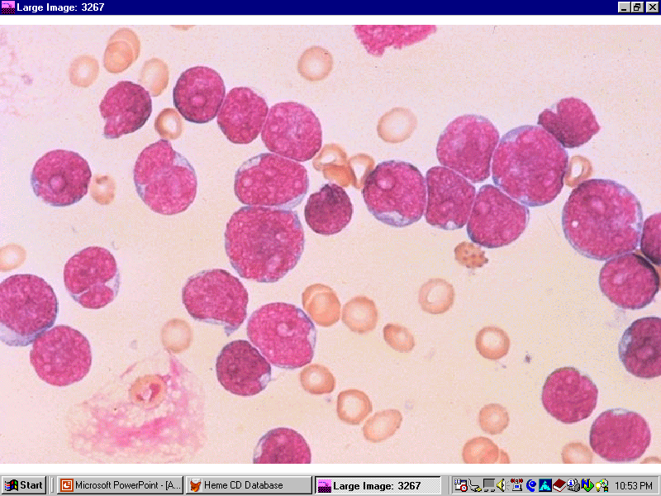

Slide 20
2- Bone marrow in Acute Leukemia
Usually markedly hypercellular with extensive infiltration by blasts cells, constituting at least 20% of all nucleated elements, with suppression of normal hemopoietic elements. However still acute leukaemia may present with a hypocellular marrow.
Based on morphology of the blasts and their pattern of maturation and the use of special stains and sometimes immunological markers, Leukaemia could be classed into lymphoid and myeloid and subtyped morphologically within each of these classes.

Slide 21
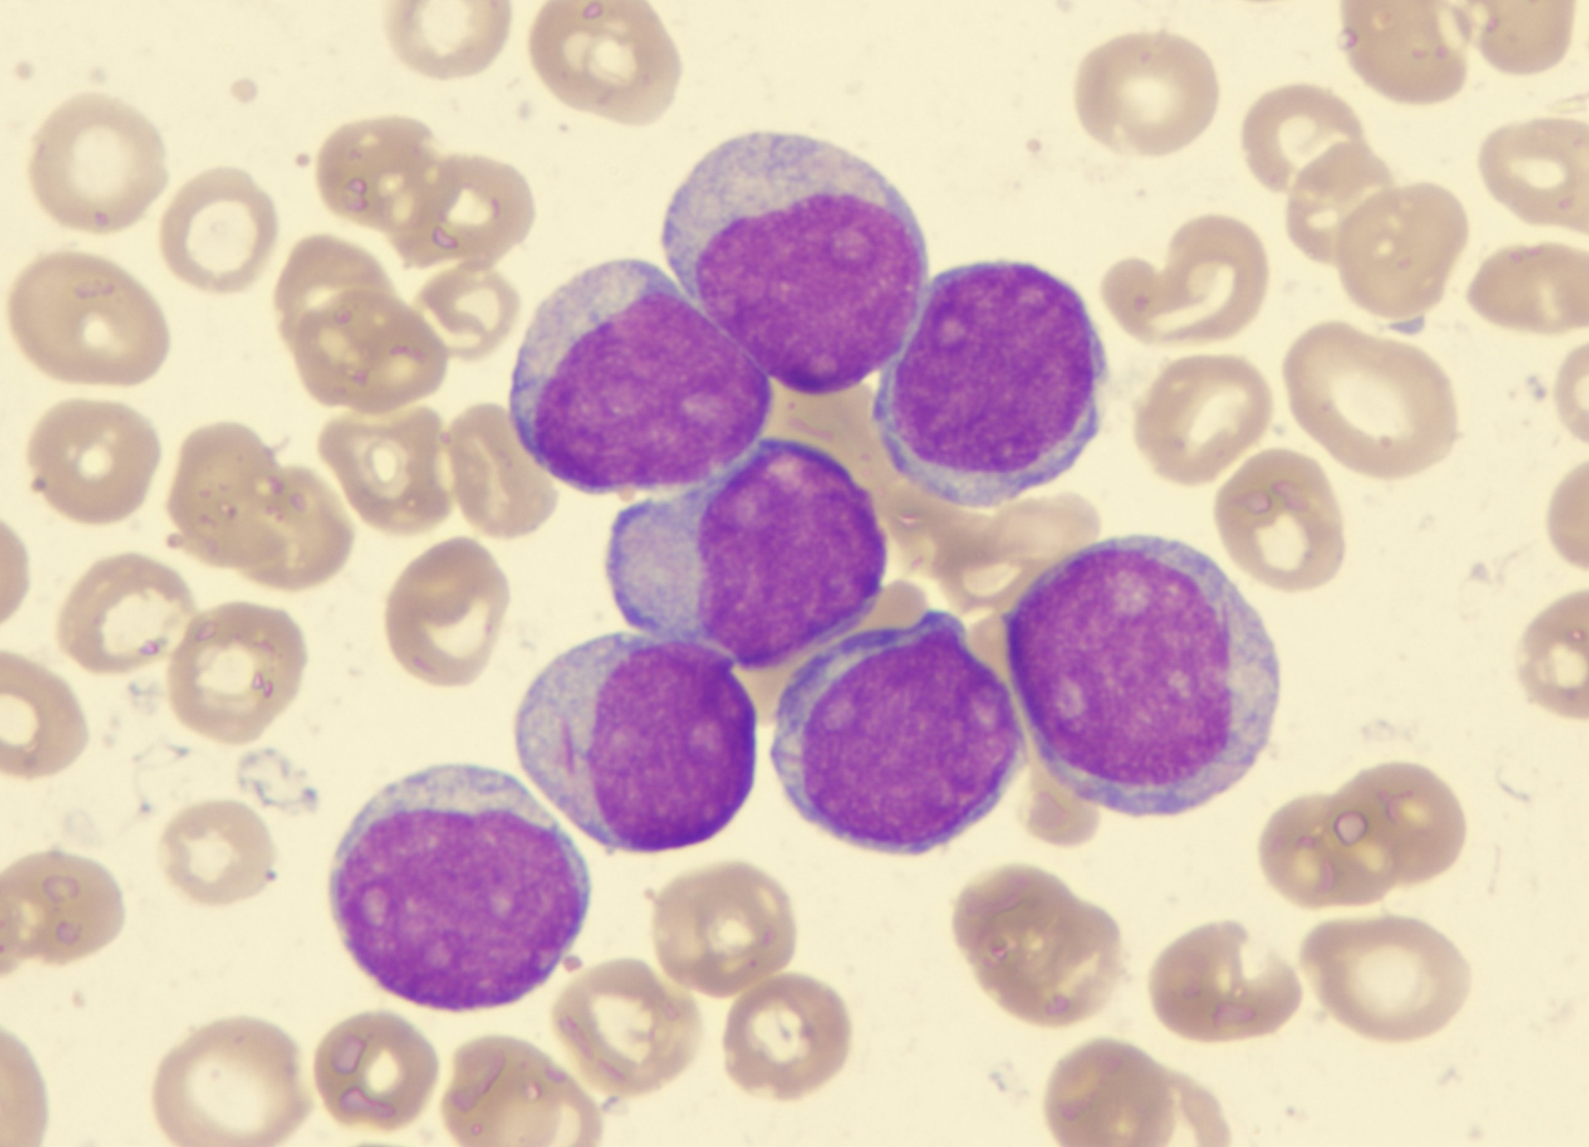
AML

Slide 22
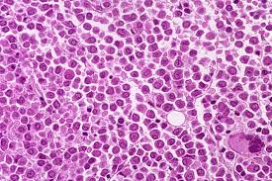

Slide 23
3- immunophenotyping , cytogenetic study.
4- biochemical tests:- ↑ uric acid & LDH , hypokalemia (it may be spurious when the WBC count is very high) , ↑Ca.
5- coagulation tests:- are mainly needed in M3 type as it s mainly associated with DIC.

Slide 24
Classification schemes of Acute leukaemia

Slide 25
FAB (French American British ) classification of acute leukaemia:-
This classification is based mainly on morphology of the blasts, and on use of special stains (cytochemistry) and limited use of monoclonal markers in special situations, and Acute leukemia is classified and subclassified into :
Acute Lymphoid Leukemia (ALL) is classified into 3 subytpes (L1, L2, L3).
Acute Myeloid Leukemia (AML) is classed into 8 subtypes : (M0, M1, M2, M3, M4, M5, M6, M7).

Slide 26
MIC classification
sometimes the morphology can help us in differentiating AML from ALL (like for example the presence of Auer rods in the blast is pathognomonic for AML ) however in many situations the distinction is difficult requiring further testing like immunological markers or cytogenetic and molecular testing to reach a final diagnosis, and these are the bases for the MIC classification (morphology, immunophenotyping, cytogenetics).

Slide 27
WHO classification:-
This is the current standard classification of acute leukemia it was first introduced in 2002 and sequentially updated with last update in 2022
The frame of classification is that each type of leukemia (AML, ALL ) is first categorized whether there are certain specific cytogenetic and molecular abnormalities that if present the diagnosis of acute leukemia can be done without the need for the 20% cutoff level of the blast.
then identifying leukemia types by the line of differentiation (like the FAB classification) with special categories for leukemia that result from secondary other diseases or leukemia developing following use of chemotherapy for other types of malignancy.

Slide 28
Why do we need this classification?
The purpose of any classification is to provide information that help in deciding diagnosis, treatment options and prognosis, the role of genetics in this field is very important and growing with new abnormalities being discovered an added.
So the WHO provide more valuable information than the Fab in this respect , but sometimes in the absence of facilities we rely on the Fab classification

Slide 29
immunophenotyping
Immunophenotyping is done by applying certain monoclonal Ab that recognize specific Ag (nuclear, cytoplasmic or surface Ag), this is very valuable in distinction between myeloid & lymphoid leukemia & between different subtypes of leukemia, it is also useful in treatment, follow up & in determining prognosis.
There are certain markers that are specific for each cell line for example cytoplasmic MPO is the most specific for AML, CD19, CD79a for B- ALL, and cytoplasmic CD3 for T –ALL and there are many other markers that can be used for further categorization.

Slide 30
Cytogenetic abnormality in ALL:-
Chromosomal abnormality is found in up to 80% of cases:- Numerical abnormalities:- Hyperploidy (> 50 chromosome) associated with good prognosis.
Hypoploidy (< 45 chromosome ) associated with poor prognosis.
Structural abnormalities:- mainly translocations, inversions, deletions, point mutations. Some of the most common translocations are:-
t(9;22) Philadelphia chromosome characteristic of CML seen in 20% of cases , more in adults associated with poor prognosis.
t(4;11) with MLL rearrangement , most common in infants associated with poor prognosis.
t(12;21) ,carry good prognosis.

Slide 31
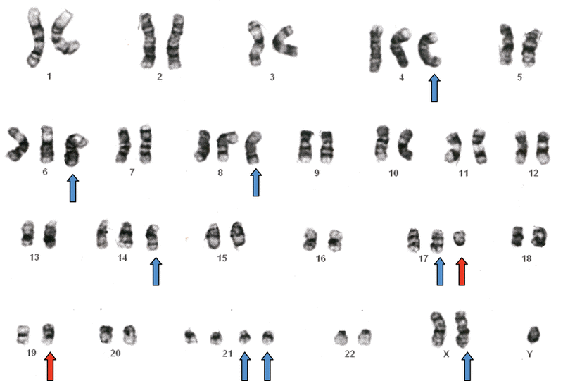
Hyperploidy of a patient with ALL showing extra 4,6,8,14,17,19,21 and X chromosome

Slide 32
Cytogenetic abnormality in AML:-
Chromosomal abnormalities seen in 70% of cases, some of the structural abnormalities in AML
t(8;21), associated with good prognosis.
t(15;17) (q31;q22)→ PML-RARα seen in 95% of cases of promylocytic leukemia it has good prognosis.
inv(3) or t(3;3), extremely poor prognosis.
inv(16) or t(16;16), carries good prognosis.

Slide 33
Molecular abnormalities in AML
Certain types of mutations are also common in AML , For example:
NPM1 mutation: seen in about 30% of adults with normal karyotype alone it carries good prognosis.
FLT3-ITD mutation, when present with NPM1 mutation the prognosis is poor.
Biallelic CEBPA mutation , 4–9% of cases of AML in children and young adults

Slide 34
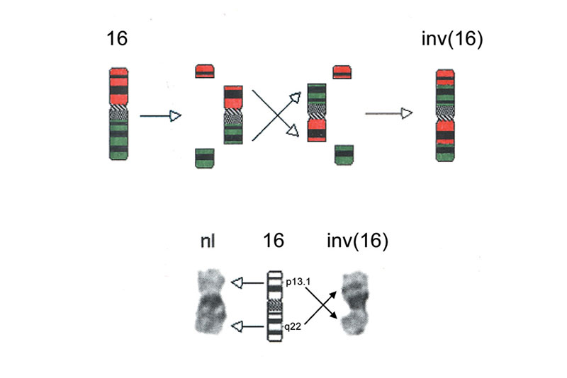

Slide 35
Keep in mind that cytogenetic and molecular abnormalities are independent prognostic factors that have a great influence on the treatment outcome.

Slide 36
Acute promyelocytic leukaemia (AML-M3):-
In this type of leukaemia the malignant cells are the abnormal hypergranular promyelocytes, those cells are characterized by having a densely packed cytoplasm with granules, multiple Auer rods (Fused granules) or fagott cells (at least 3 Auer rods/cell) are seen.
In this type of leukaemia the presentation is usually dramatic with pancytopenia, there is high incidence of DIC( disseminated intravascular coagulation) & usually precipitated shortly after treatment (this occur because the cytoplasmic granules are rich with procoagulant material that will stimulate the coagulation process when released).

Slide 37
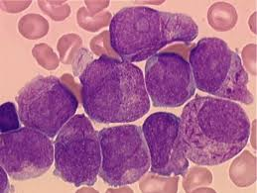

Slide 38
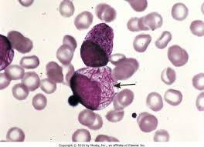

Slide 39
A characteristic feature of this type of leukaemia is the presence of t(15;17) which is seen in majority of cases (95%) ,it involves RARα gene (Retinoic acid receptor) on chromosome 17& PML gene (Promyelocyte leukaemia) on chromosome 15 . RARα gene codes for the Retinoic acid receptor which induces cell differentiation, so the translocation will reduce the function of this receptor and blocks differentiation however still this translocation carries good prognosis, because the abnormal receptor responds to high doses of ATRA (all transretinoic acid) which can induce the differentiation of the abnormal promyelocytes.

Slide 40
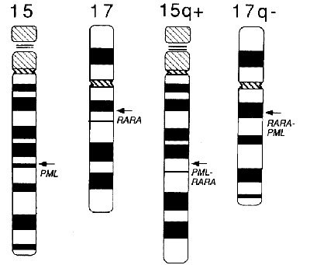

Slide 41
Thank you

