Slide 1

Myeloproliferative neoplasms
Prof. Dr. Israa M. Al-Bayaa

Slide 2
A patient presents with a dramatic onset of pancytopenia and signs of disseminated intravascular coagulation (DIC). The peripheral blood smear shows promyelocytes with numerous Auer rods. Which of the following genetic abnormalities is most specifically associated with this type of leukemia?
(A) t(9;22)
(B) t(8;21)
(C) t(15;17)
(D) inv(16)
(E) FLT3-ITD mutation

Slide 3
The World Health Organization (WHO) classification of acute leukemia differs significantly from the older French-American-British (FAB) classification by placing greater emphasis on which of the following?
(A) The overall cellularity of the bone marrow aspirate
(B) The percentage of blasts required for diagnosis (20% cutoff)
(C) The presence of specific cytogenetic and molecular abnormalities
(D) The patient's age and clinical presentation at diagnosis
(E) The response to the first cycle of induction chemotherapy

Slide 4
Objectives
Identify the types and classification of MPN.
Understand the genetic abnormality underlying MPN.
Understand the clinical presentation and diagnostic criteria for different of MPN.
Identify the laboratory features of different types of MPN

Slide 5
Myeloproliferative neoplasms (MPN)
Group of closely related clonal disorders of haemopoiesis.
There is increase in the number of one or more mature blood cells and their precursors.
They share some common clinical features and they have the possibility to transform to acute leukaemia with variable frequency.

Slide 6
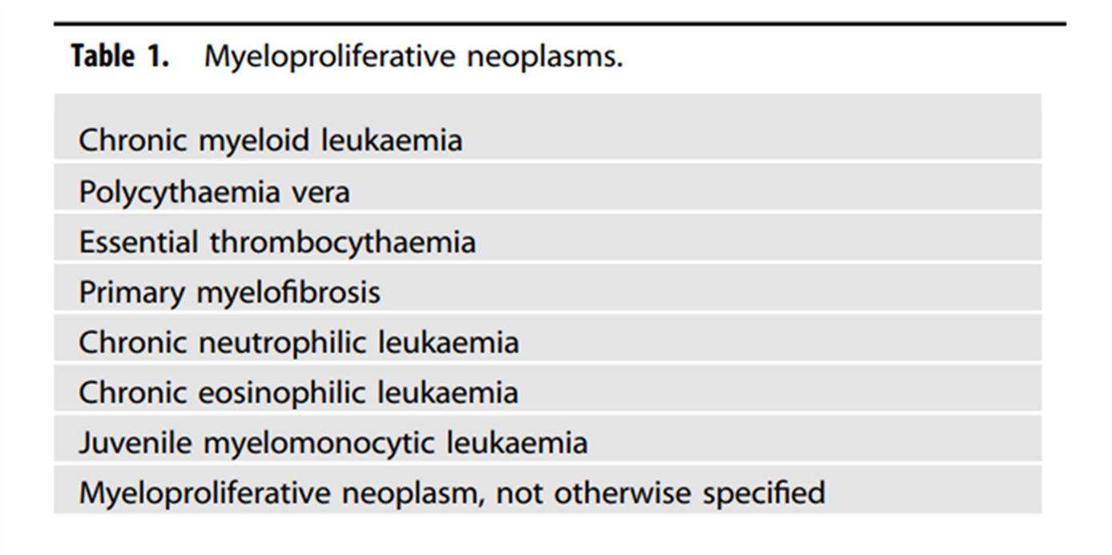

Slide 7
Chronic myeloid leukaemia

Slide 8
Chronic myeloid leukemia or what is also known as BCR-ABL positive CML is is a clonal disorder of a pluripotent stem cell. The disease accounts for around 15% of leukemias and may occur at any age, it is included in the myeloproliferative neoplasms
In general chronic leukemias are distinguished from acute leukemia by their slow progression and with currently available treatment options many patients can live for many years

Slide 9
Pathogenesis
The whole mark of the disease is the presence of the Philadelphia (Ph) chromosome. Which is found in more than 95% of the cases.
This results from the t(9;22) (q34;q11) translocation between chromosomes 9 and 22, as a result of which part of the oncogene ABL1 is moved to the BCR gene on chromosome 22 and part of chromosome 22 moves to chromosome 9.
The abnormal chromosome 22 is the Ph chromosome; the variant chromosome 9 does not have a specific name.

Slide 10
The resulting chimeric BCR-ABL1 gene usually codes for a fusion protein of size 210 kDa, This has constitutively active tyrosine kinase activity in excess of the normal resulting in uncontrolled cell proliferation.

Slide 11
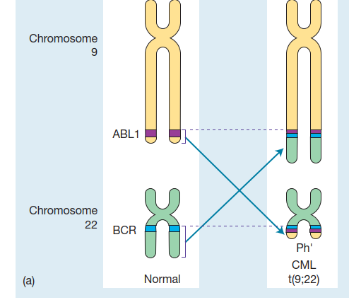

Slide 12
The PH translocation may also be seen in Acute lymphoblastic leukemia and here the breakpoint in the BCR region may be different with a fusion gene that codes for 190 kda protein which also has an enhanced tyrosine kinase activity.
The translocation is found in all myeloid cells , some B lymphocytes & very small proportion of T cells & in no other cells in the body.

Slide 13
As the disease progress additional clonal abnormalities may be detected like for example + 8 ,+19 , iso -17q , this means usually that the new clone will expand & that blastic transformation will manifest itself with in weeks or months .
The presence of the (PH) chromosome carries good prognosis in CML patients as the disease will respond dramatically to certain types of drugs that will inhibit the activity of the abnormal tyrosine kinase enzyme.

Slide 14
Disease course :-
CML is a biphasic or triphasic disease that passes into more than one phase;-
the chronic phase :- most of the patients are usually diagnosed in the chronic phase, the chronic phase usually last for about 2-7 years occasionally 10-15 year before transforming to the next phase
accelerated phase;- most patients in the chronic phase will progress gradually to the accelerated phase that may last for months or sometimes years before transforming to the blastic crises phase.
Blastic crises phase: - an acute phase characterized by increase in the number of blasts to the level seen in acute leukaemia. In 30% of patients the chronic phase transform abruptly to blastic phase (In about 1/5 of cases of blastic transformation is lymphoblastic but in the majority the transformation is to AML.

Slide 15
Investigations: -
Blood picture reveals leucocytosis usually >50 ×10⁹ /L with a complete spectrum of myeloid cells with 2 peaks of neutrophils & myelocytes .Increase basophils in blood .Platelet count is frequently ↑, or may be normal or ↓.
Bone marrow study shows a hyper cellular marrow with predominance of granulocytic component .
in order to confirm the diagnosis cytogenetic study is indicated it will show the presence of (PH) chromosome, also molecular techniques can detect the BCR-ABL fusion transcript (by PCR) and these techniques are now essential for follow up of treatment response in these patients.

Slide 16
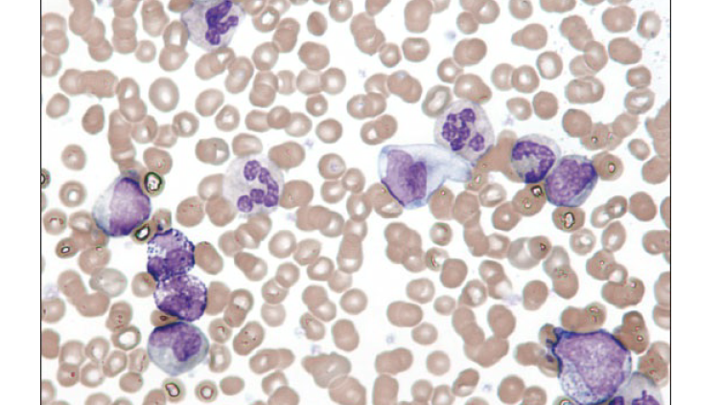

Slide 17
Keep in mind that CML may be diagnosed based on peripheral blood findings and cytogenetic study without the need for bone marrow study.
When the blast % in the blood or bone marrow exceeds 20% or when there is extramedullary accumulation of blasts , then the diagnosis of blastic phase is established.

Slide 18
Polycythemia rubra vera.:-
In this type of MPN the total volume of red cells in the circulation is increased.
The disorder result of mutation of a multipotent haemopoietic stem cell.
in many patients there is also increase in production of granulocytes & platelets but the dominant increase is in the RBC compartment.

Slide 19
Polycythaemia in general means increased in the RBC mass which can be:-
Absolute with a true increase in red cell mass.
Relative with a decrease in plasma volume (as in case of severe dehydration or in burn)

Slide 20
Absolute polycythaemia may be
primary (polycythaemia rubra vera which is one of the MPN)
Secondary to other conditions that may increase the RBC outside the bone marrow.

Slide 21
Secondary polycythaemia could be
associated with appropriate increase of Erythropoietin (hypoxic state), such as heavy smoking, living in high altitude, cardiovascular diseases especially congenital with cyanosis, pulmonary diseases with hypoventilation.
Associated with inappropriate increase in Erythropoietin, like ectopic erythropoitien secretion in renal tumours, cysts, uterine fibromomyoma, hepatocellular carcinoma.

Slide 22
Molecular genetic abnormality of polycythaemia rubra vera
A characteristic molecular abnormality, a V617F mutation in of the JAK2 gene and is observed in about 95% of patients.
This gene normally codes for a protein kinase associated with the haemopoietic growth factor receptor.
The mutation allows the JAK 2 protein to become activated even when no growth factor is bound to the receptor and this leads to cell survival and proliferation

Slide 23
Clinical features:-
It is a disorder of middle aged and old people.
Features mainly result from hyper viscosity & hypervolemia & hypermetabolisim.(headache, blurring of vision, pruritis , plethoric face)
Splenomegaly.
thrombosis(arterial or venous) due to the increase in the blood viscosity.
hypertension develops in half of the cases.

Slide 24
Laboratory investigation:-
CBC and blood film:- ↑Hb, PCV, RBC mass, the WBC and platelet count are less increased.
Bone marrow examination will show an increase in all the haemopoitic elements.
molecular analysis of the JAK2 mutation can be done by PCR .
Increase in serum uric acid and serum LDH.
Serum erythropoietin is low which is helpful to differentiate it from secondary polycythemia.

Slide 25
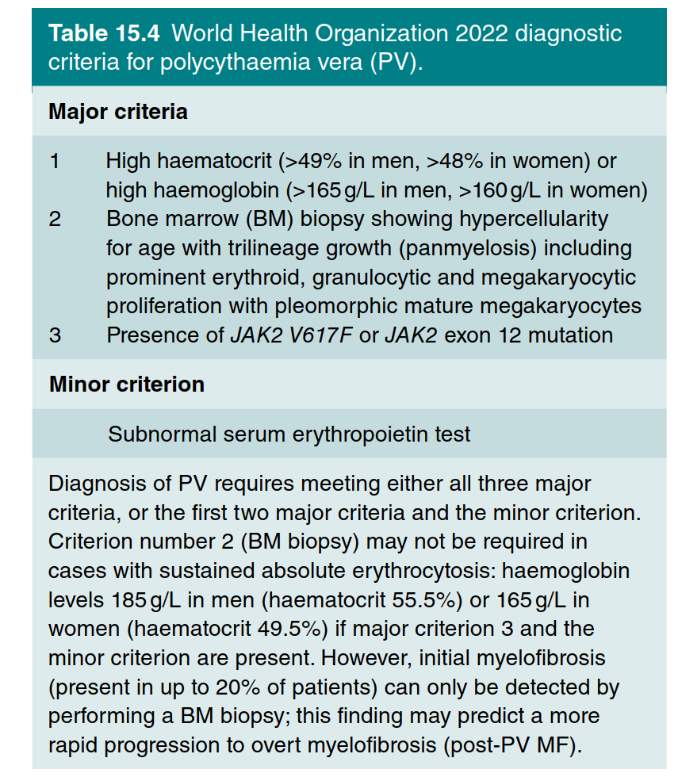

Slide 26
Course & prognosis :-
Good prognosis
thrombosis & haemorrhage are the 2 main problems.
30% of patients transform to myelofibrosis
5% of patients transform to acute leukaemia

Slide 27
Essential thrombocythaemia :-
In this type of MPN there sustained increase in platelet count because of Megakaryocytes proliferation & over production of platelets.
The dominant clinical features are thrombosis & haemorrhage.
40% of patients have palpable spleen, and some patients have spleenic atrophy due to infarction.

Slide 28
The blood film may show increase number of platelets with many abnormal large forms, the bone marrow will show excess of morphologically normal Megakaryocytes.
it is essential to exclude all other causes of reactive thrombocytosis such as haemorrhage, trauma, post operation, chronic iron deficiency, chronic infections , connective tissue diseases and other types of MPN before diagnosing essential thrombocythemia.

Slide 29
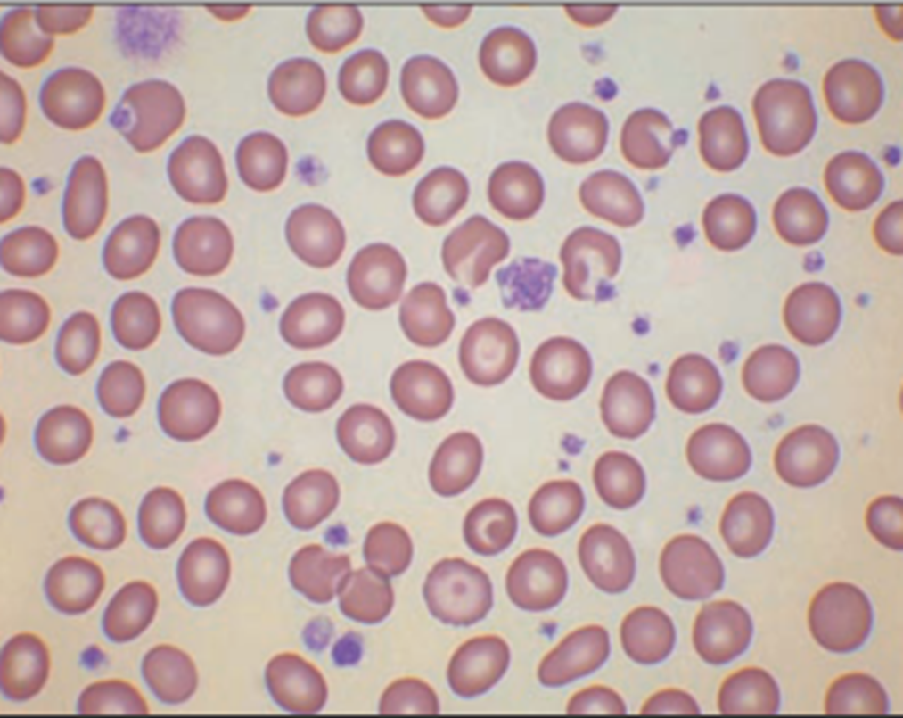

Slide 30
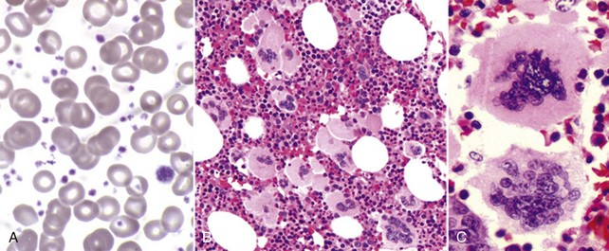

Slide 31
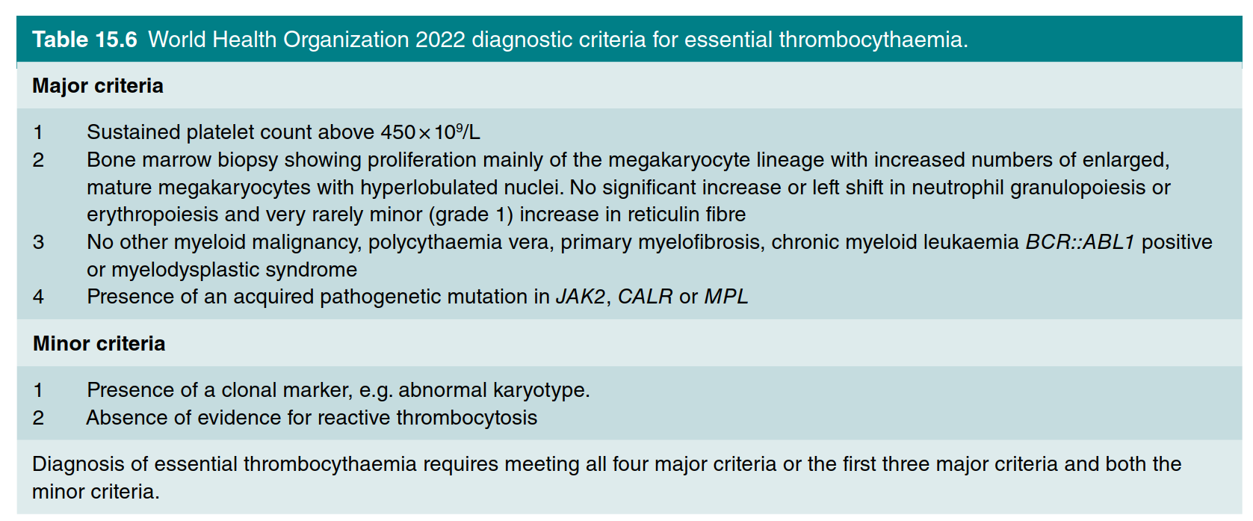

Slide 32
Course and prognosis
The disease may transform after a number of years to myelofibrosis (less than 10%)
risk of transformation to AML is relatively low (less than 5%).

Slide 33
Idiopathic myelofibrosis:
In this type of MPN there is extensive marrow fibrosis that resulted in from the proliferation of abnormal megakaryocytes that will produce platelet derived growth factor and other cytokines that will stimulate fibroblast proliferation and fibrin production.
Patients have a huge splenomegaly due to extra medullary haemopoiesis. Other clinical findings are anaemia, propensity to infection, bleeding tendency.

Slide 34
The disease passes in 2 stages
Profibrotic Stage:- characterized by hypercellular marrow marked proliferation of abnormal Megakaryocytes, minimal fibrosis, spleen smaaler han fibrotic stage.
Fibrotic stage:- with progressive generalized marrow fibrosis in association with megakaryocytes atypia, as a compensatory mechanism there will be extra-medullary hemopoiesis in the spleen and liver, massive splenomegaly will develop

Slide 35
Investigations
Peripheral blood film show anaemia with tear drop morphology of RBC and a leukoerythroblastic blood picture (the presence of immature RBC and immature WBC in the blood)
bone marrow aspiration is difficult because of the fibrosis , bone marrow biopsy will show marrow fibrosis with loss of haemopoietic tissue.

Slide 36
In addition to JAK2V617F mutation and JAK2 exon 12 mutations (60%) patients with PMF can have other mutations which are known as driver mutations (CALR in ∼25% and MPL in ∼10%.

Slide 37
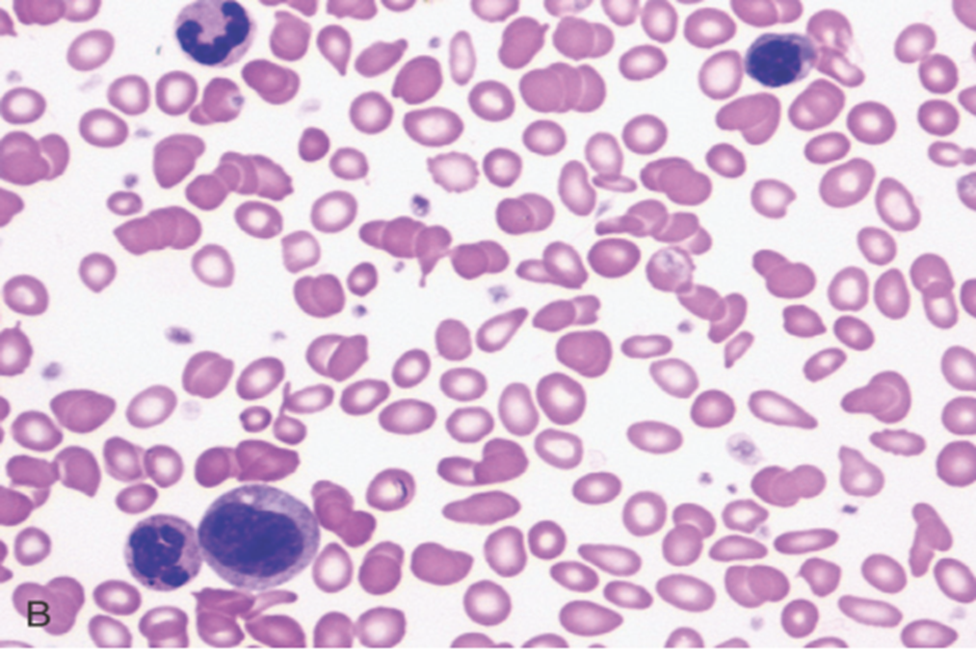

Slide 38
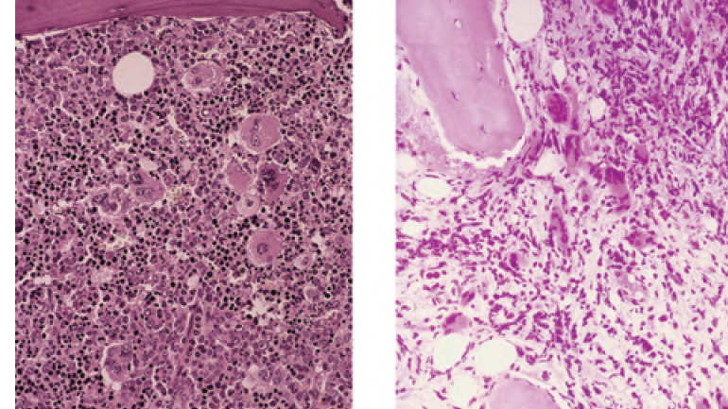

Slide 39
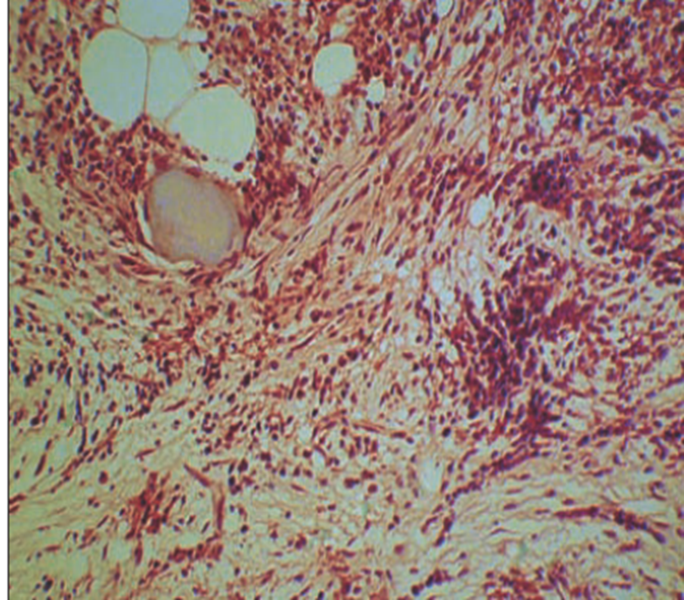

Slide 40
Course and prognosis
Transformation to AML occurs in 10–20% of patients.

Slide 41
Thank you

