Slide 1
Chronic Lymphocytic leukaemia
Prof. Dr. Israa M. Al-Bayaa

Slide 2
70-year-old man presents with fatigue, massive splenomegaly, and a peripheral blood smear showing teardrop-shaped red blood cells and a leukoerythroblastic picture. Bone marrow biopsy reveals extensive fibrosis. Which of the following mutations is most commonly associated with this condition?
A) BCR-ABL
B) JAK2 V617F
C) FLT3-ITD
D) t(15;17)
E) inv(16)

Slide 3
A 62-year-old woman presents with intense pruritus after hot showers, headaches, and a plethora. Laboratory findings include: hemoglobin 19.2 g/dL, hematocrit 58%, WBC 12,000/µL, and platelets 450,000/µL. Serum erythropoietin level is low. Which of the following molecular tests is most likely to confirm the diagnosis?
A) BCR-ABL PCR
B) JAK2 V617F mutation analysis
C) CALR exon 9 mutation
D) MPL mutation testing
E) FLT3-ITD assay

Slide 4
group of disorders that are characterised by the accumulation of mature lymphocytes (of either B or T cell types) in the peripheral blood .
Chronic lymphoid leukaemias are generally classified into B cell types and T cell types and the B cell types are the most common
There is some overlap with lymphoma but generally if the diseases starts first in the bone marrow to later on involve the lymphoid tissue then it is leukaemia.

Slide 5
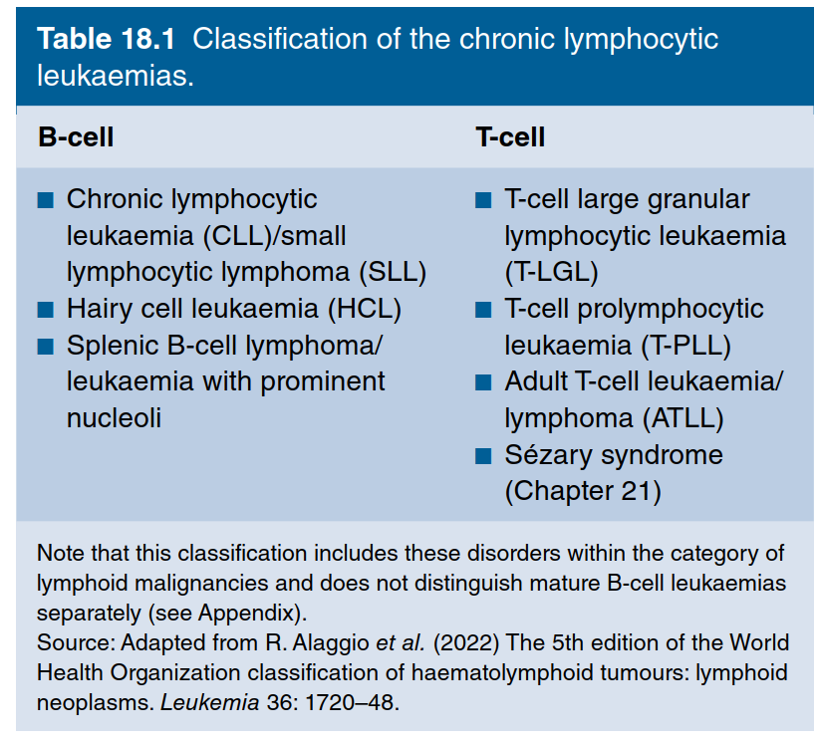

Slide 6
Chronic lymphocytic leukaemia (CLL)/SLL
This is the most common type of chronic lymphoid leukaemia , and is the most common type of leukaemia in the western countries.
the aetiology is unknown
It affects old people with peak incidence between 60-80 years
there is no higher incidence after previous chemotherapy or radiotherapy
there is an increase in incidence in to close relatives of patients which indicates the presence of genetic predisposition.

Slide 7
Pathogeneses:
In CLL there is progressive accumulation of lymphocytes with failure to undergo programmed cell death or apoptosis.
resistance to apoptosis is due to increased expression of antiapoptotic proteins (like BCL2 or MCL1) with decrease expression of the proapoptotic proteins.
the microenvironment helps to increase in the cellular resistance to apoptosis
The cell may respond to Ag by proliferation but they may also respond to self Ag causing autoimmunity

Slide 8
CLL versus SLL
SLL (Small lymphocytic lymphoma) is the tissue equivalent of CLL, SLL cells having the same immunophenotype and cytogenetics as CLL. The difference is that in SLL the neoplastic cells accumulate almost exclusively in the lymph nodes, and by definition there are fewer than 5 × 10⁹/L circulating monoclonal B cells.

Slide 9
Clinical findings: -
Affects old people with male:female ratio of 2:1
Most cases are diagnosed by routine checking (incidental findings).
The most frequent sign is symmetrical enlargement of lymph nodes . the nodes are non-tender and discrete.
There may be features of anaemia or thrombocytopenia.
Splenomegaly and less commonly hepatomegaly .
Although the number of lymphocytes are increased but they are immunologically defected (dysfunctional) with reduced level of immunoglobulin so the patients will suffer from recurrent infections.

Slide 10
Laboratory findings:-
CBC and blood film:- absolute lymphocytosis should be more than 5 X10⁹/L with the presence of many smear cells or smudge cells in the blood film. anaemia present in the later stages due to bone marrow infiltration, autoimmune haemolytic anaemia may occur, thrombocytopenia also seen in late stages and may be due to immune causes or due to BM infiltration.
Confirming the diagnosis requires immunophenotyping to determine the clonality and to see the pattern of markers expressed by the cells , in CLL in addition to the markers of lymphocytes (as CD19) are characterised by the expression of CD5, CD23 with weak or absent surface immunoglobulin with Weak or absence of other markers (FMC7 and CD79b )that help in differentiating it from other chronic lymphoid leukaemia.

Slide 11
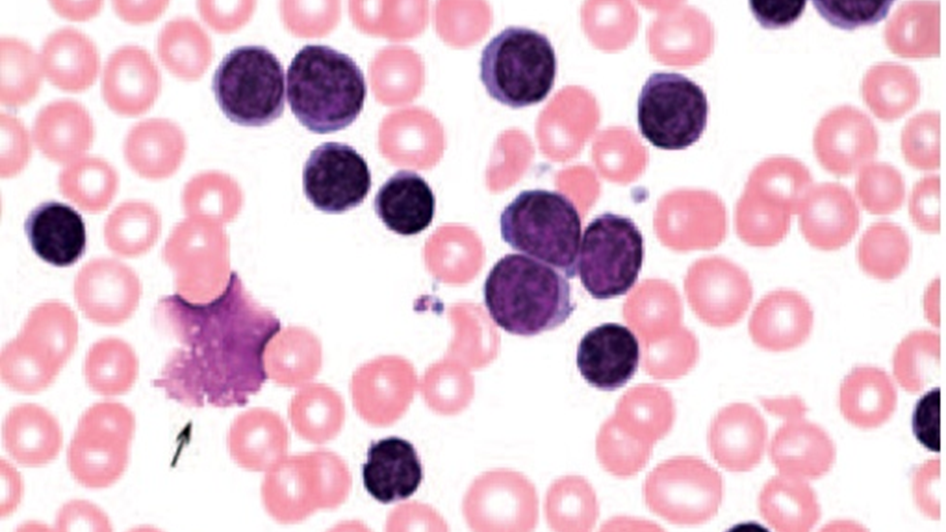

Slide 12
Bone marrow aspiration and biopsy will show infiltration of the marrow by mature lymphocytes replacing other haemopoietic elements. BM study is not necessary for diagnosis but may be helpful in complex cases and to provide information about the cause of cytopenia (infiltration or haemolytic)
Cytogenetic analysis:- many chromosomal abnormalities may be seen but none of them is specific but they carry prognostic significance.
Reduced concentrations of serum immunoglobulins are present, and this becomes more marked with advanced disease. Rarely, a paraprotein is also present.

Slide 13
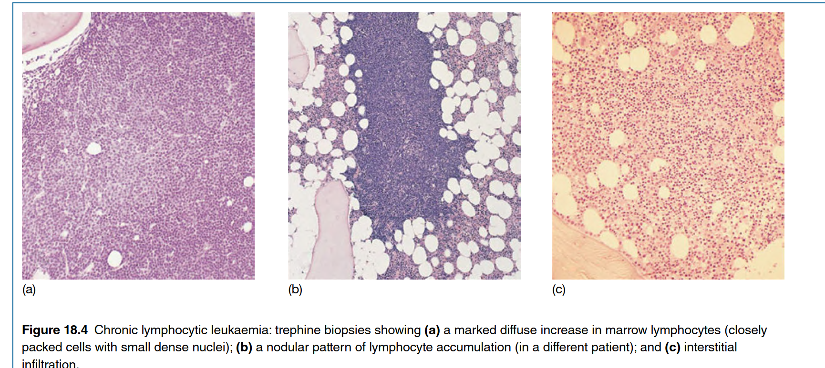

Slide 14
Genetic abnormalities
More than 80% of patients with CLL have one of four cytogenetic abnormalities:
deletion of 13q14.
trisomy 12.
deletion at 11q23.
17p deletion (involving the TP53 gene) which has poor prognosis.
Point mutations can also be seen but less frequently, for example point mutation in P53 gene.

Slide 15
Somatic hypermutation of the immunoglobulin genes
When B cells recognize antigen in the germinal centre of secondary lymphoid tissues, they undergo a process called somatic hypermutation in which random mutations occur in the immunoglobulin heavy-chain gene .
In CLL the IGVH gene shows evidence of this hypermutation in approximately 50% of cases, whereas in the other cases the VH genes are unmutated.
CLL with unmutated immunoglobulin genes has an unfavourable prognosis and may respond less well to initial and subsequent therapy.

Slide 16
Staging of CLL
Staging is useful for both prognosis & making therapy decisions, 2 systems for staging Rai classification & the Binet etal staging.

Slide 17
Binet et al
Rai staging
Stage A:- absolute lymphocytosis and not more than 2 regions of lymph node enlarged (axillary and cervical ), hemoglobin greater than 10gm/dl and platelets greater than 100× 10⁹/l.
Stage B:- absolute lymphocytosis with more than 2 regions of lymph nodes enlarged, hemoglobin greater than 10gm/dl and platelets greater than 100× 10⁹/l.
Stage C:- hemoglobin concentration less than 10 and platelet count less than 100 regardless to the number of lymph regions involved.
Stage0:- absolute lymphocytosis more than 15× 10⁹/l
Stage I:- as stage 0 with enlarged lymph nodes (adenopathy).
Stage II:- as stage 0 + enlarged liver or spleen ± adenopathy .
Stage III:- as stage 0 + anaemia (Hb less than 10 g/dl) ± adenopathy ± organomegaly.
Stage IV:- as stage 0 + thrombocytopenia (platelets less than 100×10⁹/l) ± adenopathy± organomegaly.

Slide 18
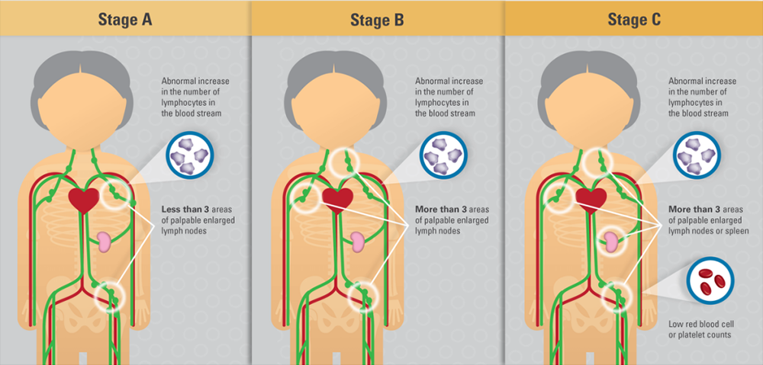
Binet etal staging system

Slide 19
Course of the disease
CLL usually runs an indolent course with many patients in stage A does not require treatment . the disease may transform into an aggressive form of Non Hodjkin lymphoma (Richter Syndrome)

Slide 20
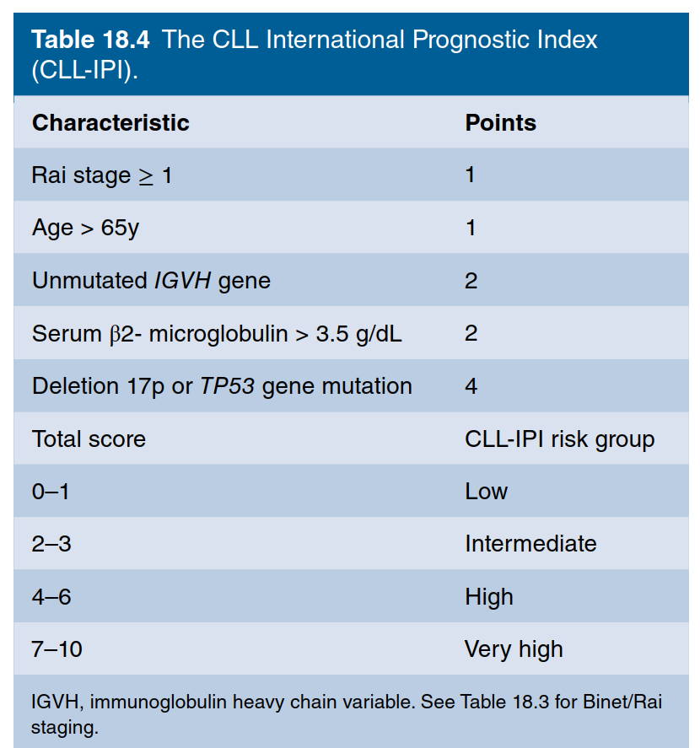
Prognosis

Slide 21
Paraproteinemia
Paraproteinemia refers to the presence of a monoclonal immunoglobulin band on serum protein electrophoresis
normally the immunoglobulins are polyclonal because the are produced from different plasma cells but when the immunoglobulin is monoclonal it means it is produced by a single clone of plasma cells.
Paraproteinemia may be a primary (neoplastic )disease or secondary to other underlying benign or malignant diseases

Slide 22
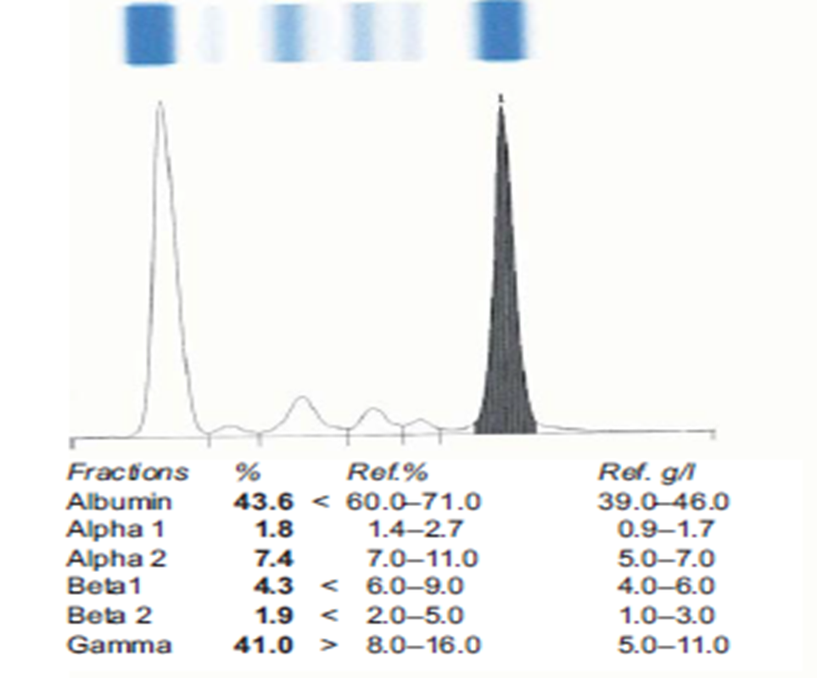
Serum protein electrophoresis showing the presence of a paraprotein (monoclonal Ig )

Slide 23
Benign | Neoplastic
Transient (with infection) | Multiple Myeloma
HIV infection | Solitary plasmacytoma
Chronic cold haemagglutinin disease | Monoclonal gammopathy of undetermined significance
 | NHL
 | CLL
 | amyloidosis
 | Waldenström macroglobulinaemia

Slide 24
Multiple Myeloma
Multiple myeloma is a neoplastic disorder characterised by the accumulation of clonal plasma cells in the bone marrow with the presence of a monoclonal protein in the serum and or urine with evidence of the presence of related organ and tissue damage
the term smouldering myeloma is used when the laboratory findings are present but no tissue damage although most cases progress later on to multiple myeloma.

Slide 25
Pathogeneses
Myeloma cells are clonal plasma cells that secrete the paraprotein the cells accumulate in the bone marrow
The exact aetiology is unknown, there is increase incidence in the black population
there are number of genetic abnormalities seen but dysregulation or increase expression of Cyclin D1 (proto-oncogene that control cell cycle progression from G1-S phase)is an early and unifying event.

Slide 26
Clinical features
Bone pain and especially backache is a prominent complaint due to vertebral involvement by lytic lesions and pathological fracture.
features of anaemia and recurrent infection (due to deficient Ab production)
features of renal failure and or hypercalcemia
there may be bleeding tendency due to interference of the monoclonal Ig with platelet function.
Amyloidosis may occur

Slide 27
Diagnosis
The diagnostic criteria for multiple myeloma is continuously updated based on emerging evidences but in general multiple myeloma diagnosis requires
The presence of monoclonal protein in the serum and or urine
Increase number of clonal plasma cells in the bone marrow
Evidence of related tissue damage (CRAB is an acronym used to describe hypercalcemia, renal impairment. Anaemia and bone disease)

Slide 28
Laboratory findings
Serum protein electrophoresis will show the presence of paraprotein (60% is IgG in type) with decrease in albumin, the normal immunoglobulins are reduced. The urine contains Bence Jones protein which is the monoclonal light chain of the monoclonal Ig (seen in 2/3 of the cases). Rarely the myeloma cells are non-secretary and no paraprotein is detected in the serum or in the urine however the abnormal Ig may be seen inside the plasma cell.
Anaemia which is normochromic normocytic in type or can be macrocytic there is increase in erythrocyte sedimentation rate (ESR)

Slide 29
Bone marrow examination usually shows the presence of increased number of clonal plasma cells that have certain immunophenotyping to differentiate it from normal plasma cells.
Radiological investigation will show bone lesions such as osteolytic lesions without surrounding sclerosis in 60% of the cases or generalized osteoporosis in 20% of thee cases and in 20% of patients no bone lesion is seen. The osteolytic change occur due to osteoclast activation due to release of substances from the plasma cells and the BM microenvironment.

Slide 30
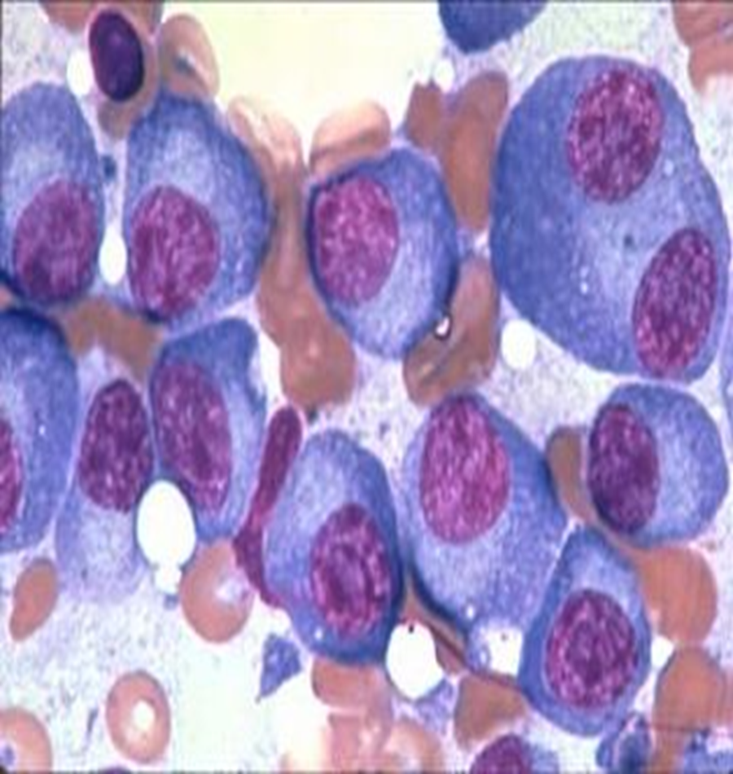

Slide 31
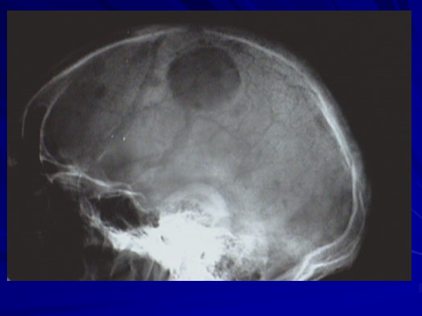

Slide 32
Serum Ca⁺² is increased in about 50% of the cases , renal impairment with increased serum creatinine is seen due to the effect of the deposited protein and the hypercalcemia on the renal tubules.
Cytogenetic study will reveal different forms of chromosomal abnormalities that are very important in determining prognosis.
Serum B2-microglobulin is often raised and is a useful prognostic marker.

Slide 33
Elevated serum immunoglobulin free light chains. Immunoglobulin free light chains (FLC) are κ or λ light chain proteins that have not been paired with heavy chain, Typically in myeloma there is an increase in either the κ or λ serum free light chain value. The normal κ: λ serum free light chain ratio s skewed with an excess of either κ or λ chains.

Slide 34
Thank you

