Slide 1
Lab – 9
Corynebacterium & Mycobacterium

Slide 2
Corynebacterium

Slide 3
Corynebacterium
Corynebacterium
Is a genus of Gram-positive rod-shaped bacteria that are straight or slightly curved & arranged in a V or Y shape, or what is called "Chinese letters arrangement".
They are widely distributed in nature.
They are catalase positive
Non-spore-forming & non -motile
Have a metachromatic granules (energy storage granules).

Slide 4
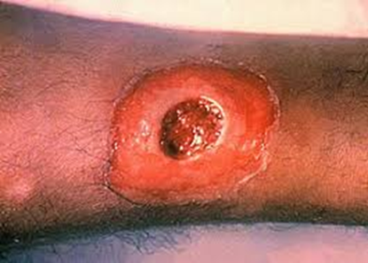
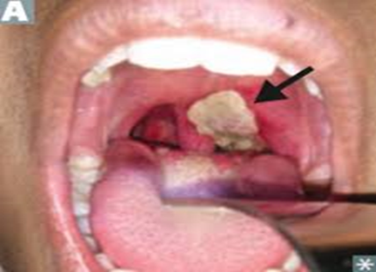
This group includes:
a) C. diphtheria: the most notable human pathogen.
Only toxigenic bacteria (acquired by β phage lysogenic infection) have a powerful toxin that causes
Diphtheria. This infection characterized by formation of pseudomembrane ( A local fibrinous inflammation and necrosis in the tonsils, pharynx, or larynx mucosa)
Skin infection
b) C. diphtheroid: present as part of human flora of skin, nasopharynx, oropharynx, urogenital and intestinal tract.
Skin infection
pseudomembrane

Slide 5
Laboratory diagnostic tests:
Specimen Throat swab from a diphtheria case
Direct microscopic examination
Gram stain; is performed to show gram-positive, non spore forming highly pleomorphic organisms with no particular arrangement (classically resembling Chinese letters).
2. Special stain like Alberts's stain is used to demonstrate the metachromatic granules.
Fixed smear is prepared,
Albert's stain is added for 3-5 minutes,
Washed with tap water,
Lugol's iodine is applied for 1 minute,
Washed then dried and finally examined under the microscope.
The cytoplasm appears light green and the granules blue/black.

Slide 6
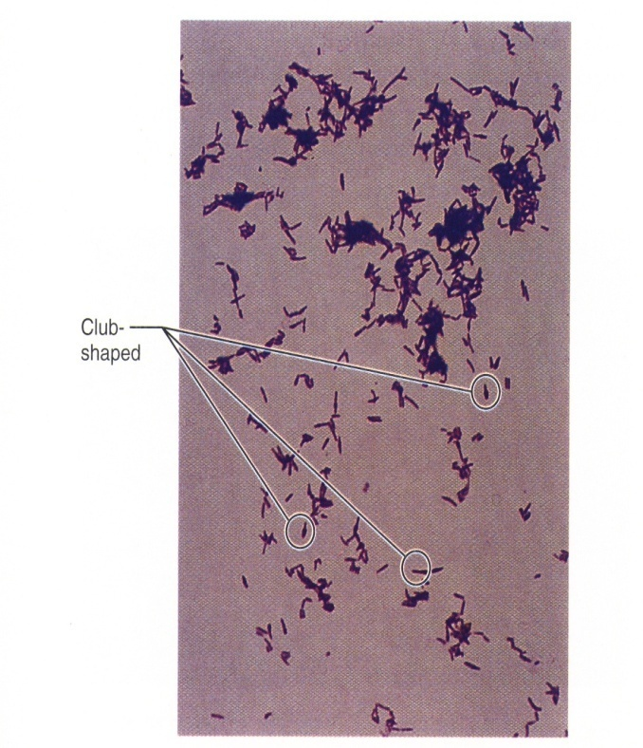
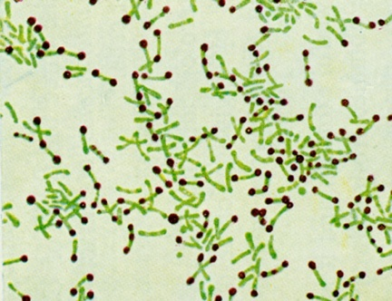
Gram’s stain → G + ve bacilli, Chinese letter.
Albert's stain → Metachromatic granules (dark), bacilli (green).

Slide 7
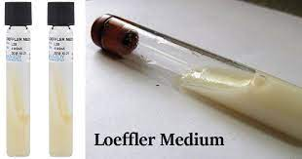
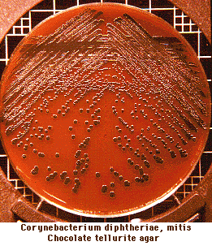
3. Culture:
Culture media include:
Loeffler’s medium.
is used primarily for the cultivation of corynebacteria
It is a selective medium, does not enrich other organisms of the throat.
b. Tellurite blood agar (blood agar + potassium tellurite)
It is a selective medium which allows all Corynebacteria (including C. diphtheriae).
It is medium of choice to study the colonies. Colonies are brown to black because tellurite is reduced intracellularly (inside the bacteria) to tellurium. Bacterial colonies can be differentiated to Gravis, Intermedius and Mitis type.
Black colonies

Slide 8
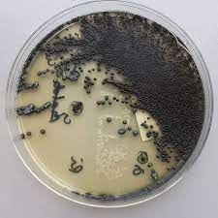
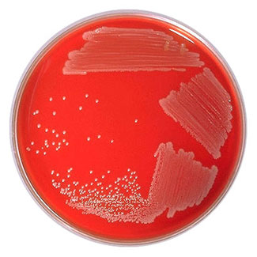
c. Tinsdale medium: It contains cystine–tellurite, this medium is light yellow , colonies of C. diphtheriae appear Small, brownish-black colonies surrounded by a brown halo in the agar.
Tinsdale agar
d. Can grow on Blood or chocolate agar
Corynebacteria on blood agar
The bacteria grow into convex and semi-opaque colonies.

Slide 9
Transmission:-
Respiratory air droplets
contact with cutaneous lesion and /or contaminated objects.
Treatment:-
1. Antitoxin ------------ Neutralize toxin.
2. Antibiotics ---------- Erythromycin to eliminate bacteria.
Protection:-
Vaccines (DPT), booster dose DT after 10 years.

Slide 10
Virulence tests:
1. Invitro Elek's test for toxigenicity :
Identify if the organism is able to produce diphtheria toxin or not.
Filter paper strep containing antitoxin is placed on agar plate.
The tested culture is streaked across the plate at right angle to filter paper
After 48 hours, if the organism is toxigenic a precipitation lines will be formed indicating a specific antitoxin interaction.
2. PCR: by detection of diphtheria toxin genes
3. ELISA test: detection of diphtheria toxin in clinical isolates

Slide 11
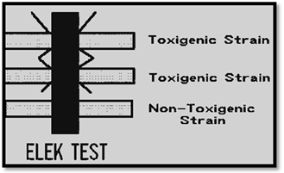

Slide 12
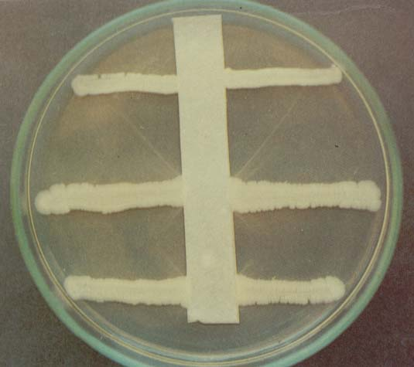
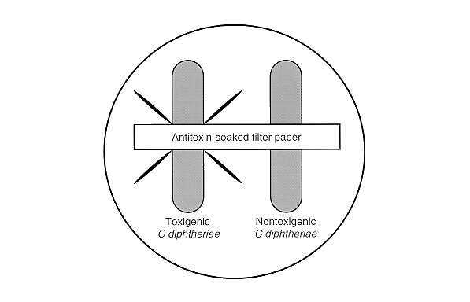
Gel-diffusion test (Elek's test )

Slide 13
Diagnosis of person immunity & susceptibility to infection
Detect the presence of anti-toxin neutralizing antibodies (by previous infection or by immunization) which rendering the person protected or susceptible to infection.
Serum detection of antitoxin by ELISA test
In vivo Schick's test includes intradermal injection of 0.1 ml of purified toxin.
a) Schick positive: If a person does not have enough antibodies to neutralize that toxin, the skin around the injected area will become red and swollen reaches the maximum after 4-7 days and disappear after 10 days. This mean that the person susceptible to infection.
b) Schick negative: If the person has neutralizing antibodies (anti-toxin), then little or no swelling and redness will occur. This mean that the person is immune or not susceptible to infection.

Slide 14
Genus Mycobacterium

Slide 15
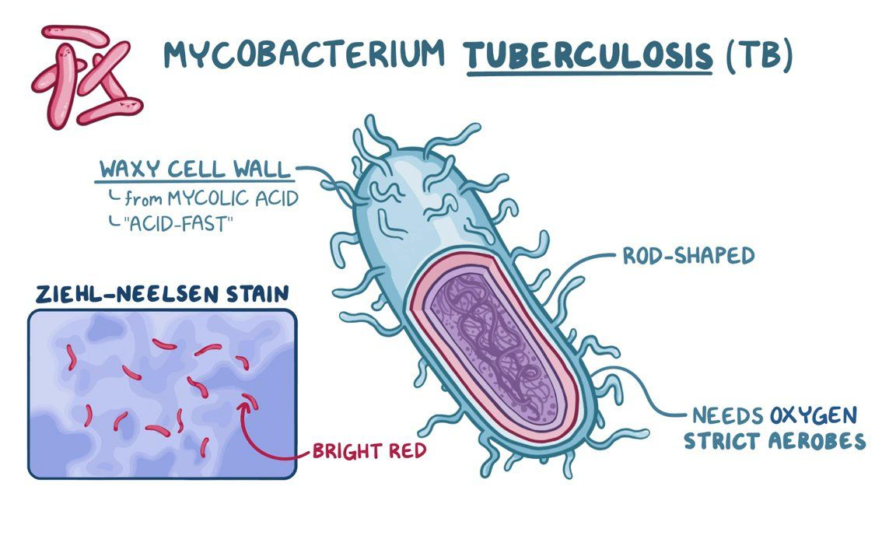

Slide 16
Mycobacterium
The genus includes pathogens known to cause serious diseases in human, including tuberculosis and leprosy
Mycobacteria are aerobic and nonmotile bacteria.
Mycobacteria do not contain endospores or capsules.
They are not classified as either Gram-positive or Gram-negative they are acid fast bacilli referring to their resistance to decolonization by acids during staining procedures.

Slide 17
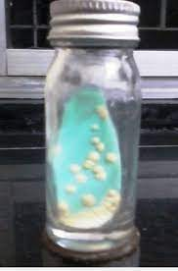
Mycobacterium tuberculosis
Mycobacterium tuberculosis (MTB) is the etiologic agent of tuberculosis in humans.
The bacterium is a facultative intracellular parasite, usually of macrophages, and has a slow generation time, 15-20 hours.
The cell wall structure of Mycobacterium tuberculosis contains peptidoglycan and complex lipids. Over 60% of the mycobacterial cell wall is lipid.
The lipid fraction of MTB's cell wall consists of three major components:
mycolic acids, cord factor, and wax-D.
Löwenstein-Jensen medium, better known as LJ medium, is a selective egg-based medium specifically used for the culture and isolation of Mycobacterium species, including Mycobacterium tuberculosis, from clinical specimens
Löwenstein-Jense medium

Slide 18
Unique Cell Wall
Mycolic acid, giving Waxy feature
Resist decolorization by high acid concentration
so the name "ACID FAST BACILLI = AFB" is given.
Does not stain by Gram’s Stain

Slide 19
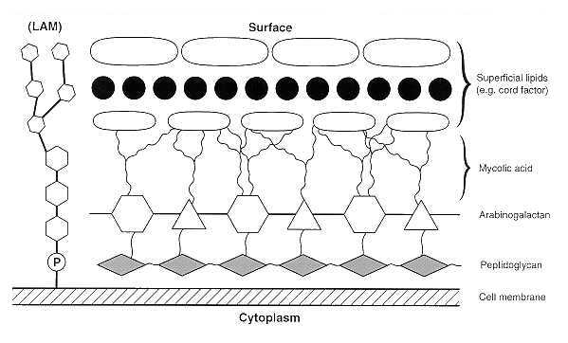
Mycobacterium tuberculosis cell wall

Slide 20
Laboratory diagnostic tests
Specimen; sputum, CSF, joint fluids, urine gastric washings, biopsy material.
Direct smear; Ziehl-Neelsen staining for examining the AFB (acid fast bacilli). In order to detect Mycobacterium tuberculosis in a sputum sample.
Procedure;
Strong carbol fuchsin is added to a fixed smear of sputum. Flood the slide with stain, heat until steaming.
Decolorize with 20% H2SO4 .
Wash with tap water.
Add methylene blue for 1 minute (counter stain).
Dry and examine under microscope. Acid-fast bacilli appear pink in a contrasting blue background.

Slide 21
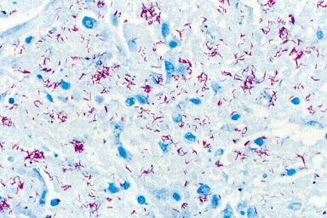
ZN stain

Slide 22
Another method is the Kinyoun method.
The procedure for Kinyoun staining is similar to the Ziehl-Neelsen stain, but does not involve heating the slides being stained.
The Kinyoun staining method uses carbol fuchsin as a primary stain, followed by decolorization with an acid-alcohol solution and methylene blue as a counterstain.
Kinyoun carbol fuschsin has a greater concentration of phenol and basic fuchsin and does not require heating in order to stain properly.

Slide 23
Culture;
Lowenstein-Jensen medium which is an egg based medium prepared as slants contain eggs, potato, serum, glycerol, malachite green and antibiotics.
Colonies appear dry, rough, wrinkled; these bacteria are very slow growers it takes 4-6 weeks until visible growth appears.

Slide 24
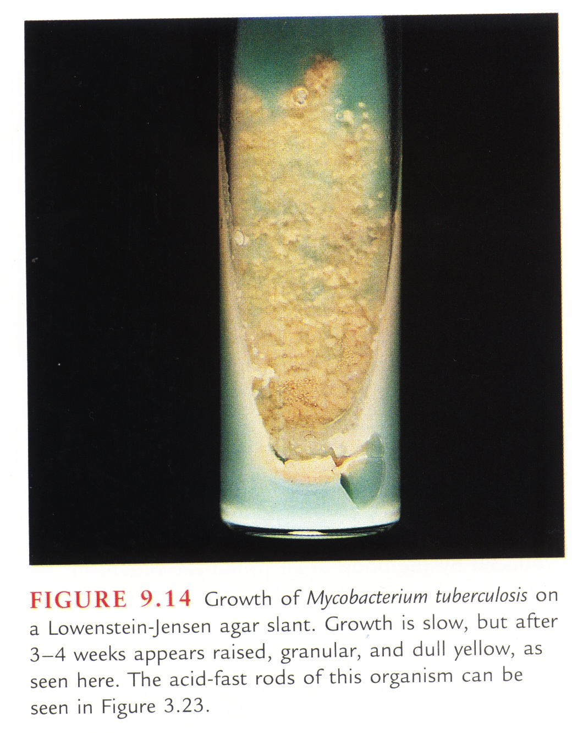
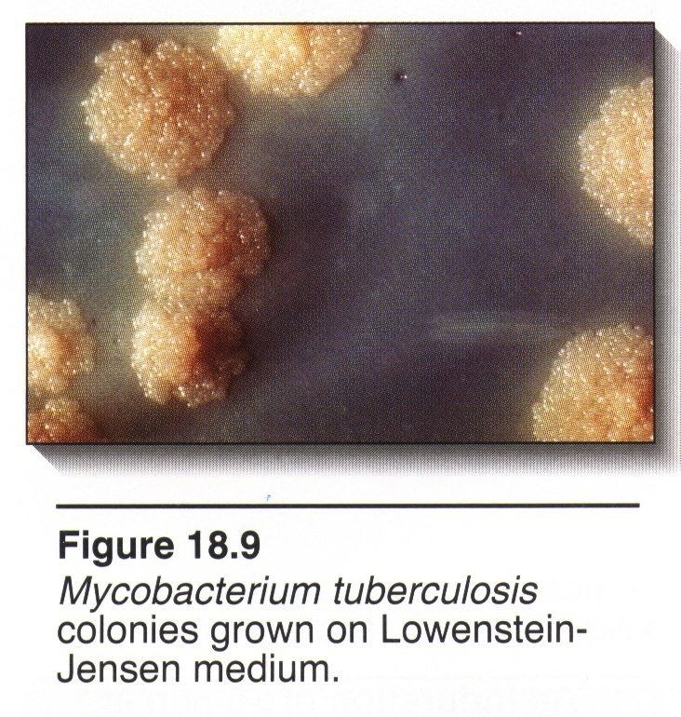
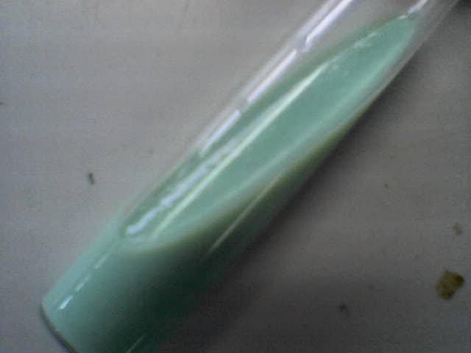
TOUGH, ROUGH, BUFFY colonies

Slide 25
THANKS

