Slide 1
Lab – 14
Genus: Clostridium spp.

Slide 2
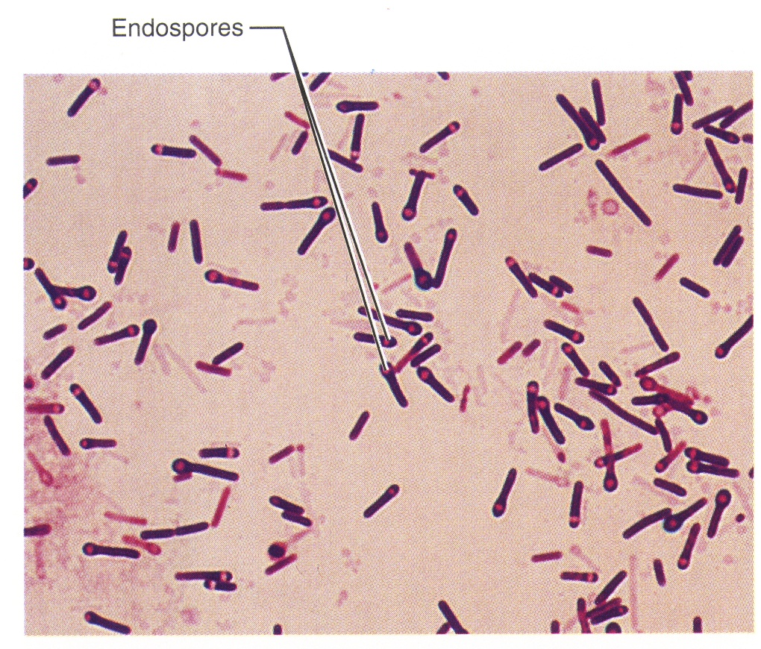
Genus: Clostridium
G + ve Bacilli
Anaerobic spore forming

Slide 3
Genus: Clostridium
4 important species:
C. tetani
C. botulinum
C. perfringens
C. difficile

Slide 4
Clostridium is G+ve, obligate anaerobic spore-forming bacilli.
Four main species responsible for disease in humans:
I// Clostridium tetani
Rod-shaped, rounded ends.
Motile with peritrichous flagella
Spores are rounded terminal, form drum-stick appearance.
Spores are highly resistant, may remain alive for years, and resist boiling for 15-90 min., some may resist dry heat at 150⁰C for 1 hour.

Slide 5
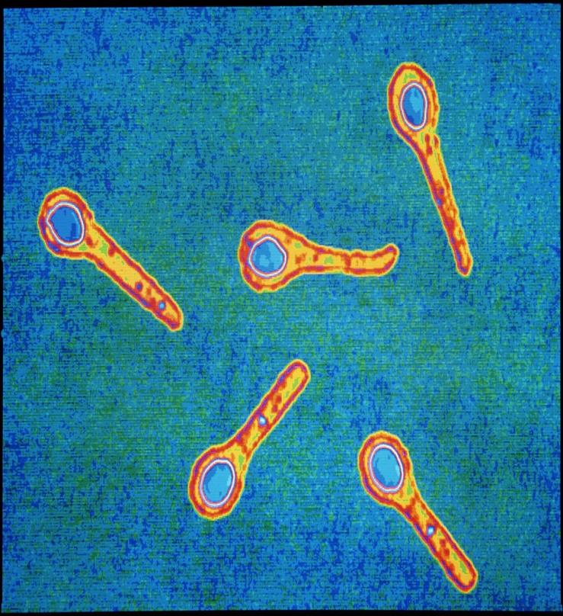
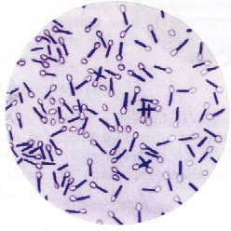
Clostridium tetani
C. tetani their spores are terminally location

Slide 6
II. Clostridium botulinum
Rod-shaped, single or in pairs or in chains
Spores are oval, subterminal, bulging
Motile with 4-8 peritrichous flagella
Form large irregular, glistening colonies with fimbriated border.
Meat is digested in cooked meat medium with putrid odour.
Spores are destroyed at 180ºC in dry heat for 5-15 min., and in boiling for 5 hours.

Slide 7
III. Clostridium perfringens
Gram +ve, obligate anaerobe,
Non-motile,
Spore-forming, Spores are oval, central or subterminal, not bulging.
Capsulated
Grow best on media containing carbohydrates such as; glucose agar, or glucose blood agar.

Slide 8
Spores of strains of food poisoning resist boiling for 1-3 hours. Other strains can resist boiling for several hours.
Produce double zone inhibition {narrow zone of complete hemolysis (theta toxin), while α- toxin (lecithinase) produce a wide zone of hemolysis}.
C. perfringens cause gas gangrene and food poisoning

Slide 9
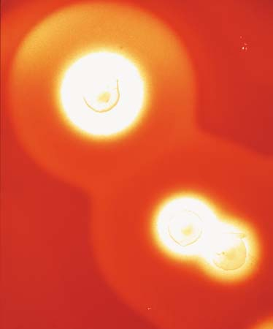
NOTE : C. perfringens produce double zone of hemolysis
Theta toxin
α- toxin (lecithinase

Slide 10
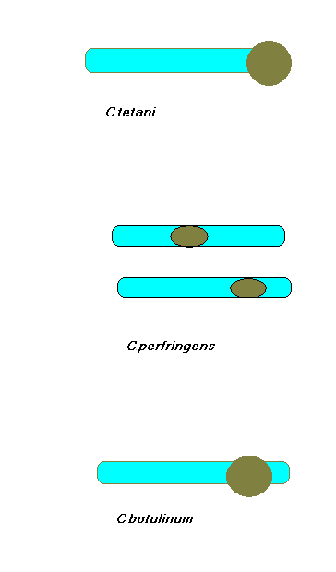
Types of spores

Slide 11
IV. Clostridium difficile
which overgrows during antibiotic therapy, may lead to pseudomembrane colitis.

Slide 12
Laboratory diagnostic tests
Clostridium spp. could be divided into:
Saccharolytic organisms; C. perfringens, ferments carbohydrates, produces acid and gas
Proteolytic organisms; C. tetani, digest proteins with blackening and bad smell production.
Mixed saccharolytic & proteolytic; certain groups of C. botulinum.

Slide 13
Specimen: Wound, food, stool.
1. Gram stain: G+ve rods with spore site according to spp
2. Culture: Cultures are incubated under anaerobic conditions.
a. Blood agar:
Most clostridia produce flat, gray colonies.
They are also usually hemolytic.
Clostridium perfringens produces raised, entire colonies with double zone hemolysis, the complete zone round the colony is due to theta toxin, and the wider zone around it is due to alpha toxin (lecithinase).

Slide 14
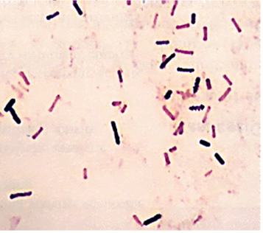
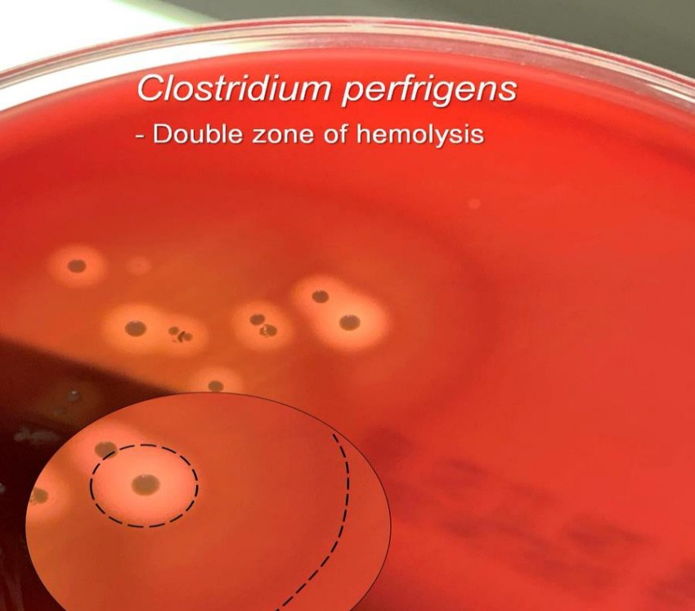
Micro & Macroscopic C. perfringens
Gram stain: G+ve rods
C. perfringens on blood agar with double zone of hemolysis

Slide 15
b. Robertson's medium (cooked meat medium):
Cooked Meat Medium provides a favorable environment for the growth of anaerobes, since the muscle protein in the heart tissue is a source of amino acids and other nutrients.
The sulfhydryl groups, which exert the reducing effect, are more available in denatured protein; therefore, the meat particles are cooked for use in the medium.
Cooked Meat Medium is still widely used for the cultivation and maintenance of clostridia and for determining proteolytic activity of anaerobes.
On Robertson's cooked meat medium → blackening of meat will be observed

Slide 16
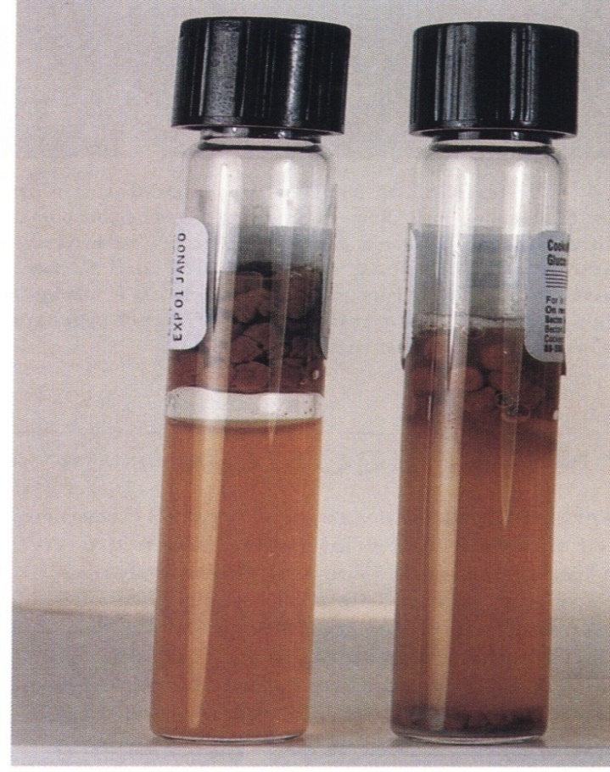
The anaerobic conditions can be provided by:
(Growth & gas produced are evident).
Gas produced lifted the cooked meat particles to the surface.
gas
Cooked Meat Medium Tubes

Slide 17
Reaction on Cooked Meat Medium
Saccharolytic reaction
  It causes fermentation of glycogen of muscles
  Production of acid and gas
  Meat particles remain intact
  e.g C. Perfergines
Proteolytic Reaction
  It causes digestion of meat particles with the production of H2S and NH3
  Formation of black, foul smelling due to sulfur compounds
  e.g C. tetani.

Slide 18
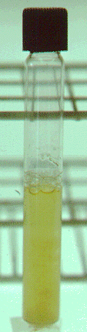
c. Brewer Thioglycollate Medium :
Contains highly nutritious proteose peptone and beef infusion which support the growth of fastidious bacteria.
Sodium thioglycollate helps to create anaerobic conditions.
Methylene blue indicates oxygen content of the medium by exhibiting a bluish-green color of the medium in the presence of oxygen.
Brewer's anaerobic jar is used for growing bacteria under anaerobic condition.
Reducing agents in the medium absorb oxygen and allow obligate anaerobes to grow

Slide 19
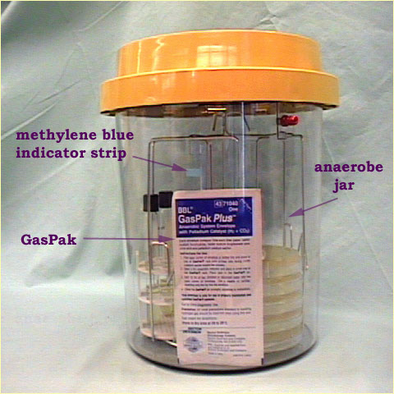
The anaerobic conditions can be provided by:
Anaerobic Jar

Slide 20
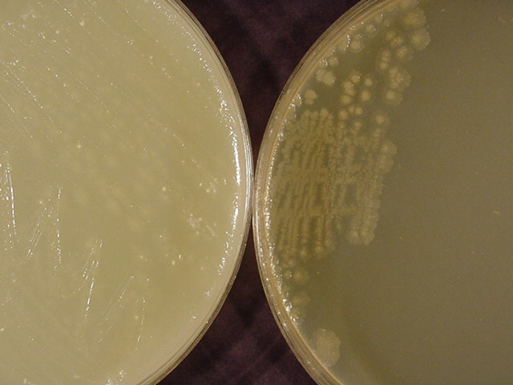
d. Egg yolk agar medium
Definitive diagnostic test for C. perfringens
with C. perfringens growth
White opaque insoluble precipitation around colonies due to lecithinase activity
C. perfringens

Slide 21
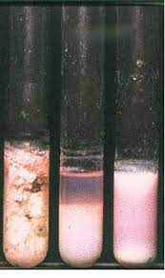
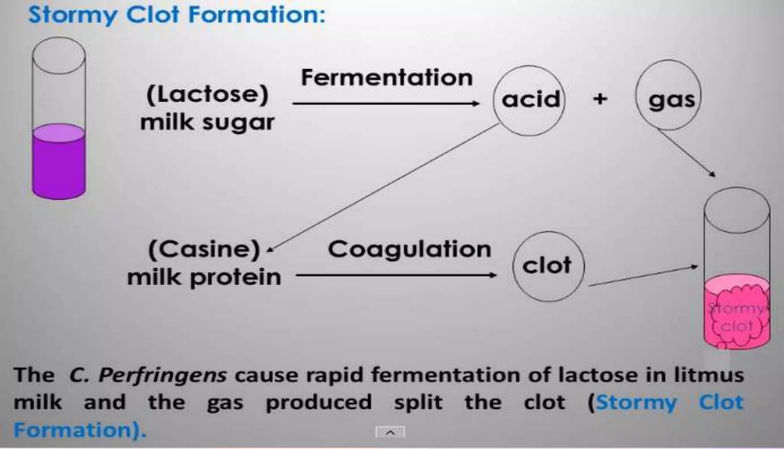
3. Biochemical tests:
a. Stormy fermentation
Stormy fermentation

Slide 22
b. Nagler's reaction for the detection of lecithinase activity
Nagler's reaction is related to the detection of lecithinase activity (alpha toxin of Clostridium perfringens). Nagler's reaction is a test used to identify bacteria that produce the enzyme lecithinase, which hydrolyzes lecithin, a phospholipid found in egg yolk.
An egg-yolk plate is divided into two halves. Over one half is spread with a specific antitoxin.
The culture to be tested, together with a positive control is streaked across the plate, going from the untreated area of the plate to the area that is covered with antitoxin.
The culture is then incubated anaerobically.
Following incubation, lecithinase activity, caused by the action of the Clostridium perfringens a-toxin is seen as a precipitate in the medium on the side of the plate that did not receive the antitoxin, but not on the side that was treated.

Slide 23
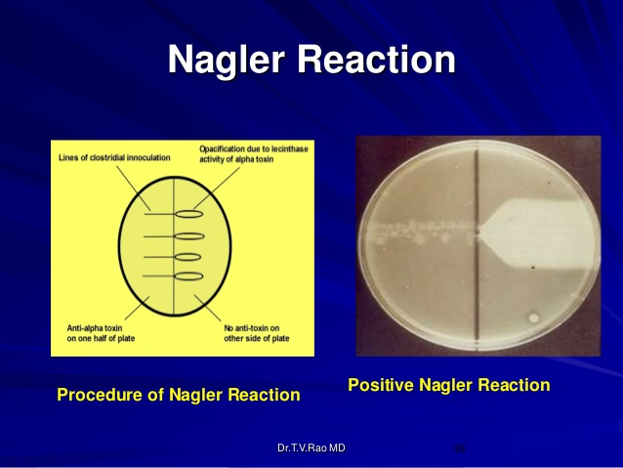

Slide 24
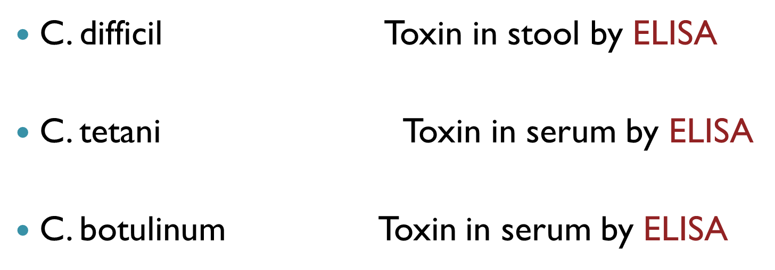
6. Serological test:

Slide 25
Thank you

