Slide 1
Enamel, Dentin, and Pulp; biological consideration
Dr . Farah Salahaldeen
Lecturer in restorative department

Slide 2
Objectives
Understanding the chemical composition, physical properties and clinical consideration of enamel, dentine and pulp.

Slide 3
Enamel
Enamel is the hardest substance of the human
Body.
95% - 98% inorganic matter by weight.
Hydroxyapatite [Ca₁₀(PO₄)₆(OH)₂], in the form
of a crystalline lattice, is the largest minerals
constituent and is present 90% to 92% by volume.
The remaining constituents of tooth enamel are an organic content of about 1% to 2% and a water content of about 4% by weight, and these total approximately 6% by volume.

Slide 4
Enamel Structure
million of enamel rods or prisms,
rod sheaths and a cementing interrod substance in some areas.
The crystallites are tightly packed in a distinct pattern of orientation that gives strength and structural identity to the enamel prisms.
An organic matrix or prism sheath also surrounds individual crystals, and it appears to be an organically rich interspace rather than a structure entity.

Slide 5
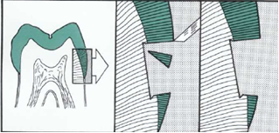
Enamel is the hardest substance of the human body.
Hardness may vary over the external tooth surface according to the location of the area.
also, it decreases inward, with hardness lowest at the dentinoenamel junction.
Enamel is very brittle structure (rigid structure).

Slide 6
Enamel Permeability
Enamel is permeable to certain ions and molecules, permitting partial and complete penetration.
The route of passage / hypomineralized and rich in organic content such as rod sheaths, enamel cracks, and other defects.
Enamel permeability decreases with age because of the changes in the enamel matrix (maturation).
It was reported that application of low Fluoride conc. For a longer period can achieve better remineralisation through lesion depth compared to high conc within shorted period of time.

Slide 7
Enamel attrition
Enamel is as hard as steel, however enamel will wear because of attrition or friction contact against opposing enamel or harder restorative materials such as porcelain.
Heavy occlusal wear is demonstrated when rounded cuspal contacts are ground to flat facets.
Depending on the factors such as bruxism, malocclusion, age and diet; cusps may be completely lost and enamel abraded away so that dentin is exposed. So cavity outline form should be designed so that the margins of restorative materials avoid critical high stress area of occlusal contact.

Slide 8
Enamel solubility
Enamel is soluble when exposed to acid medium.
Solubility increases from the enamel surface to the dentinoenamel junction.
When fluorides are present during enamel formation or are topically applied to the enamel surface, the solubility of surface enamel is decreased.

Slide 9
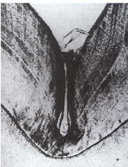
Pit and fissures
Deep invaginations occurs in pit and fissure areas of occlusal surfaces of premolals and molars that decrease enamel thickness in these areas.
These fissures act as food and bacterial traps that may predispose the tooth to dental caries.

Slide 10
Color of enamel
Enamel is mostly grey and is semitranslucent,
the color of the tooth depends upon:
the color of the underlying dentin,
the thickness of the enamel,
the amount of the stain in the enamel.
Abnormal conditions of enamel usually result in aberrant color.

Slide 11
Enamel becomes temporary whiter within minutes when the tooth is isolated from the moist oral environment by rubber dam or absorbents.
This change in color explained by the temporary lost of loosely bonded (or exchangeable) water (less than 1% by weight).
Accordingly, the shade must be determined before isolation and preparation for a tooth - colored restoration.

Slide 12
Dentine

Slide 13
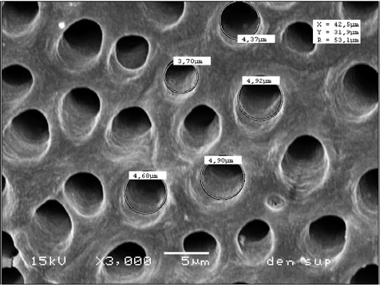
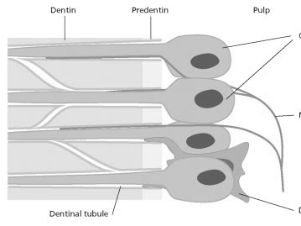
Main structure of dentine /Dentinal tubules
75% inorganic material, 20% organic material, and 5% water and other materials.

Slide 14
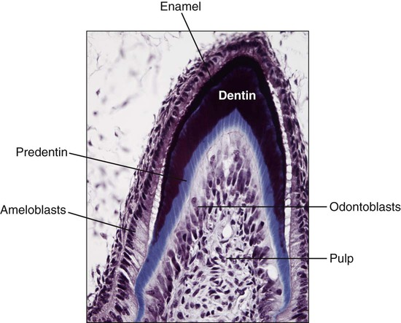
Stages of dentine formation
Predentine:
most recently formed layer of dentine.
This unmineralized zone of dentin is immediately next to the cell bodies of the odontoblastes

Slide 15
Primary dentine
The dentine forming the initial shape of the tooth.
It is usually completed three years after tooth eruption (for permanent teeth).

Slide 16
Secondary dentine
Slowly formed dentin that continues to
construct the dimensions of the pulp chamber.
In response to mild occlusal stimulus.
Mainly deposited in the pulp horns and on the roof and floor of the pulp chamber (narrow occlusogingivally).
The dentist must pay attention for the size and location of the pulp chamber to decide the design of the preparation and placement of retentive features such as pins.

Slide 17
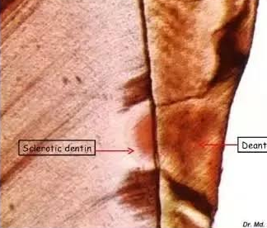
Sclerotic dentine (Transparent or peritubular dentin);
results from aging or mild irritation (such as slow caries) and causes a change in the composition of the primary dentin.
The peritubular dentine becomes wider, gradually filling the tubules with calcified materials, progressing from the dentinoenamel junction pulpally.
Harder, denser, less sensitive, and more protective of the pulp against subsequent irritation.
Sclerosis resulting from aging is physiological dentine sclerosis, and that resulting from a mild irritation is reactive dentine sclerosis.

Slide 18
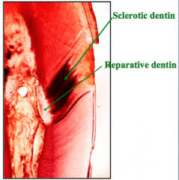
Reparative dentine (tertiary dentine)
is formed in response to moderate – level irritants, such as attrition, abrasion, erosion, trauma, moderate - rate dental caries, and some operative procedures.
In about 15 days, mesenchymal cells of the pulp are converted or differentiated to stimulate the activities of original odontoblast(termed secondary odontoblasts), and form irregularly organized tubules.
The rate of formation and the thickness and organization of reparative dentin depend on the intensity and duration of the stimulus.

Slide 19
Pulp
It composed of nerves, arteries, veins, lymph channels, connective tissue cells, intercellular substance, odontoblasts, fibroblasts, macrophages, and collagen and fine fibers.
The central areas of pulp chamber contains the large blood vessels and nerve trunks.
The area made up of (1) the odontoblasts, (2) the cell-free zone, and (3) the cell-rich zone.

Slide 20
Function of pulp
formative or developmental; is the production of primary and secondary dentin by the odontoblasts.
(2) nutritive;
(3) sensory or protective;
(4) defensive or reparative; is related primarily to its response to irritation by mechanical, thermal, chemical, or bacterial stimuli.

Slide 21
Thank you

