Slide 1
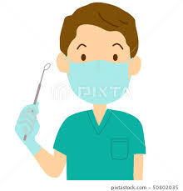
Occupational Hazards in Dentistry
Dr. farah

Slide 2
Occupational hazard
Occupational hazard can be defined as a risk to a person usually arising out of employment.
It can also refer to a work, material, substance, process, or situation that predisposes or itself causes accident or disease in a work place.

Slide 3
The practice of dentistry exposes dental professionals to a variety of work related hazards. These includes:
Working in a sanitary state
Working at a high level of concentration for long hours
Working with anxious patients
Exposure to microbial aerosols generated by high speed rotary hand pieces.
Exposure to various chemicals used in clinical dental practice

Slide 4
Major occupational hazards
The major occupational hazards are:
Biological health hazards
Physical hazards
Chemical hazards
Musculoskeletal disorders and diseases of the PNS
Mechanical hazards
Psychosocial hazards
Legal hazards

Slide 5
Biological health hazards
Dental patients and dental health care workers may be exposed to a variety of microorganisms via blood or oral or respiratory secretions.
It includes: cytomegalovirus, hepatitis B virus (HBV), hepatitis c virus (HCV), herpes simplex virus types 1 and 2, human immunodeficiency virus (HIV), mycobacterium tuberculosis, staphylococci, streptococci, and other viruses and bacteria especially those that infect the upper respiratory tract.

Slide 6
Hepatitis B virus (HBV) Modes of transmission in dentistry
• HBV is transmitted both percutaneously and non-percutaneously.
• During treatment multiple opportunities exist for inadvertent percutaneous wounds to the operator and staff.
• Non percutaneous transmission in the dental environment includes transfer of infectious bodily secretions such as saliva, blood and crevicular fluid.
• Dental practitioners are considered as a group with one of the highest risk exposures to HBV.

Slide 7
Signs and symptoms of hepatitis B infection
It varies from a mild flu like illness to fatal liver failure depending on the individuals general health and immune response. The incubation period in the average being 60 - 120 days. The onset of acute disease is generally insidious.
The prodromal phase begins suddenly with anorexia, malaise, nausea, vomiting and fever. Urticaria and arthralgia may also occur. After 3 to 10 days, dark urine appears followed by jaundice. After 1 to 2 weeks jaundice fades and recovery begins in 2 to 4 weeks.
Sequel to this infection could be asymptomatic or symptomatic carrier state, cirrhosis, acute hepatitis infection, primary liver cancer or death.

Slide 8
Physical hazards
Cuts from sharp instruments, or puncture wounds from needles or other sharp instruments. Such injuries can result in the transmission of serious infectious disease to the dental worker.
Light: The acute effects of poor illumination are eyestrain, headache, eye pain, lachrymation, congestion around the cornea, exposure to excessive brightness is associated with discomfort, annoyance, and visual fatigue.
Noise: Auditory effects which consist of temporary or permanent hearing loss. Non auditory effects which consists of nervousness, fatigue, interference with speech.

Slide 9
4. Vibration: Vibration affects hands and arms. After some months or years of exposure, the fine blood vessels of the fingers may be increasingly sensitive to spasm.
5. Ultraviolet radiation: Occupational exposure to ultraviolet radiation affects the eye, causing intense conjunctivitis and keratitis.
6. Ionizing radiation: in medicine and industry X rays and radioactive isotopes are widely used. The radiation hazards comprises of genetic changes, cancer, leukemia and in extreme cases the death.

Slide 10
Chemical Hazards
Many biomaterials and auxiliary products used in dentistry are chemically reactive. Hazardous chemical agents used in clinical dentistry include mercury, powdered natural rubber latex (NRL), Disinfectants and nitrous oxide (N2 O). By far the most important and most dangerous of these agents is mercury.
Mercury poisoning can be characterized by tumors of the face, arms or legs and can also be associated with progressive, tremulous illegible handwriting and slurred speech. It is advisable to conduct regular mercury vapor assessments in clinical settings; receive episodic individual amalgam blood level tests; and use water spray, and suction during the removal of old amalgam restorations.

Slide 11
Musculoskeletal disorders and diseases of PNS
At work, the dentist assumes a strained posture both while standing and sitting close to a patient, while providing care which causes an overstress of the spine and limbs and the peripheral nervous system (PNS)
This results in back pain syndrome, neck discopathy, cervicocranial pains and carpel tunnel syndrome.
Carpel tunnel syndrome It is a defect of the median nerve and cubital nerve. In its early phase, it is manifested as paresthesia of thumb and index finger the atrophy of the thenar. Carpel tunnel syndrome is also seen in dental professionals due to the Vibrations of dental instruments

Slide 12
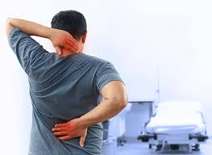

Slide 14
Psychosocial hazards
Stress is the most common psychological condition that occurs in the dental profession. Stress situations form an inherent part of a dentist’s everyday work. Many clinical situations are the source of stress to a dentist and these include:
procedures connected with anesthetization of patients, overcoming of pain and fear, unexpected emergency situations in which a patient’s health or life is in danger, or procedures with uncertain prognosis.
Several factors such as the necessity to keep a proper professional standard, aspiration to achieve technical perfection, cancelled visits or late arrivals by patients, different levels of cooperation with patients.

Slide 15
Legal hazards
In every country there are relevant statutes and regulations which apply to the practice of dentistry to help assure a safe work environment in dental treatment,
The hazard awareness and prevention of legal risks should be made known to all clinical workers of the dental hospital/clinic.

Slide 16
Prevention of occupational hazards
Education is one of the important strategies for the prevention of occupational injuries and diseases.
The role of one’s occupation as an important factor in maintaining personal health needs to be constantly emphasized so workers understand any possible negative health implication of their jobs and how to minimize them.
Concerning prevention, the international literature focuses mostly on infection control and proper handling of potentially infected materials.
Because of the high profile of dentistry regarding transmission of infection, barrier techniques include gloves, masks, protective eye wear, high power suction and good ventilation to reduce aerosols and vapor dangers. Hypoallergenic non latex gloves are proposed to deal with latex allergy. Lead aprons, periodic maintenance of the X-ray machine and radiation level sensors prevent radiation hazards.

Slide 17
Eye precautions
Eye glasses & face shield prevent air borne particles (old restoration, tooth structure, bacteria) during operative procedures .
Dentist more direct path of such particles.
Unusual light sources visible L.C. unit & Laser equipment; using colored plastic shield attached to fiber optic tip.

Slide 19
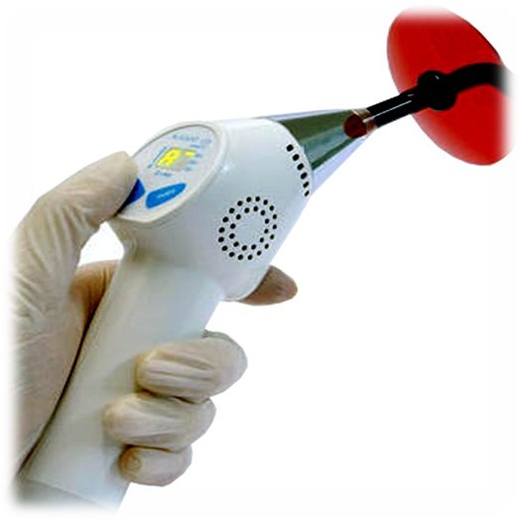

Slide 20
Inhalation precautions
Aerosols are fine dispersions in air consist of water, tooth debris, M.Os.,restorative material
Aerosols & vapor are created by cutting tooth structure& restor. Material.
Aerosols are health hazard to all present.
Cutting amalgam or composite produce submicron particles & vapor; may be inhaled produce alveolar irritation & tissue reaction.
Mask filter out bacteria ;do not filter out mercury or monomer vapor.

Slide 21
According to the centers for disease control dental insruments classified into 3 categories depend upon their risk for transmitting infection:
1-critical: penetrate oral soft tissue
Bone ,blood sream.
Forceps, scalpels, bone chisels, surgical burs.
Sterilized after each use
Steam under pressure, dry Heat or chemical sterilization
2- semi critical: not penetrate oral tissue
In contact oral mucous membrane
Non intact skin
Dental mirror, amalgam condensor, impression tray.
Sterilized after each use.
Or high level disinfictant
3- non critical: contact intact skin, m. membrane.
X-ray head, pulse oximeter.
Cleaned by low level disinfectant.

Slide 22
Pre sterilization Instrument cleaning
Before sterilization or high-level disinfection, instruments should be cleaned thoroughly to remove debris.
• Persons involved in cleaning and reprocessing instruments should wear heavy- duty (reusable utility) gloves to lessen the risk of hand injuries.
•Placing instruments into a container of water or disinfectant/detergent as soon as possible after use will prevent drying of patient material and make cleaning easier and more efficient.

Slide 23
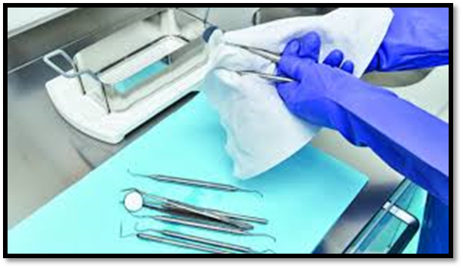
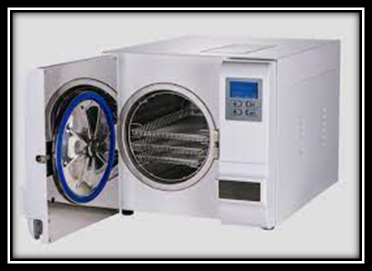
Pre sterilization Instrument cleaning

Slide 24
Disposal of Waste Materials
• Blood, suctioned fluids, or other liquid waste may be poured carefully into a drain connected to a sanitary sewer system.
• Disposable needles, scalpels, or other sharp items should be placed intact into puncture-resistant containers before disposal.
• Solid waste contaminated with blood or other body fluids should be placed in sealed, sturdy impervious bags to prevent leakage of the contained.

Slide 25
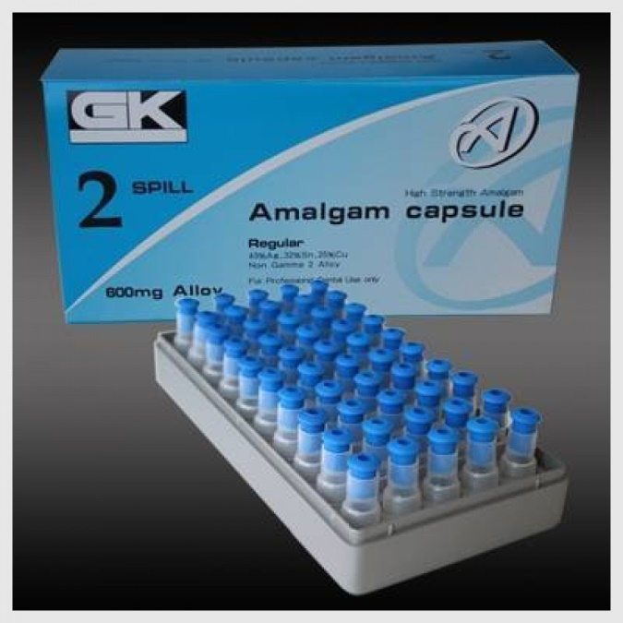
Pre capsulated amalgam
Amalgam waste regulation

