Slide 1
Lecture 1
The Human Body &
Prefixes and Suffixes
By
Assist.Lect. Noor Alaa Addulrazziq
Lecturer at College of Dentistry/Mustansiriyah University

Slide 2
Medical Terms
Medical terminology is a language of compound words matched together to define and condense phrases related to the human body, disease, and conditions.
Misspellings and mispronunciations in a medical setting can result in life-threatening situations.
A misspelled or a misunderstood abbreviation for a medicine dosage can have very serious consequences.
People in health care must check and recheck verbal instructions.

Slide 3
Medical Terms
Forming Medical Terms
Many medical terms are formed from two or more of the following four basic word parts:
Word root is the portion of the word that contains its basic meaning. Example, the word root (cardi) means “heart.”
Combining forms are the word root and a combining vowel that connects or links two parts whenever two consonants come together.
Prefixes are word parts attached to the beginning of a word or word root that modify its meaning.
Suffixes are word parts attached to the end of a word or word root that modify its meaning.

Slide 5
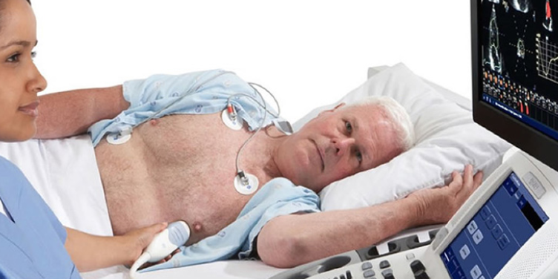
Medical Terms
Cardi o graphy
Word root
Suffix
Combining forms
/car-dee-OG-rah-fee/
“Process of recording heart activity”

Slide 6
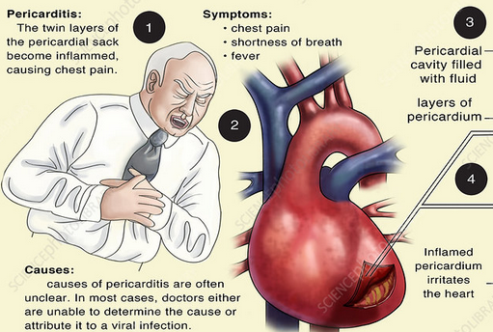
Medical Terms
Peri card itis
Prefix
Suffix
Word root
/peh·ree·kaa·dai·tuhs/
“Inflammation of the pericardium”

Slide 7
Medical Terms
Phonics
With medical terminology, sounds are not always pronounced the same as in everyday English pronunciation.
One thing that helps in both the Standard English and medical worlds, is to learn how to pronounce phonetically — by breaking up word sounds into smaller parts
Peri card itis
/peh·ree·kaa·dai·tuhs/
“Inflammation of the pericardium”

Slide 8
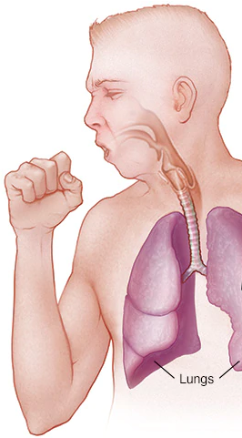
Medical Terms
Pronouncing Common Prefixes and Beginning Sounds
Terms beginning with the letters (ps) are pronounced with “s” sound
Psychology
/sigh-CALL-ogy/
“science of mind & behaviour”
Terms beginning with the letters (pn) are pronounced with “n” sound
/new-MOAN-ia/
Pneumonia
“infection of lung”

Slide 9
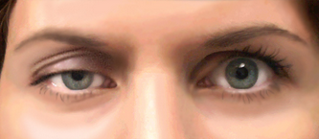
Medical Terms
Pronouncing Common Prefixes and Beginning Sounds
Terms beginning with the letters (pt) are pronounced with “t” sound
Ptosis
/TOE-sis/
“dropping of the upper eyelid”

Slide 10
Medical Terms
Pronouncing Common Prefixes and Beginning Sounds
Terms beginning with (ch) often pronounced like “k” sound
Chronic
/KRON-ic/
“long time illness”
Terms beginning with (c) or (g) can pronounced like “s” or “j” sound if come before i, e, y
/SIGH-toe-plazm/
Cytoplasm
“liquid fills the inside of a cell”
/je-NET-ic/
Genetic
“branch of biology, study of genes”
/je-NET-ic/
Giant
“large”
But (c) and (g) have a hard sound before other letters.
/CARD-iac/
Cardiac
“related to heart”
/GAS-trick/
Gastric
“adj. of stomach”

Slide 11
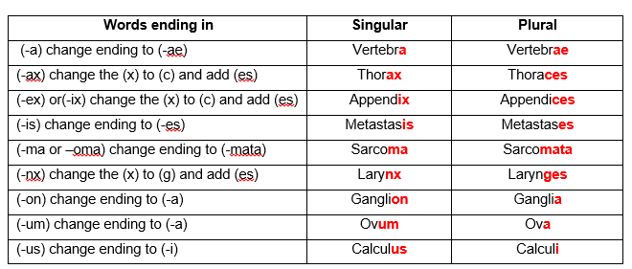
Medical Terms
Pronouncing Common Suffixes and Endings
Singular and Plural Endings
Many medical terms originate from Greek and Latin words. The rules for forming the singular and plural forms of some words follow the rules of these languages rather than English.

Slide 12
Medical Terms
Pronouncing Common Combinations
Some people like to look at the suffix first to determine if the term is a condition, a procedure, disorder, or disease.
Once the suffix is defined, then move to the beginning of the word to define the prefix, if there is one, and the word root. This method is preferred by many people.
Others prefer to tackle the term from the beginning, establishing a meaning for the prefix first, then moving to the word root, and to the suffix last of all.

Slide 13
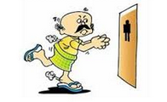
Medical Terms
Pronouncing Common Combinations
Polyuria
Oliguria
/pol-ee-YOUR-ee-ah/
“frequent urination”
/ol-ig-YOUR-ee-ah/
“infrequent urination”

Slide 14
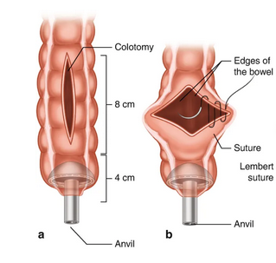
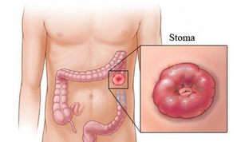
Medical Terms
Pronouncing Common Combinations
Colotomy
Colostomy
/koh-LOT-oh-me/
“Surgical cutting into the colon”
/koh-LOST-oh-me/
“Surgical creation of opening in the colon”

Slide 15
Prefixes Ø Prefixes Related to Size and Quantity
Prefix | Meaning | Example with pronunciation & meaning
bi-, di- | twice, double | bilateral [bī-LAT-er-ăl] (both sides of the body)
hemi- | half | Hemiplegia [hĕm-ĭ-PLĒ-jē-ă] (paralysis of half of the body)
micro- | small | Microscopic [mī-krō-SKOP-ik] (too small to see without a scope device)
mono- | single | monomania [m˘on-ō-MĀ-nē-ă] (single thought or idea)
uni- | one, single | unilateral [yū-nĭ-LĂT-ĕr-ăl] (one side of the body)
multi- | many | multiarticular [MUL-tē-ăr-T˘IK-yū-lăr] (many joints)
poly- | many | polyarteritis [p˘ol-ē-ăr-tĕr-Ī-tĭs] (inflammation of multiple arteries)

Slide 16
Prefixes Related to Position or Location
Prefix | Meaning | Example with pronunciation & meaning
sub- | less than, under, inferior, below or beneath | subcutaneous [sŭb-kyū-TĀ-nē-ŭs] (beneath the skin)
supra- | above, over, excessive | supramaxillary [sū-pră-MĂK-sĭ-lār-ē] (above the maxilla)
trans- | across, through | transdermal [trăns-DĔR-măl] (across/through the skin)
peri- | around, about, near | periappendicitis [PĔR-ē-ă-pĕn-dĭ-SĪ-tĭs] (Inflammation surrounding the appendix)

Slide 17
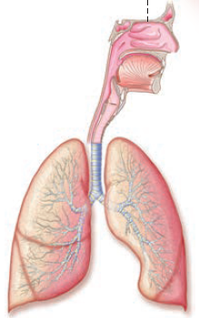
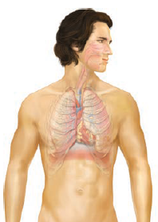
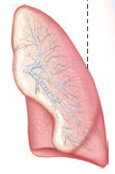
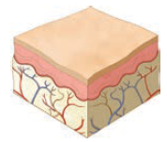
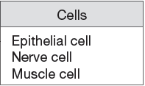
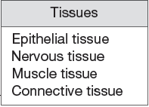
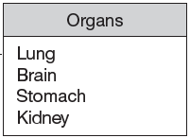
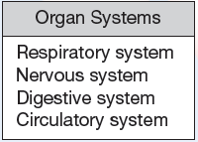
The Human Body
The human body is composed of cells, tissues, organs, and systems. These components are arranged into levels.

Slide 18
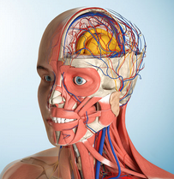
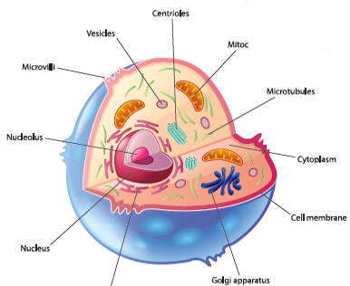
The Human Body
The branches of science which cover the study of the body
Anatomy: is the science that studies the structure of the body and the relationships of its parts to each other.
Biology: is the study of all forms of life and living things.
Embryology: studies the origin and the development of an organism. This covers from the 2nd to the 8th week after conception (embryonic stage).

Slide 19
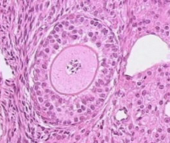
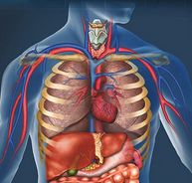
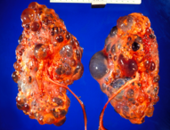
The Human Body
The branches of science which cover the study of the body
Histology: studies the body microscopically. The minute structures and their composition, plus the functions of normal cells, tissue, and organs.
Physiology: studies the normal activity and functions of the body.
Pathology: studies the changes caused by disease to the structures of the body or changes due to disease that alter the functions of the body.

Slide 20
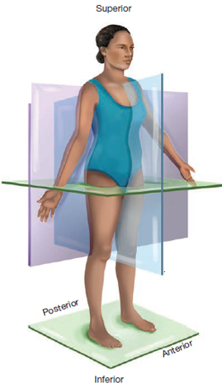
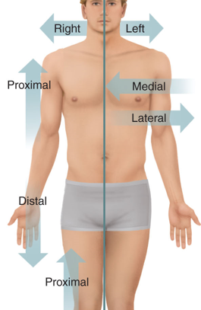
The Human Body
In making diagnoses or prescribing treatments, health care providers use standard terms to refer to different areas of the body. These terms describe each anatomical position as a point of reference.
Directional Terms: are words used to describe the relative location of the body or its parts.

Slide 21
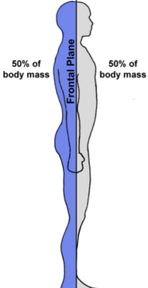
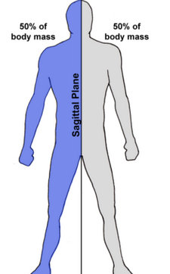
The Human Body
Plane of the Body: is an imaginary flat field that is used as a point of reference for viewing three-dimensional objects. Anatomical planes divide the body into imaginary sections that are useful in describing the location of body parts relative to one another.
Sagittal
Frontal (coronal)

Slide 22
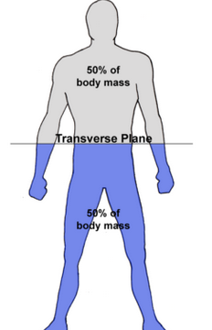
The Human Body
Transverse

Slide 23
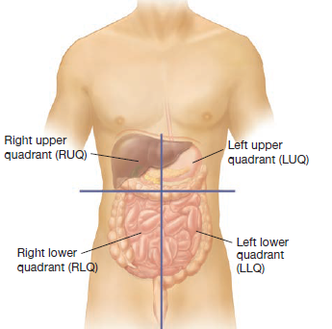
The Human Body
The regions of the body are areas that have been named to give healthcare workers the ability to communicate possible problems that may be revealed during a physical examination.

