Slide 1
Assist.Lect. Noor Alaa Addulrazziq
College of Dentistry/Mustansiriyah University

Slide 2
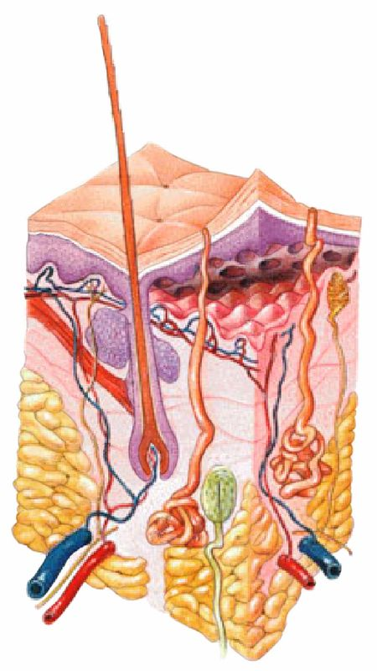
The integumentary system is the largest organ of the body that forms a physical barrier between the external environment and the internal environment that it serves to protect and maintain.

Slide 3
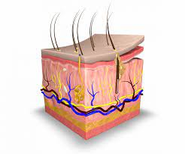
This system is divided into:
1- skin
2- hair
3- nails
4- glands
5- nerve endings

Slide 4
Skin is an organ because it consists of different tissues that are joined to perform a specific function.
Largest organ of the body in surface area and weight.
Dermatology is the medical specialty concerning the diagnosing and treatment of skin disorders.

Slide 5
Skin layers
The human skin consists essentially of three superimposed layers. From the outside to the inside, these are called:
The epidermis, the outermost layer of skin, provides a waterproof barrier and creates our skin tone.
The dermis, beneath the epidermis, contains tough connective tissue, hair follicles, and sweat glands.
The hypodermis is the deeper subcutaneous tissue and is made of fat and connective tissue.

Slide 6
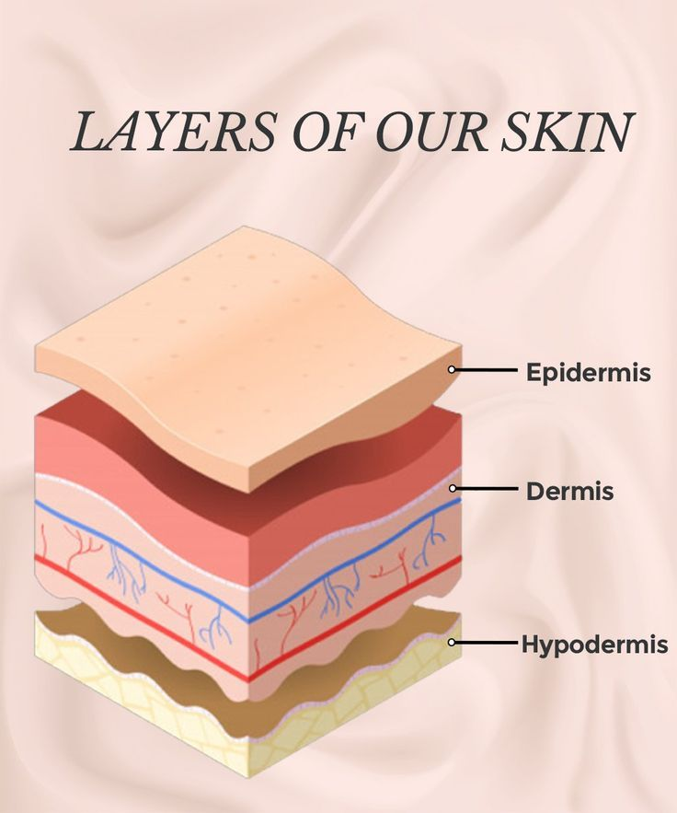

Slide 7
Epidermis
Keratinized stratified squamous epithelium.
It provides a barrier to infection from environmental pathogens and regulates the amount of water released from the body into the atmosphere.
The epidermis does not contain blood vessels and is nourished by diffusion from the dermis.

Slide 8
Epidermis layers
It is composed of the following layers (strata):
Stratum corneum
Stratum lucidum
Stratum granulosum
Stratum spinosum
Stratum basale.

Slide 15
Dermis
The dermis is the layer of skin that lies beneath the epidermis.
It is the thickest layer of the skin, and is made up of fibrous and elastic tissue. Thus it provides strength and flexibility to the skin.
It is comprised of two layers:
The papillary dermis
The reticular dermis

Slide 16
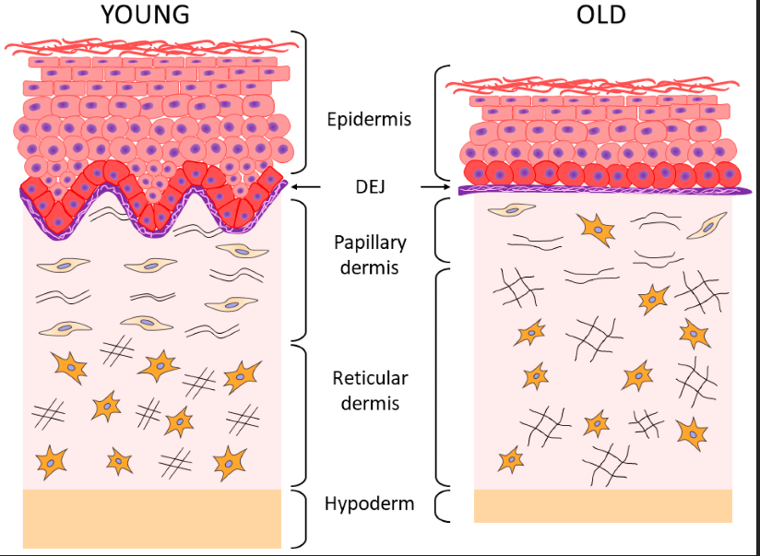

Slide 17
Hypodermis
The hypodermis (also called the subcutaneous layer or superficial fascia) is a layer directly below the dermis and serves to connect the skin to the underlying fascia (fibrous tissue) of the bones and muscles.
It consists of loose connective tissue and adipose tissue. Adipose tissue present in the hypodermis consists of fat-storing cells called adipocytes.
This stored fat can serve as an energy reserve, insulate the body to prevent heat loss, and act as a cushion to protect underlying structures from trauma.

Slide 18
Epidermal Derivatives
Epidermal derivatives (also called epidermal appendages), Accessory structures of the skin include hairs, nails and glands.
They are derived from the stratum basale of the epidermis and are embedded in the reticular layer of the dermis.

Slide 19
Hair
Hair consists of three parts:
Hair shaft is the part that projects from the skin and may extend slightly below the surface of the epidermis,
Hair root is the part embedded within the dermis,
Hair bulb contains a projection of the dermis called the hair papilla, with a capillary of blood supply.

Slide 20
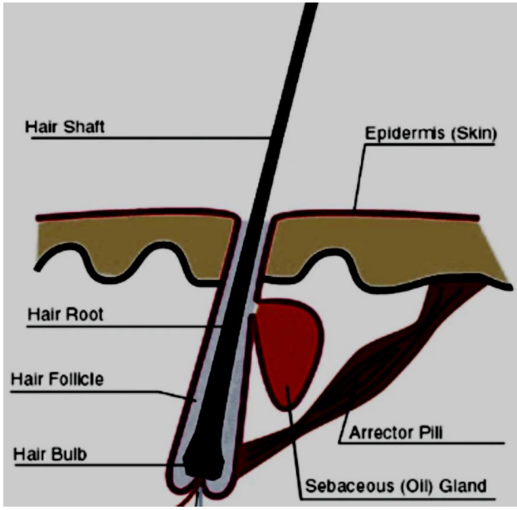

Slide 21
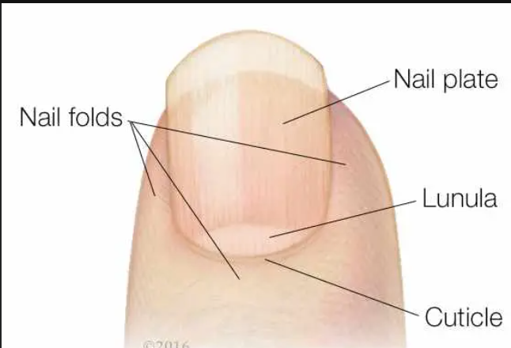
Nails:
The nail is made up of hard, keratinized epidermal cells. It has:

Slide 22
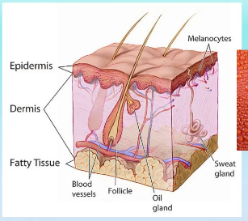
Glands:
Two types of glands exist in the integument.
- Sebaceous glands (oil glands)
- Sudoriferous glands (sweat glands)

Slide 23
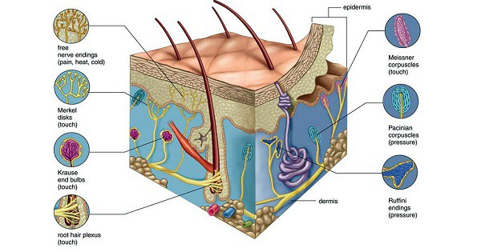
Skin receptors (Cutaneous receptors)
Skin is the most extensive sensory receptor of the body, and both dermis and epidermis layers contain nerve tissue.
Cutaneous receptors :
Mechanoreceptors (touch & pressure).
Thermoreceptors (temperature).
Nociceptors (pain)

Slide 25
Skin Disorders
These are some of the following disorders that affect the skin:
Leukoderma: It is also known as ‘vitiligo’. Skin pigmentation (melanin) is lost from smaller or larger patches at different regions of the body. The exact cause of the disease is still unknown.
Albinism: Loss of pigmentation of the skin all over the body including eyebrows, hair, eyelashes, and even the iris. The skin of affected individuals appears pinkish because of the underlying blood capillaries. Albinism is a recessive trait caused due to inheritance; an albino couple would produce all albino children.
Acne: It commonly occurs on the face, neck, chest, and shoulders. The symptoms are redness, blackheads, pimples, or deep cysts. It may leave scars on the skin if untreated.

Slide 26
Measles: It causes red rashes which spread from the face to down the body within 3 to 5 days. The symptoms include fever, red or watery eyes, cough, and runny nose.
Melanoma: It is the most serious form of skin cancer. It can also appear as a mole that has changed color or gotten bigger over time. Melanoma occurs in areas that are less exposed to the sun and it is common in people with light skin.
Lupus: The symptoms include fever, headaches, fatigue, and painful joints. It spreads across the cheeks and nose.
Wart: It is caused due to different type of viruses called Human papillomavirus(HPV).

