Slide 1
Useful Health and Medicine Idioms in English
Assist.Lect. Noor Alaa Addulrazziq
College of Dentistry/Mustansiriyah University

Slide 2
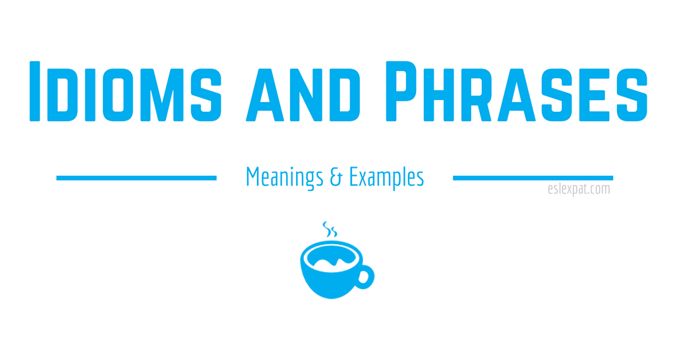

Slide 3
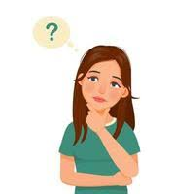
What Is an Idiom?

Slide 4
An idiom is a group of words, or in other words, a phrase that has a meaning different from the literal meaning of the words in it. According to the Oxford Learner’s Dictionary, an idiom is defined as “a group of words whose meaning is different from the meanings of the individual words”

Slide 5
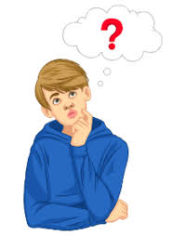
Why You Must Learn Idioms?

Slide 6
Understanding English idioms is important because they require a deeper familiarity of the English language to comprehend what someone means when they use them in conversation.
Idioms may seem complicated at first, but they can actually be a lot of fun to learn.
Idioms Give You a New Way to Express Yourself in the English Language

Slide 7
The meaning of an idiom generally depends on the specific context in which it is used. When someone in America tells you to ‘break a leg’, for example, they aren’t saying that in a literal sense, but instead are wishing you good luck, usually before a performance. Similarly, if someone asks you to ‘think outside the box’, they mean that you should use a different approach than what you might normally do.

Slide 8
Learn list of health idioms, medical idioms, medicine idioms and doctor idioms with meaning and examples.

Slide 9
Alive And Kicking
Meaning: Someone who is still full of energy and is very active. Usually despite health problems or old age.
Example: Even though my grandma is 70 years old, she is alive and kicking.

Slide 10
An apple a day keeps the doctor away
Meaning: Eating healthy and taking care of oneself can prevent illnesses and diseases.
Example: I make sure to eat an apple a day to keep the doctor away.

Slide 11
As fit as a fiddle
Meaning: To be healthy and physically fit.
Example: After going to the gym every day for a month, I feel as fit as a fiddle.
As pale as a ghost
Meaning: To look very pale, usually due to being scared or sick.
Example: She was as pale as a ghost after hearing the bad news.

Slide 12
As pale as death
Meaning: To look extremely pale, usually due to being very sick or close to dying.
Example: After being in the hospital for a week, he was as pale as death.
At death’s door
Meaning: To be very sick or close to dying.
Example: After being diagnosed with cancer, she felt like she was at death’s door.

Slide 13
Back on one’s feet
Meaning: To be healthy and active again after being sick or injured.
Example: After a few days of rest, I was back on my feet and ready to go back to work.
Be on the Mend
Meaning: To be recovering from an illness or injury.
Example: After a week of rest, I was on the mend and feeling much better.

Slide 14
Bitter pill to swallow
Meaning: Something unpleasant or difficult to accept.
Example: Losing the championship game was a bitter pill to swallow, but we learned from our mistakes.
Black-and-blue
Meaning: Bruised, showing signs of having been physically harmed.
Example: After the accident, she was black-and-blue all over.

Slide 15
Break out in a cold sweat
Meaning: To suddenly feel very scared or nervous.
Example: I broke out in a cold sweat when I realized I had left my phone at the restaurant.
Catch one’s death of cold
Meaning: To catch a very bad cold that could lead to serious illness.
Example: If you don’t wear a coat, you’ll catch your death of cold.

Slide 16
Feel on top of the world
Meaning: To feel very happy and confident.
Example: After getting a promotion at work, I felt on top of the world.
Get a charley horse
Meaning: To get a sudden painful cramp in a muscle.
Example: After running a marathon, I got a charley horse in my leg.

Slide 17
Go Under the Knife
Meaning: To have surgery.
Example: After years of suffering from back pain, she decided to go under the knife.
Green around the gills
Meaning: To look or feel sick.
Example: After eating the bad sushi, I felt green around the gills.

Slide 18
Have foot-in-mouth disease
Meaning: To say something inappropriate or embarrassing.
Example: I always seem to have foot-in-mouth disease when I’m nervous.
Have one foot in the grave
Meaning: To be very old or sick and close to dying.
Example: After being diagnosed with cancer, he felt like he had one foot in the grave.

Slide 19
Just what the doctor ordered
Meaning: Something that is exactly what is needed to improve one’s health or situation.
Example: After a long day at work, a relaxing bath was just what the doctor ordered.
Kink in one’s neck
Meaning: A stiff or sore neck.
Example: After sleeping on a bad pillow, I woke up with a kink in my neck.

Slide 20
Run in the family
Meaning: To have a health condition or trait that is common in one’s family.
Example: Diabetes runs in my family, so
I have to be careful about what I eat.
Sick as a Dog
Meaning: To be very ill or sick.
Example: After eating that bad sushi, I was sick as a dog for two days.

Slide 21
Take your medicine
Meaning: To accept the consequences of one’s actions, or to do something unpleasant that is necessary.
Example: You made a mistake, now it’s time to take your medicine and face the consequences.
Under the weather
Meaning: To be mildly ill or not feeling well
Example: I’m feeling a bit under the weather today, so I think I’ll stay home and rest.

Slide 22
Laughter is the best medicine
Meaning: Laughing and having a good time can improve one’s mood and health.
Example: After a stressful day, we watched a comedy and remembered that laughter is the best medicine.

