Slide 1
The Musculoskeletal System
By
Assist.Lect.Noor Alaa
College of Dentistry/Mustansiriyah University

Slide 2
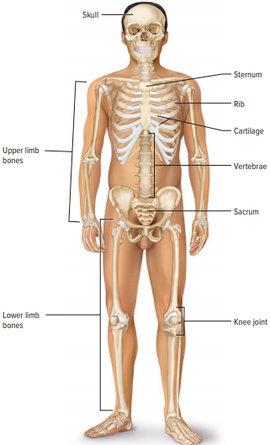
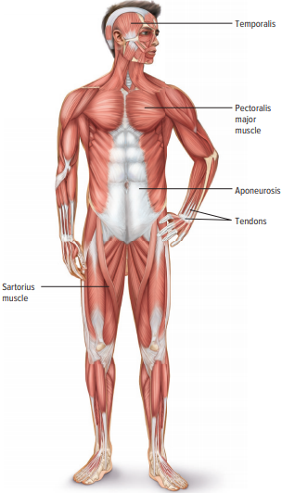
The Musculoskeletal System
This system forms the framework that holds the body together, enables it to move, and protects and supports all the internal organs.
This system includes bones, joints, and muscles.

Slide 3
The skeletal System
The bony skeleton is composed of 206 bones. It provides framework of the body, as giving it a shape.
Bones, also called osseous tissue, are one of the hardest materials in the body. They are connected to other bones by ligaments.
Functions of Bones
Provide shape, support, and the framework of the body
Provide protection for internal organs
Serve as a storage place for mineral salts (calcium and phosphorus)
Play an important role in the formation of blood cells
Provide areas for the attachment of skeletal muscles
Help make movement possible through articulation

Slide 4
The skeletal System
Types of Bones
Long bones: form the extremities of the body, found in arms (humerus is the upper arm) and legs (femur is the thigh).
Short bones: are small, cube-shaped bones found in the wrists, ankles, and toes.
Flat bones: they have large, flat surfaces that cover organs (shoulder blades, pelvis, and skull) are examples of flat bones.
Irregular bones: are specialized bones with specific shapes(bones of the ears, vertebrae, and face) are irregular bones.
Sesamoid bones: are bones formed in a tendon near joints, example: patella (kneecap)

Slide 5
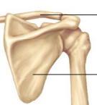
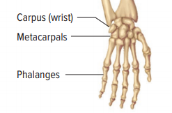
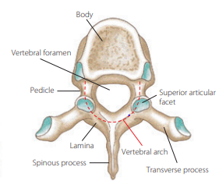
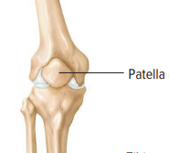
Types of Bones
Short bones
Flat bones
Long bones
Irregular bones
Sesamoid bones

Slide 6
Bones of the Head
The head or skull is divided into two parts cranium and facial bones.
Cranial bones form the skull, which serves to protect the brain and the structures inside of the skull.
Facial bones surround the mouth, nose, and eyes
Cranial bones
Facial bones

Slide 7
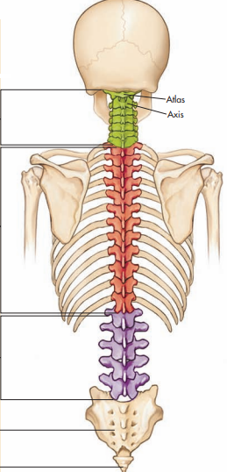
Vertebral column
The vertebral or spinal column extends from the skull to the pelvis. It is composed of 26 bone segments called vertebrae, which are arranged in five divisions
Cervical vertebrae: seven vertebrae located in the neck.
Thoracic vertebrae :12 vertebrae connect to the ribs.
Lumbar vertebrae: five bones of the middle back.
Sacrum: curved bone of the lower back and consists of five separate bones at birth that fuse together in early childhood.
Coccyx: called the tailbone, is formed from four bones fused together.

Slide 8
Bones of the Chest and Pelvis
There are two weight-transferring transverse sections of bones. The upper is the group formed by the
clavicle (collar bone) and scapula (shoulder blade), which transfers the weight of the upper body and
distribute it evenly to the spine.
The second weight-transferring transverse section is formed by the pelvic girdle. The bones of the pelvis
serve to support and protect the body. The pelvic girdle transfers the weight of the body from one leg
to the other during running, walking, or any movement.

Slide 9
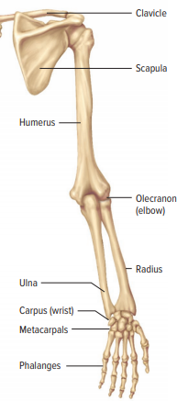
Bones of the Extremities
Bones of the arms, hands, and legs allow the body to move.

Slide 10
Humerus [HYŪ-mĕr-ŭs]: Upper arm bone
Radius [RĀ-dē-ŭs]: forearm bone on thumb side of lower arm.
Ulna [U˘L-nă]: forearm bone on little finger side of lower arm
Carpus (carpal bones) [KĂR-păl bōnz]: the eight bones of wrist
Metacarpus (metacarpal bones) [MĔT-ă-KĂR-păl bōnz] are the five bones of the palm that radiate out to the finger bones.
Phalanges [fă-LĂN-jēz]: finger bones; three in each finger and two in each thumb.
Femur [FĒ-mŭr]: upper leg bone or thigh bone
Patella [pă-TĔL-ă]: Kneecap
Tibia [TI˘B-ē-ă]: shin bone; thicker lower leg bone
Fibula [FI˘B-yū-lă] Thinner long bone in lateral side of lower leg

Slide 11
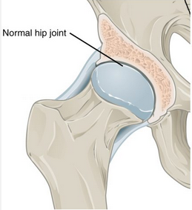
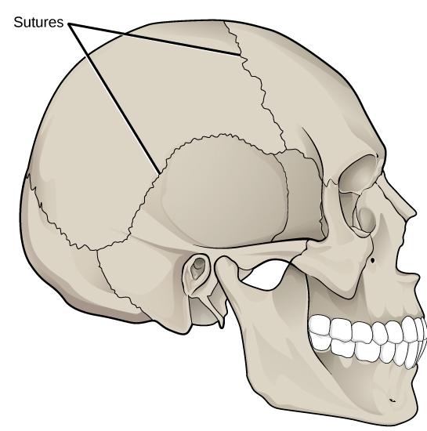
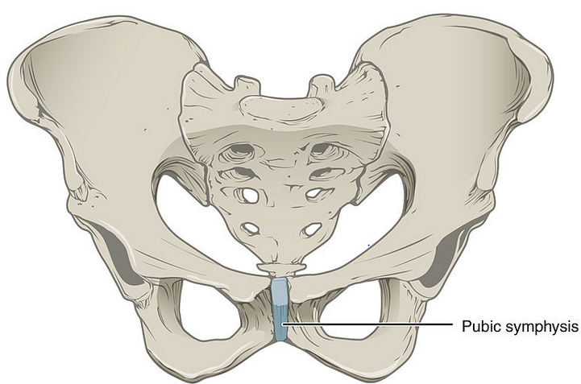
Joints
Joints are formed when two or more bones meet.
This is also referred to as an articulation.
There are three types of joints
Synovial joints : are freely movable joints
Cartilaginous joints: allow for slight movement
Fibrous joints: allow almost no movement

Slide 12
The Muscular System
Muscles are bundles of parallel muscle fibres. As these fibres contract (shorten in length) they produce movement of or within the body.
Muscle tissue may be either voluntary or involuntary
Voluntary muscles a person consciously chooses to contract and for how long and how hard to contract them (skeletal muscles of the arm and leg)
Involuntary muscles under the control of the subconscious regions of the brain (smooth muscles found in internal organs and cardiac muscles)

Slide 13
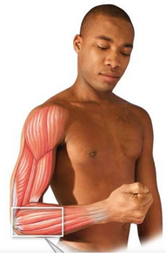
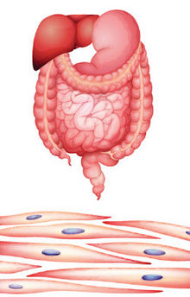
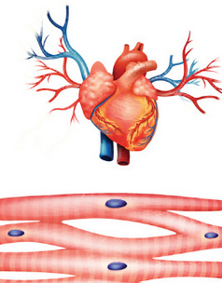
Skeletal Muscle
Types of Muscles
It is directly or indirectly attached to a bone and produces voluntary movement of the skeleton.
Smooth Muscle
This is found in association with internal organs. It is also referred to as visceral muscle.
Cardiac Muscle
It makes up the wall of the heart.

Slide 14
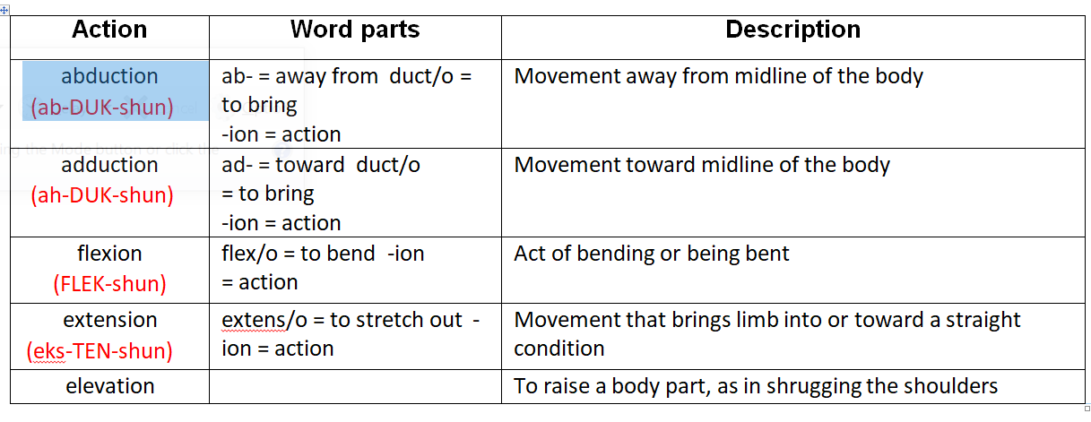
Some common terminology for muscle actions are described below:

Slide 15
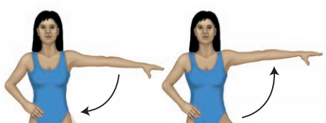
Skeletal Muscle Actions
Adduction
Adduction
Abduction
Abduction
Abduction: Movement away from midline of the body
Adduction: Movement toward midline of the body

Slide 16
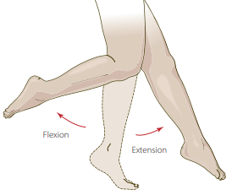
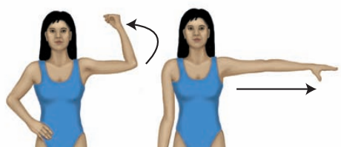
Skeletal Muscle Actions
Flexion
Extension
Flexion
Extension
Flexion: Act of bending or being bent
Extension: Movement that brings limb toward a straight condition

Slide 17
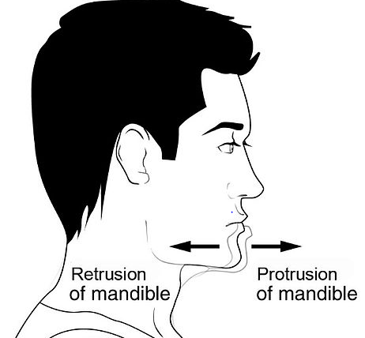
Muscles of Mastication
These muscles are associated with movements of the mandibular jaw.

