Slide 1
Protozoology
Lab .5
Dr. Maryam M. Hussain
Ph.D. Biology

Slide 2
2-Mastigophora (flagellata)
Kingdom: - Protista
Phylum: - Protozoa
Super class: - 2 -Mastigophora (flagellata)
Family : - Trypanosomatidae
Leishmania Spp. (flagellates found in the blood and tissues).
from genus leishmania about 21 species infect human . 3 species are the most important:
Ex.1:-L. tropica
Ex.2:-L. donovani
Ex.3:-L. braziliensis

Slide 3
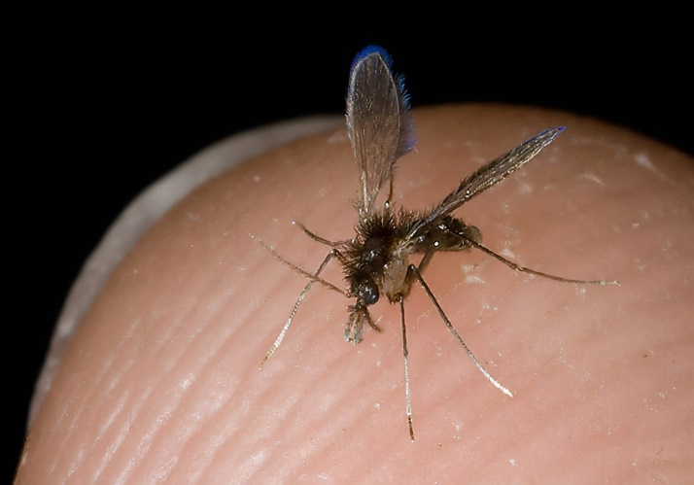
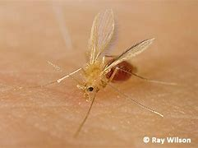
classification
All members of the flagellate genus Leishmania are obligate parasites that require a host for their survival, they are heteroxenous and thus require two hosts to complete their life cycle.
the mammalian host (final host) and the insect vector sandfly (intermediate host) including flies in the genus lutzomyia and Phlebotomus.
lutzomyia
Phlebotomus

Slide 4
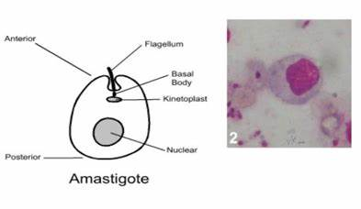
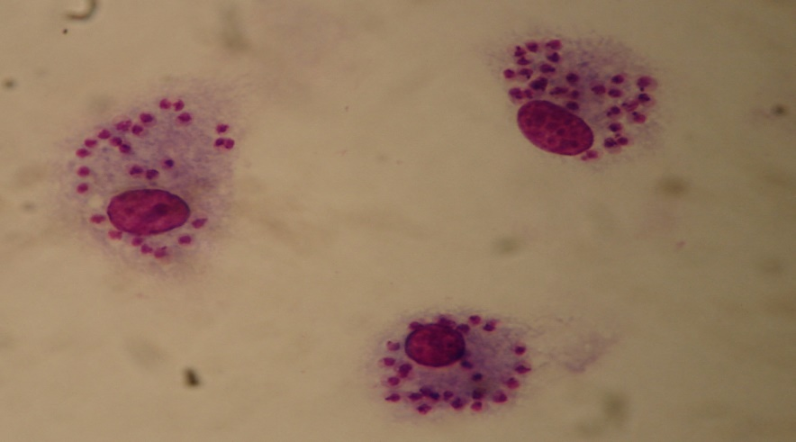
The parasite exists in 2 forms :-
1- Amastigote : -
Spherical or Oval in shape
2-3 um in diameter.
non-motile.
Large eccentrically located nucleus.
Rod shaped Kinetoplast.
Usually found in the vertebrate host.
Leishmania Spp. amastigotes

Slide 5
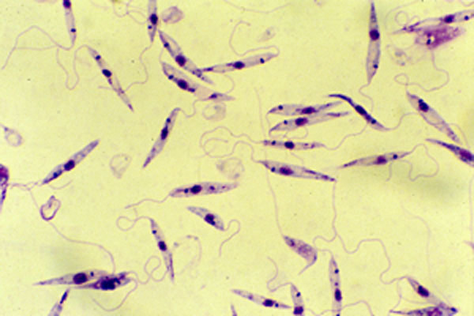
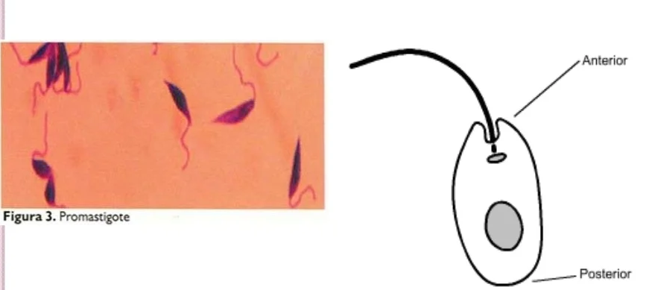
2- Promastigote (Leptomonad stage) :
Spindle shaped with 14-20 by 1.5-4 um in diameter.
Free anterior flagellum.
small nucleus and situated in the middle of the cell.
Kinetoplast at the anterior end of the body.
There is no undulating membrane.
Usually promastigote found in female Sandflies and artificial Culture.
Leishmania Spp. promastigotes

Slide 7
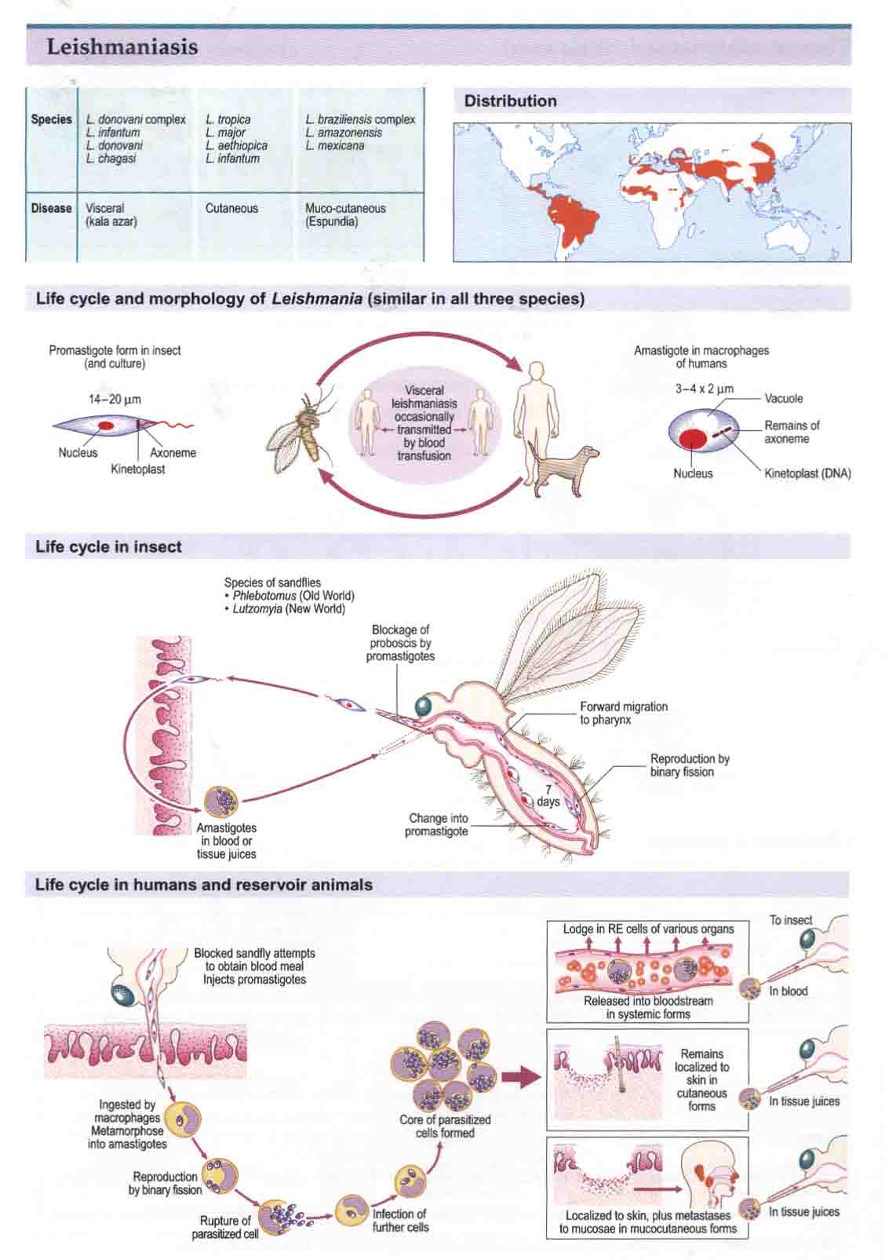
Life cycle of Leishmania Spp.

Slide 8
Leishmania tropica (cutaneous leishmaniasis) (CL)
most common one
Habitat :- skin
Disease :- the cutaneous leishmaniasis (oriental sore or Baghdad boil) .
Transmutation :- female sandflies Phlebotomus sp.
characterized by:
1- one or more sores on their skin, or nodules on the skin.
2- The sores can change in size and appearance over time.
3- They often end up looking somewhat like a volcano, with a raised edge and central crater.
4- A scab covers some sores.
5- The sores can be painless or painful.
6- Most sores develop within a few week of the sand fly bite, however they can appear up to month later.
7- Skin sores of cutaneous leishmaniasis can heal on their one, but this can take months or even yrars.
8- Sores can leaves siginifant scars and disfiguring if thy occure on the face.

Slide 9
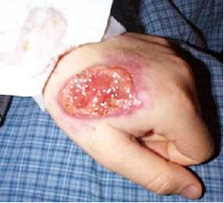
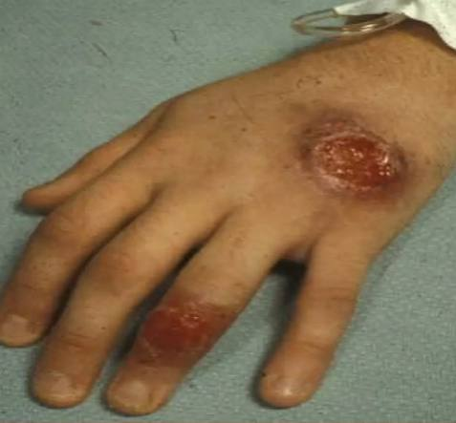
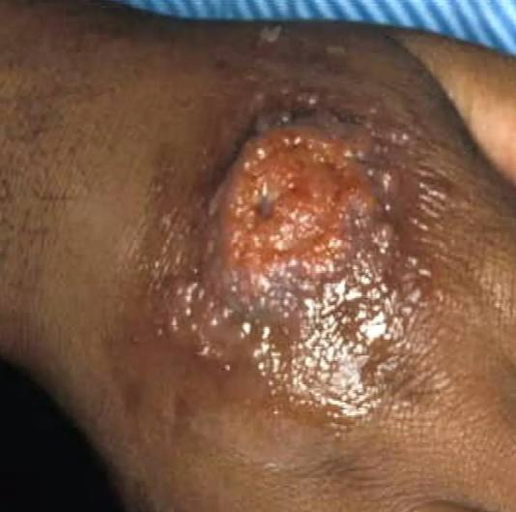
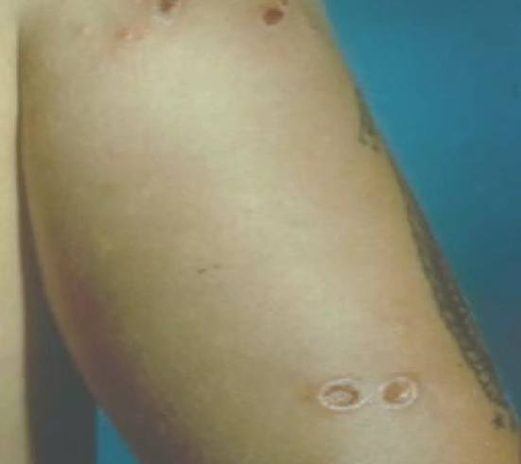
Baghdad boil

Slide 10
L. donovani (visceral leishmaniasis) (VL)
Habitat :- internal organ (liver, lymph nodes, spleen, bone marrow).
Disease :- the visceral leishmaniasis, kalaazar, Dum Dum fever.
Transmutation :- female sandflies Phlebotomus sp.
characterized by:
1- Most severe form of the disease, usually fetal if left untreated.
2- Usually associated with fever, weight loss, and an enlarged spleen and liver.

Slide 11
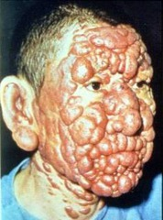
visceral leishmaniasis
Post kala-azar dermal leishmanoid

Slide 12
L. braziliensis (mucocutaneous leishmaniasis) (MCL)
Habitat :- skin and mucosa.
Disease :- the mucocutaneous leishmaniasis, Espundia.
Transmutation :- female sandflies lutzomyia.
characterized by:
1- This type occurs if a cutaneous lesion on the face spreads to involve the nose or mouth.
2- May occur months to years after original skin lesion.
3- Lesions can be very disfiguring.

Slide 13
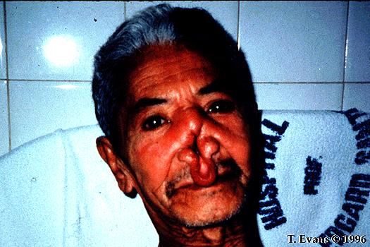
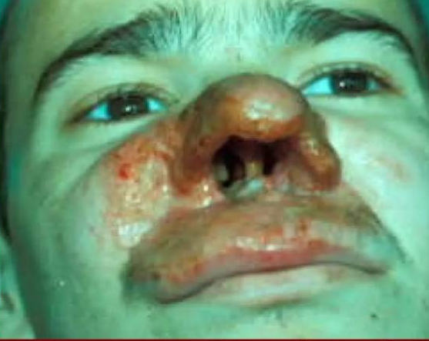
Espundia

Slide 14
diagnosis :-
L. tropica & L. braziliansis: - Demonstration of the parasite is possible in stained films from slit-skin smears taken from the indurated edge of an ulcer, biopsy of the margin of the ulcer and from mucosal scrapings in mucocutaneous type.
L. donodvani: - Amastigote can be demonstrated by staining bone marrow, lymph node, nasal scrapings, liver biopsies or splenic aspiration specimens.

Slide 15
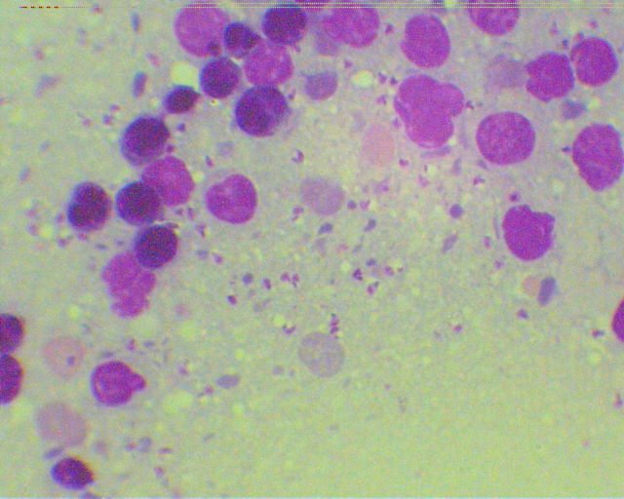
Leishmania Spp. amastigotes
Leishmania Spp. promastigote

