Slide 1
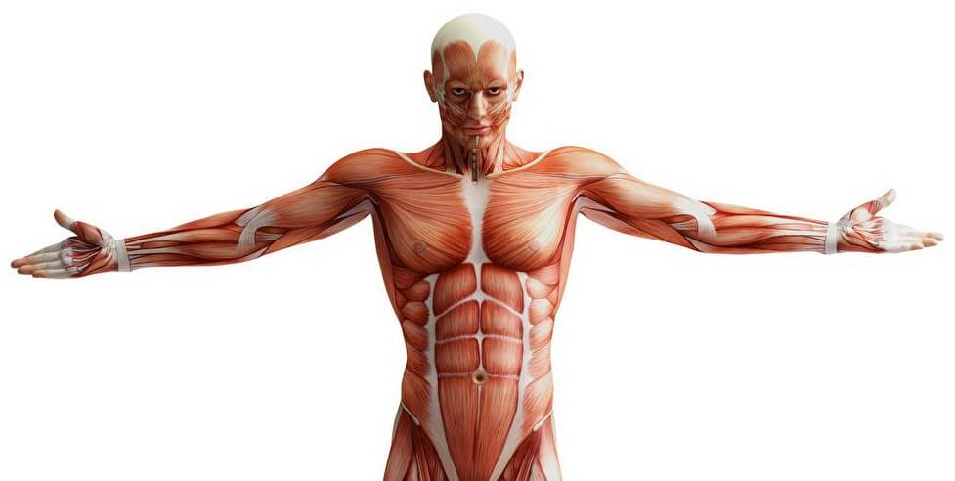
Lab 12 muscle tissue
By Zeena Ali

Slide 2
Muscle tissue:
Muscle (contractile) tissue is composed of differentiated cells called muscle fibers. Muscle fibers contain actin filaments and myosin filaments that are the contractile proteins.
The cytoplasm of muscle cells is called sarcoplasm, and the sarcolemma is the cell membrane or plasmalemma.
Three types of muscle tissue in mammals can be distinguished on the basis of morphologic and functional characteristics, and each type of muscle tissue has a structure adapted to its physiologic role.

Slide 3
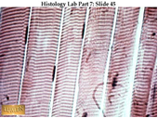
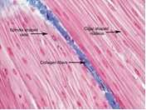
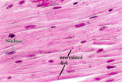
Table1. Comparison between muscle tissues
Differences | Skeletal muscle | Smooth muscle | Cardiac muscle
1-Composition | Composed of bundles of very long, cylindrical, multinucleated cells that shows cross striations | Composed of collection of fusiform cells that do not show striations, have central nucleus and they are uninucleated. | Composed of elongated, branched, individual cells that lie parallel to each other, has cross striations, and at sites of end to end contact are the intercalated disks.
2-Location | Skeletal system | Walls of internal visceral, hollow organs(stomach, intesine,bladder) respiratory, urinary, and reproductive systems. In the eyes, the ciliary muscles,)iris dilator muscle, and iris sphincter muscle In the skin, smooth muscle cells such as those of the arrector pili cause hair | Heart
3-Activity | Voluntary contraction | Involuntary contraction | Involuntary contraction

Slide 4
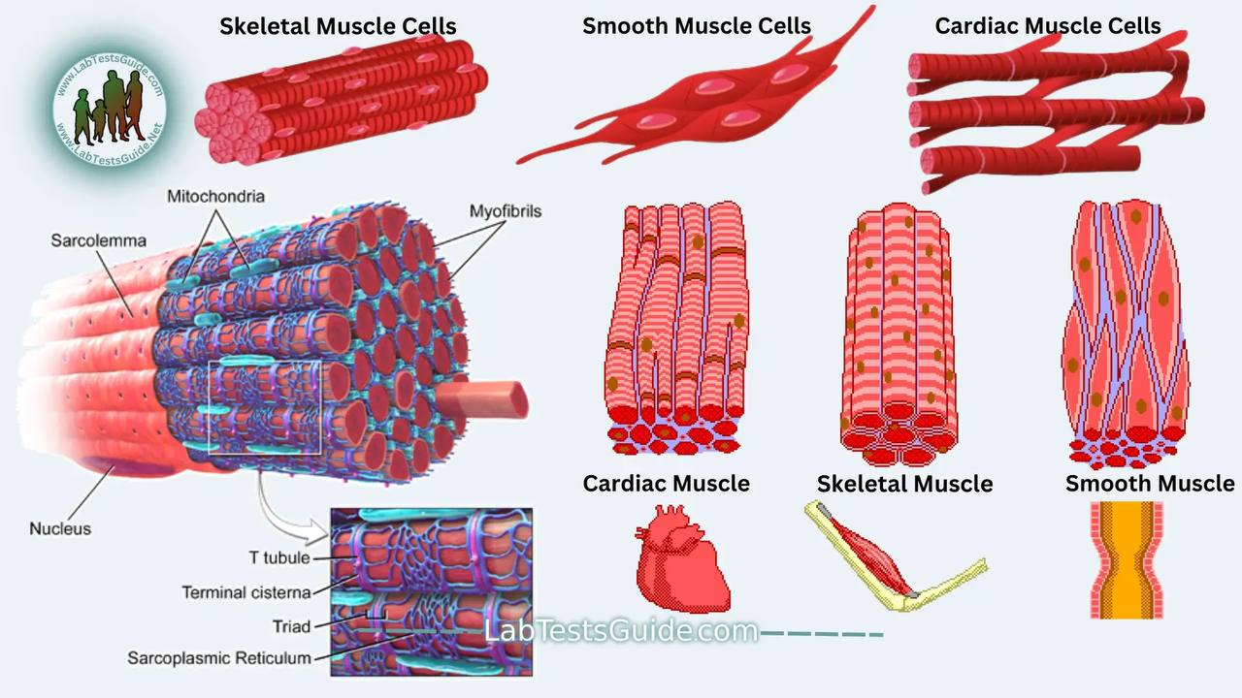

Slide 5
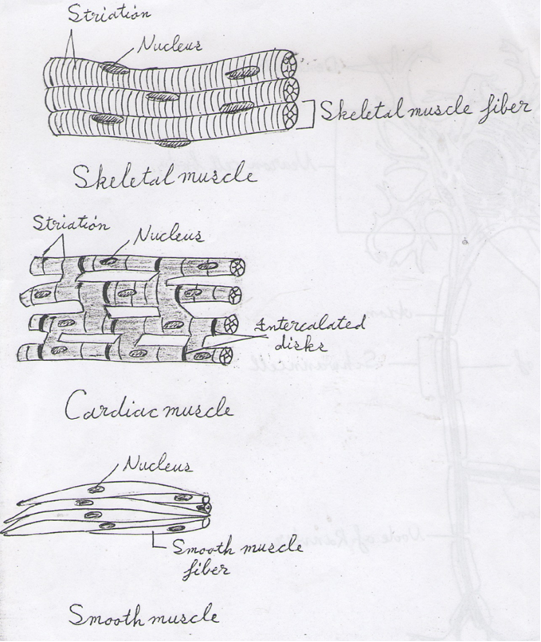

Slide 7
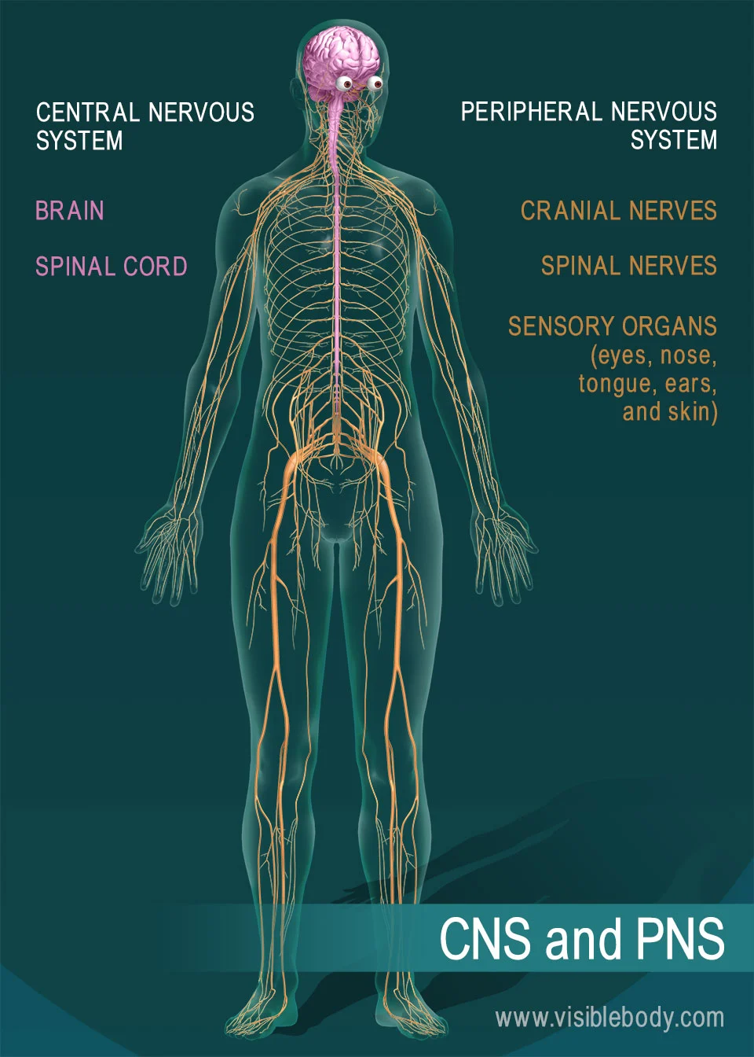

Slide 8
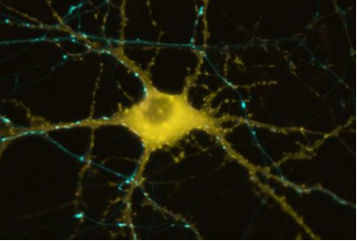
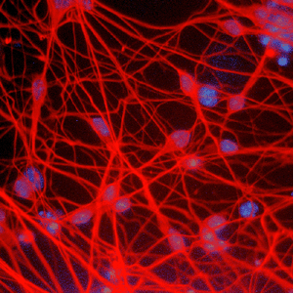
Nervous tissue :-
Nervous tissue, which contains nerve cells called neurons, is present in the brain and spinal cord.
Nerve cells, or neurons are responsible for the reception, transmission and processing of stimuli; the triggering of certain cell activities and the release of neurotransmitters and other informational molecules.

Slide 9
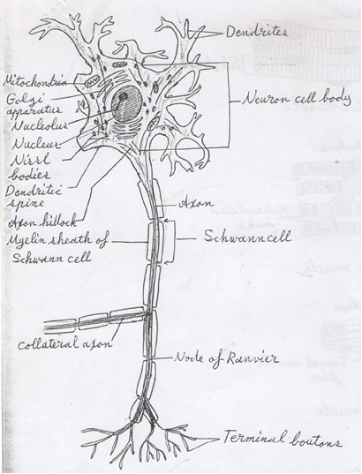
Motor neurons consist of 3 parts:-
The dendrites:- Which are multiple elongated processes specialized in receiving stimuli from the environment, sensory epithelial cells, or other neurons.

Slide 10
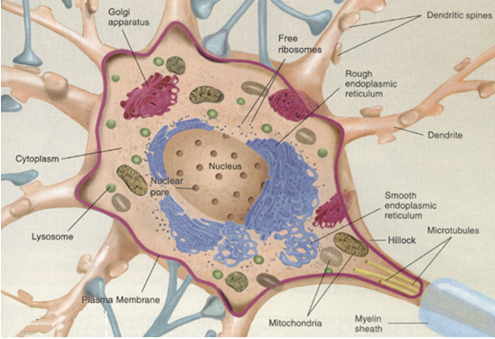
2. the cell body or perikaryon:-Which is the trophic center for the Whole nerve cell and is also receptive to stimuli.

Slide 11
3. The axon:-Which is a single process specialized in generating or conducting nerve impulses to other cells (nerve, muscle, and gland cells). Axon may also receive information from other neurons; this information mainly modified transmission of action potential to other neurons.

Slide 12
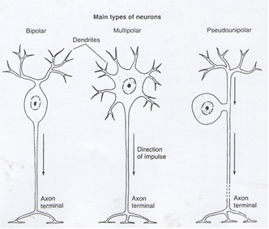
According to the size and shape of their processes, most neurons can placed in one of the following categories :-
1-Multipolar neurons:-Which have more than two cell processes, one process being axon and the others dendrites.
2-Bipolar neurons:-Which have one dendrite and one axon.
3-Pseudounipolar neurons:-Which have a single process that is close to the perikaryon and divides into two branches. The process then forms a T shape with one branch extending to a peripheral ending and other toward the central nervous system (CNS).

Slide 13
Most neurons of the body are multipolar.
Bipolar neurons are found in the cochlear and vestibular ganglia as well as in the retina and the olfactory mucosa.
Pseudounipolar neurons are found in the spinal ganglia (the sensory ganglia located in the dorsal roots of the spinal nerves ).They are also found in most cranial ganglia.
Notes:
Cochlear
Vestibular ganglia
Olfactory mucosa
Spinal ganglia
Sensory ganglia
cranial ganglia

Slide 14
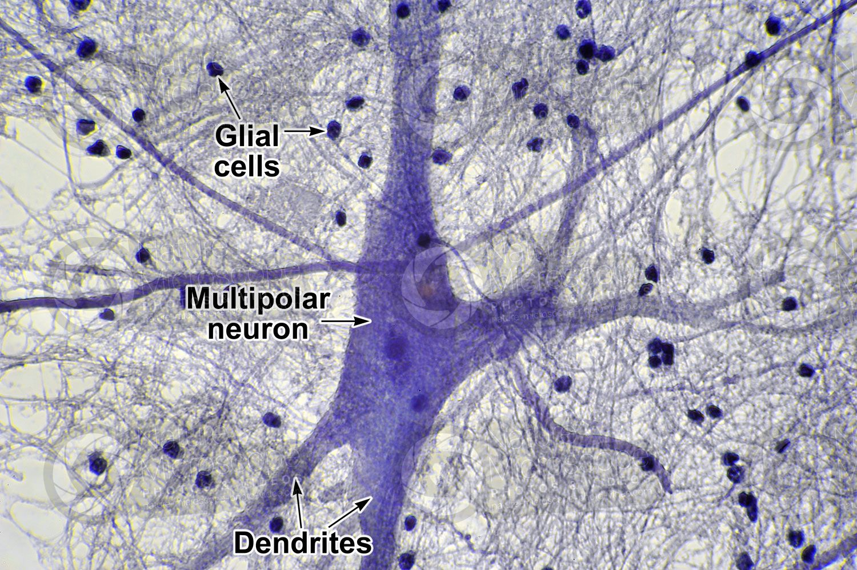
Neuroglial cells
Glia, also called glial cells (gliocytes) or neuroglia, are non-neuronal cells in the central nervous system) brain and spinal cord) and the peripheral nervous system that do not produce electrical impulses. The neuroglia make up more than one half the volume of neural tissue in the body. They maintain homeostasis, form myelin in the peripheral nervous system, and provide support and protection for neurons.
There are several different types of neuroglial In (CNS) and (PNS):
Oligodendrocyte
Schwann cell (Neurolemmocyte).
Astrocyte
Ependymal cell
Microglia
Notes:
Neuroglial cells خلايا دبقية

Slide 15
Gilial cell | Origin | Shape | Location | Main function
1-Oligodendrocyte | Neural tube ( is the embryonic precursor to the central nervous system, which is made up of the brain and spinal cord) | Has processes that wrap around axons | CNS | Myelin production, electric insulation
2- Schwann cell (Neurolemmocyte). | Neural tube | Has processes and the cell membrane wrap around axons | Peripheral nerves | Myelin production , electric insulation
3- Astrocyte | Neural tube | Star – shaped Cells with multiple radiating processes | CNS | Structural support , repair processes blood – brain barrier ,metabolic exchange.
4- Ependymal cell | Neural tube | Low columnar epithelial cells (sometimes ciliated) | CNS | Lining cavities of CNS
5- Microglia | Bone marrow | Small elongated cells with short irregular processes and have elongated nuclei. | CNS | Macrophagic Activity

Slide 16
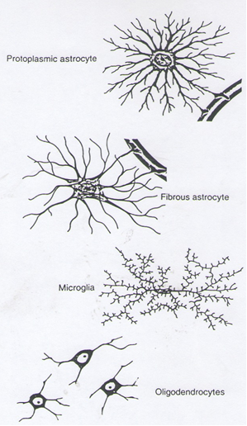

Slide 17
