Slide 1
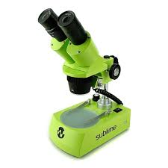

Slide 2
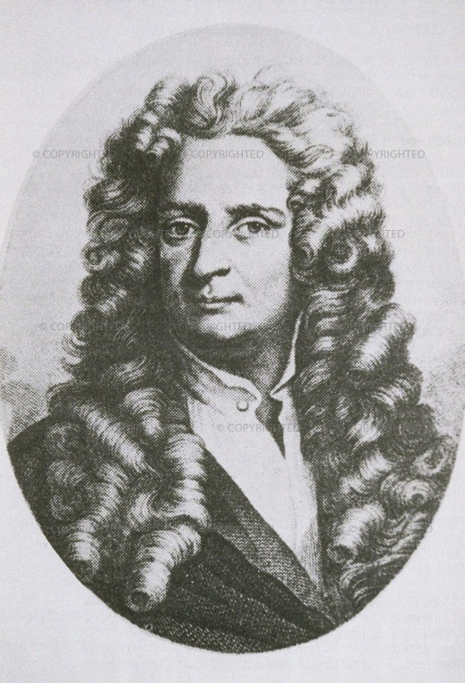
Microscope History
1665 – English physicist, Robert Hooke looked at a sliver of cork through a microscope lens and noticed some "pores" or "cells" in it.

Slide 3
3 Types of Microscopes
simple microscope has only 1 lens.
compound microscope has 2 sets of lenses. It can magnify things 100 - 200 times larger than they really are.
electron microscope can magnify objects up to 300,000 times. They do not use lenses, but use electrons to enlarge the image.

Slide 8
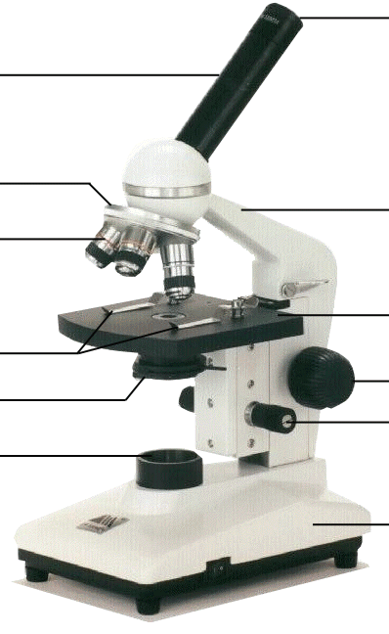
base
the bottom of the microscope, used for support
base

Slide 29
Microscope Care
Always carry with 2 hands
Never touch the lenses with your fingers.
Only use lens paper for cleaning
Keep objects clear of desk and cords
When you are finished with your "scope", rotate the nosepiece so that it's on the low power objective, roll the stage down to lowest level, rubber band the cord, then replace the dust cover.

Slide 30
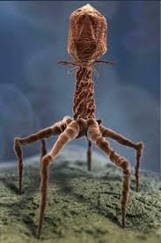

Slide 31
