Slide 1
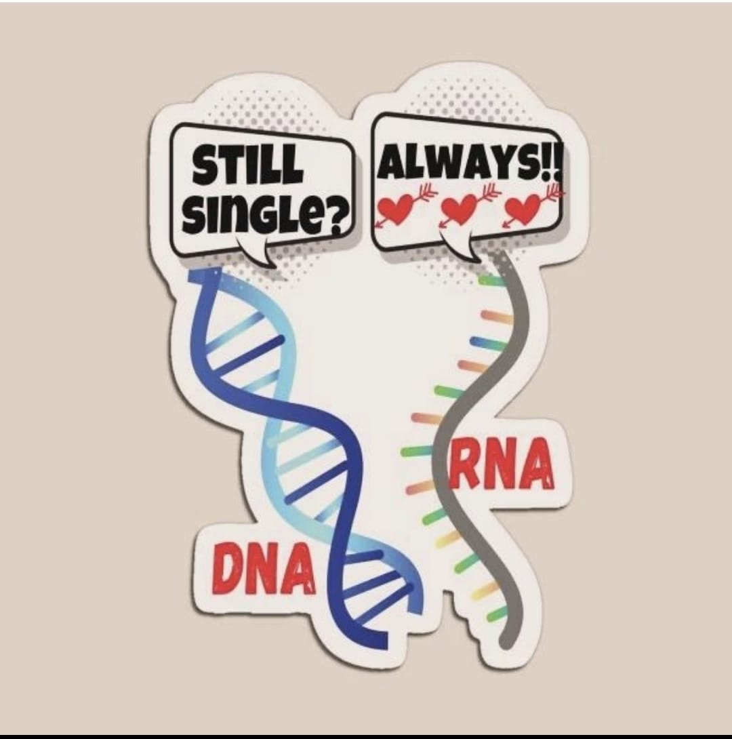
General Pathology (Genetic) 3th.
Msc. sura sabah naji

Slide 2
Human diseases were classified into three categories:
Genetically determined diseases.
Environmentally determined diseases.
Genetically and environmentally determined diseases.

Slide 3
CHROMOSOME
What are Chromosomes?
Chromosomes are a thread-like structures holding genetic information.
It is present in the cell nuclei.
A normal cell contains 23 pairs (46n) of chromosomes. Out of these, one pair (2n) is sex chromosomes.
Sex chromosomes are denoted as X and Y.
A male cell contains XY sex chromosomes, while a female cell contains XX sex chromosomes.
Somatic 23 pair, sex cell23 chromosome

Slide 4
Chromatin
Chromatin refers to a mixture of DNA and proteins that form the chromosomes found in the cells of humans and other higher organisms
Chromatin is composed of DNA that is wrapped around small proteins known as histones.
Histones help to organize DNA into structures called nucleosomes, which form chromatin fibers.
Chromatin fibers are further coiled and condensed into
The main functions of this genetic material include:
Preventing DNA damage. Tightly packing the DNA to fit into the cell. Control the DNA replication and gene expression. Support the DNA molecule to permit the process of the cell cycle – meiosis and mitosis.

Slide 5
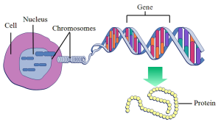
DNA is the genetical material.
Chromatin is the organized structure of DNA and proteins in the nucleus.
Genes are specific sequences within DNA that code for proteins or RNA.
DNA can be found in each cell in your body.
The majority of your DNA resides in the nucleus (center) of each cell in your body and some DNA lives in mitochondria (little organelles inside of your cells that produce energy).

Slide 6
DNA structure
DNA (deoxyribonucleic acid) is a type of macromolecule known as a nucleic acid.
It is shaped like a twisted double helix and is composed of long strands of alternating sugars and phosphate groups, along with nitrogenous bases (adenine, thymine, guanine, and cytosine).
DNA is organized into structures called chromosomes and housed within the nucleus of our cells.

Slide 7
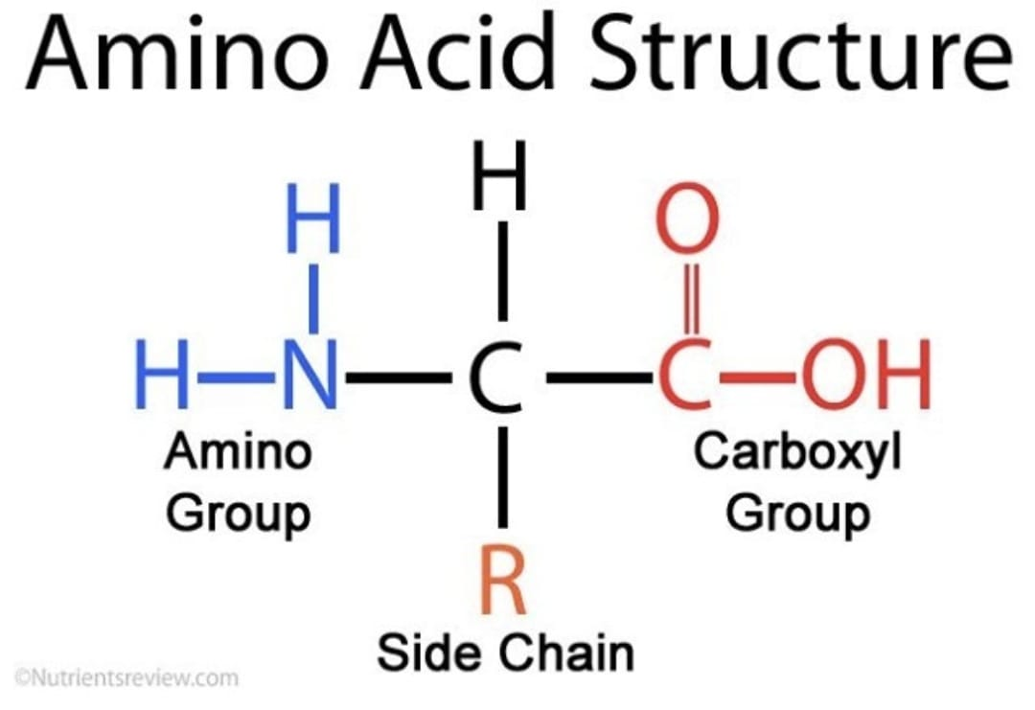
Nuclear DNA
Mitochondrial DNA
What is DNA? Deoxyribonucleic acid (DNA)
What is DNA made of? DNA has a language that it uses to write your instruction manual (a code). Four chemical bases make up your DNA language including: Adenine (A). Cytosine (C). Thymine (T). Guanine (G).

Slide 8
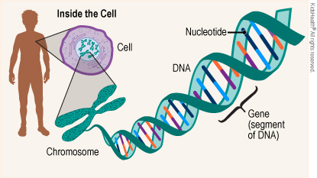
The genetic information is encoded in the DNA contained in the cell nucleus

Slide 9
DNA Replication
Replication occurs in three major steps:
the opening of the double helix and separation of the DNA strands
the priming of the template strand,
and the assembly of the new DNA segment.
During separation, the two strands of the DNA double helix uncoil at a specific location called the origin.
Several enzymes and proteins then work together to prepare, or prime, the strands for duplication. Finally, a special enzyme called DNA polymerase organizes the assembly of the new DNA strands. The following description of this three-stage process applies generally to all cells, but specific variations within the process may occur depending on organism and cell

Slide 10
DNA Mutation
* Any change in the DNA sequence of a cell. Mutations may be caused by:
mistakes during cell division,
Or they may be caused by exposure to DNA-damaging agents in the environment.
Mutations can be harmful, beneficial, or have no effect. If they occur in cells that make eggs or sperm, they can be inherited
if mutations occur in other types of cells, they are not inherited.
Certain mutations may lead to cancer or other diseases.
A mutation is sometimes called a variant

Slide 11
Types of RNA: Messenger RNA (mRNA) – a transcript copy of a gene which encodes a specific polypeptide
Transfer RNA (tRNA) – carries the polypeptide subunits (amino acids) to the organelle responsible for synthesis (ribosome)
Ribosomal RNA (rRNA) – a primary component of the ribosome and is responsible for its catalytic activity
RNA Structure
It is made up of nucleotides, which are ribose sugars attached to nitrogenous bases and phosphate groups.
The nitrogenous bases include adenine, guanine, uracil, and cytosine.
RNA mostly exists in the single-stranded form, but there are special RNA viruses that are double-stranded

Slide 13
Protien synthesis
In order for a cell to manufacture these proteins, specific genes within its DNA must first be transcribed into molecules of mRNA; then, these transcripts must be translated into chains of amino acids, which later fold into fully functional proteins
Protein synthesis can be divided broadly into two phases: transcription and translation. During transcription, a section of DNA encoding a protein, known as a gene, is converted into a template molecule called messenger RNA (mRNA

Slide 14
GENE
Gene is a part of the DNA molecule that contains the information needed to code for proteins and enzymes needed for the day-to-day function of the cells in the body.
humans have only about 25,000 protein-coding genes.
With few exceptions, each gene provides the instructions for the synthesis of single protein.
Gene; intron and exon Genes are made up of:
promoter regions.
and alternating regions of introns (noncoding sequences).
and exons (coding sequences).

Slide 15
The production of a functional protein involves .
the transcription of the gene from DNA into RNA,
the removal of introns and splicing together of exons,
the translation of the spliced RNA sequences into a chain of amino acids,
and the posttranslational modification of the protein molecule

Slide 19
What are autosome and allosome?
-The allosomes are the 23rd pair of chromosomes that determine the human sex.
-The male allosomes are XY, and the female allosomes are XX.
The remaining 22 pairs are termed autosomes
Somatic refers to a type of cell.
Autosomal refers to a type of chromosome.
Somatic cells are the normal cells of the body.
The reproductive cells (gametes) are not somatic
Germline mutations are changes to your DNA that you inherit from the egg and sperm cells during conception.
Somatic mutations are changes to your DNA that happen after conception to cells other than the egg and sperm. Mutations can lead to genetic conditions that.

Slide 20
Difference between Autosomes and Allosomes
These determine the somatic traits
These determine the sex of an organism
There are same copies of autosomes in males and females.
difference in size, behaviour and form in males and females.
The pair of autosomes are homologous in humans
Female allosomes are homologous while male allosomes are non-homologous
The number of genes varies from 200 to 2000.
Y chromosome contains a few genes but X chromosome contains more than 300 genes.

Slide 21
Hapliod &Diploid
Hapliod :
Those cells which contain only one set of chromosomes are called haploid cells.
The most common types of haploid cells are gametes or sex cells.
Those somatic cells having half the number of chromosome sets can be also called haploid cells.
Haploid cells are genetically diverse and they are produced through meiosis or reduction division.
Cells with a single set of chromosomes are also called monoploids and this condition is called

Slide 22
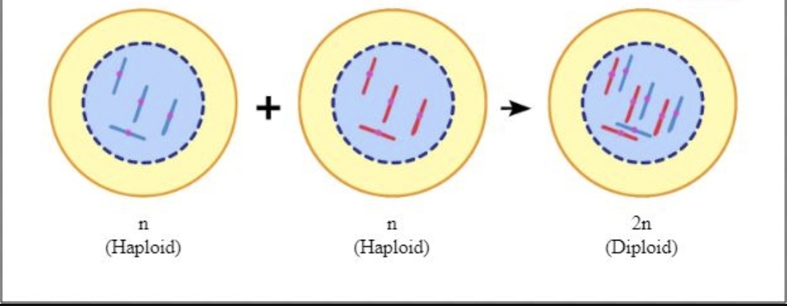
Hapliod &Diploid
Diploid :
Those cells which contain two homologous copies of each chromosome (two sets of chromosomes) are called diploid cells.
One set of chromosomes will be from the mother (maternal) and another set of chromosomes will be from the father (paternal).
The fusion of two haploid cells results in the formation of a diploid cell. They then multiply by mitosis.

Slide 23
Mitosis
Meiosis
1. occurs in somatic cells
2. No pairing of homogolous chromosomes.
3. Cells split once
4. Produces 2 daughter cells
5. Daughter cells are identical
6. End as diploid (46chromosomes or 23 pairs)
1.occurs in germ cells
2.Homogolous chromosomes pair up
3.Cells split twice
4.Produces 4 daughter cells
5.Daughter cells are each genetically 6.uniqueEnd as haploid
(23 chromosomes)

Slide 24
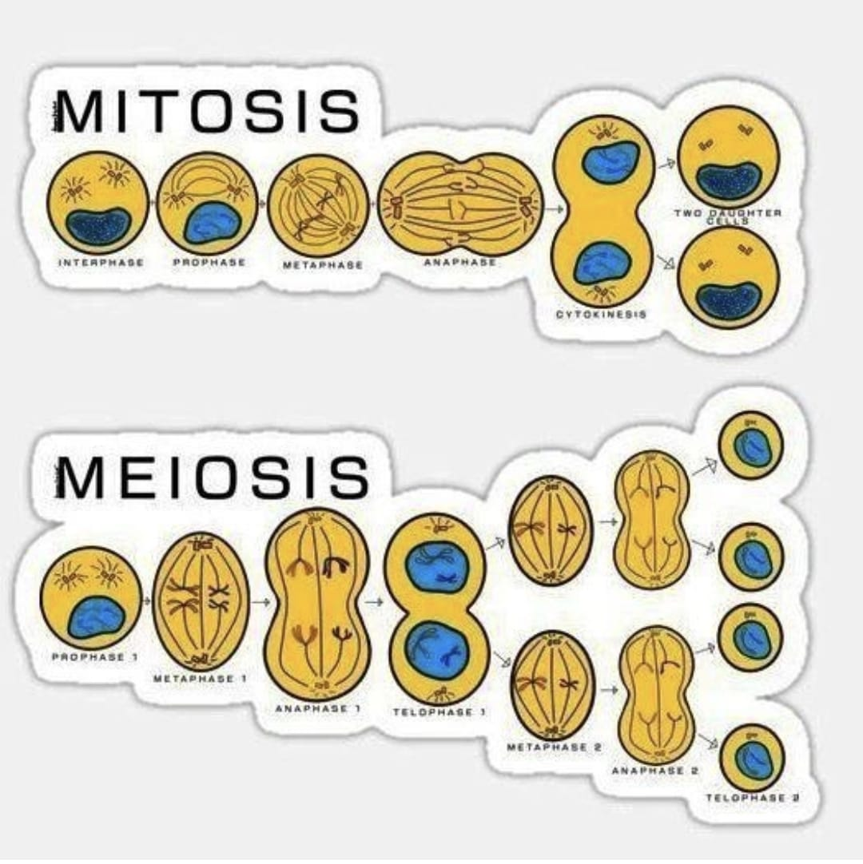

Slide 25
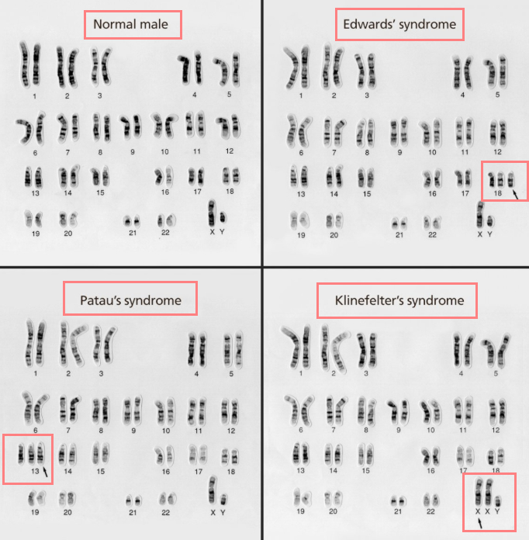
A karyotype is a photographic representation of a stained metaphase in which the chromosomes are arranged in order of decreasing length.

Slide 26
Karyotyping of patient with turners syndrome
Homozygous: You inherit the same version of the gene from each parent, so you have two matching genes.
Heterozygous: You inherit a different version of a gene from each paren

Slide 27
Cytogenetic is the study of the structure and numeric characteristics of the cell’s chromosomes.
The 23rd pair of chromosomes in the female karyotype is XX.
It is used to determine female sex chromosome abnormalities like triple X syndrome and Turner syndrome.
It is used to determine male sex chromosome abnormalities like Klinefelter syndrome.
The male karyotype shows XY chromosomes as its 23rd pair.

Slide 28
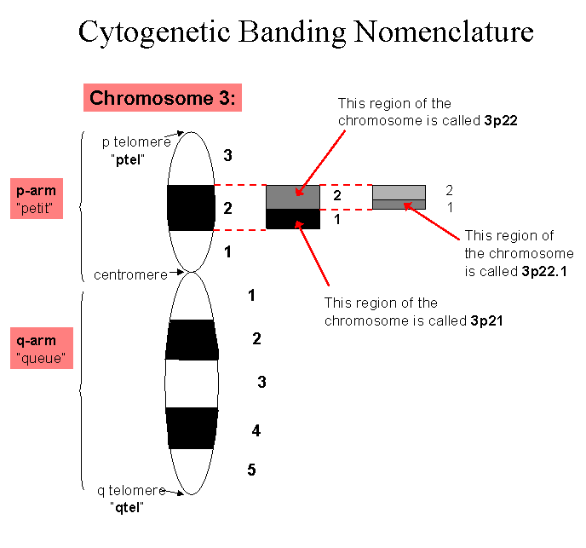
11p13.2
4q22.1
21p12
3q1
14q22.2
Xq21.2

Slide 29
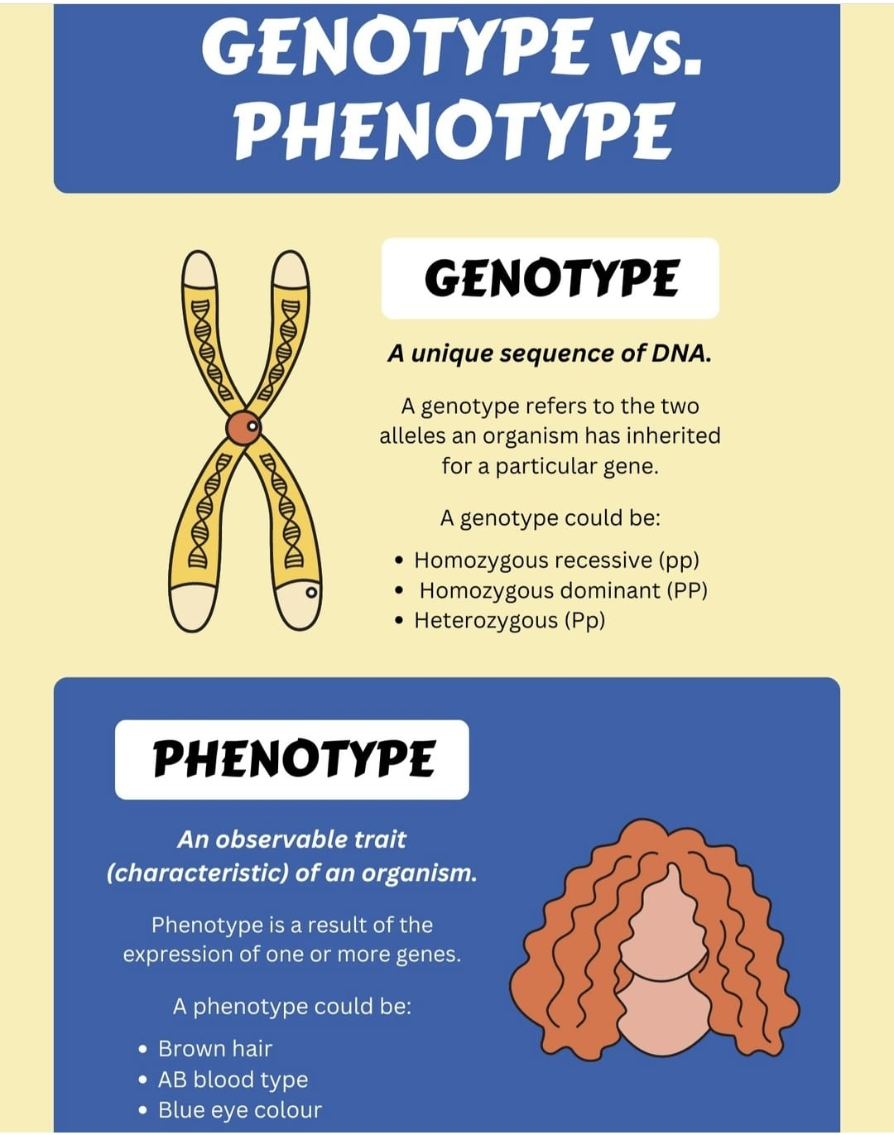
The position of a gene on a chromosome is called its locus. alternate forms of a gene at the same locus are called alleles. alleles can be the same (homozygous) or different (heterozygous),
The genotype of a person is the genetic information stored in the base sequence triplet code.
The phenotype The observable expression of a genotype in terms of morphologic, biochemical, or molecular traits.
More than one genotype may have the same phenotype.
Some brown-eyed persons are carriers of the code for blue eyes, and other brown-eyed persons are not. Phenotypically, these two types of brown-eyed persons are the same, but genotypically they are different.

Slide 30
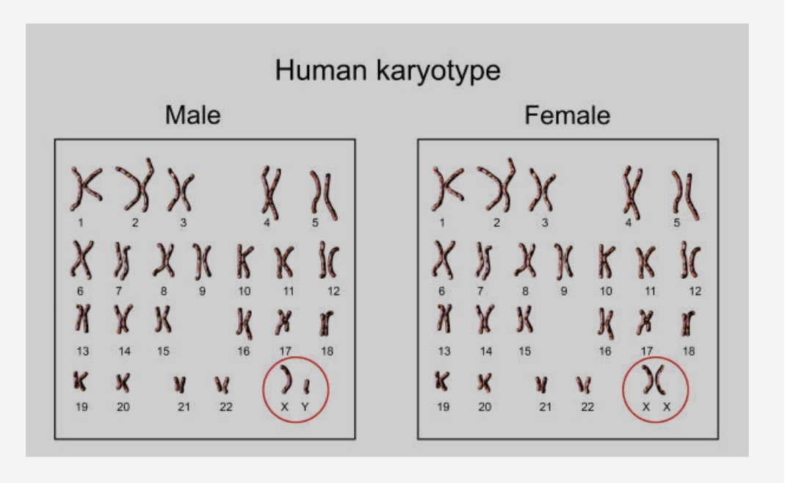
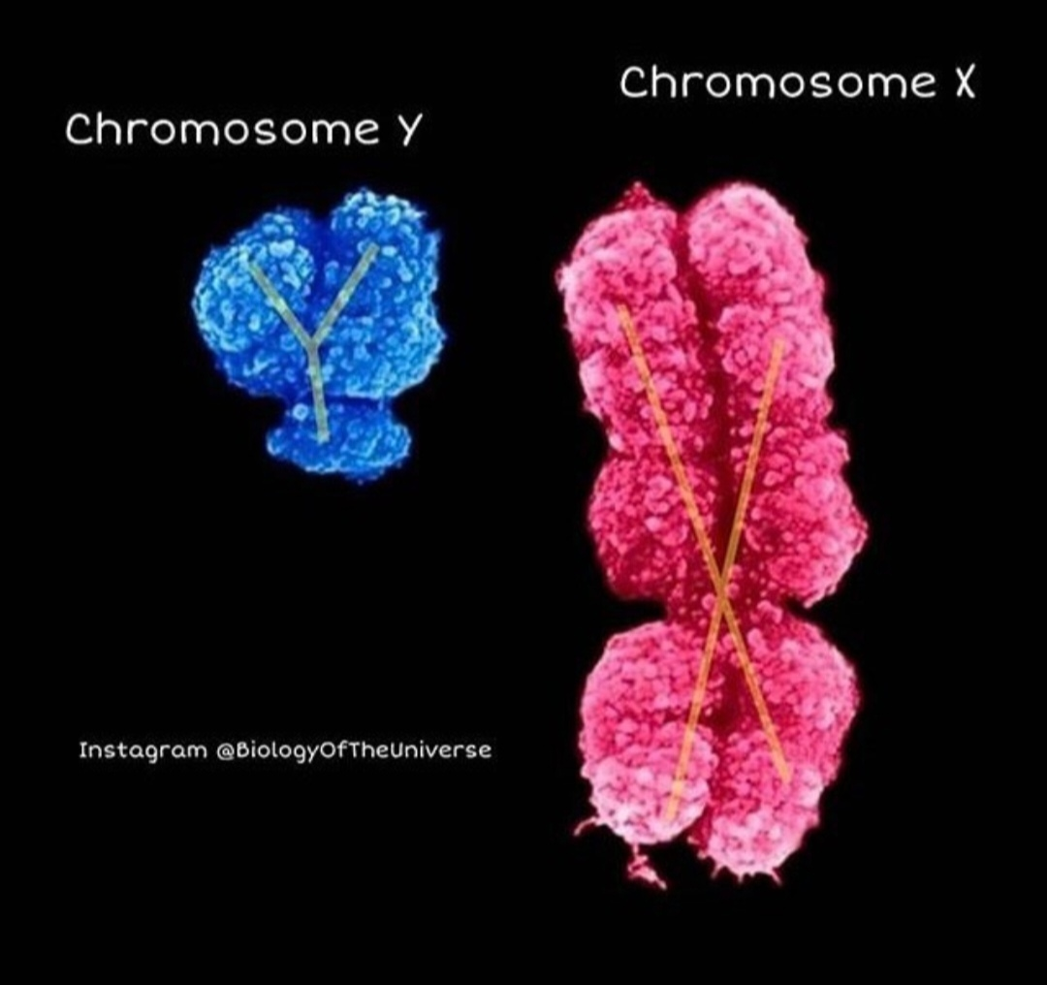

Slide 31
Thank you …
Any question???

