Slide 1
Saliva
Properties, Functions, and Clinical Conditions
Najem Hussein

Slide 2
What is Saliva?
• Saliva is secreted by three pairs of major salivary glands and minor salivary glands.
• It contains water, electrolytes, proteins, and enzymes that play vital roles in oral health and digestion.
• Helps maintain oral balance, protects against microbes, and aids in taste perception.

Slide 3
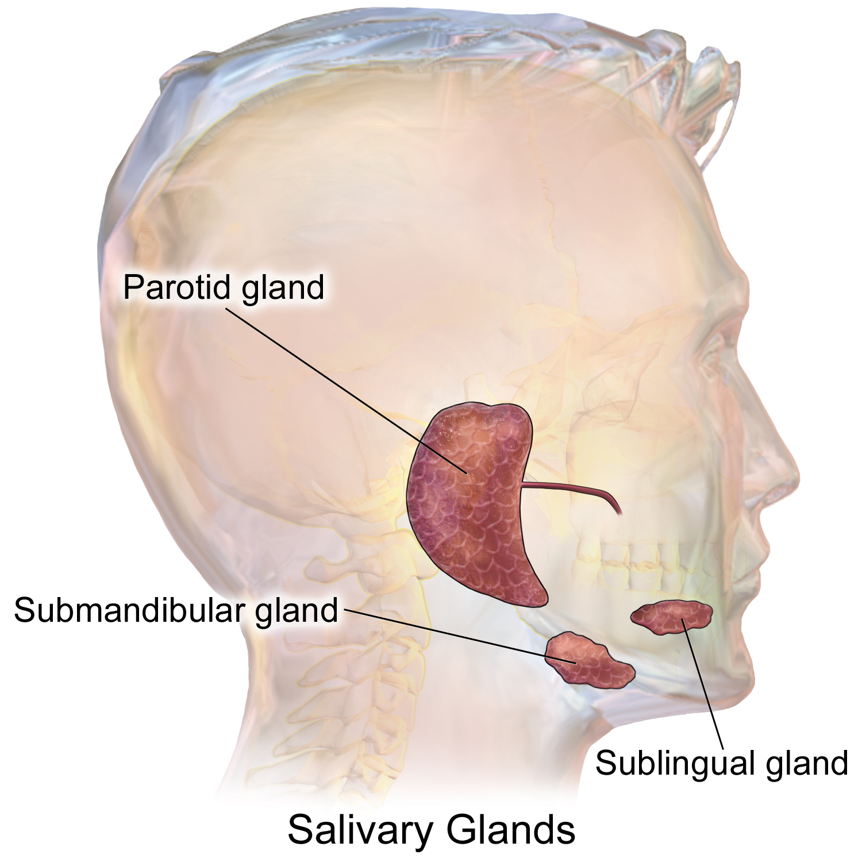
Salivary Glands

Slide 5
Properties of Saliva
• Volume: 1000 – 1500 ml/day at a rate of 0.5 – 1 ml/min.
• pH: Slightly acidic (6.35 – 6.85), optimal for enzyme functions.
• Specific Gravity: 1.002 – 1.012.
• Tonicity: Hypotonic to plasma.
• Composition: 99.5% water, 0.5% solids including Na, K, Ca, Cl, enzymes, and mucin.

Slide 6
Functions of Saliva
• Assists in swallowing by moistening food.
• Enhances taste by dissolving food substances.
• Initiates digestion with salivary amylase and lingual lipase.
• Cleanses the mouth and prevents bacterial growth.
• Facilitates speech by lubricating the mouth.

Slide 7
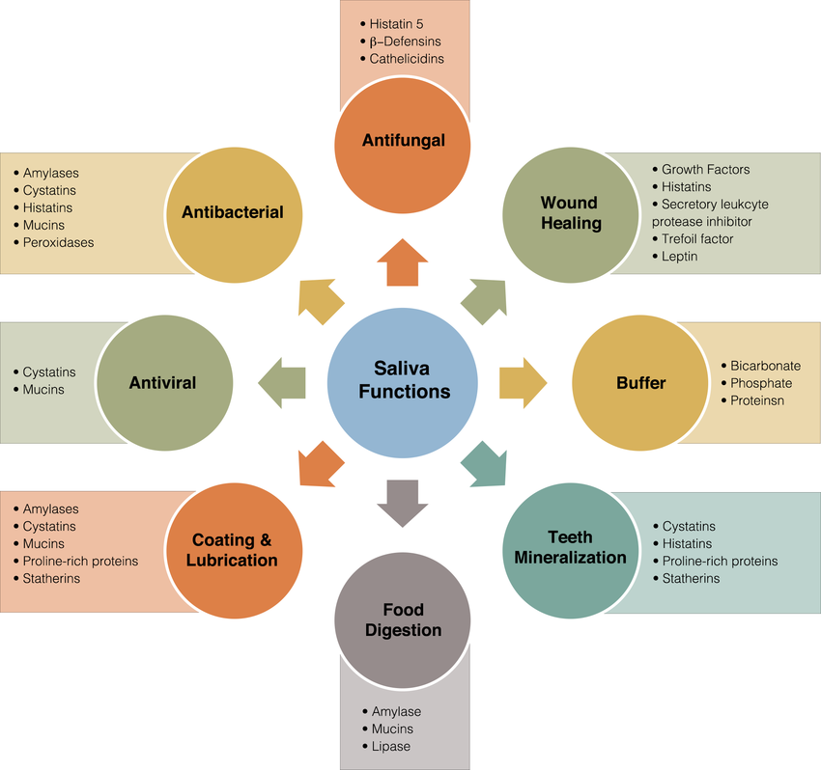
Saliva Function

Slide 8
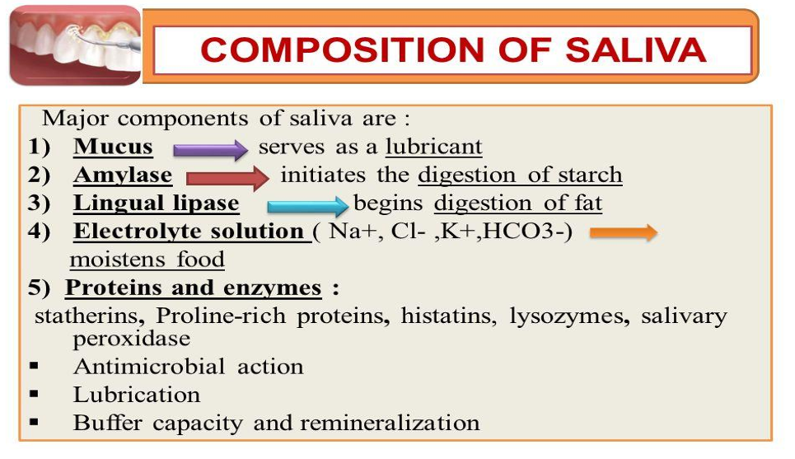
Composition of Saliva

Slide 9
Clinical Conditions Related to Saliva
• Hyposalivation: Reduced salivary secretion due to dehydration, fever, or gland disorders.
• Hypersalivation: Excess saliva production due to pregnancy, oral issues, or neurological disorders.
• Xerostomia: Dry mouth condition caused by medications, Sjögren syndrome, or radiation therapy.
• Mumps: Viral infection affecting parotid glands causing swelling and fever.
• Sjögren Syndrome: Autoimmune disorder leading to dry mouth and eyes.

Slide 10
Regulation of Salivation
• Controlled by neural reflex mechanisms.
• Unconditioned reflex: Triggered when food enters the mouth.
• Conditioned reflex: Triggered by sight, smell, or thought of food.
• Sympathetic and parasympathetic nerves regulate the type and amount of saliva secreted.

Slide 11
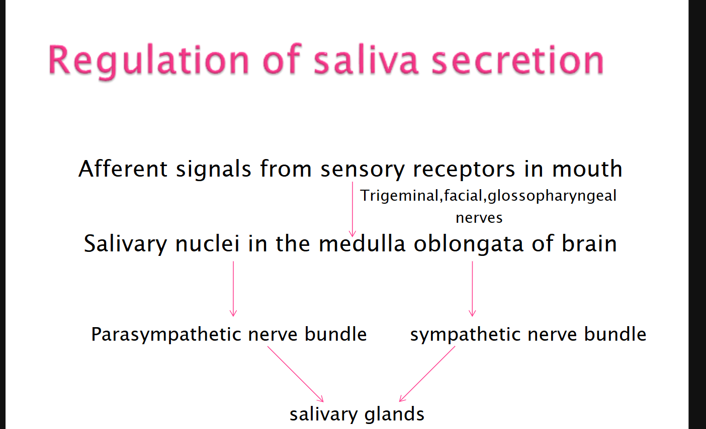
Regulation of Salivation

Slide 12
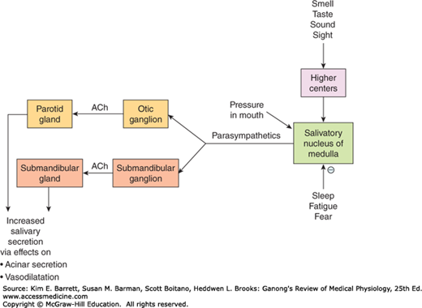

Slide 13
Thank you

