Slide 1
Isolation and identification of Staphylococci
Practical Microbiology
3rd grade
Second course_Lab 3
م.م. زهراء عباس صحن

Slide 2
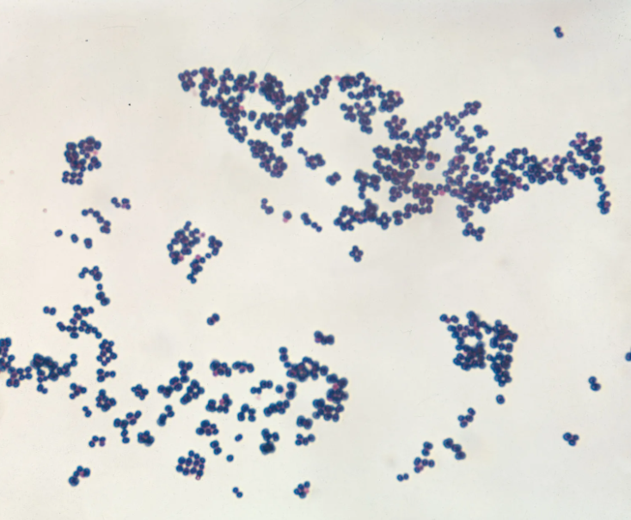
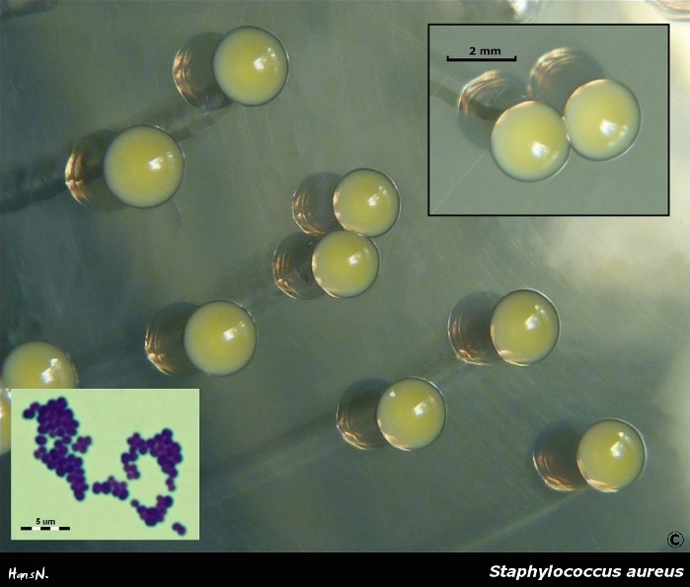
These bacteria are G+ve.
cells aggregation like bunch of grapes.
non-motile.
non-spore-forming.
facultative anaerobic.
colonies are round, convex, mucous.
Staphylococci are found on the skin mouth and upper respiratory tract. Such as pathogenic Staphylococcus aureus.

Slide 3
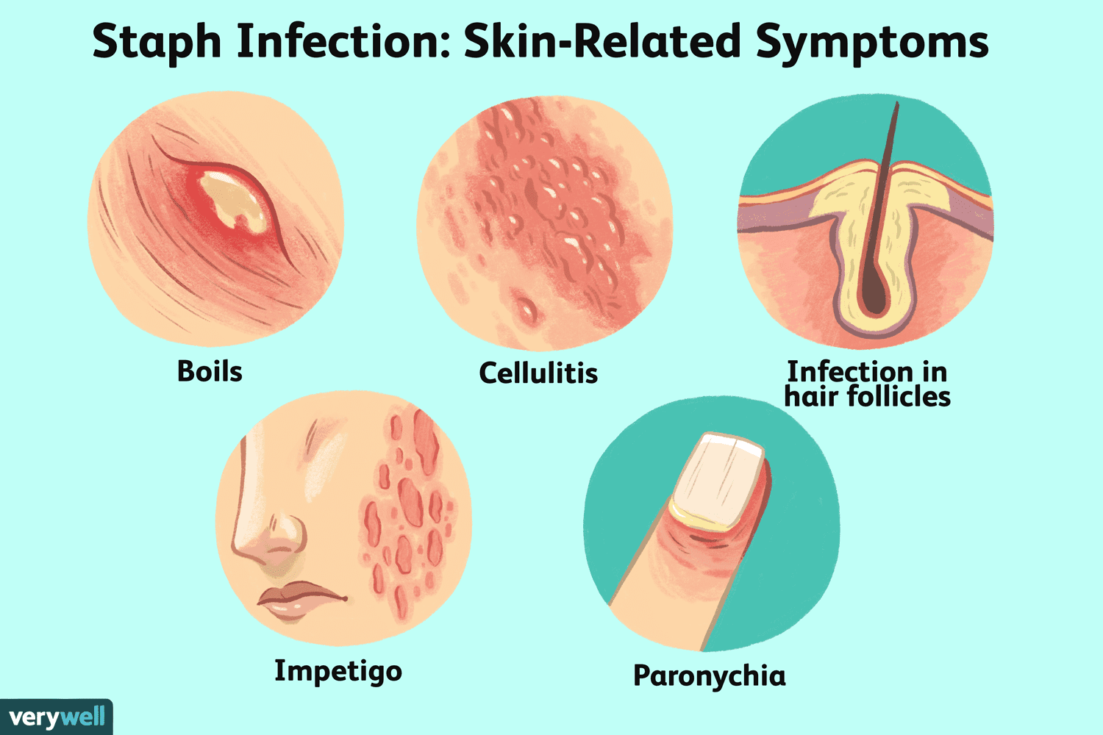
Culturing on blood agar results in B-hemolysis.
It may be isolated from Skin or mucous membrane of oral cavity.
Common skin infections caused by Staph. aureus include: pimples, furuncle and impetigo.
Systemic infections causes various diseases (pneumonia, endocarditis, tonsillitis, bacteremia, osteomyelitis, and food poisoning)

Slide 4
(deep tissue) infections that result from Staph. aureus also produce infections of the sinuses (sinusitis) and middle ear (otitis media).
May also cause oral infection, angular chelitis together with Candida at the angles of the mouth. In gingival carbuncles forming abscesses.

Slide 5
Staphylococcus epidermidis is a non-pathogenic and member normal microflora of the skin.
It may cause serious infections, if it has unusual opportunity to enter surface barriers for example cardiac surgery patients or those with intra venous catheters.

Slide 6
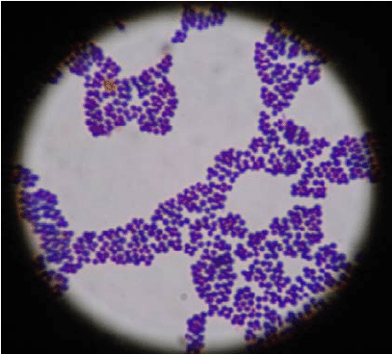
Identification
1. Under microscope
2. Colonial

Slide 7
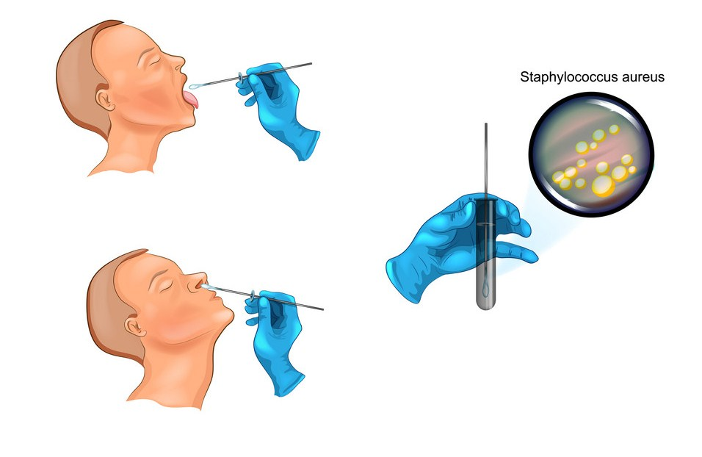
Procedure:
Swab from the throat around the tonsilar area or rotate a moist with (saline) swab around entire perimeter of both nares.
Roll the swab near the edge of a blood agar plate, and mannitol salt agar.
Streak with sterile loop, label the plates.
Repeat the same steps for Gingivae and tongue label the plate.
Incubate the plates at 35°c for 24-48 hr.

Slide 8
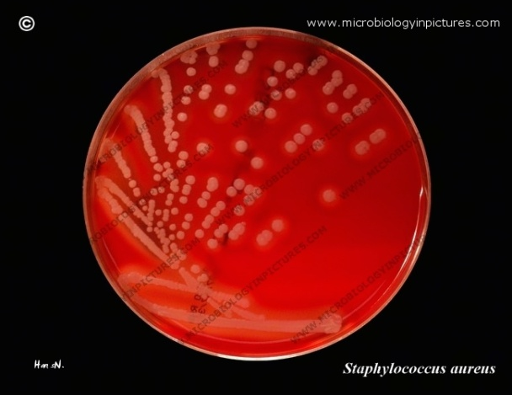
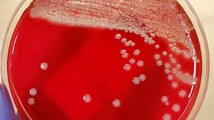
Observe the growth on blood agar:
Staph. aureus: colonies are large , smooth β-hemolytic (clear zone around the colonies).

Slide 9
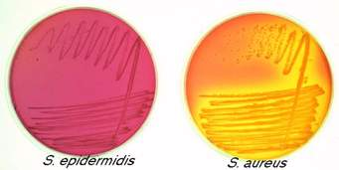
Staph. aureus on manitol salt agar:
Colonies and culture medium turn to yellow due to fermentation of mannitol.

Slide 10
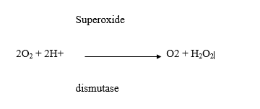
3. Catalase tests
Some bacteria contain flavoproteins that reduce O2 resulting in the production of hydrogen peroxide (H2O2) or superoxide (O2). These are toxic for obligate aerobes and facultative anaerobes. Many bacteria produce enzymes to protect them self against superoxide (O2), these enzymes are catalase, peroxidase or superoxide dismutase, which catalyze the destruction of H2O2 or O2 as follows:
Catalase production can be noted by mixing H2O2 with the tested bacteria. Bubbles of O2 represent a positive catalase test, and the absence of bubbles represents a negative catalase test. Most strict anaerobes lack both enzymes and cannot tolerate O2

Slide 11
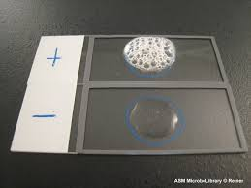
Procedure
Label two nutrient broths or nutrient agar slants.
Using aseptic technique, inoculate one agar slant or broth with staphylococcus and the other tube with streptococcus.
Incubate all the cultures at 37ºc for 18 to 24 hours.
Add few drops of 3% H2O2 over the growth of the slants or broths and observe the appearance of gas bubbles.
Record the results.

Slide 12
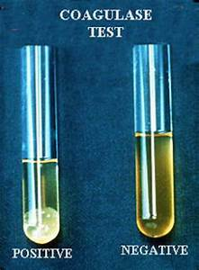
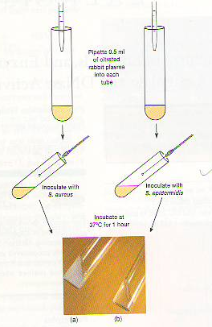
4. Coagulase test
This test is used to distinguish between pathogenic and non-pathogenic staphylococci
Coagulase is enzyme produced by pathogenic Staphylococci, that clot blood plasma . Citrate is usually added to act as anticoagulant and prevent false positive results.
Procedure:
Add 0.5 ml of citrated rabbit plasma to two small test tubes; label the tubes with name of bacteria.
Add 0.5 ml broth culture of S. aureus to one tube and 0.5 ml broth culture of S. epidermidis to the other tube.
Incubate the broth cultures at 37ºc for 1 to 4 hours in water bath.
Examine the broth cultures for the presence (coagulase positive) or absence (coagulase negative) of clouding and clots.

Slide 13
5. Protein A latex agglutination test
Protein A, synthesized by almost all strains of Staph. aureus , has a special affinity to fragment of immunoglobulin G ( IgG ). Hence when latex practicles coated with IgG are mixed with a suspension of organism visible agglutination of latex particles occurs.
6. DNase test:
Most coagulase positive staphylococcus are produced this enzyme.
Most pathogenic strains of staphylococcus produce a nuclease enzyme called DNase degrades host DNA and increases the pathogenicity of staphylococcus.

Slide 14
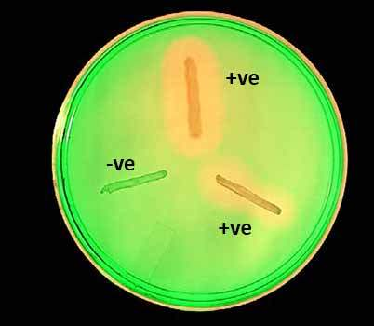
Procedure:
Divide a DNase agar plate in half with a wax pencil and label each part with the name of bacteria .
On one part of the agar plate, put heavily spot-inoculate of S.aureus and the other part inoculated by the same way with S.epidermidis.
Incubate at 37ºc for 18 to 24 hours.
Flood the DNase test agar with 1 N HCl. A zone of clearing around the colony indicates a positive DNase test.
Record the result.

Slide 15
Comparison between Staph. aureus & Staph. epidermidis
Staph. aureus | Staph. epidermidis
pathogenic | Non - pathogenic
Coagulase +ve | Coagulase –ve
On mannitol salt ager: mannitol fermentation +ve Tolerate High Salt concentration | On mannitol salt ager: mannitol fermentation –ve Will not tolerate High Salt concentration
DNase +ve | DNase –ve

Slide 16
Thanks for your consideration

