Slide 1
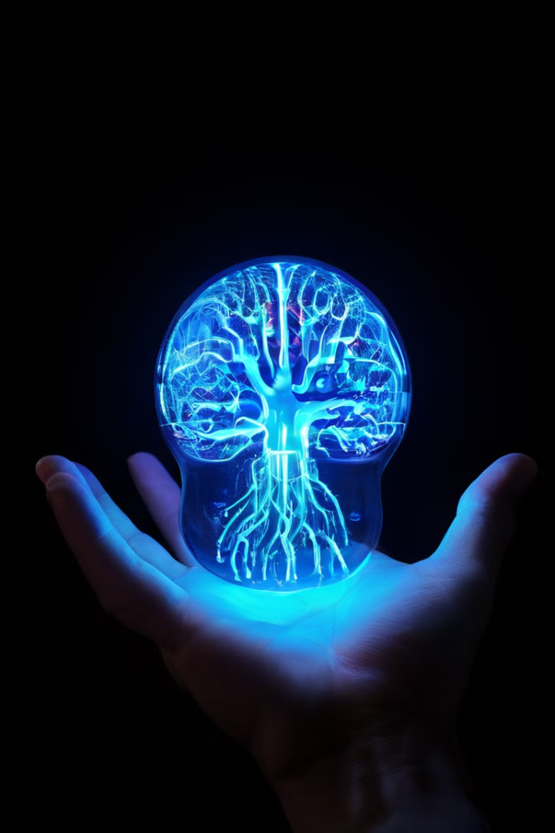
The Nervous System
The nervous system is the body's command center, responsible for receiving, processing, and transmitting information throughout the body. It is a complex network of specialized cells called neurons that communicate with each other using electrical and chemical signals. This intricate network allows us to perceive our environment, control our movements, think, feel, and remember.
By: Assist.Lect. Noor Alaa

Slide 2
Introduction to the Nervous System
Functions
Importance
The nervous system's primary functions include receiving sensory input from the environment, integrating and processing this information, and generating motor output to control bodily functions. It also plays a crucial role in higher-level cognitive processes like thinking, learning, and memory.
The nervous system is essential for our survival. It allows us to react to stimuli, coordinate our movements, and maintain homeostasis. Dysfunction of the nervous system can lead to a wide range of disorders, from simple numbness to severe paralysis.

Slide 3
Divisions of the Nervous System
Central Nervous System (CNS)
Peripheral Nervous System (PNS)
The CNS is the control center of the body, consisting of the brain and spinal cord. It receives, processes, and integrates information from the body and sends out commands to initiate actions.
The PNS is composed of all the nerves outside the CNS. It acts as a communication network, transmitting information between the CNS and the rest of the body, allowing the CNS to monitor and control various bodily functions.

Slide 4
The Central Nervous System: Brain and Spinal Cord
Brain
Spinal Cord
The brain is the most complex organ in the body, responsible for higher-level cognitive functions, sensory perception, motor control, and emotional responses. Its intricate structure enables diverse and sophisticated operations.
The spinal cord is a long, cylindrical bundle of nerves that extends from the brain down the back. It relays sensory information to the brain and motor commands from the brain to the body. The spinal cord also controls reflexes, which are rapid, involuntary responses to stimuli.

Slide 5
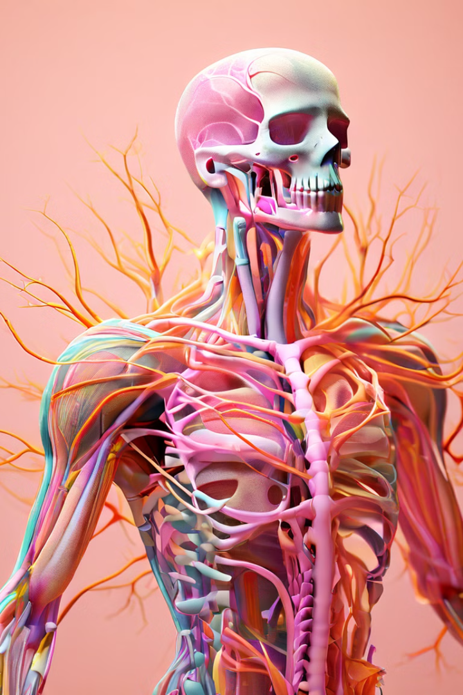
The Peripheral Nervous System
Sensory Nerves
Motor Nerves
Sensory nerves carry information from sensory receptors in the body to the CNS, providing the brain with information about the environment and the body's internal state.
Motor nerves transmit signals from the CNS to muscles and glands, initiating movements and controlling bodily functions like digestion, breathing, and heart rate.

Slide 6
The Somatic and Autonomic Nervous Systems
1
Peripheral Nervous System
2
Somatic Nervous System
Controls voluntary movements of skeletal muscles.
3
Autonomic Nervous System
Regulates involuntary bodily functions, such as heart rate, digestion, and breathing.
4
Sympathetic Nervous System
The "fight-or-flight" response, prepares the body for action and stress.
5
Parasympathetic Nervous System
The "rest-and-digest" response, conserves energy and promotes relaxation.

Slide 7
Neurons and Glial Cells
Neurons
Glial Cells
Neurons are the fundamental building blocks of the nervous system. They are specialized cells that transmit electrical and chemical signals throughout the body. These signals allow for communication between different parts of the nervous system, enabling complex functions like thought, movement, and sensation.
Glial cells, also known as neuroglia, are non-neuronal cells that provide support and protection to neurons. They play crucial roles in maintaining the structural integrity of neural tissue, regulating the chemical environment around neurons, and providing insulation to neurons.

Slide 8
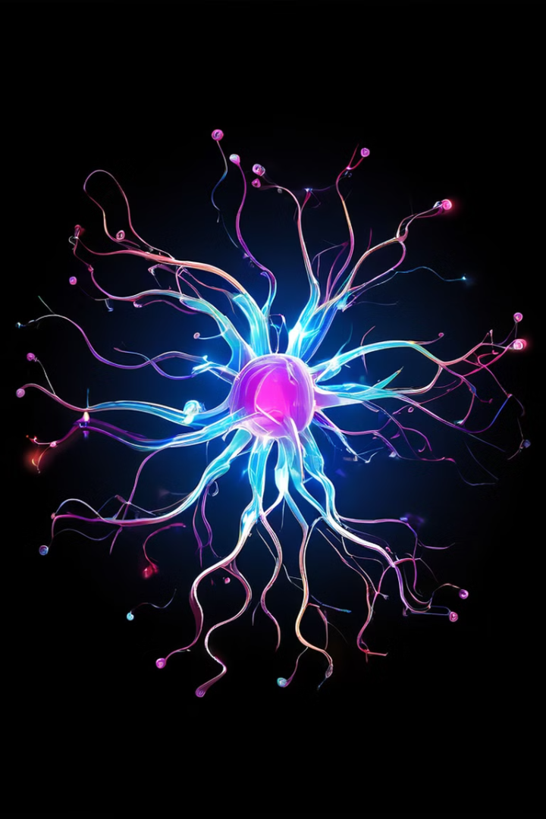
The Action Potential
1
Resting Potential
The neuron is at rest, with a negative charge inside the cell membrane. The inside of the neuron is more negatively charged compared to the outside.
2
Depolarization
A stimulus triggers the opening of sodium channels, allowing positive sodium ions to flow into the cell, causing the membrane potential to become more positive.
3
Repolarization
Sodium channels close, and potassium channels open, allowing potassium ions to flow out of the cell, restoring the negative charge inside the cell.
4
Hyperpolarization
The membrane potential temporarily dips below the resting potential before returning to normal. This is a refractory period where the neuron cannot fire another action potential.

Slide 9
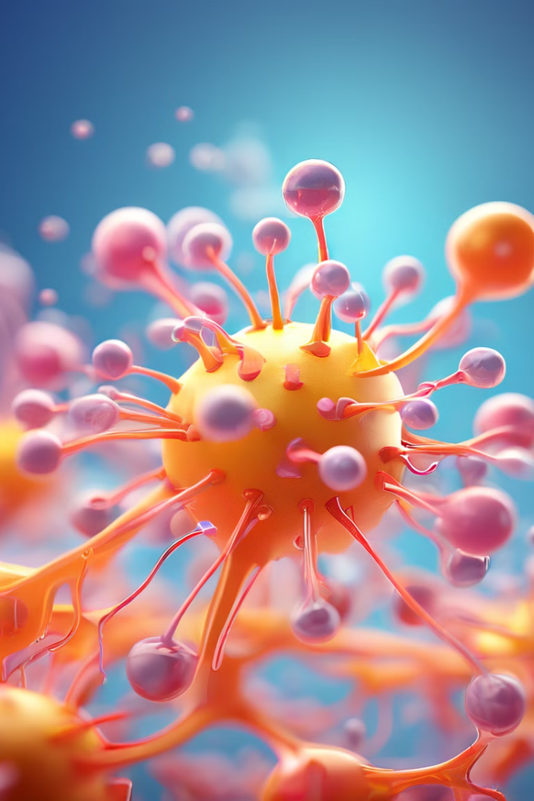
Neurotransmitters
Acetylcholine
Dopamine
Involved in muscle contraction, learning, and memory.
Plays a role in mood, motivation, and reward.
Serotonin
GABA
Influences mood, sleep, appetite, and cognition.
The main inhibitory neurotransmitter in the brain, reducing neuronal activity.

Slide 10
Medical Conditions of the Nervous System
Spinal Cord Injuries
Parkinson's Disease
Alzheimer's Disease
Damage to the spinal cord can result in loss of sensation and movement below the level of injury.
A progressive neurodegenerative disorder characterized by tremors, rigidity, and slow movements.
A neurodegenerative disease that causes progressive memory loss, cognitive decline, and behavioral changes.

