Slide 1
Muscular System
Presented by :Assist.Lect.Noor Alaa Abdulrazziq

Slide 2
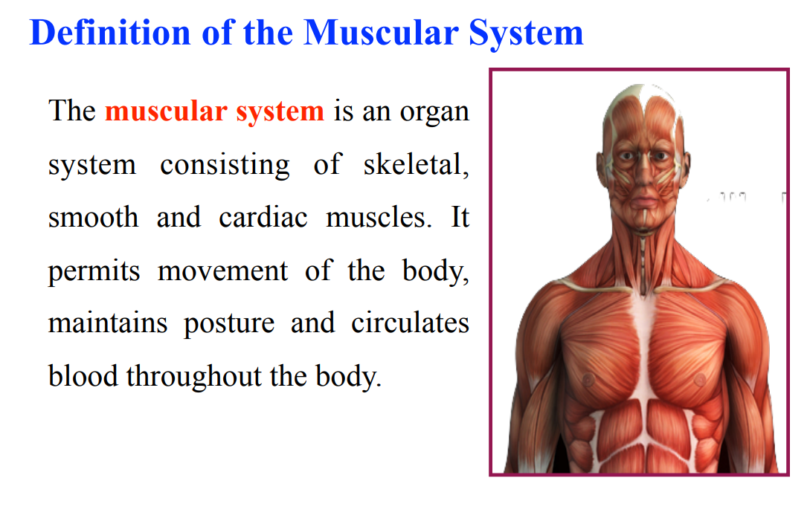

Slide 3
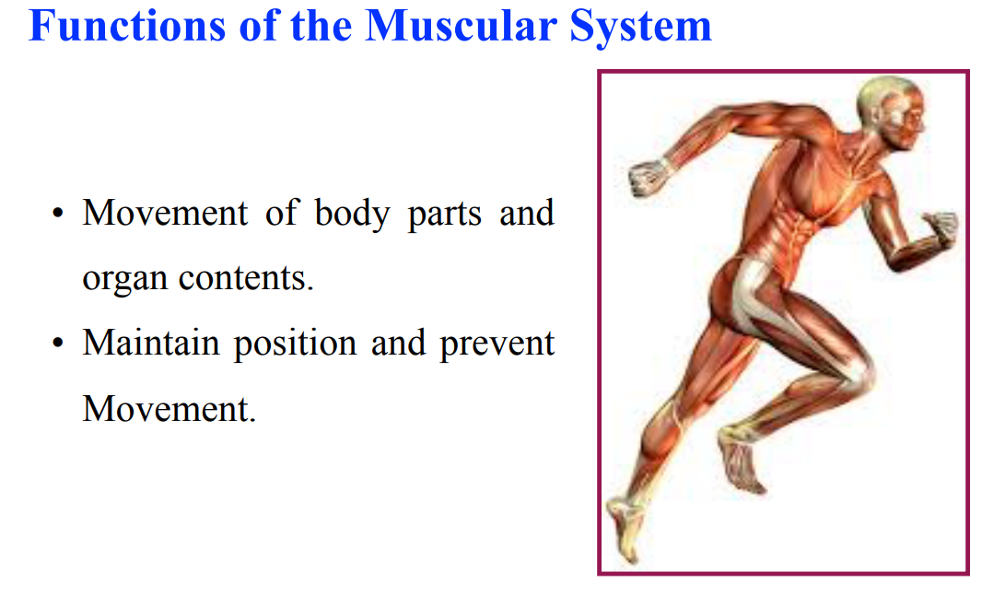

Slide 4
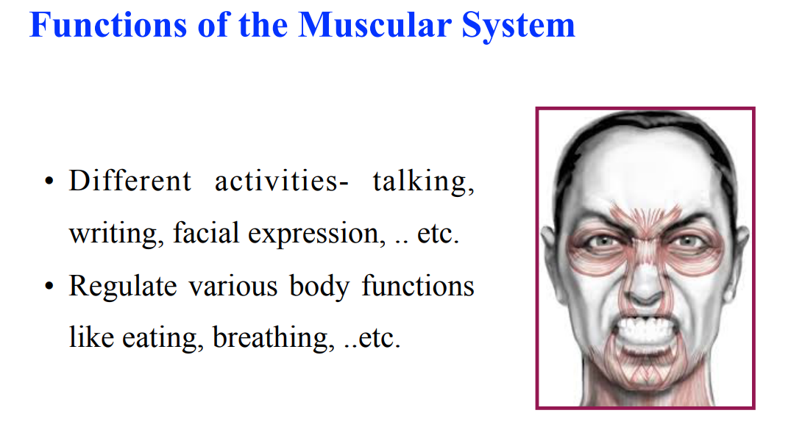

Slide 5
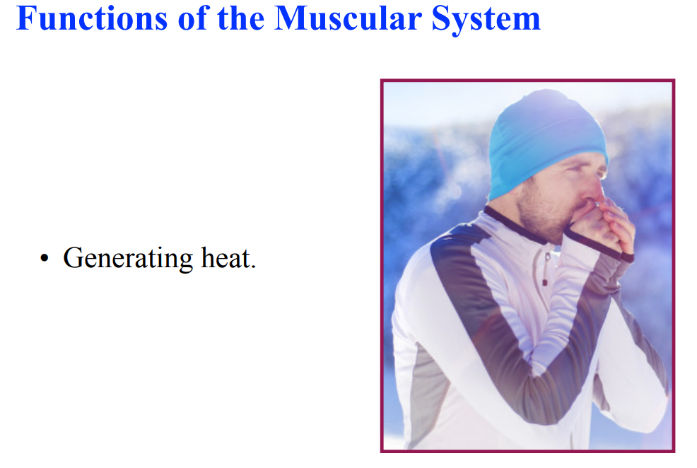

Slide 6
What is the anatomy of muscles?
Your muscles are made of thousands of small fibers woven together. These fibers stretching and pressing together is what moves your organs or body. Your muscles weave together like a quilt that covers your body. They run in all directions and work together to move you.

Slide 7
Voluntary movements & Involuntary movements
Voluntary movements: are actions you control. You choose to perform an action and your muscles move your body to make it happen. You use your nervous system to control these movements.
Involuntary movements: happen automatically without you thinking about them. The muscles in and around your organs move involuntarily to keep your body working properly.

Slide 8
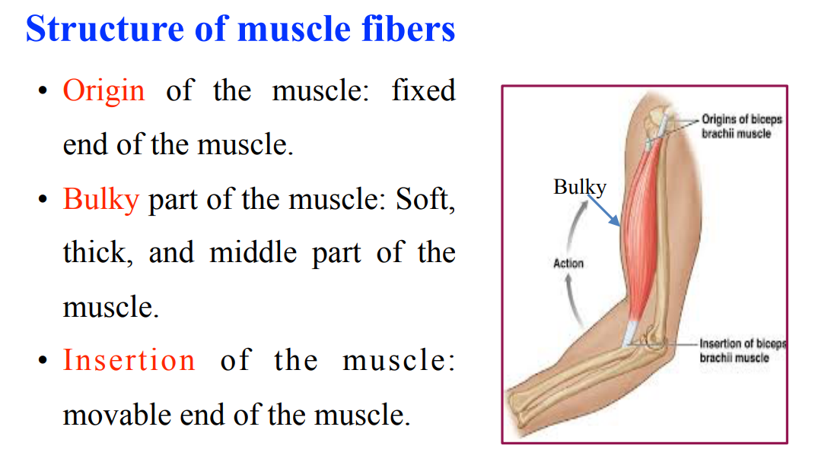

Slide 9
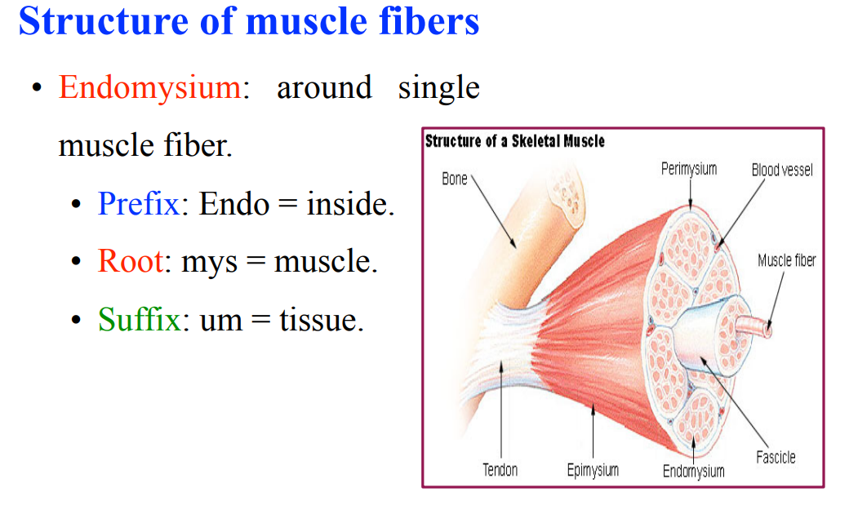

Slide 10
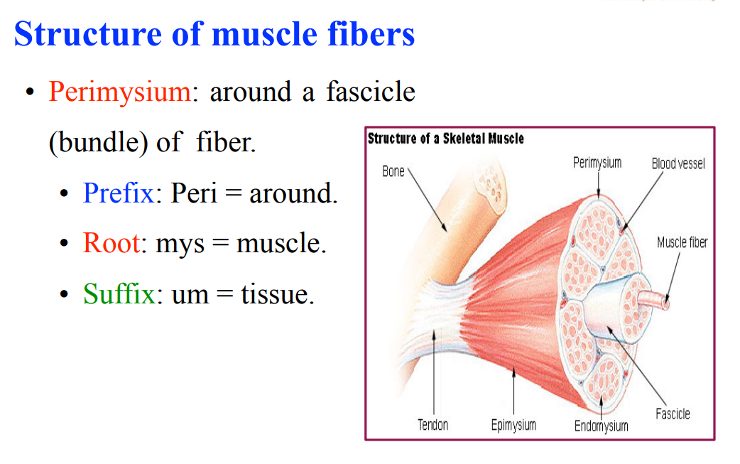

Slide 11
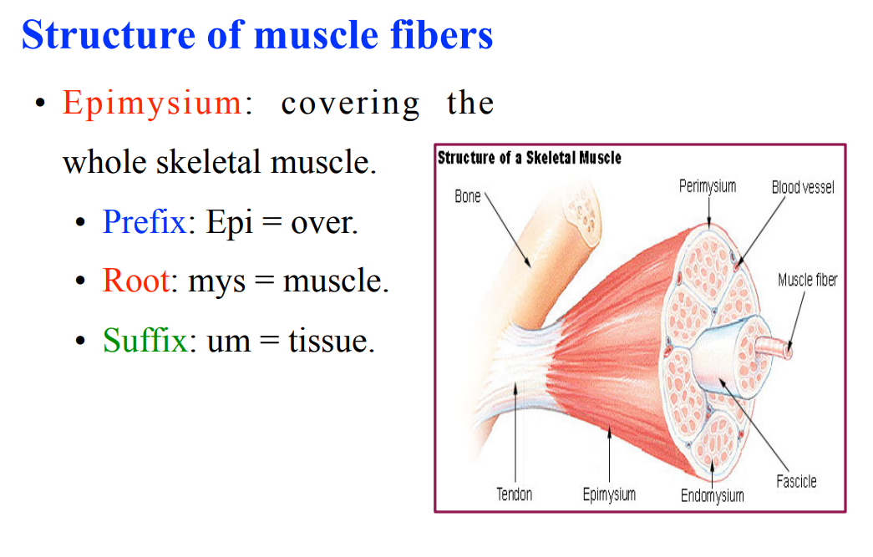

Slide 12
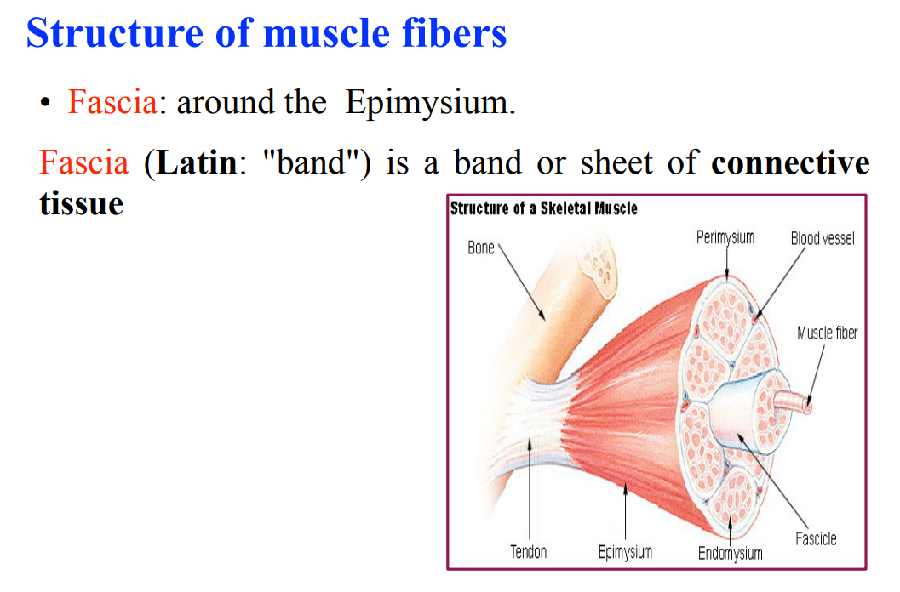

Slide 13
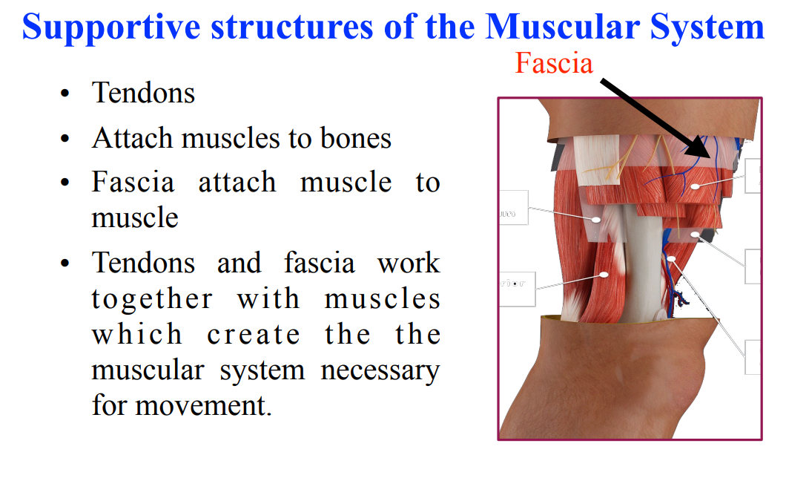

Slide 14
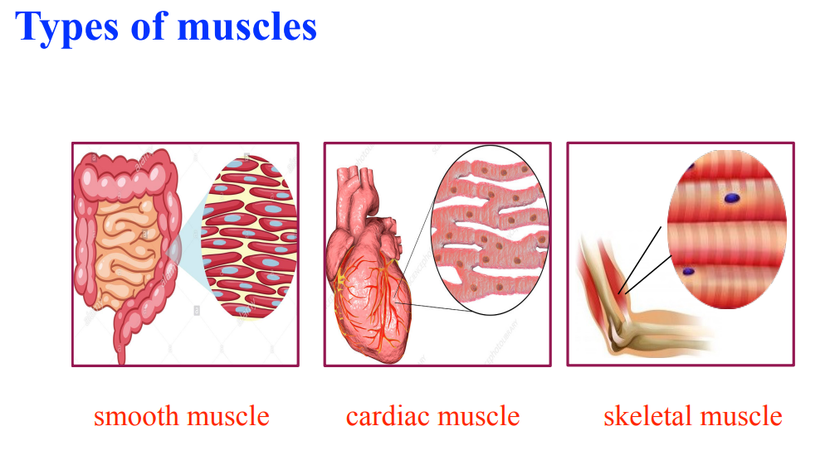

Slide 15
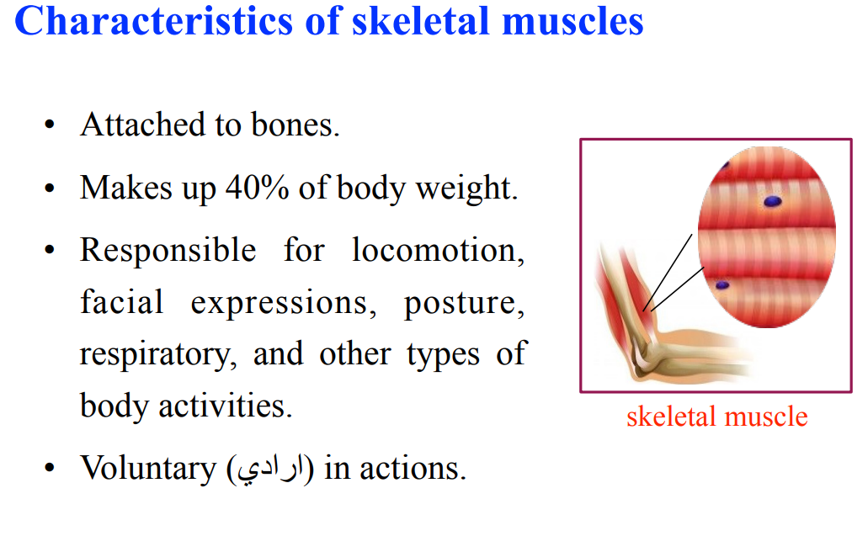

Slide 16
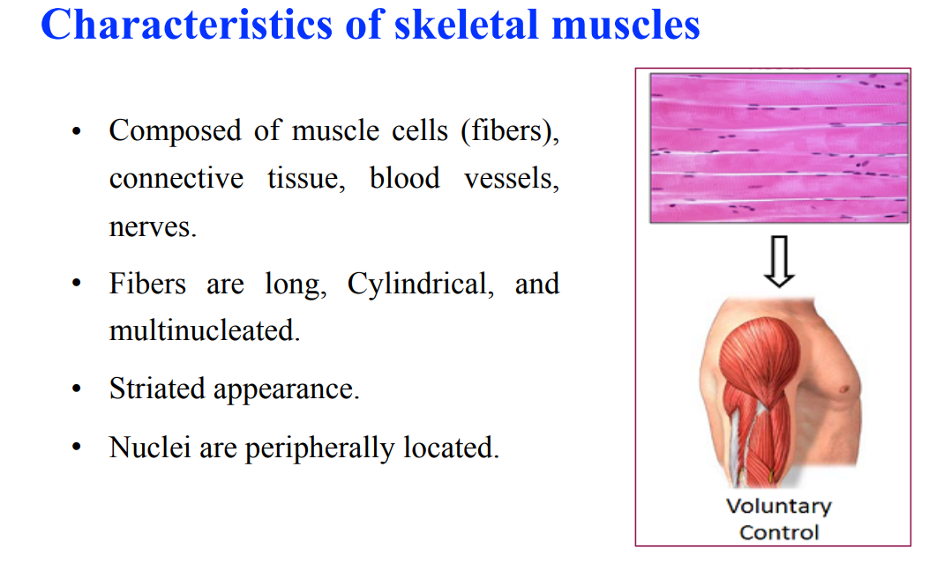

Slide 17
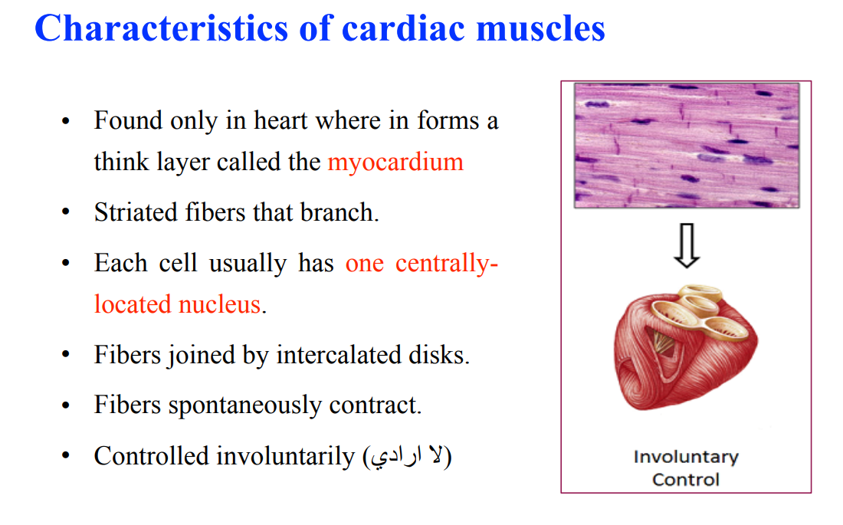

Slide 18
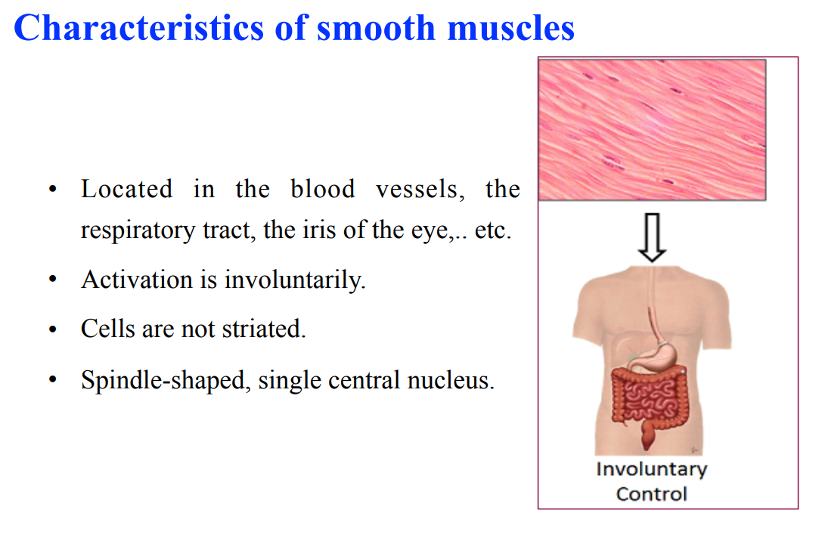

Slide 19
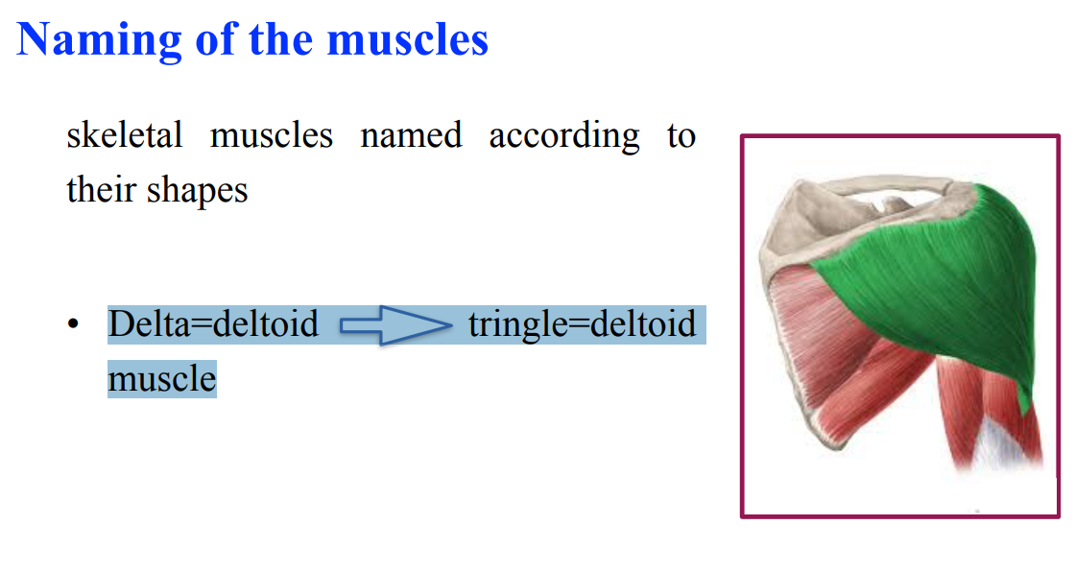

Slide 20
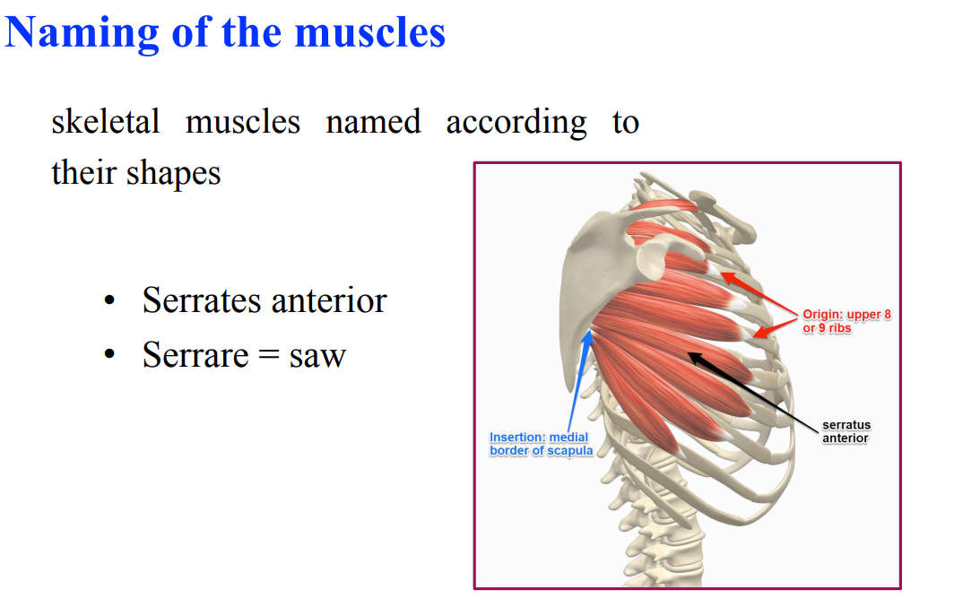

Slide 21
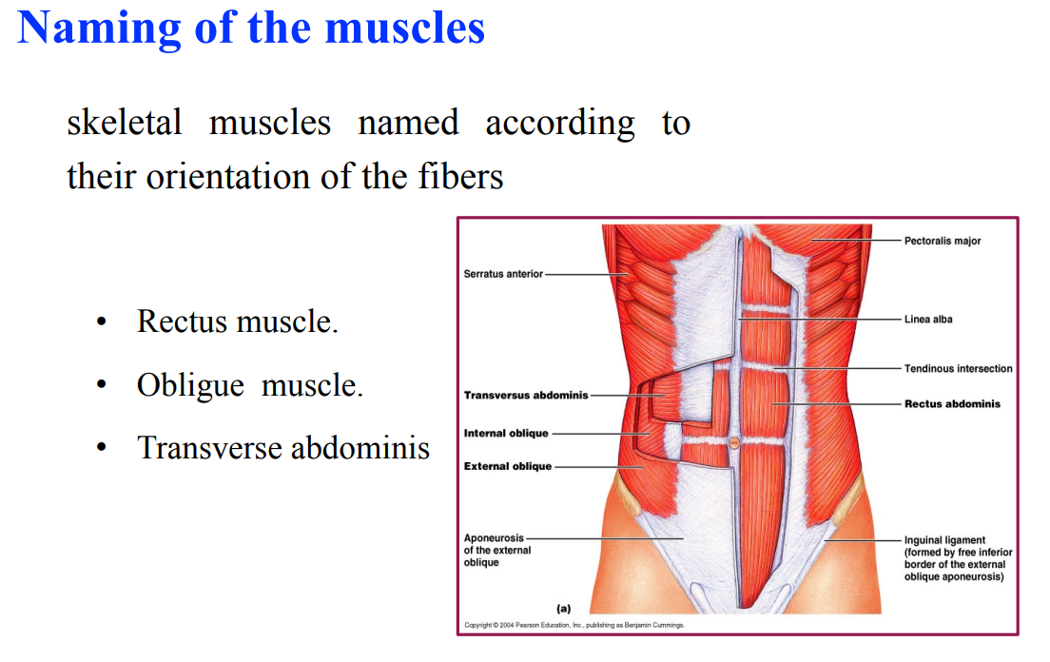

Slide 22
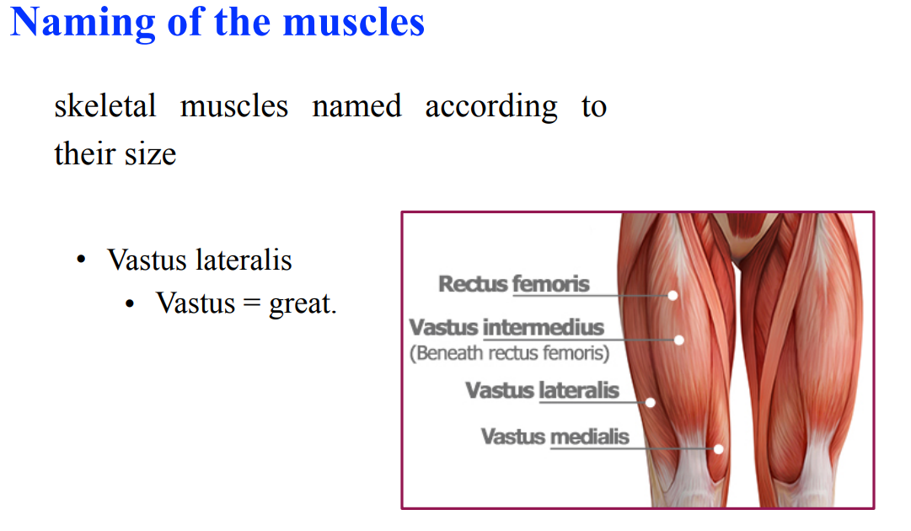

Slide 23
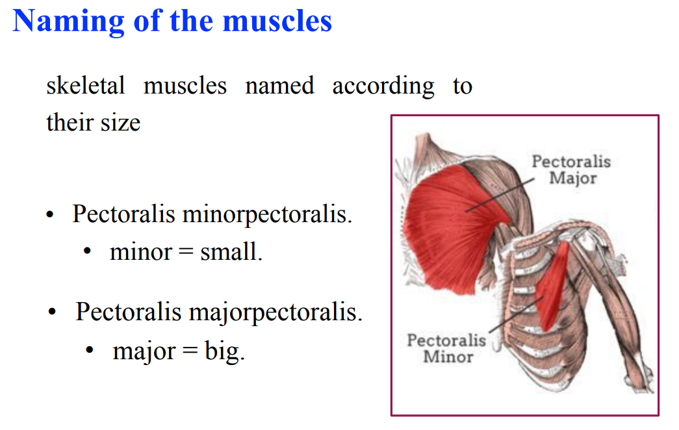

Slide 24
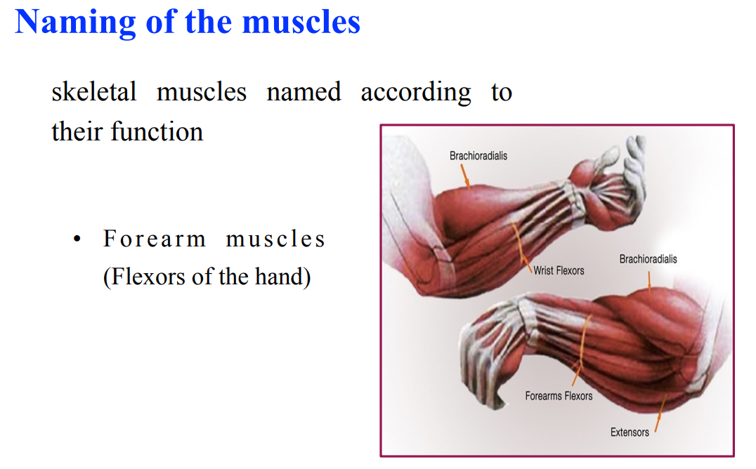

Slide 25
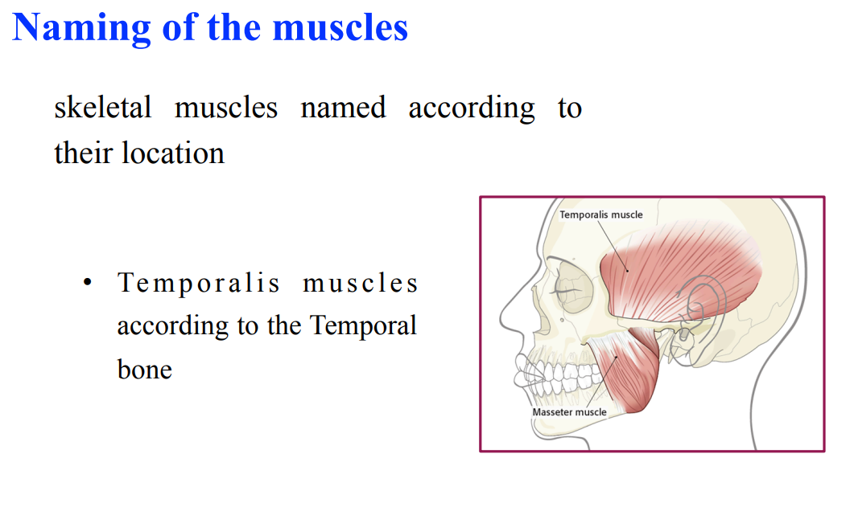

Slide 26
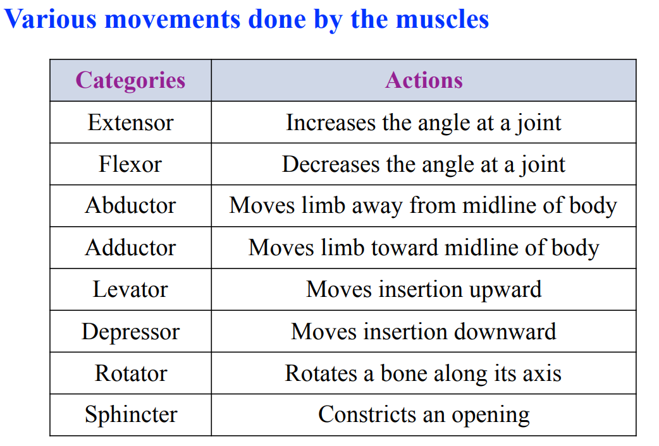

Slide 27
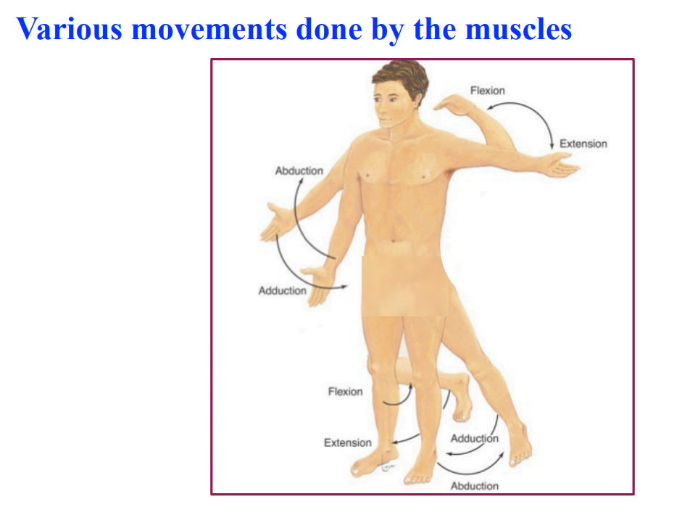

Slide 28


