Slide 1
General Histology Practical for second stage students
Endocrine system

Slide 2
Pituitary gland
Hypophysis has two subdivisions:
A. Adeno hypophysis (glandular portion)
1- Pars distalis
2- Pars intermedia
3- Pars tuberalis
B. Neuro hypophysis (nervous portion)
1- Median eminence
2- infundibulum
3- Pars nervosa

Slide 3
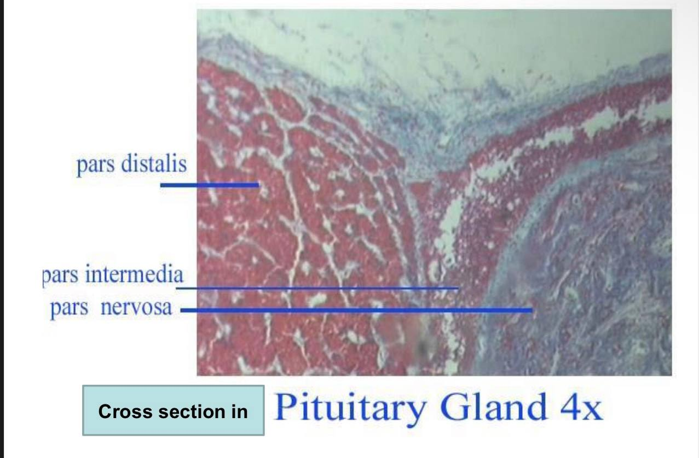

Slide 4
Pituitary gland
Pars Distalis
Contains glandular cells arranged in irregular clusters or cords.
Chromophils (cells with dye affinity) are divided into:
Acidophils (most abundant) Stain pink/red, include somatotrophs & mammotrophs.
Basophils (stain blue):
Subtypes of basophils corticotrophs, thyrotrophs, gonadotrophs.
3. Chromophobes: Weakly staining small cells.

Slide 5
Pituitary gland
Pars Intermedia
Located between pars distalis and pars nervosa.
Characterized by cuboidal cells.
Pars Tuberalis & Infundibulum Form the hypophyseal stalk (absent on the posterior aspect).

Slide 6
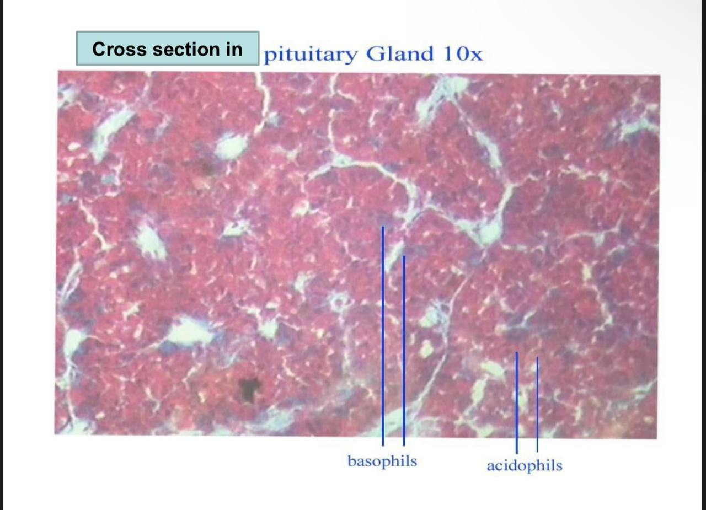

Slide 7
Thyroid gland
Location: Lies just below the larynx.
Structure : Consists of two lobes connected by an isthmus.
Surrounded by a dense, irregular collagenous connective tissue capsule.
Septa from the capsule subdivide the gland into lobules.

Slide 8
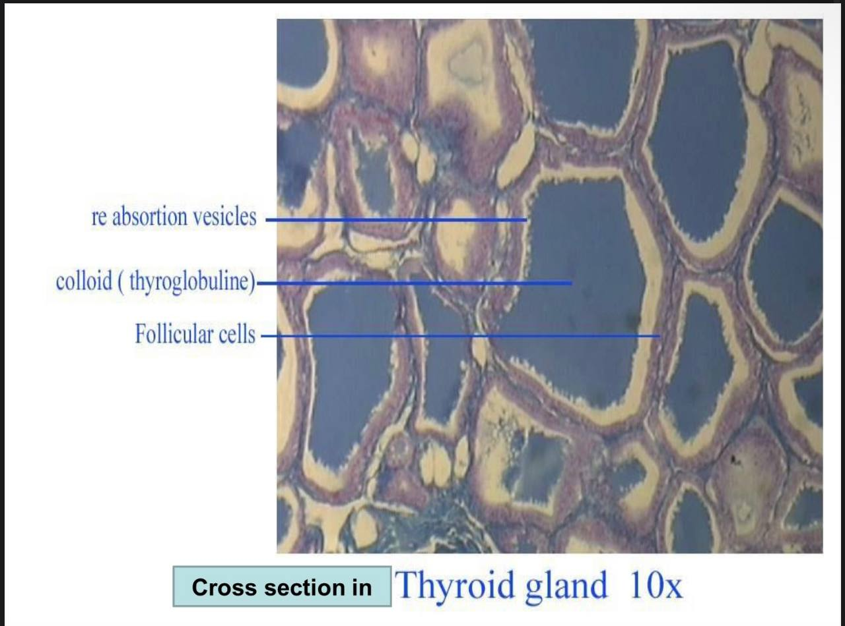

Slide 9
Thyroid gland
The cells which consisting of the gland is:
1. Follicle( filling with colloid).
2. Follicular cells.
3. Parafollicular cells.
4. Clear cells.
5. C - cells.
6. reabsorption vesicles.

Slide 10
Parathyroid gland
consists of four small, oval lobes situated on the back of the thyroid gland.
Compose of two cell types
chief cells which stain eosinophilic
oxyphil cells which are fewer in number, larger, and stain more deeply with eosin compared to the chief cells.

Slide 11
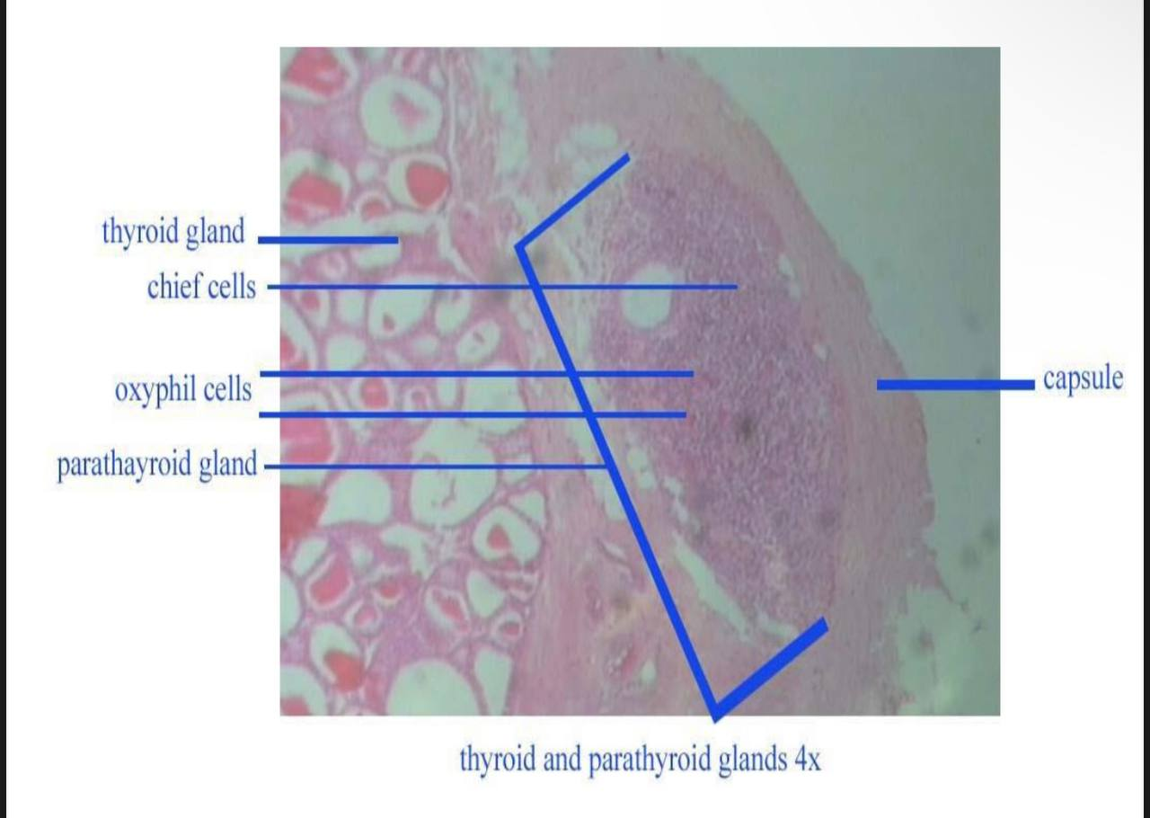

Slide 12
Adrenal glands
Location: Cranial to the kidneys, surrounded by dense connective tissue.
Regions:
Cortex (80-90% of the gland, yellowish, outer part)
Medulla (inner region)

Slide 13
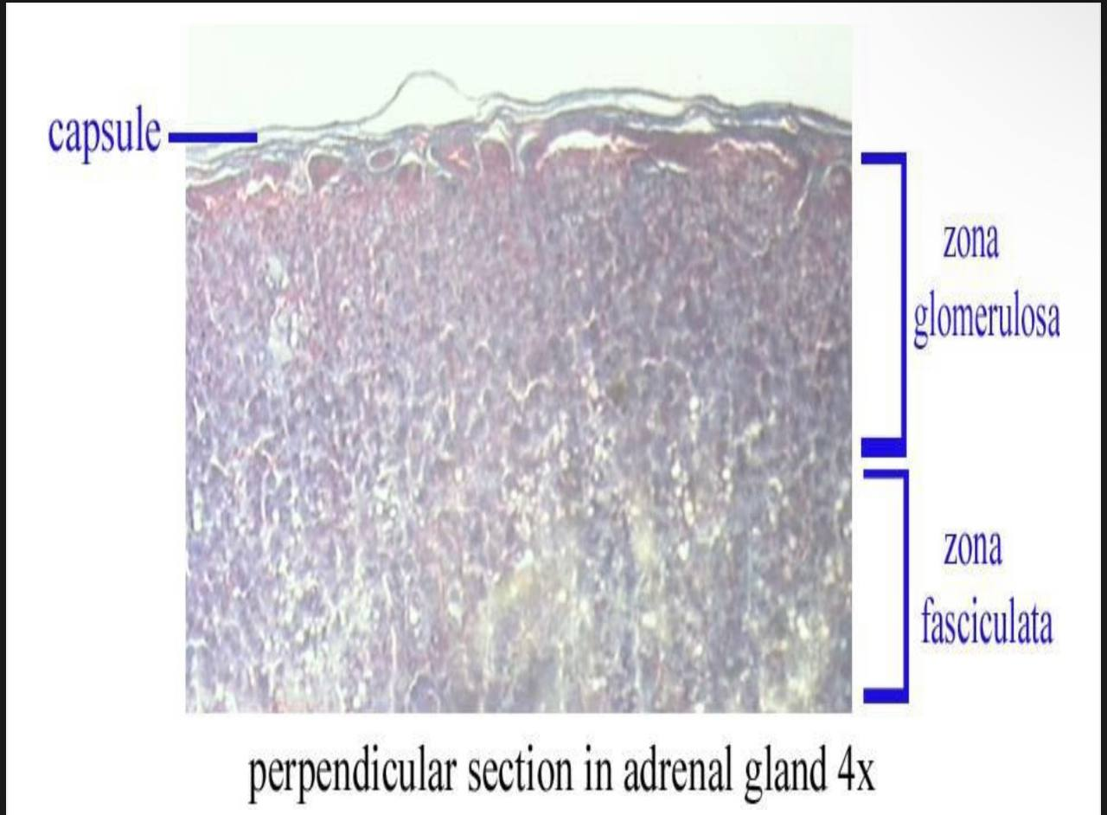

Slide 14
adrenal glands
Cortex Layers:
1. Zona Glomerulosa (13% of adrenal volume)
Small columnar cells in cords and clusters.
2. Zona Fasciculata (80% of adrenal volume)
Largest layer, contains large polyhedral spongiocytes in radial columns.
3. Zona Reticularis (7% of adrenal volume)
Dark acidophilic cells in cords, smaller than spongiocytes.

Slide 15
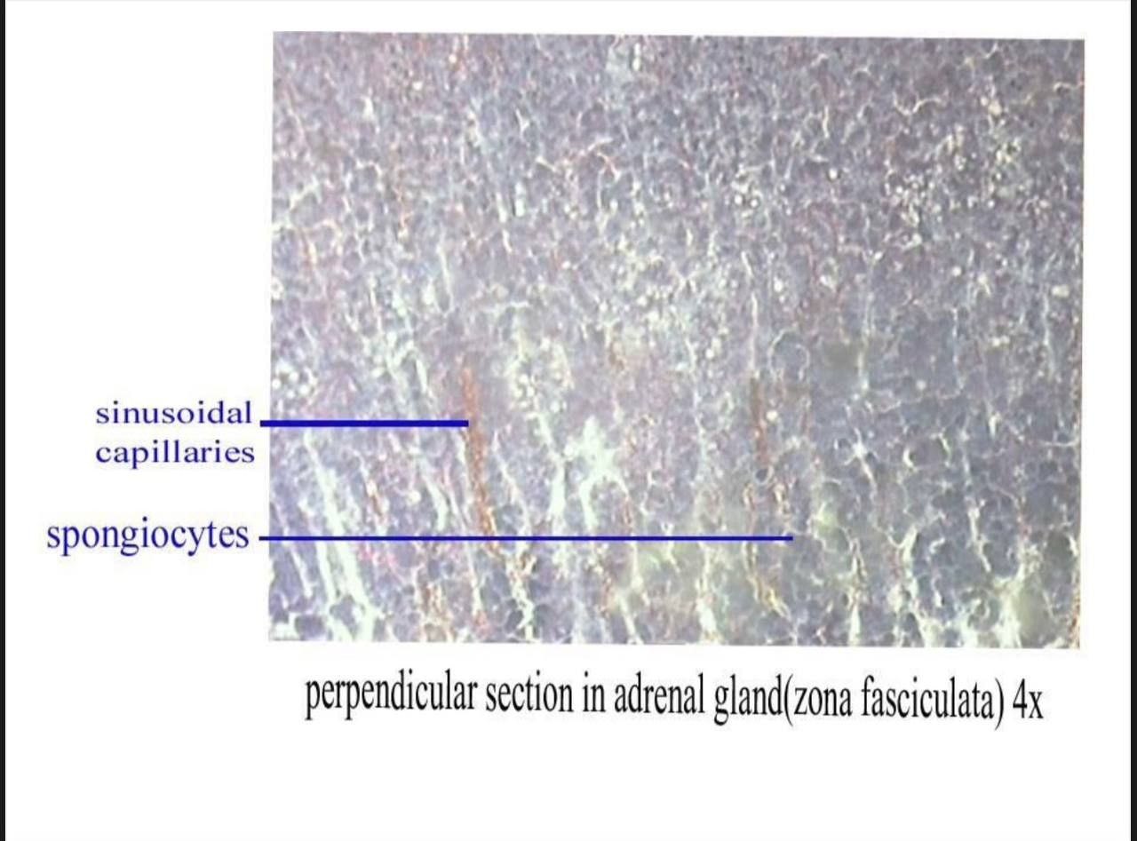

Slide 16
Suprarenal (adrenal) glands
Medulla
Contains chromaffin cells (large epithelial cells in clusters or short cords).
Sympathetic ganglion cells interspersed within dense connective tissue.

Slide 17
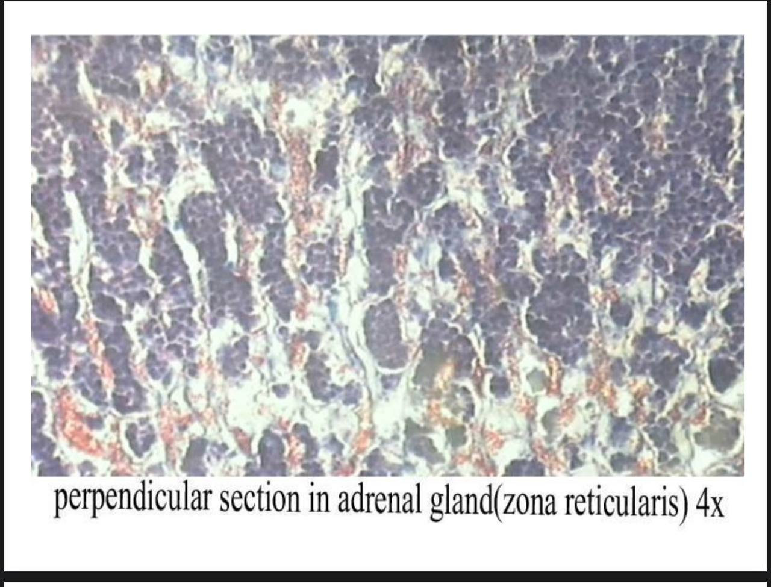

Slide 18
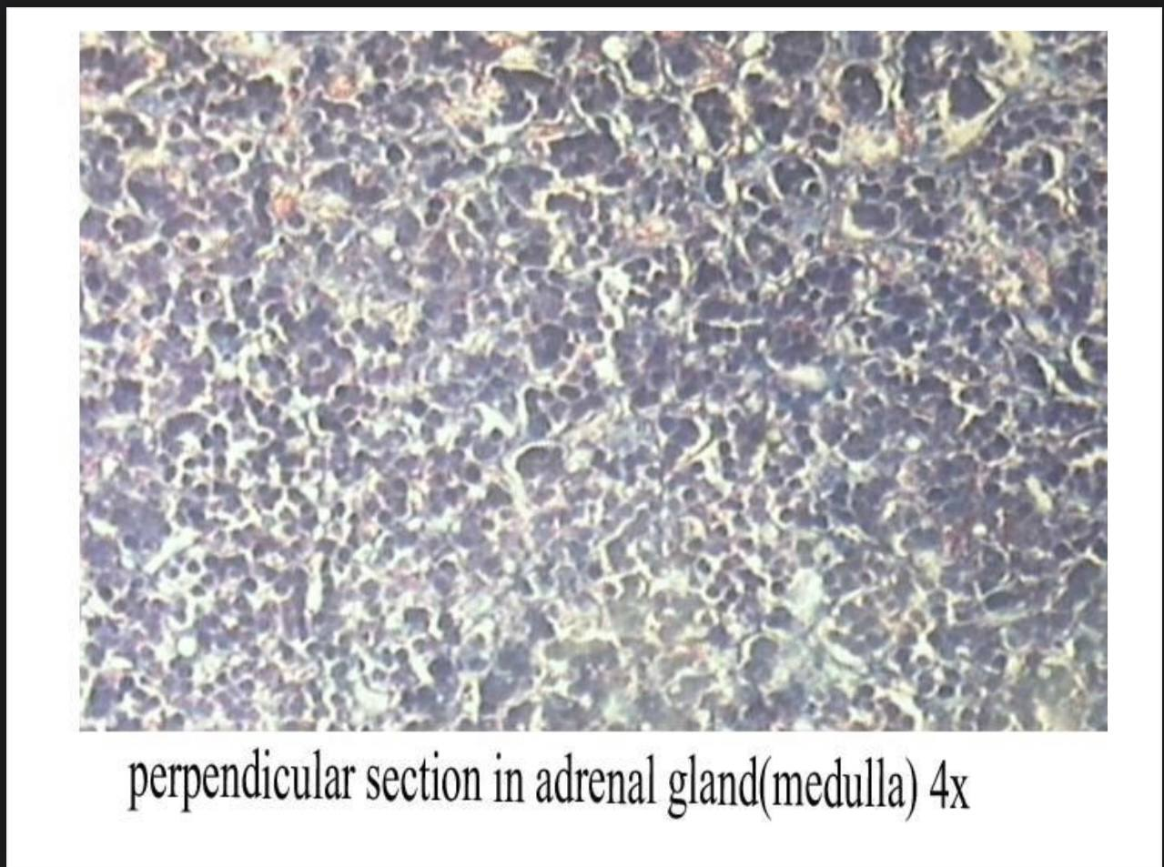

Slide 19
Pineal gland
it is conically shaped, the parenchymal cells are composed of:
1.Pinealocytes.
2.interstitial cells(neuroglial cells).
3. Brain sand.
Pinealocytes are basophilic cells with one or two long processes.

Slide 20


