Slide 1
Medical Terminology
Understanding Prefixes, Roots, and Suffixes
Presented by: Assist.Lect. Noor Alaa Abdulrazzaq

Slide 2
Introduction to Medical Terminology
Medical Terminology: is the language used by healthcare professionals to describe the human body, its functions, medical procedures, diseases, and treatment methods. It is a specialized vocabulary that allows clear, precise, and efficient communication in medical settings.

Slide 3
Why Do We Study Medical Terminology?
Accuracy: Avoid misunderstandings in diagnosis and treatment.
Professional Communication: Doctors, nurses, pharmacists, and technicians all use the same terminology.
Efficiency: It saves time and provides clarity in medical records.
Global Language: Medical terms are used internationally

Slide 4
Origin of Medical Terms
Medical terms come from Greek and Latin, which gives them consistency and universal understanding.
Greek → often related to diseases, conditions, and treatments
Latin → often related to body structures
Examples:
Cardio (heart) ← Greek
Pulmo (lung) ← Latin

Slide 5

The Building Blocks of Medical Terms
Medical words are usually composed of three main components:
  Prefix: A word part at the beginning, often indicating number, location, time, or negation.
  Root: The base part, indicating the primary meaning, often a body part or condition.
  Suffix: A word part at the end, frequently indicating a condition, procedure, or type.
Example: Hypertension
Hyper- = Excessive
Tension = Pressure
Together: Hypertension means "high blood pressure."

Slide 6
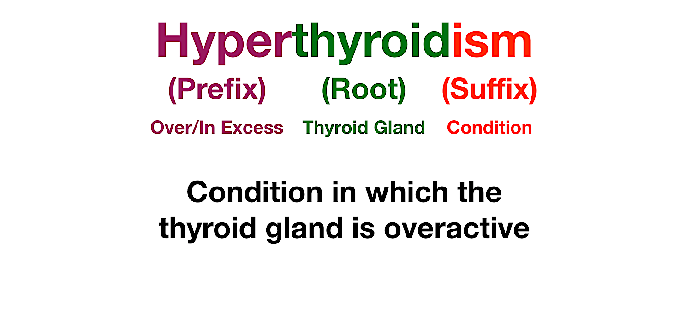

Slide 7
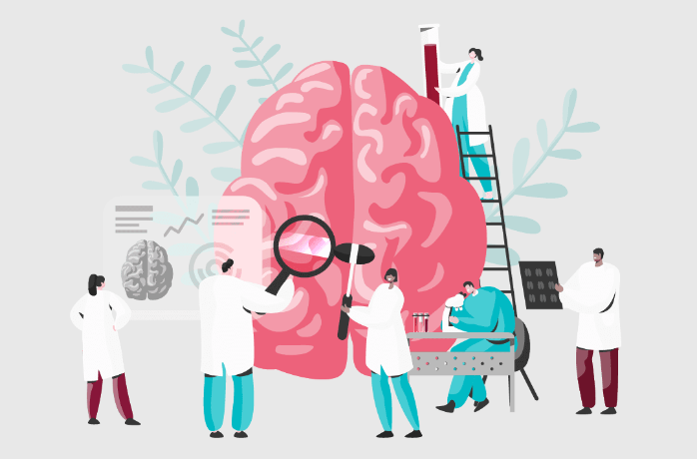
Prefixes in Medical Terminology
Definition and Importance
Prefix: Modifies the meaning of the root by adding context—often location, time, quantity, or state.
Importance: Recognizing prefixes helps identify the context or severity of a condition.

Slide 8
Common Prefix Examples with Meanings and Medical Examples
Numbers:
Uni- (one) → Unilateral (one-sided)
Bi- (two) → Bilateral (both sides)
Tri- (three) → Triceps (three-headed muscle)
Time or Speed:
Brady- (slow) → Bradycardia (slow heart rate)
Tachy- (fast) → Tachycardia (fast heart rate)
Neo- (new) → Neonatal (newborn)

Slide 9

Location or Position:
Epi- (upon, over) → Epidermis (outer layer of skin)
Sub- (under) → Subcutaneous (under the skin)
Peri- (around) → Pericardium (around the heart)
Negation:
A- or An- (without) → Anemia (without enough blood/iron)
Anti- (against) → Antibiotic (against bacteria)

Slide 10
Roots in Medical Terminology
Definition and Importance
Root: Provides the core meaning of the term, often relating to a body part, system, or condition.
Importance: Knowing the root helps pinpoint the main subject or area of focus.

Slide 11
Common Roots with Meanings
Body Parts:
Cardi- (heart) → Cardiologist (heart specialist)
Gastro- (stomach) → Gastroenteritis (inflammation of stomach and intestines)
Neuro- (nerve) → Neuropathy (disease affecting nerves)
Conditions:
Path- (disease) → Pathology (study of disease)
Hem- or Hemo- (blood) → Hemorrhage (excessive bleeding)
Psych- (mind) → Psychology (study of the mind)
Processes or Actions:
Therm- (heat) → Thermometer (device to measure temperature)
Gen- (create, form) → Carcinogen (substance that can cause cancer)

Slide 12
Suffixes in Medical Terminology
Definition and Importance
Suffix: A word part that completes the term, often providing information about the procedure, condition, or disease.
Importance: Suffixes help identify the type of word, whether it's a condition, a specialty, a procedure, or a type of disease.

Slide 13
Common Suffixes with Meanings
Conditions and Diseases:
-itis (inflammation) → Arthritis (inflammation of the joints)
-osis (abnormal condition) → Cirrhosis (liver disease)
Procedures and Treatments:
-ectomy (removal) → Appendectomy (removal of the appendix)
-scopy (to view) → Endoscopy (viewing the inside of the body)

Slide 14
Specialties or Studies:
-ology (study of) → Neurology (study of the nervous system)
-logist (specialist) → Dermatologist (skin specialist)
General Types:
-emia (blood condition) → Leukemia (blood cancer)
-pathy (disease) → Neuropathy (nerve disease)

Slide 15
Combining Forms and Vowels
Explanation:
When combining a root and suffix that don’t naturally blend, a vowel (usually “o”) is added for smoother pronunciation.
Examples:
Gastroenterology: Gastro- (stomach) + Entero- (intestine) + -logy (study of)
Cardiovascular: Cardi- (heart) + Vascular (vessels) = related to heart and blood vessels

Slide 16
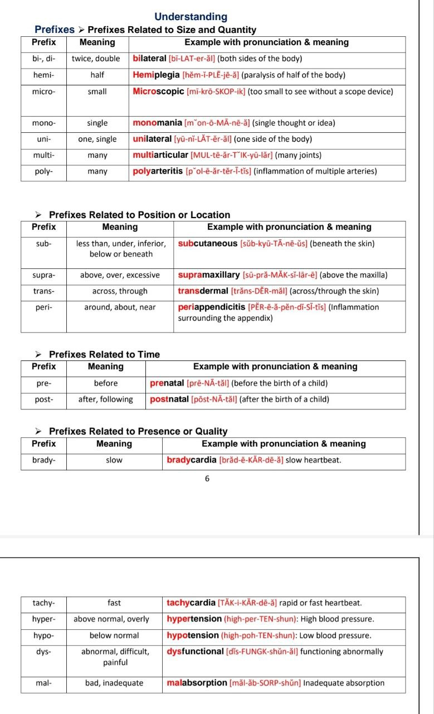

Slide 17
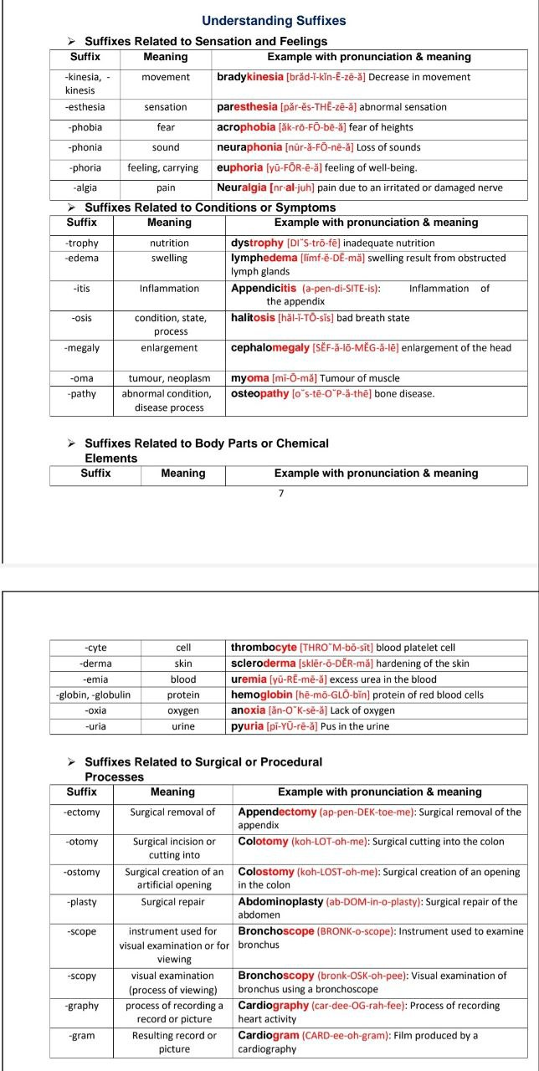

Slide 18


