Slide 1
How plot graph
HOW TO PLOT A GRAPH IN MEDICAL PHYSICS LAB

Slide 2
TYPYS OF GRAPH PAPER
1 - Statistical graph paper.
2 – Normal graph paper.
3 - Logarithmic graph paper.

Slide 3
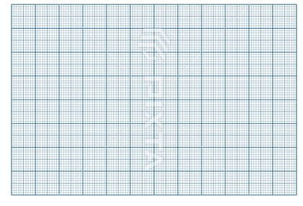

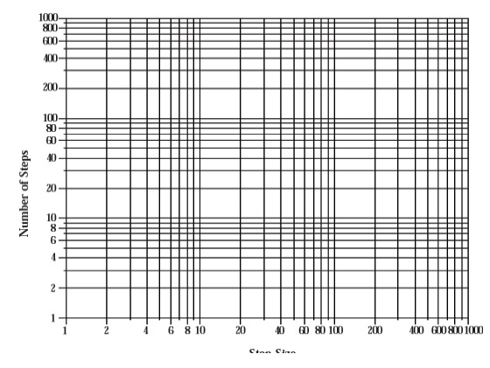
SHAPES OF GRAPH PAPERS

Slide 4
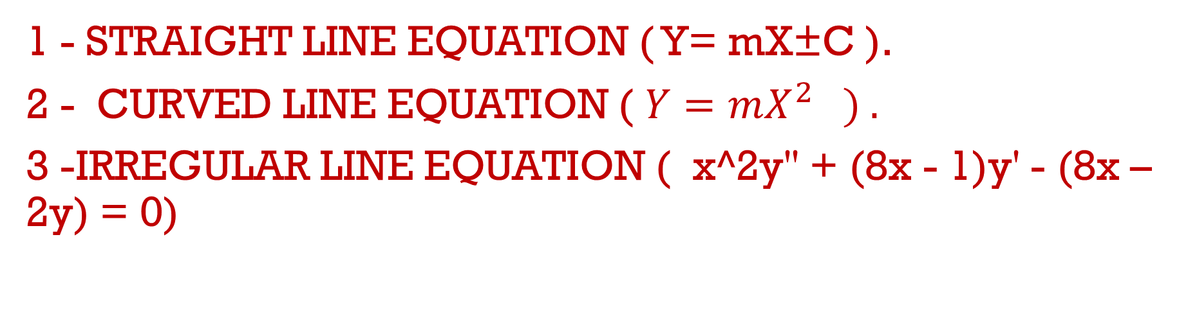
TYPES OF GRAPH LINES
1 - STRAIGHT LINE EQUATION ( Y= mX±C ).
2 - CURVED LINE EQUATION ( $Y=mX^{2} ) .$
3 -IRREGULAR LINE EQUATION ( x^2y'' + (8x - 1)y' - (8x – 2y) = 0)

Slide 5
HOW to GET DATA TO DRAWING GRAPH
1- Data tables.
2- Equations.
3- By reading & recording from instruments & tools that are used in measuring.

Slide 6
STEPS TO DRAWING GRAPH
1- Choose axes.
2- Draw axes.
3 - Give the names to axes.
4- Give suitable SI system Units to axes.
5 - Give weight to axes.
6 - Divide the axes depending on the recorded data from the measuring tools & instruments.
7 – Draw points on graph paper by use rular to drop x –axes on y-axes .
8 –Drawing the line that take the average of geometric positions of drawed points .
9 – Find the slope of the curve .
10 – Find error percentage.
.

Slide 7
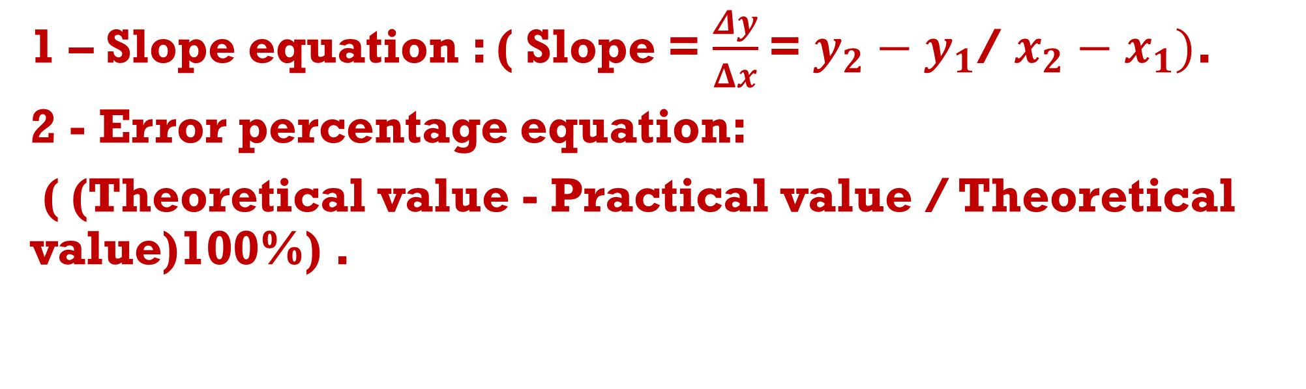
IMPORTANT EQUATIONS
1 – Slope equation : ( Slope = $\frac{Δy}{Δx}$= $y_{2}−y_{1}$/ $x_{2}−x_{1})$.
2 - Error percentage equation:
( (Theoretical value - Practical value / Theoretical value)100%) .

Slide 8
IMPORTANT TOOLS TO DRAW GRAPH
1- Book of drawing paper.
2 – Transperant Ruler (30cm).
3 – pencils.
4 – Eraser.
5 – pencils Sharpener.
6 – Simple electronic calculat.

Slide 9
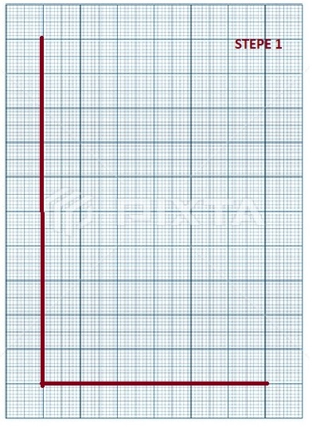

Slide 10
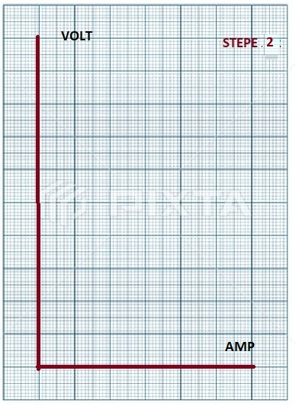

Slide 11
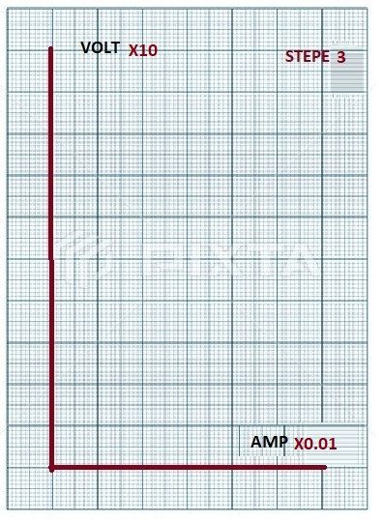

Slide 12
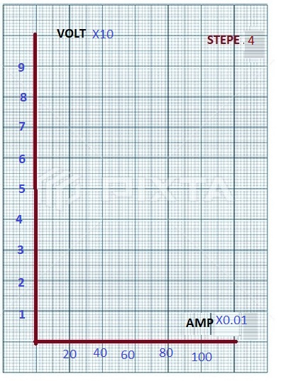

Slide 13
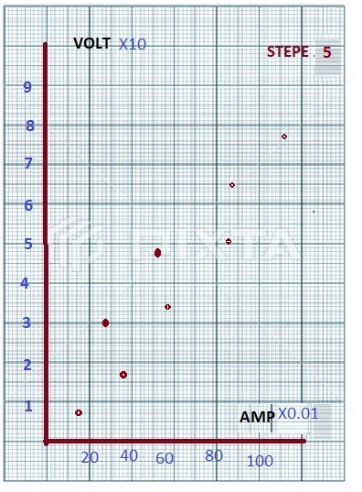

Slide 14
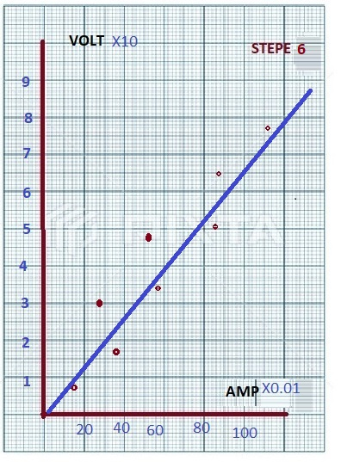

Slide 15
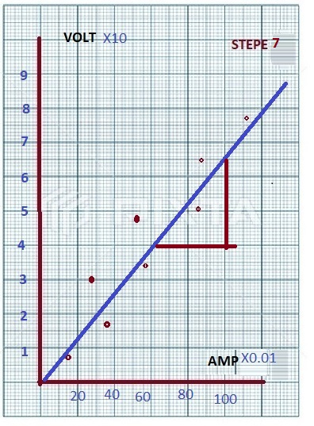

Slide 16

THANK YOU FOR LISTENING

