Slide 1
Introduction to Students

Slide 2
Practical work in physics is intended to teach the student how to select and set up apparatus skillfully and well, to make careful observations and precise measurements while at the same time realising the limitations of the measuring instruments employed, and to use the experimental results obtained to the best advantage.

Slide 3


Slide 4
Graphs
The majority of experiments in physics require the drawing of a graph, for not only does a graph give an immediate visual picture of results and information (e.g. how one variable quantity varies with another) but it also usually provides the most convenient way of obtaining the average of a set of readings.
It is better to draw a graph of the different values as ordinates (Y-axis) against the corresponding values as abscissae (X-axis).

Slide 5
Types of Lines in Graphs
Lines
Straight
Curved
Irregular

Slide 6
Straight Lines
The straight lines occur when there is an increase or a decrease in both X-values and Y-values.
The general equation of this line is: -
Y = mX ± C

Slide 7
The straight lines can be found in
three forms

Slide 8
Intersection through the original point (0.0).
When the line intercepts the original point (0.0) as represent in the following graph: -
The equation of this line is: -
Y = mX
Because of: -
In ΔAMC, tan AĈM=AM/CM
But AĈM=θ
AM=Y
CM=X
Hence tanθ=Y/X
Y=Xtanθ
Writing m for tanθ,
Y=mX
Y
K
A
X
C=O
M
H

Slide 9
Intersection through the Y⁺ axis.
When the line intercepts the Y⁺ axis as represent in the following graph: -
The equation of this line is: -
Y = mX + C
Because of: -
In ΔAMC, tan AĈM=AM/CM
But AĈM=θ
AM=AN-MN
AM=AN-OC
AM=Y-C
CM=ON
CM=X
Hence tanθ=(Y-C)/X
Y=Xtanθ+C
Writing m for tanθ,
Y=mX+C
K
Y
A
C
M
X
O
N
H

Slide 10
Intersection through the Y⁻ axis.
When the line intercepts the Y⁻ axis as represent in the following graph: -
The equation of this line is: -
Y = mX - C
Because of: -
In ΔAMC, tan AĈM=AM/CM
But AĈM=θ
AM=AN+MN
AM=AN+OC
AM=Y+C
CM=ON
CM=X
Hence tanθ=(Y+C)/X
Y=Xtanθ-C
Writing m for tanθ,
Y=mX-C
Y
K
A
O
N
X
C
M
H

Slide 11
Curved Lines
The curved lines occur when there is an increase in X-values with a decrease in Y-values or a decrease in X-values with an increase in Y-values.
So the curved lines indicate that the relations between the data are inversely proportional.
Irregular Lines
The irregular lines occur when there is an increase or a decrease in X-values and Y-values randomly.

Slide 12
The SI System of Units

Slide 13
The Systeme Internationale d'Unites, abbreviated to the SI system of units, was approved in 1960 by the General Conference of Weights and Measures, an international organization, and is coming into increasing use throughout the world because of its many advantages over the multitudinous national systems it is now superseding. Apart from its own intrinsic merits, it has the great advantage over all other systems of units in that it is international-the one system that is common to all countries. So, once everyone uses the system, gone will be the need to convert laboriously from one system of units to another, involving time and energy that can be more profitably spent.

Slide 14
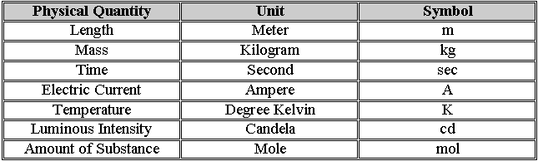
Table (1): - The International System (SI)
All other units are derived from these units. The more important derivative units, which all have special names, are as follows: -

Slide 15
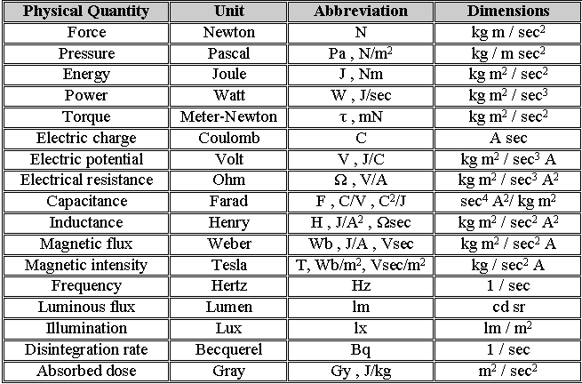
Table (2): - Derived Units.

Slide 16
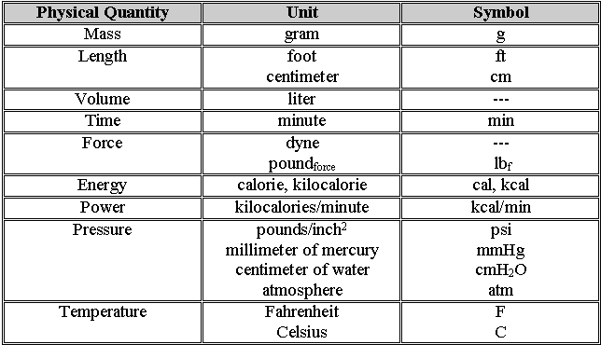
Note: -
The abbreviation for steradian, the SI unit of solid angle, is sr.
Table (3): - Non-SI Units.

