Slide 1

Measurement of a.c. and d.c. voltage with the cathode ray oscilloscope (CRO)

Slide 2
Introduction
An oscilloscope (sometimes abbreviated CRO, for cathode ray oscilloscope, or commonly just scope or O-Scope) is a piece of electronic test equipment that allows signal voltages to be viewed, usually as a two-dimensional graph of one or more electrical potential differences (vertical axis) plotted as a function of time or of some other voltage (horizontal axis), so it is used in many fields of basic and applied research to measure time-dependent voltage signals.

Slide 3
The CRO is used as a voltmeter with any voltage change shown on screen by an up (positive) or down (negative) movement of a bright dot.
This dot is produced by a beam of electrons hitting the phospor layer on the inside of the screen.
Over time, the dot traces a graph across the screen showing voltage change against time. If voltage remains constant, the graph consists of a horizontal line.

Slide 4
The Oscilloscope
The oscilloscope is an electronic display device containing a cathode ray tube (CRT), used to produce visible patterns that are the graphical representations of electrical signals.
A typical oscilloscope is usually box shaped with a display screen, numerous input connectors, control knobs and buttons on the front panel. To aid measurement, a grid called the graticule is drawn on the face of the screen. Each square in the graticule is known as a division.

Slide 5
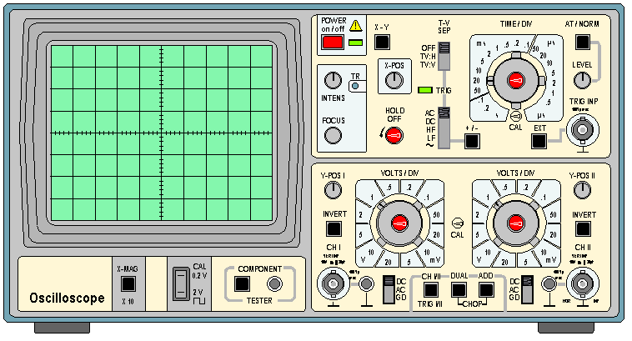
An oscilloscope looks a lot like a small television set, except that it has a grid drawn on its screen and more controls than a television. The front panel of an oscilloscope normally has control sections divided into Vertical, Horizontal, and Trigger sections. There are also display controls and input connectors.

Slide 6
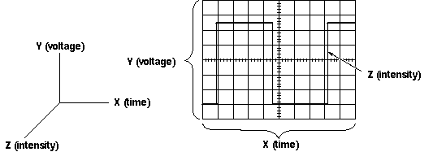
The oscilloscope is basically a graph displaying device, it draws a graph of an electrical signal. In most applications, the graph shows how signals change over time: the vertical (Y) axis represents voltage and the horizontal (X) axis represents time. The intensity or brightness of the display is sometimes called the (Z) axis.

Slide 7
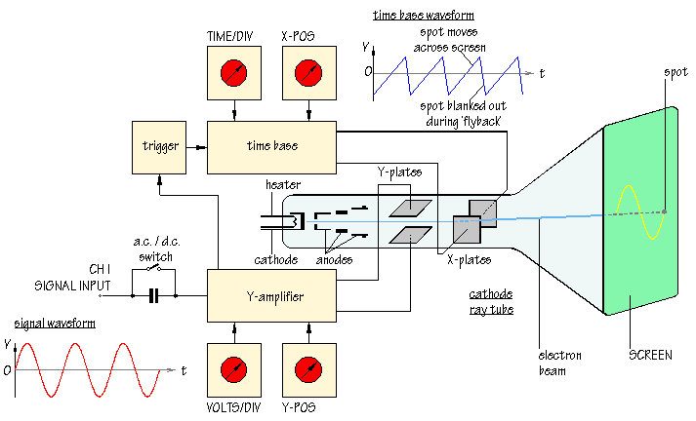
How Does an Oscilloscope Work?
An outline explanation of how an oscilloscope works can be given using the block diagram.

Slide 8
Cathode rays exist in the form of streams of high-speed electrons emitted from the heating of a (cathode) inside a vacuum tube, at its rear end. The electron beam emitted by the heated (cathode) at the rear end of the tube is accelerated and focused by one or more (anode), and strikes the front of the tube, producing a bright spot on the phosphorescent screen.
The emitted electrons are due to the voltage difference applied across the two electrodes (the CRT screen typically forms the anode).

Slide 9
The electron beam is then perturbed (deflected or bent), either by a magnetic or an electric field, to trace over (scan) the inside surface of the screen (anode).
The screen is covered with a phosphorescent coating (often transition metals or rare earth elements), which emits visible light when excited by the electrons.

Slide 10
A cathode ray tube or CRT is a specialized vacuum tube in which images are produced when an electron beam strikes a phosphorescent surface. Television sets, computers, automated teller machines, video game machines, video cameras, monitors, oscilloscopes and radar displays all contain cathode ray tubes. Phosphor screens using multiple beams of electrons have allowed CRTs to display millions of colors.

Slide 11
A transducer is a device that creates an electrical signal in response to physical stimulion, such as sound, mechanical stress, pressure, light, or heat. For example, a microphone is a transducer.
oscilloscope can measure all kinds of phenomena depending on transducer.

Slide 12
The Medical Applications of Cathode Ray Oscilloscope (CRO)
1. To study the electrical signals from the muscle though electromyogram (EMG).
2. To study the electrical signals from the heart though electrocardiogram (ECG).
3. To study the electrical signals from the brain though electroencephalogram (EEG).
4. To study the electrical signals from the eye though electroretinogram (ERG) and electrooculogram (EOG).

