Slide 1
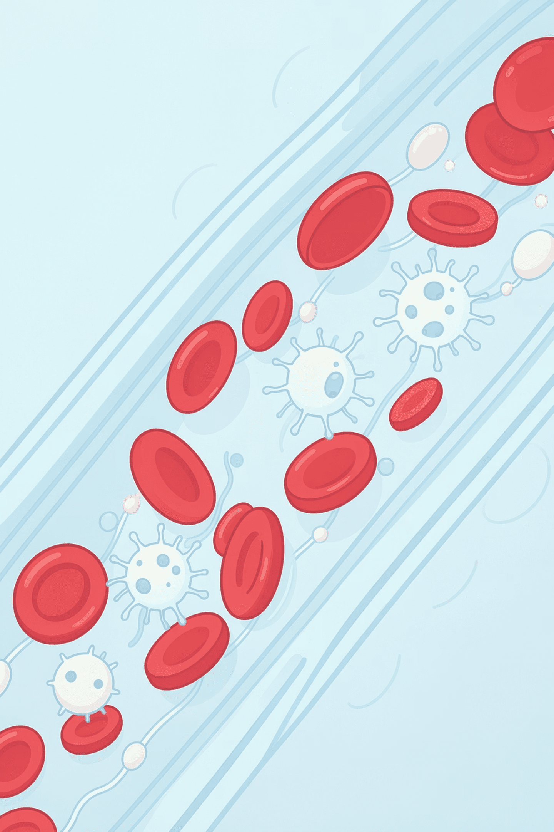

Blood, Lymph & Immune Systems
Assist.Lect. Noor Alaa Abdulrazziq

Slide 2

🎯 Learning Objectives
By the end of this module, you will be able to:
Explain the role of white blood cells (WBCs) in immunity
Differentiate between key blood and immune-related disorders
Analyze symptoms and link them to underlying conditions
Apply knowledge through real-life scenarios and activities

Slide 3
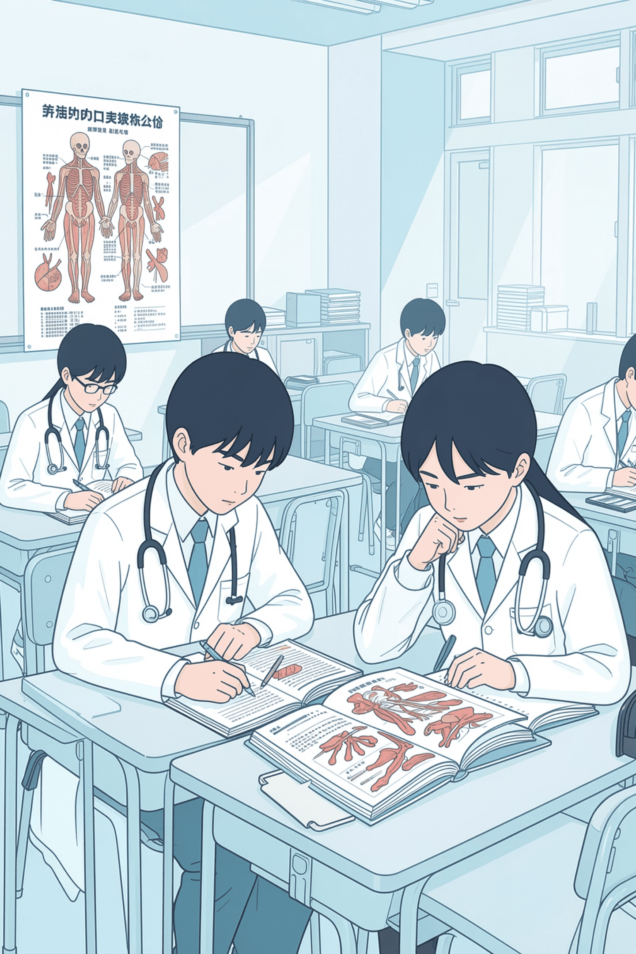
Quick Oral Review Questions
Blood Basics
1
Components & functions?
Plasma, RBCs, WBCs, Platelets
Transport of oxygen, nutrients, and waste
Lymphatic System
Formation & function?
2
Capillary fluid → lymph
Returns fluid to blood; lymph nodes filter infection
Lymphatic System

Slide 4
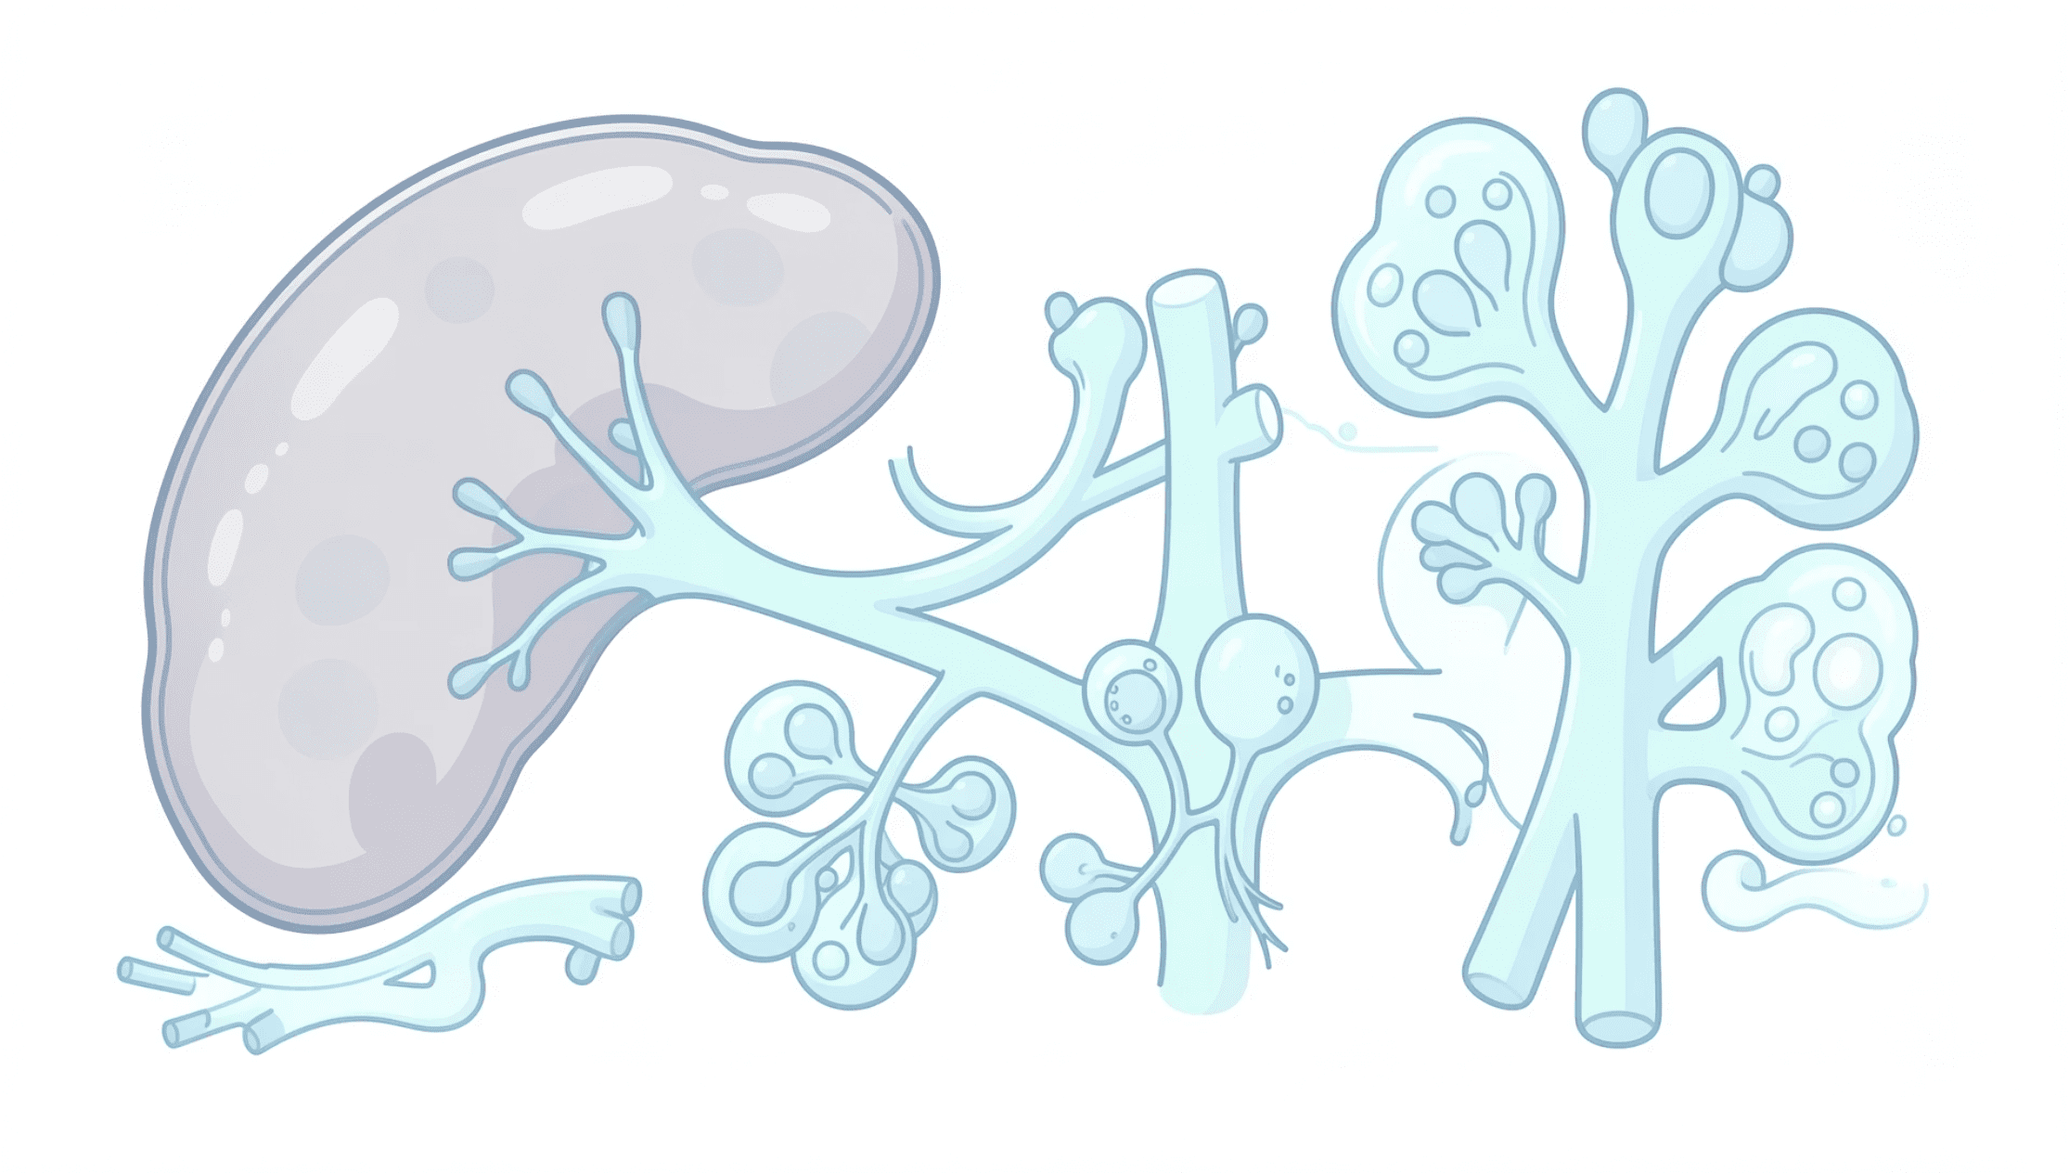


Immune System Overview
The immune system is the body's primary defense network — identifying, neutralizing, and remembering pathogens to protect against future threats.
Key Organs: Spleen · Lymph Nodes · Bone Marrow
Detects Antigens
Eliminates Threats
Builds Immune Memory
Recognizes foreign substances and pathogens
Destroys invaders through coordinated cellular responses
Retains memory of past infections for faster future response

Slide 5
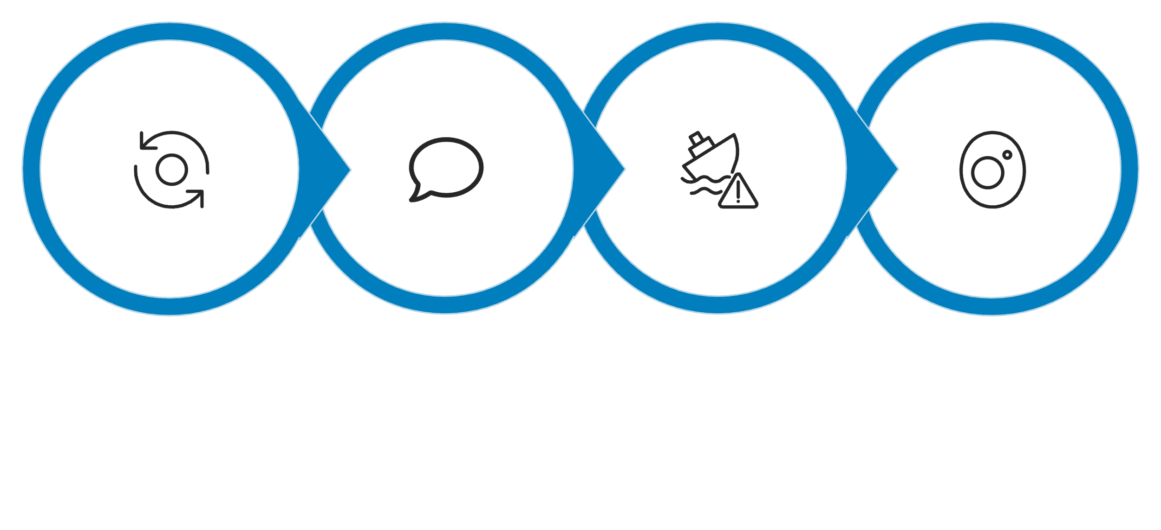




White Blood Cells: Mechanism of Action
Monocytes circulate in the blood before migrating into tissues, where they mature into macrophages — powerful phagocytic cells central to innate immunity.
Monocyte Migration
Antigen Processing
Antigen Presentation
Phagocytosis
As Antigen-Presenting Cells (APCs), macrophages bridge innate and adaptive immunity by displaying antigen fragments to T cells.

Slide 6
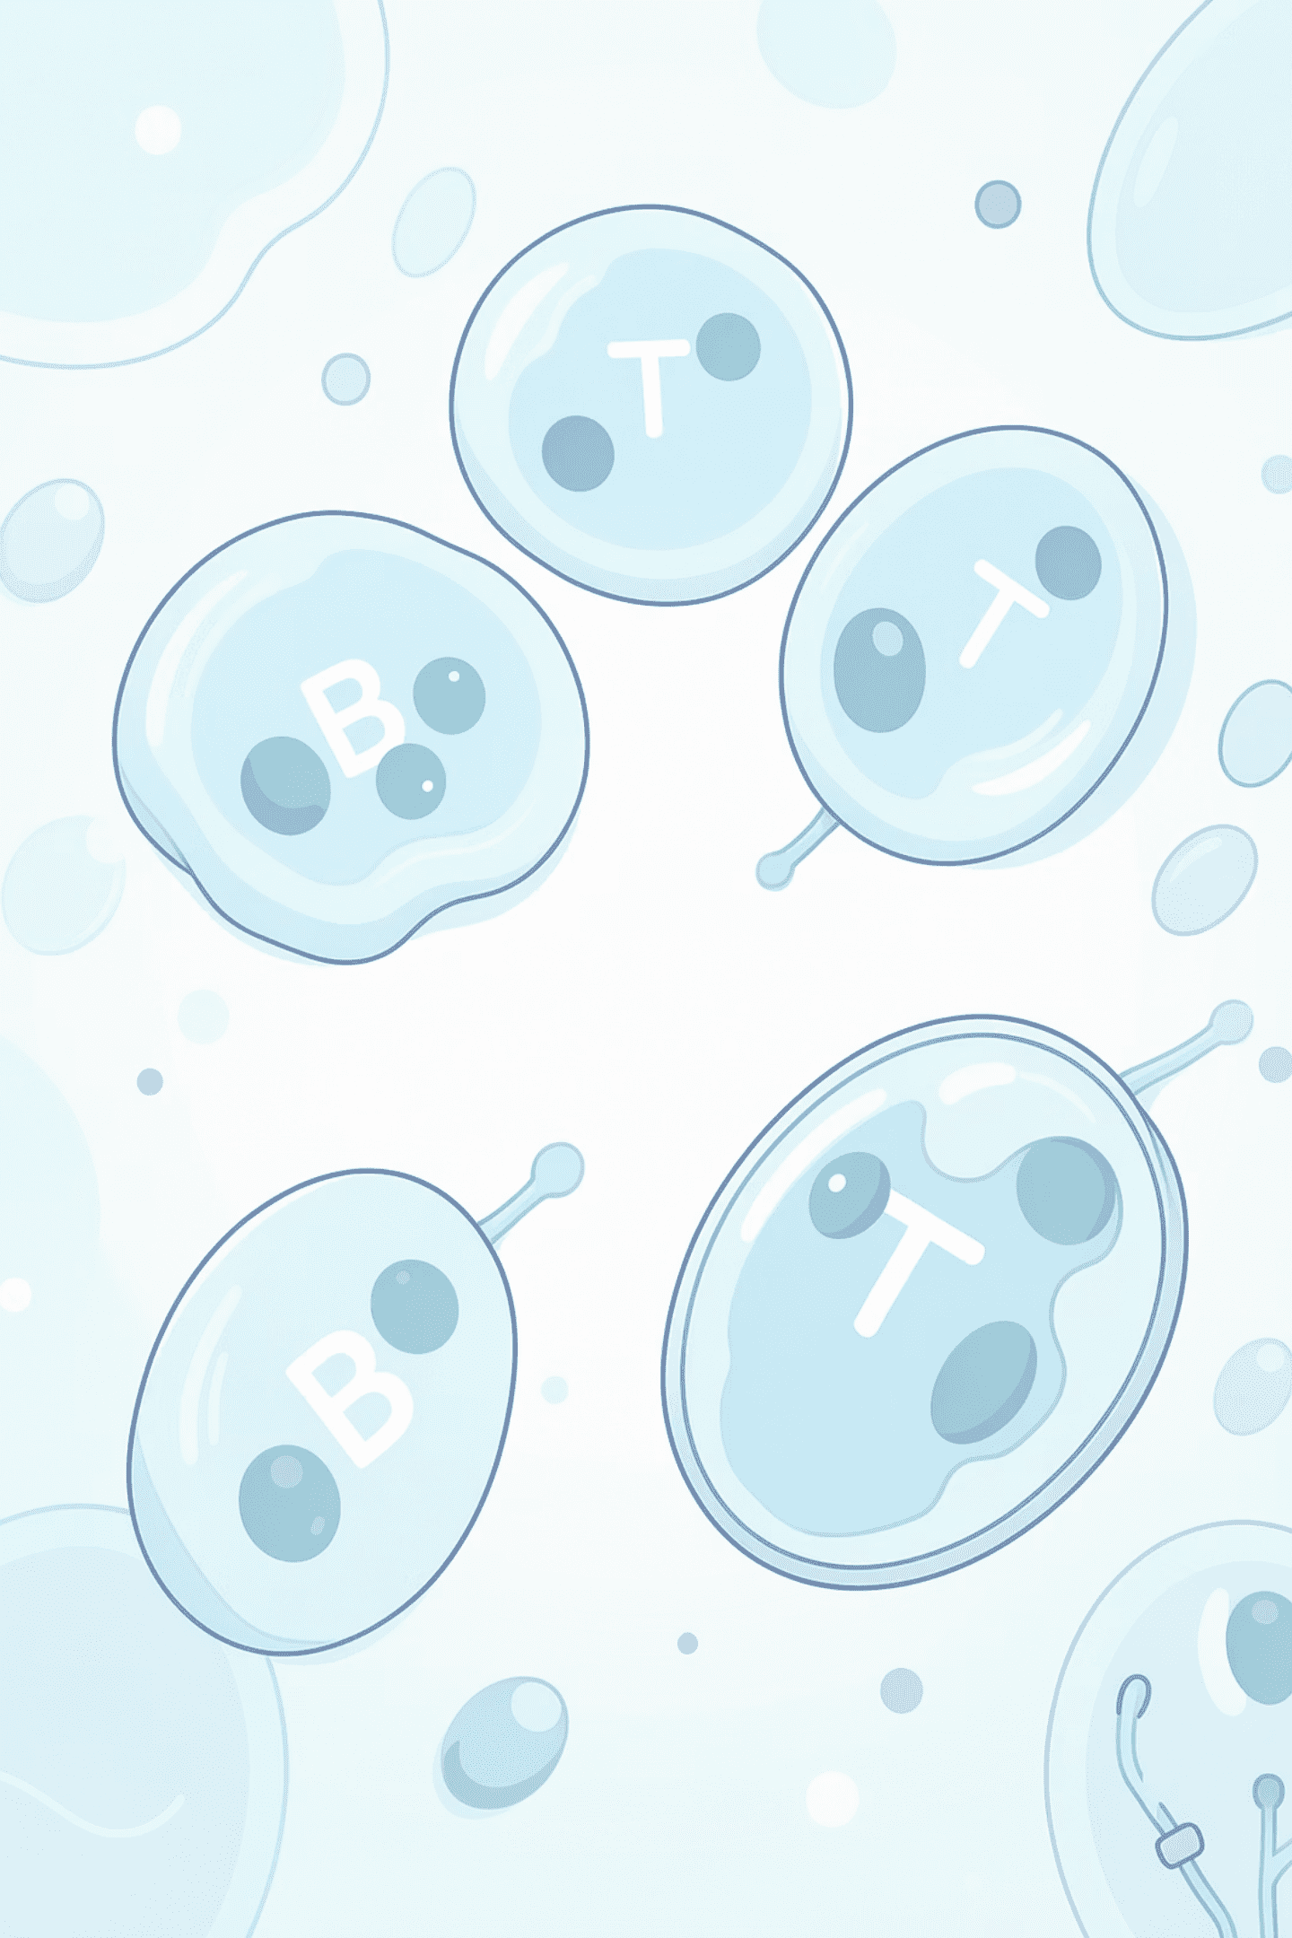
Adaptive Immunity
Once APCs activate lymphocytes, the adaptive immune response delivers a precise, targeted attack with long-lasting memory.
B Cells
T Cells
Produce antibodies that bind to specific antigens, neutralizing pathogens in the bloodstream
Destroy infected cells directly and coordinate the broader immune response
Immune Memory
Memory cells enable a faster, stronger response upon re-exposure to the same antigen

Slide 7
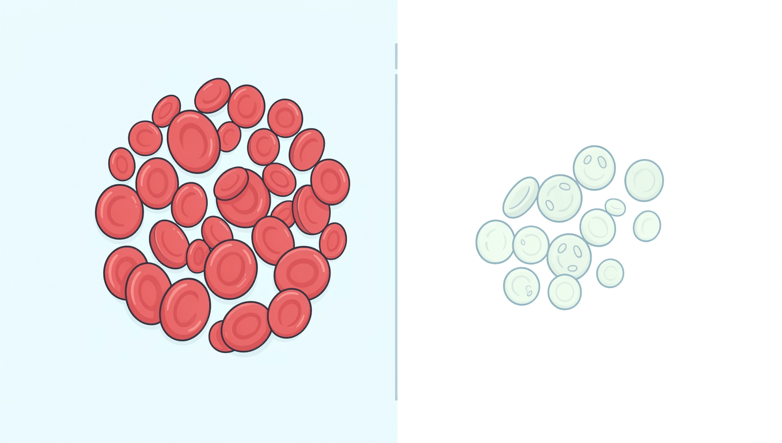
Blood Disorders
Anemia
Reduced RBCs or hemoglobin
Impaired oxygen delivery to tissues
Symptoms: fatigue, weakness, pallor
A symptom, not a standalone disease
Hemophilia
Deficiency in clotting factors (VIII or IX)
Prolonged bleeding after injury
Can cause spontaneous internal bleeding

Slide 8
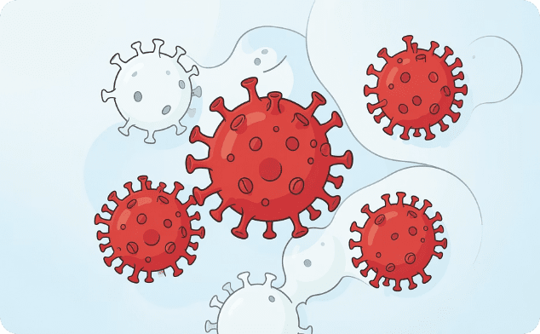
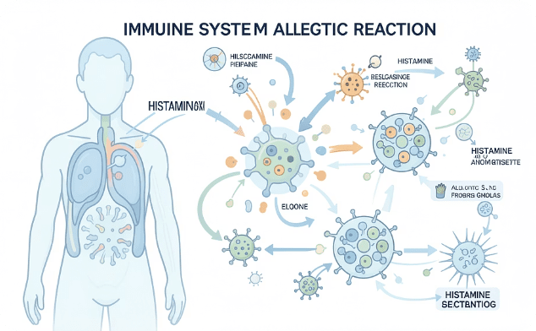
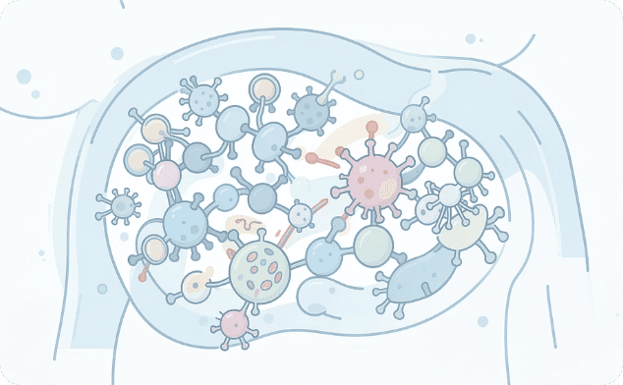
Immune Disorders
(Acquired Immunodeficiency Syndrome (AIDS)
Allergy
Autoimmune Disease
HIV destroys CD4 T cells, progressively weakening immune defenses and leading to severe immunosuppression and opportunistic infections.
An overreaction of the immune system to harmless substances (allergens), triggering histamine release and inflammatory responses.
The immune system mistakenly attacks the body's own tissues, causing chronic inflammation and organ damage (e.g., lupus, rheumatoid arthritis).

Slide 9
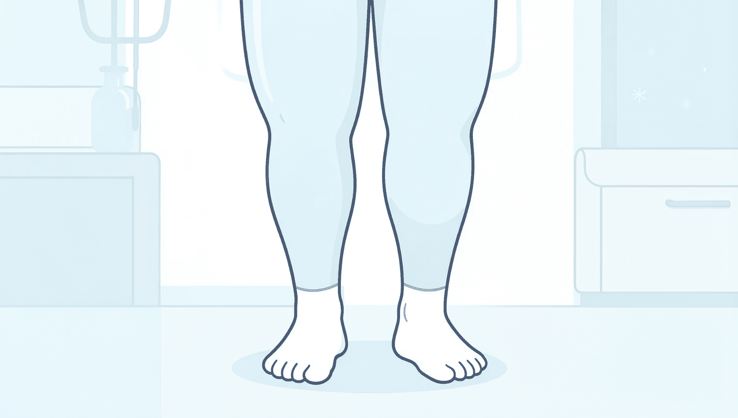
Edema: Fluid Accumulation in Tissues
What Is Edema?
Edema occurs when excess fluid accumulates in interstitial spaces, causing visible swelling and discomfort. It reflects an imbalance in fluid dynamics.
Heart Failure
Reduced cardiac output causes fluid backup
Kidney Dysfunction
Impaired fluid and electrolyte regulation
Lymph Obstruction
Blocked drainage prevents fluid return
Inflammation
Increased capillary permeability
Low Plasma Proteins
Reduced oncotic pressure

Slide 10
Final Integration: Key Takeaways
Immune System Balance
Disease Categories at a Glance
Innate Immunity
Adaptive Immunity
Deficiency → AIDS (immune suppression)
Overreaction → Allergy (hypersensitivity)
Dysfunction → Anemia, Hemophilia, Edema
Infection → Mononucleosis (EBV)
Macrophages and neutrophils provide rapid, non-specific first-line defense
B cells and T cells deliver targeted, antigen-specific responses with lasting memory

Slide 11

Knowledge Check (Quiz)
1. What is the main role of macrophages?
1
a) Produce hormones
b) Destroy pathogens
c) Carry oxygen
2. Which condition is NOT a disease but a symptom?
2
a) Leukemia
b) Anemia
c) AIDS
3. Autoimmune disease means:
3
a) Weak immunity
b) Body attacks itself
c) External infection

Slide 12
🎯 Activity: “True or False – Fix the Mistake”
Ready Statements:
Macrophages produce hormones.
The immune system protects the body from pathogens.
B cells produce antibodies.
T cells carry oxygen in the blood.
Lymph nodes help filter infections.
The immune system has memory.
Red blood cells fight infection.
The spleen is part of the immune system.

Slide 13


